Slide 1
The “DESIGNATOR Empowered SO/AC Model”
Reflecting and Respecting Multi-Stakeholder Input on ICANN Accountability
by formalization of ICANN’s existing designated director Board structure
(Modification by John Curran of the excellent “Empowered SO/AC Model” presentation in order to facilitate discussion –legal analysis per 7 April 2015 message with subject
“[CCWG-ACCT] Reference for legal subteam”)

Slide 2
Goal of the Designator Empowered SO/AC Model
A simple, fast, low/no risk path to enhanced accountability that:
Permits timely implementation of accountability enhancements;
Relies on the SO/AC structure that we know and trust;
Requires no change in the structure and operating procedures of SOs and ACs;
Respects and addresses the variety of community perspectives/concerns with both the “avatar” membership model and the voluntary/cooperative model; and
Provides flexibility for the future.
Relies only upon legal rights given to Board director designators, i.e. does not require legal rights of members to anchor enforcement.

Slide 3
The Designator Empowered SO/AC Model
Does not touch the existing legal nature the SOs/ACs
SOs/ACs can exercise the proposed community powers as soon as they are adopted in the bylaws, no formalization requirement.
SOs/ACs can choose at some future point in time to formalize or evidence their intent to exercise authority and acquire legal personality, e.g., through a resolution.
Whether or not an SO or AC formalizes, the number of votes / power / influence it has in exercising the new community accountability powers should not change.
The designator empowered approach provides the desired community powers, but does not provide for enforcement of those community powers via specific corresponding legal rights
The designator empowered approach provides for enforcement of community powers via the empowered community’s willingness to utilize their principal legal right as designators, i.e. the ability for an organization to recall their designated directors to the ICANN Board

Slide 4
What do SOs and ACs need to do?
Nothing
Enjoy all the rights and authorities granted to SOs and ACs in the Bylaws;
Including the full participation in the community accountability powers
Including removal of their appointed ICANN Board directors, if they should ever choose to do so

Slide 5
What does ICANN need to do?
Clarify the existing designator structure of the current Board director model (including ability of an SO/AC to recall their designated Board directors)
Change NomCom to standing body with ability to recall NomCom appointed directors (and potentially change the number of NomCom appointed directors to reflect community preference for weighting in empowered community model)
Adopt recommended Bylaws provisions regarding role and authority of SOs and ACs – there is direct empowerment of SOs and ACs – no avatar or new “who’s watching the watchers” problem
ICANN operates as normal, following its bylaws with respect to additional community accountability powers -
Full Board Removal
Operating Budget review/approval
Strategic plan review/approval
Bylaw Change/Fundamental Bylaw Change
Binding IRP

Slide 6
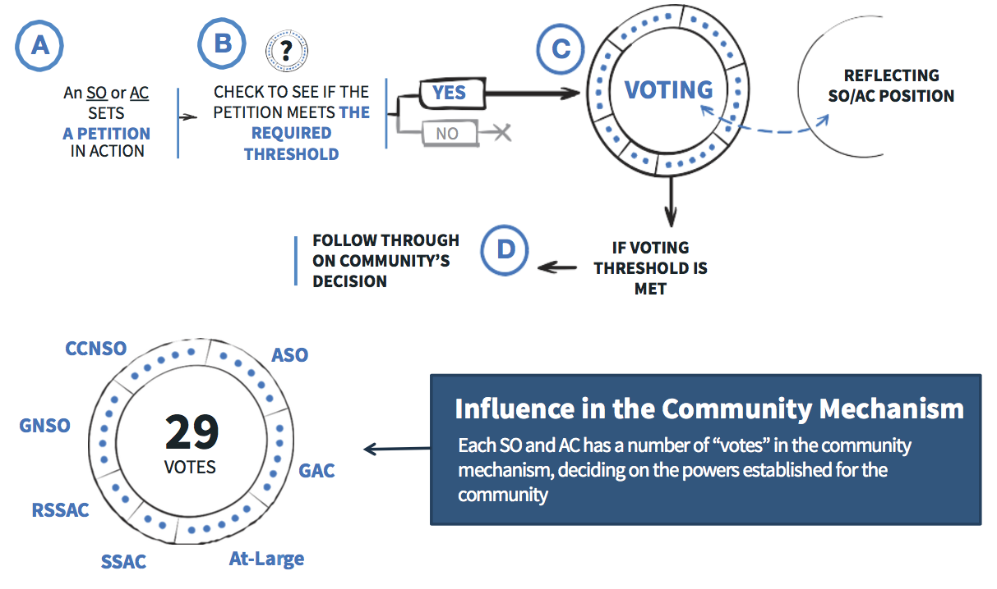
How do the community accountability powers work?
Per the CWG/Town Hall presentation on 22 June 2015, community powers are engaged by any SO/AC via petition and a “weighted vote” approval process
Each power has its own threshold for community approval
ICANN follows through with execution on community’s decision
Community petitions for: modification of bylaws/fundamental bylaws, full board removal, budget/strategic plan ratification
Under designator empowered SO/AC model, community has no direct legal enforcement rights with respect to the community accountability powers

Slide 7
Legal Enforcement of Community Powers
In the event that ICANN does not abide by the community powers, there must be a mechanism which provides for legal redress of the situation
Designator empowered SO/AC model relies upon the one mechanism which is legally provided to those delegating directors to a CA public benefit corporation board – the ability of each organization designating directors to the Board to recall/replace them
If some number of SOs/ACs (e.g. three or more), believe that ICANN failed to comply with its Articles/Bylaws/Resolutions (including enforcement of community powers in the bylaws), they may call for a “SOs/ACs accountability meeting” to discuss the situation within the empowered SO/AC community. The ICANN Board would be encouraged to attend such a meeting so as to provide any relevant information for consideration.
Ultimately, each SO/AC would need to decide whether to recall their directors based on the information presented. It is clear that if a supermajority of SOs/ACs felt that the Board had violated its commitments, the replacement of an corresponding number of directors would allow for significant change of Board composition followed by appropriate Board actions to correct the situation.
Recall/replacement of designated Board directors is a legal right of designators and one that ICANN is highly likely to directly comply with. If legal enforcement should prove necessary, all of the organizations designating directors to the ICANN Board have legal standing to seek redress, as do any existing ICANN directors.

Slide 8
C’est fini

Slide 9
Additional notes/questions - 1
While some non-SO/AC directors are likely quite desirable, 8 NomCom appointed directors creates the potential for a Board that is less accountable to the “empowered community SOs/Acs” than may be desired. Should the number of NomCom appointed directors be lowered in the Designator empowered SO/AC model, and if so, to what number?
How many SOs/ACs need to believe in a potential Article/Bylaw/Resolution violation to call for a community accountability meeting? Too low a number risks nuisance claims, too high a number undermines the usefulness of the mechanism.
It is desirable for the community accountability powers to be protected by placing them in the Bylaws and then making sure that the Bylaws cannot be changed by the Board without designator ratification. This is also legal right available to designators by law, but should be distinguished from the new empowered community petition of approving bylaw changes, i.e. a normal bylaw change process would include empowered community ratification petition, and in the “implementation phase” of the bylaw change, ICANN would still need to seek approvals from designator organizations to comply with the otherwise unchangable bylaws. Presumably the same SOs/ACs that approved the ratification petition would concur with the request for written concurrence?

Slide 10
Additional notes/questions - 2
A “community accountability meeting” is defined in the Designator Empowered SO/AC Community model in order to provide some structure to the process of the community calling the Board to account for alleged violation of ICANN’s Articles, Bylaws and resolutions; but nothing prevents individual SOs/ACs from recalling and replacing their directors at all time and for any reason. Is the additional of a “community accountability meeting” actually desirable, including the assertion that such community meetings are for consideration alleged violations of ICANN’s commitments (Articles, Bylaws, Resolutions) rather than simply displeasure at the Board’s behavior or decision making in general?
The empowered community is dependent upon one another to act jointly if it should prove necessary to remove the Board due to failure to uphold its commitments, but each SO/AC following through with removal its respective directors is entirely based on shared sense of responsibility among the empowered SO/AC community. Is this sufficient? If it is not sufficient, then does there even exist an “ICANN community” capable of accepting overall stewardship of ICANN from NTIA?

