Slide 1
ICANN At-Large Onboarding
Dev Anand Teelucksingh | Isaac Maposa | Beran Gillen
Community Onboarding Program | 25 April 2017

Slide 2


At-Large Community Onboarding Program
Promoting At- Large
Target participants for At Large
How each type of participant can be involved in At Large
What should draw them to this unique and diverse community
Promoting
Understanding At- Large
How the community operates
Information on community activities
Community organisational structure
Understanding
Joining At- Large
Various ways to join the At-Large community through various mediums
Joining
Engaging in At-Large
Active participation & involvement stage leading to further involvement such as leadership positions.
Engaging
Notes:
Use this slide for diagrams or other graphic elements.

Slide 3
The challenges of promoting At-Large
DNS, Domain Names?
TLDs, ccTLD, gTLD?
IANA , post IANA Stewardship ?
What do all of these things mean, What are the relationships, How are they interconnected?
Many end users, Academia, Civil Society, Consumer Groups, Enthusiasts, members of our existing At-Large Structures that are part of the ICANN At-Large Community:
don’t have an understanding of what these terms means.
may have misconceptions of what these terms means.
Hence
No understanding or appreciation of the issues involved ;
The attitude ‘it does not affect me so why should I care?”
Notes:
Look for different ways to display your data or text by using alternatives to simple bullets.
To adjust the number in the arrow to text or another number, click on the text box around the number, revise.
To add an arrow, click on the arrow, ensure the arrow is highlighted, COPY and PASTE and move to the desired placement, or DELETE if there are too many arrows.

Slide 4
Overcoming the challenges
We saw the need to develop a series of ordered lessons/presentations that:
can form a toolkit for At-Large Community members in educating the wider public
At-Large Structure (ALS) representatives can use to educate members in their organisations in getting persons in their organisation to care about ICANN issues and become more involved in the At-Large Community.
can be available online and offline for ease of use and access.
Notes:
This is a simpler agenda slide, the outline for your presentation.

Slide 5
Overcoming the challenges
We’ve worked with members of the At-Large Outreach and Engagement SC to develop a series of ordered lessons/presentations on:
Start here - presents tailored set of topics/slides depending on the audience
What is the DNS and who coordinates all of this stuff ? - Introduce the concepts of the DNS and introduce entities like ICANN the corporation, and ICANN the community.
Policy challenges/issues in the DNS - slidedeck to help new or potential At-Large Community members to learn about the various ICANN policy issues of interest to end users, why end users should care about these issues, and how as part of the ICANN At-Large Community they can become involved on these issues.
Introduction to the ICANN At-Large Community - slidedeck about the At-Large Community, its key activities, and how to engage with the At-Large Community
Navigating At-Large - for existing At-Large Community members, how to find relevant information and participate in At-Large activities
Notes:
This is a simpler agenda slide, the outline for your presentation.

Slide 6
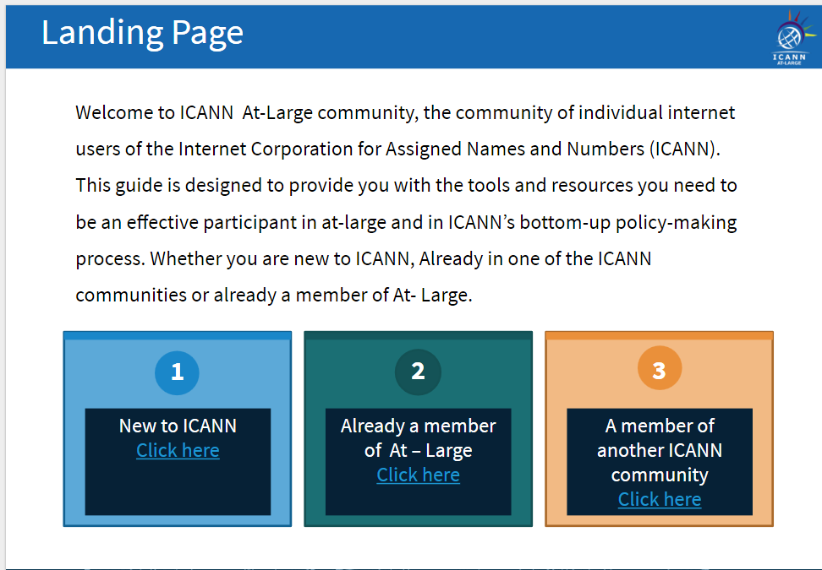
Start Here
Notes:
This is a stylized agenda slide for your presentation.
To delete a box, if there are too many boxes, click the edge of the box, ensure the entire box is highlighted, then DELETE.
To update the numbers and text, click inside the circle for the numbers or in the box for the text, revise the text.

Slide 7
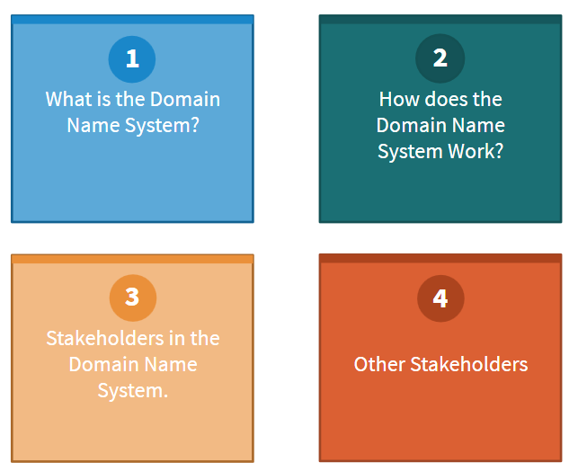
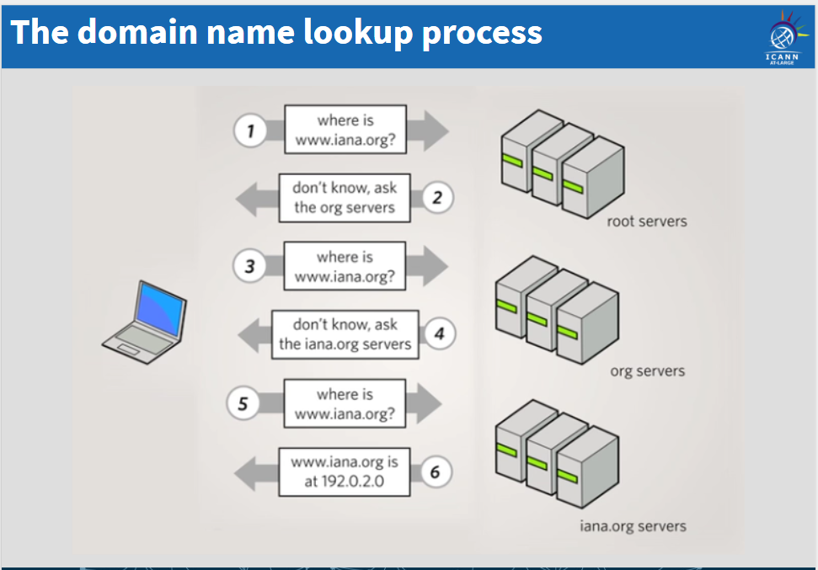
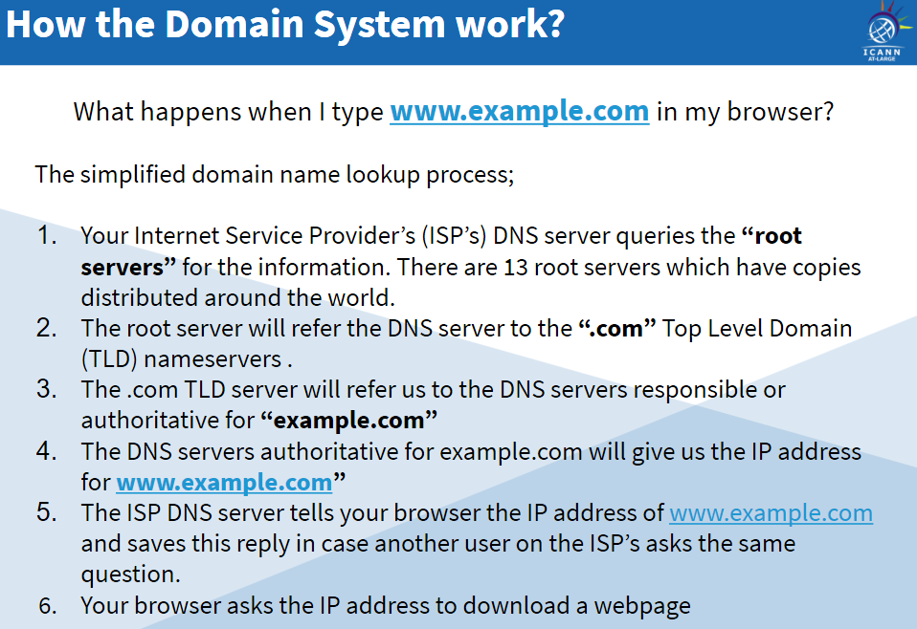
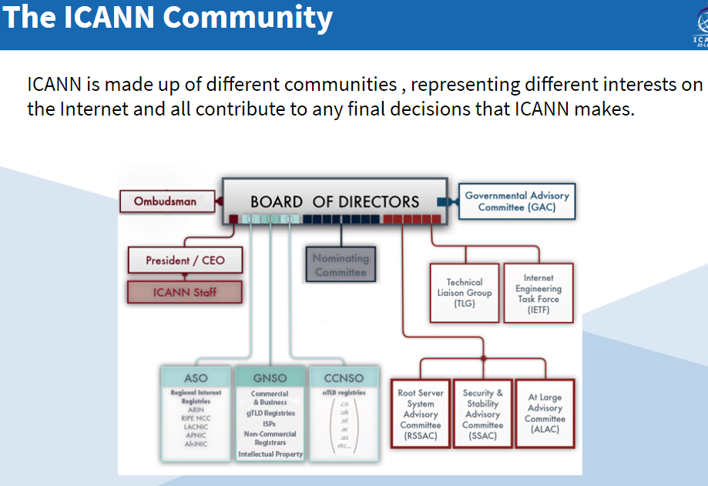
What is the DNS?
Notes:
This is a stylized agenda slide for your presentation.
To delete a box, if there are too many boxes, click the edge of the box, ensure the entire box is highlighted, then DELETE.
To update the numbers and text, click inside the circle for the numbers or in the box for the text, revise the text.

Slide 8
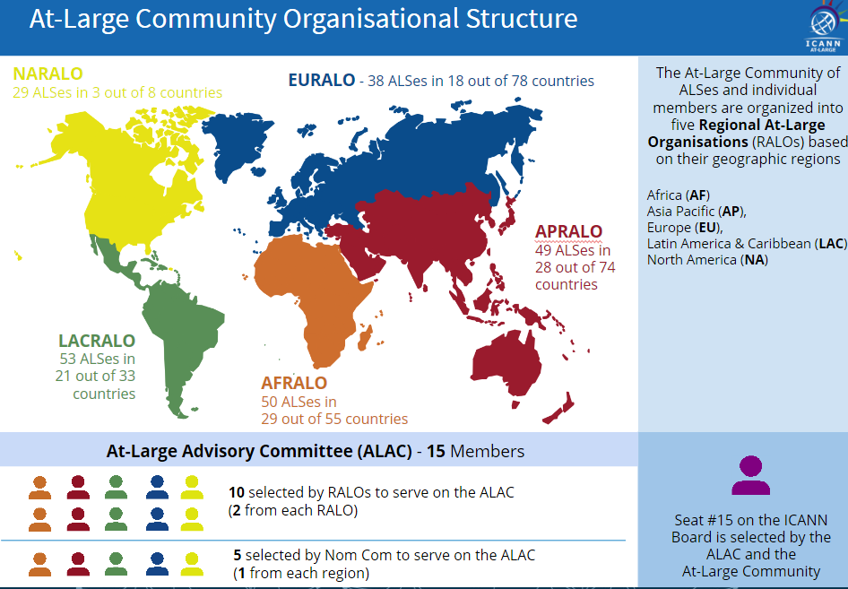
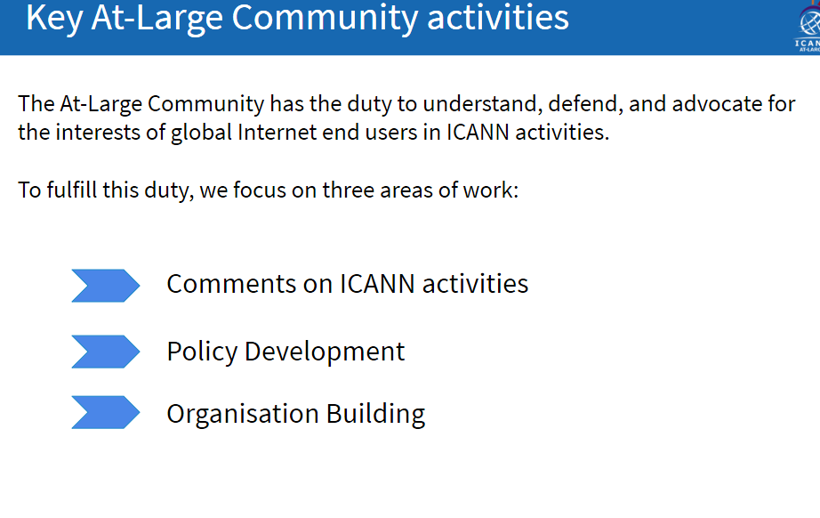
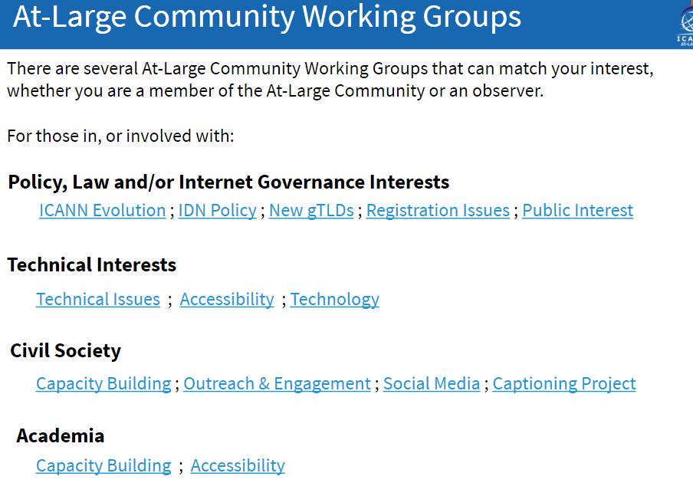
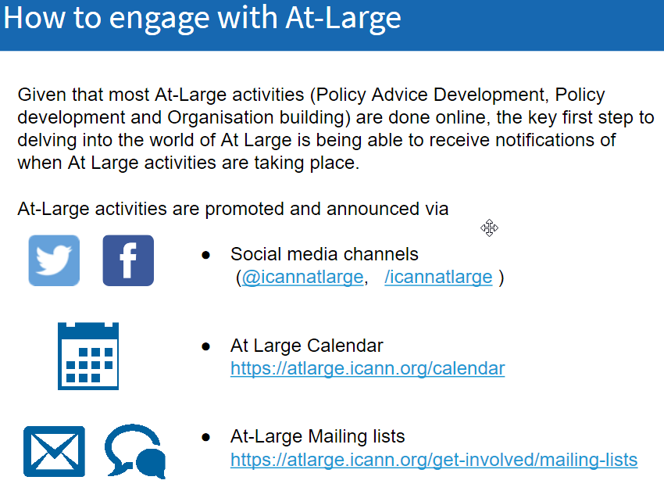
Introduction to At-Large
Notes:
This is a stylized agenda slide for your presentation.
To delete a box, if there are too many boxes, click the edge of the box, ensure the entire box is highlighted, then DELETE.
To update the numbers and text, click inside the circle for the numbers or in the box for the text, revise the text.

Slide 9









Engage with ICANN
Thank You and Questions
Reach us at:
Email: staff@atlarge.icann.org
Website: atlarge.icann.org
twitter.com/icann_atlarge
gplus.to/icann
facebook.com/icann.atlarge
weibo.com/ICANNorg
linkedin.com/group/icann-atlarge-2238621
flickr.com/photos/icann
youtube.com/user/icannatlarge
slideshare.net/icannpresentations
Notes:
You can adjust the email/web address to whichever email or web address is best suited to your presentation. This should be your final slide.

