Slide 1

ICANN 57
ICANN 57
Capacity Building

Slide 2
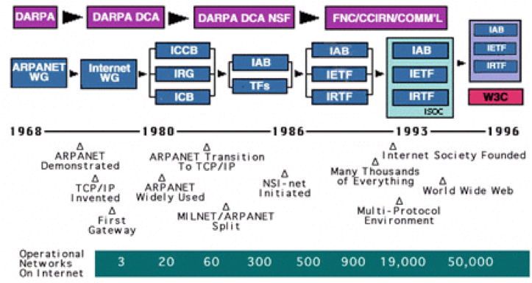
Capacity Building
ABOUT ICANN
History of the Internet (Briefly)

Slide 3
Capacity Building
ABOUT ICANN
The Beginnings of ICANN:
February 1998: The National Telecommunications and Information Administration (NTIA) (within the US Department of Commerce) issued a Green, then White Paper for the improvement of the ‘technical management of Internet Names and Addresses’
September 1998: ICANN established as a private, Not-For-Profit Corporation in California – under contract with NTIA – to be responsible for the the management of domain names, numbers and protocols.

Slide 4
Capacity Building
ABOUT ICANN
The Beginnings of ICANN: (continued)
The bodies responsible for the policies and procedures of the three identifiers:
Domain name identifiers - the Domain Name Supporting Organisation (then split to become the Generic Supporting Organisation (GNSO) and the Country Code Name Supporting Organisation (ccNSO)
Address Identifiers – Address Supporting Organisation (ASO) (comprised of five Regional Internet Registries)
Protocol Identifiers – the IETF

Slide 5
Capacity Building
ABOUT ICANN
The Beginnings of ICANN: (continued)
The advisory Committees are:
Government Advisory Committee (GAC) – Governments and treaty organisations
Stability and Security Advisory Committee (SSAC)
At-Large Advisory Committee – representing Internet Users (ALAC)
Root Server System Advisory Committee (RSSAC)

Slide 6
Capacity Building
ABOUT ICANN
History of the Internet (continued)
ICANN, under contract with the NTIA in 2000, also took over responsibility for IANA functions that had been exercised by the Defense Advanced Research Project Agency (DARPA). The Functions included:
  Coordination of the assignment of technical protocol parameters
  Administrative functions associated with root management/root name name servers
  Allocation of IP address blocks to RIRs
  Other services associated with APRA and .INT

Slide 7
Capacity Building
ABOUT ICANN
NTIA/DoC – ICANN Relationship
1998: Original Contract
2006: Contract replaced by the Joint Project Agreement (JPA)
2009: Affirmation of Commitments (replacing the JPA)
March 2014: DOC announced its intent to transition – providing the following criteria were met:

Slide 8
Capacity Building
ABOUT ICANN
NTIA/DoC – ICANN Relationship
Doc Criteria: Must have broad community support and address the following principles:
Support and enhance multi-stakeholder model
Maintain security, stability and resiliency of Internet DNS
Meet needs and expectations of the global customers and partners of IANA services
Maintain openness of the Internet – and
Will not accept a proposal that replaces with NTIA role with a government led or inter-governmental organisation solution

Slide 9
Capacity Building
ABOUT ICANN
NTIA/DoC – ICANN Relationship
August 2016: DoC confirmed its criteria for transitioning IANA stewardship to Internet multi-stakeholder community had been met
October 1 2016: US Government-ICANN contract allowed to expire and stewardship officially transitioned

Slide 10
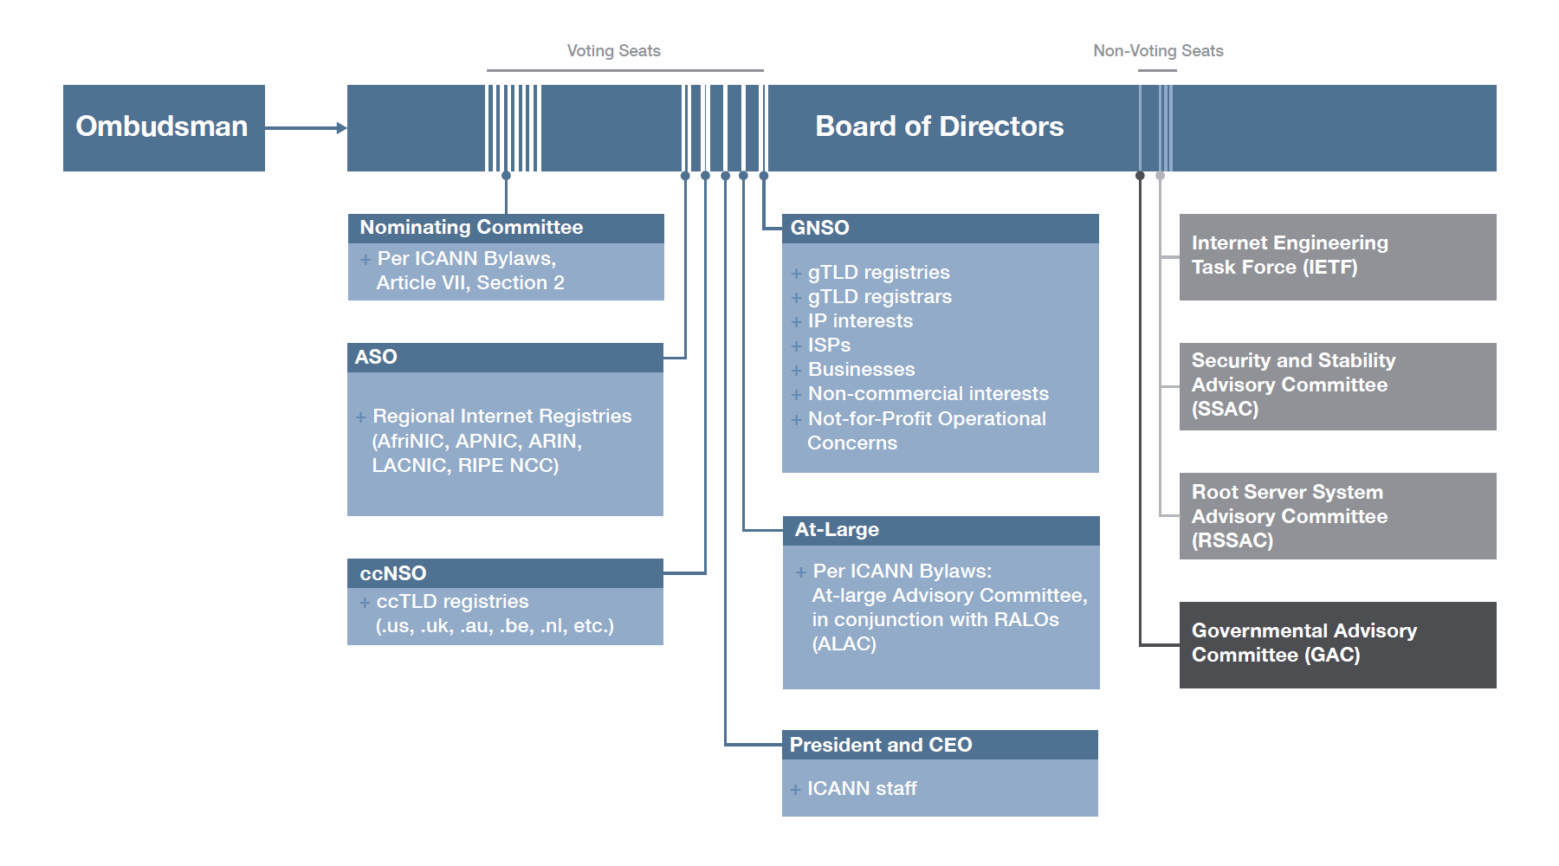
Capacity Building
ABOUT ICANN

Slide 11

Capacity Building
ABOUT ICANN
What does ICANN do?
Directly draws up contracts with registries
Runs an accreditation system for registrars.
Coordinates policy with the five regional Internet registries (RIRs) for allocating and assigning unique numerical identifiers.
Works closely with the Internet Engineering Task Force (IETF) to maintain and administer protocol parameters.

Slide 12
Capacity Building
ABOUT ICANN
Group work:
Each group select an SO or AC (except ALAC)
Describe its functions
Describe at least one piece of output from the SO or AC
QUESTIONS

Slide 14
Capacity Building
ALAC
What does ALAC Do?
At-Large Advisory Committee (ALAC) is the primary organizational home for the voice and concerns of the individual Internet user
Advises on the activities of ICANN, including Internet policies developed by ICANN's Supporting Organizations (is empowered to initiate a Public Comment proceeding and to request the GNSO to initiate a Policy Development Process)
Participates in ICANN's outreach and engagement programs
Selects a Director to serve on ICANN's Board of Directors.

Slide 15
Capacity Building
ALAC
Background:
March 2003: Board decision to create an Interim ALAC progressing to the ALAC structure
By 2007: Current ALAC structure complete with establishment of the final RALO
2008-9: First ALAC Review ➔ Implementation
2015➔ongoing - ALAC Review

Slide 16
Capacity Building
ALAC
The Structure:
ALAC Executive – (ALT)
ALAC
RALOs
ALSs

Slide 17
Capacity Building
ALAC
The Structure:
Leadership Team: (ALT) (regionally balanced) with Chair, VC(s) and 2-3 other ALAC members ) (5 members)
Full ALAC: Two members from each of the 5 RALOs and 5 appointed by the nominating Committee (one from each region) (15 members)
Liaisons to the GAC,GNSO, ccNSO, SSAC (may be an ALAC member)

Slide 18
Capacity Building
ALAC
The Structure:
Regional At-Large Organizations (RALOs)
African Regional At-Large Organisation (AFRALO)
Asian, Australasian and Pacific Island At-Large Regional Organisation (APRALO)
European Regional At-Large Regional Organisation (EURALO)
Latin American and Caribbean Islands Regional At-Large Regional Organisation (LACRALO)
North American Regional At-Large Organisation (NARALO)

Slide 19
Capacity Building
ALAC
The Structure:
At-Large Community:
Made up of over 200 At-Large Structures (ALSs), that can include, for example
ISOC Chapters
Academia
Consumer advocacy groups
Civil Society groups

Slide 20
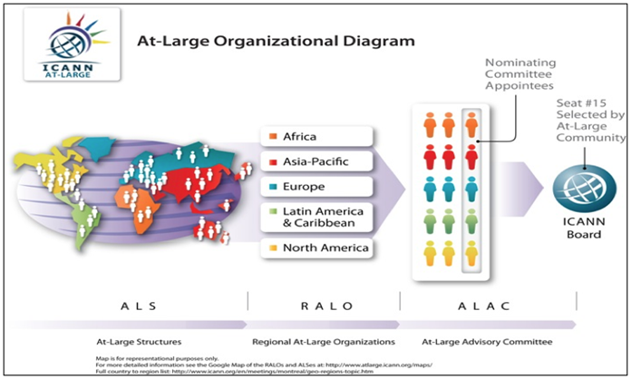
Capacity Building
ALAC
The Structure:

Slide 21
Capacity Building
ALAC
The Structure: RALOs - serve as the main forum and coordination point for public input to ICANN in its Geographic Region.
Criteria:
Not For Profit
MoU with ICANN to address;
The process for selecting ALAC members
Requirements of openness
Participatory opportunities
Transparency
Accountability
Diversity in the RALO's structure and procedures
Criteria and standards for the RALO's constituent At-Large Structures

Slide 22
Capacity Building
ALAC
Group Work
Each of five groups give presentation on a RALO
Region
ALSs – size/membership
Area(s) of interest

Slide 24
Capacity Building
POLICY
ICANN Policy Development
GNSO – develops (and recommends to the Board for approval) policy on generic TLDs
ccNSO - develops (and recommends to the Board for approval) policy on country code TLDs
ASO - advises the Board on policy issues relating to the operation, assignment, and management of Internet addresses.

Slide 25
Capacity Building
POLICY
Types of ICANN Policy:
DNS Policy – developed through a formal policy development process – (PDP)
Operational Policy – defines ICANN operational policies - input is usually sought via public comment or other means.
General Practices – operational – but have not gone through a formal process

Slide 26
Capacity Building
POLICY
Participation in ALAC Policy Development
Contribute to ALAC development of a policy position on an issue
Participate in policy ‘webinars’
Attend ICANN meeting ‘Open Forums’
For PDPs
Become a member of a Working Group as part of the PDP process
Become a ‘pen holder’/contribute to an ALAC policy statement

Slide 27
Capacity Building
POLICY
ALAC Policy Development
Consideration of whether ALAC should comment at all
Identification of individual(s) to draft initial statement (pen holder(s))
Use ‘wiki space’ on webpage for comment
Pen holder(s) draft final statement – again open for final contribution
ALAC vote on ratification of statement

Slide 28
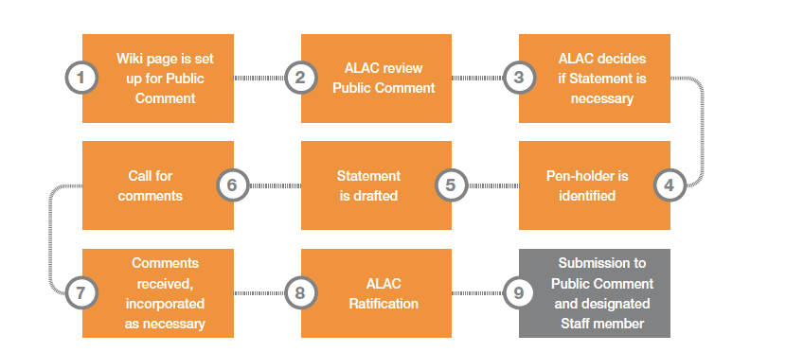
Capacity Building
POLICY
ALAC Policy Development

Slide 29
Capacity Building
POLICY
Group work:
Each group identify an ALAC policy statement
What was the issue - explain
What was the ALAC Response

Slide 31
Capacity Building
ICANN ‘Independence’
March 2014:US Dept of Commerce announced its intent to transition – providing the following criteria were met:
Must have broad community support and address the following principles:
Support and enhance multi-stakeholder model
Maintain security, stability and resiliency of Internet DNS
Meet needs and expectations of the global customers and partners of IANA services
Maintain openness of the Internet – and
Will not accept a proposal that replaces with NTIA role with a government led or inter-governmental organisation solution

Slide 32
Capacity Building
ICANN ‘Independence’
ICANN Response: Two Parallel processes
IANA Stewardship Transition Coordination Group (ICG)
  Cross Community WG (Naming related functions) (CWG)
  Consolidated RIR IANA Stewardship Proposal Team (numbering) (CRISP)
  IANAPLAN –(protocol related issues) (IANAPLAN WG)
Cross Community WG (enhancing ICANN accountability) (CCWG)

Slide 33
Capacity Building
ICANN ‘Independence’
The Root Zone Management track contains projects relating to changes to the root zone management system (RZMS) to remove NTIA's authorization process, parallel testing of the production and parallel test RZMS and the development, and execution of an agreement with Verisign as the root zone maintainer.
The Stewardship Transition track contains projects to prepare relationship documentations with the operational communities, creation of a Post-Transition IANA (PTI) entity, establishment of a Customer Standing Committee (CSC) and a Root Zone Evolution Review Committee (RZERC), operationalizing the IANA customer service escalation mechanisms and SLAs.
The Accountability Enhancements track contains projects to implement enhancements to ICANN’s Independent Review and Reconsideration Request processes, to update ICANN’s governance documents, and to operationalize new Community Powers defined by the CCWG-Accountability.

Slide 34
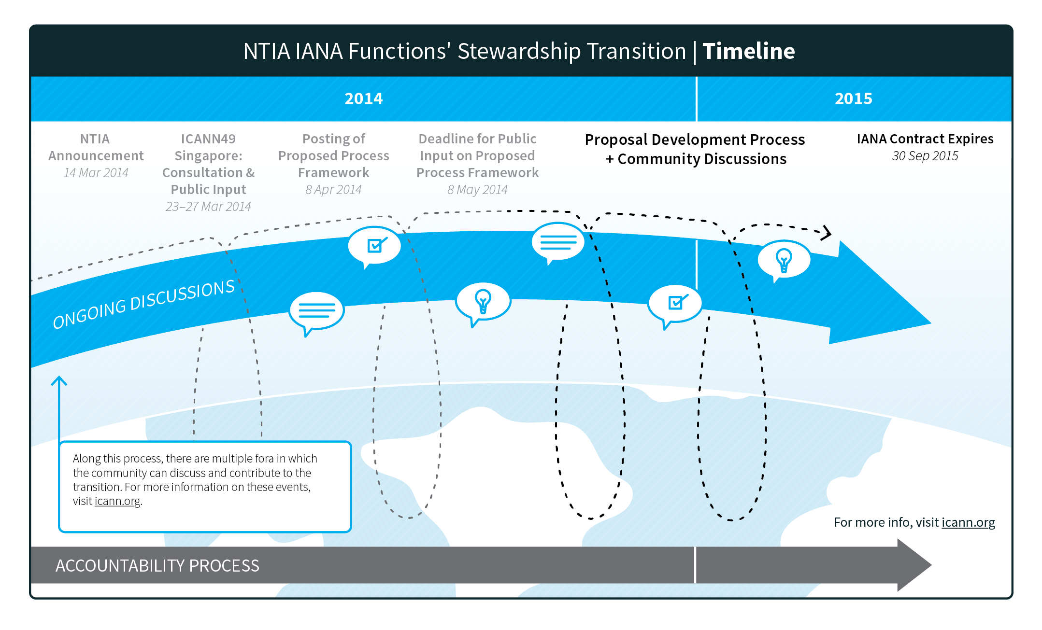
Capacity Building
ICANN ‘Independence’

Slide 35
Capacity Building
ICANN ‘Independence’
March 2014 – August 2016 Development of proposals on transition process and new accountability mechanisms
August 2015 – US DOC announcement – criteria for transition had been met
1 October 2016 – Doc – ICANN contract lapsed
With the completion of all required implementation tasks, the global multistakeholder community, with the support of ICANN the organization, is ready for the IANA stewardship transition to occur. We thank the ICANN community for their ongoing support and dedication throughout this transition process .Akram Atallah

Slide 36
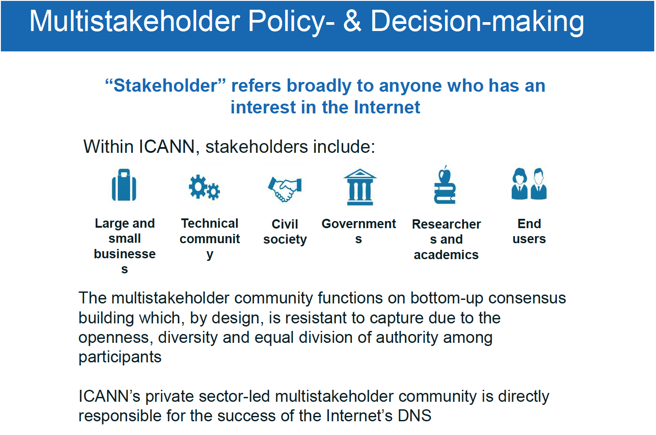

Slide 37
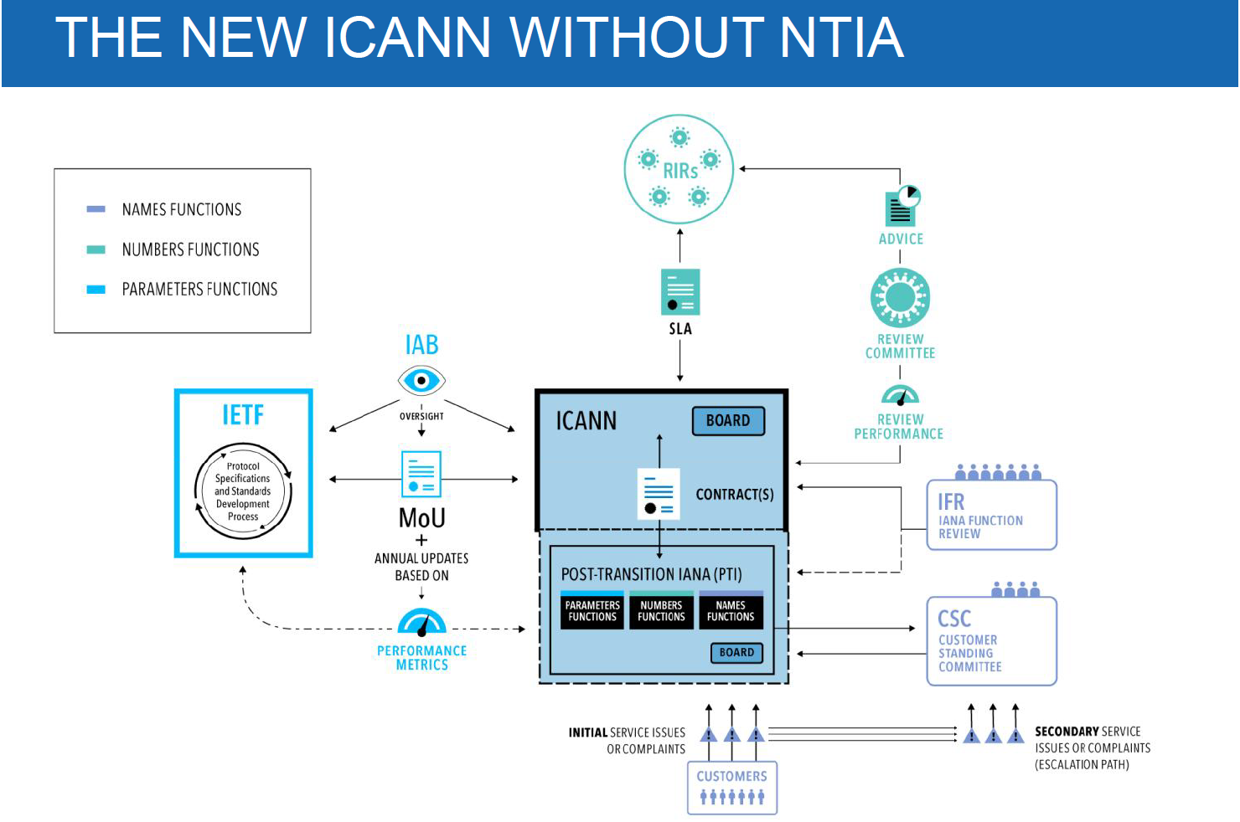

Slide 38
Capacity Building
ICANN ‘Independence’
Questions and Discussion

