Slide 1
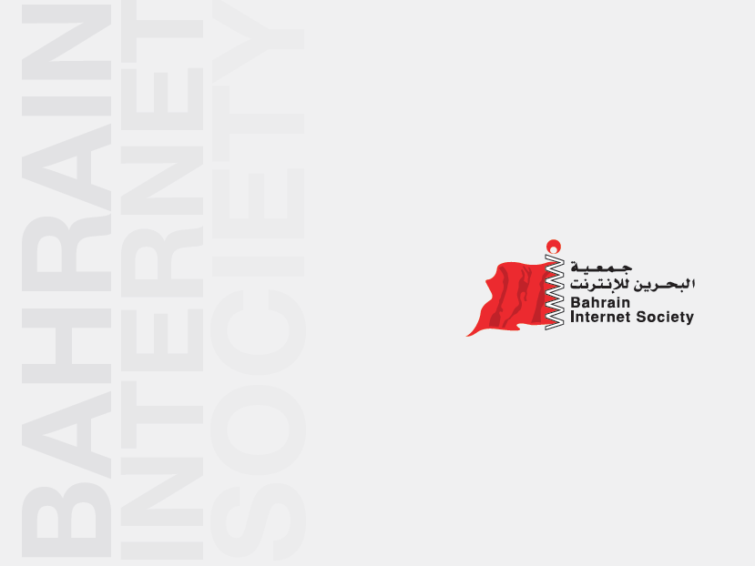

Slide 2
About Bahrain Internet Society
Non-profit organization established in order to help, support and empower the Internet and ICT community in Bahrain, it strives to serve the community of Bahrain by spreading awareness on the benefits of Internet and ICT. BIS also strives to engage in ICT Development toward eBahrain.
The society started in 1999 as the “Internet Club”, and in 2003 it has been officially established as “Bahrain Internet Society”, BIS started many initiatives and project in the country.

Slide 3
About Bahrain Internet Society
Non-profit organization
Started in 1999
Officially established in 2003

Slide 4

About Bahrain Internet Society
ICT
Internet
eContent

Slide 5
Strategy
Mission: To promote, spread awareness, and develop the use of the internet for the benefit of the community in the Kingdom of Bahrain.
Vision: Promoting the Kingdom of Bahrain to become a leading regional and international center for the use and the development of the Internet, eContent, and Information & Communications Technology.

Slide 6
Objectives
To provide substantiated and authenticated information about the Internet in The Kingdom of Bahrain.
To provide technical services and consulting to all categories of society from individuals to organizations in the field of Internet.
To enfold all Internet users, including beginners and those with experience.
To organize events and work activities and participation in national projects that discuss issues and challenges related to using the Internet in technical, commercial, social and other fields.
To contribute to the localization and dissemination of Arab culture in the field of Internet and Information Technology.
To contribute to raising the level of information networks through effective cooperation with the providers of the service and the relevant authorities.
To ensure the provision of information and services, far from all harm to the customs and traditions and the security of the Kingdom of Bahrain.

Slide 7
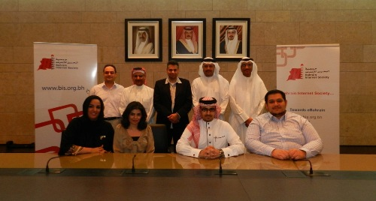
Board Members

Slide 8





Member and Partners
Chapter
Member Since
March 2012
Partners

Slide 9
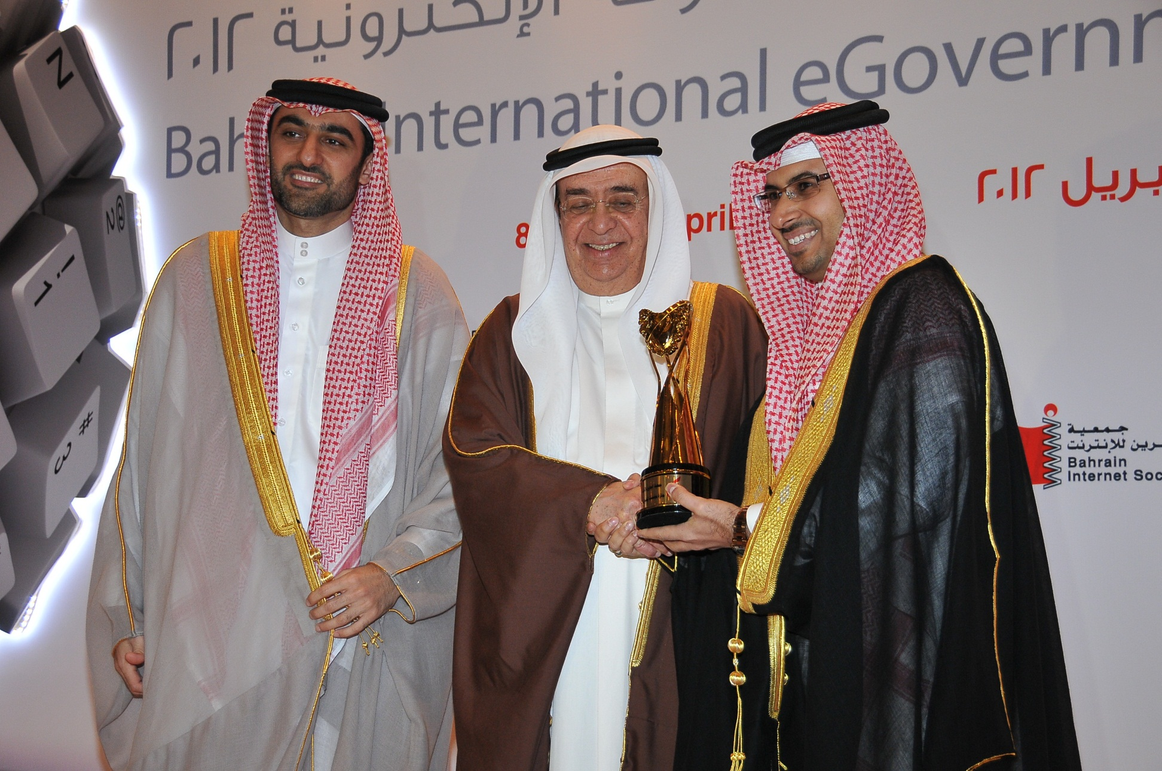
Winning Best eNGO Award

Slide 10
BIS Projects

Slide 11
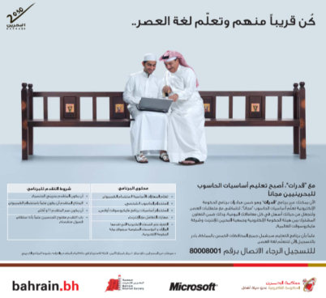
eCitizen (Qudarat)
Free training courses for citizens of all governorates of the Kingdom in order to computer literacy among citizens. Training: computer skills and programs "Microsoft Office" and how to use Internet and e-mail, in addition to the use of e-government portal
Citizen Benefited: 800 Citizen
Partners:
Microsft
eGovernment Authority
Gulf Future Business
Notes:
Objectives
New Election
Achievements
Projects

Slide 12
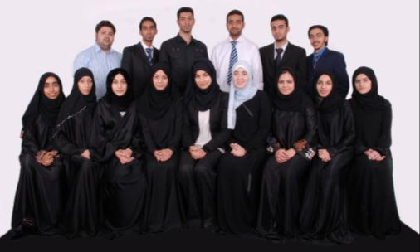
Future IT Leaders
Targeting excelled university students, and provides them with recognized professional certifications that include:
  Microsoft Solution Developer
  Soft skills
  ITIL, Project Management and Quality Management
In addition provides a practical experience (on job induction with Microsoft and on job training with Microsoft Partner)
This project increases the employment opportunities for graduates.
Citizen Benefited: 15 University Students
Project Partners:
Microsoft
Mumtalakat
University of Bahrain
Gulf Future Business
Notes:
Objectives
New Election
Achievements
Projects

Slide 13

Zain eShabab
A competition for the youth of Bahrain to encourage creativity in the fields of ICT and eContent, where the youth employ the technology and eContent to develop projects that benefit the society, the youth are mentored by experts in the field to ensure the success of their projects.
Citizen benefited: 80 youth annually
Partners:
Zain
General Organization for Youth and Sport
Gulf Future Business
Microsoft
Website: http://eshabab.org
Video: http://www.youtube.com/watch?v=0GstULheWWc&feature=related

Slide 14
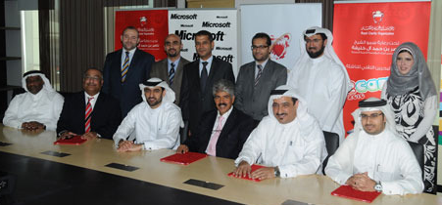
Summer e-Camp
e-Camp program is a collective initiative to support and train orphan students registered at the Royal Charity Organization in 5 week. Microsoft shall offer training program free of charge in 30 hour training.
Benefited: 147 Orphans
Project Partners:
Royal Charity Organization
Bahrain eGovernment Authority
Microsoft
Gulf Future Business

Slide 15
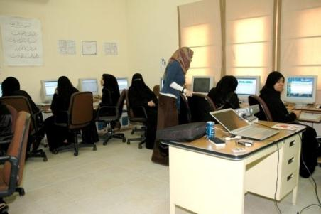
Women in Technology
The objective of this program is to empower women in the field of information technology in order to find a broad and strong women who enjoy the skills in the field of information technology and career development
In-Class Learning: 500 Women
eLearning: 5500 courses
Partners:
  Tamkeen
  Bahrain Women’s Union

Slide 16





Women in Technology

Slide 17
The Objectives of the Program
To provide substantial capacity building in the use of technology to partner organization enabling them to expand their reach, sustainability and ability to serve woman.
To create strong base of woman with vital IT and professional development skills, allowing them to gain access to new careers and training opportunities.
To empower program participants to play an integral role in shaping their country’s future. Be playing active roles in socio- economic development of the country.

Slide 18
Program Features
Number of woman who expected to benefit from the program are from 1500 to 2000 women.
Trainee will obtain three licenses up to 5 licenses as maximum.
The validity of the training license 3 months from first use.

Slide 19

Project Portal
www.ewatan.com

Slide 20
Categories of the Courses
Administration
Information
Technology
Marketing
Finance
Soft
Skills
Business
Computer
Skills

Slide 21
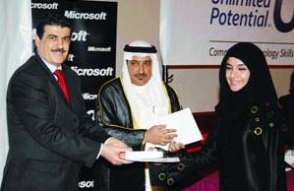
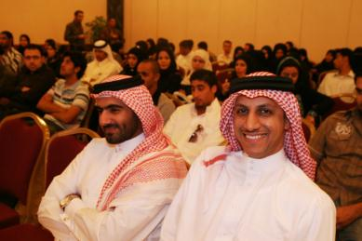
Career Connection
The objective of this program is to train unemployed citizen on basic IT skill to make them more competitive to enter the job market .
Citizen Benefited: 600+
Partners:
  Microsoft

Slide 22
Initiatives and Conferences

Slide 23

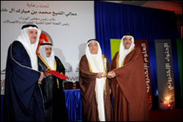
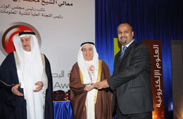
Bahrain eContent Award
The concept of Bahrain eContent Award inspired by the World Summit Award (WSA) which showcases best eContent projects. The Award is distinctively featured as a national event which contributes to introduce and promote Bahrain eProducts locally and globally, the award has been launched 2005 and organized bi-annually.
www.bea.bh

Slide 24
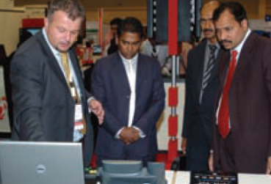
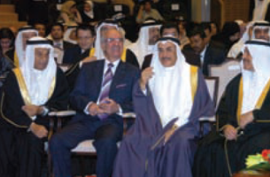
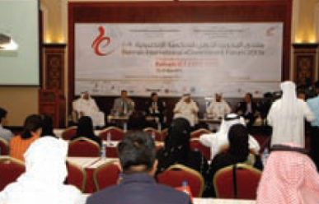

Bahrain International eGovernment Forum & ICT Expo
Bahrain Internet Society is an Executive Committee Member and Chairman of the Technical Committee of the event the largest in the field of information technology and telecommunications in Bahrain for the year 2009, 2010, 2011 & 2012

Slide 25
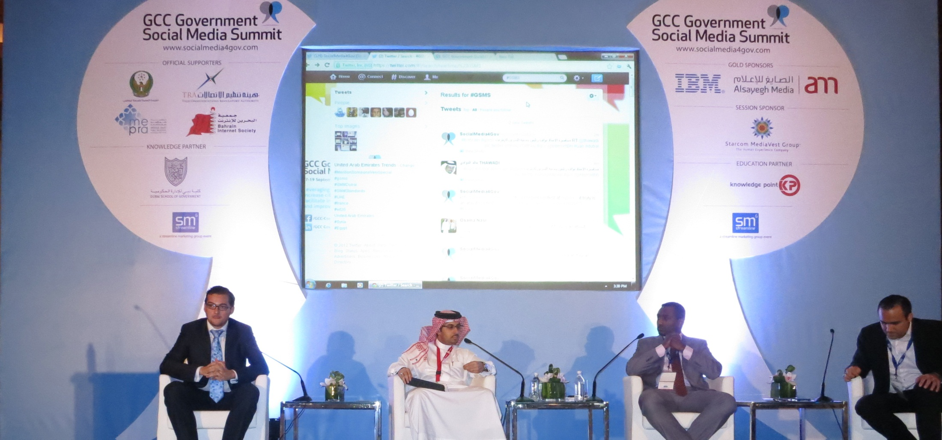
GCC Government Social Media Summit

Slide 26
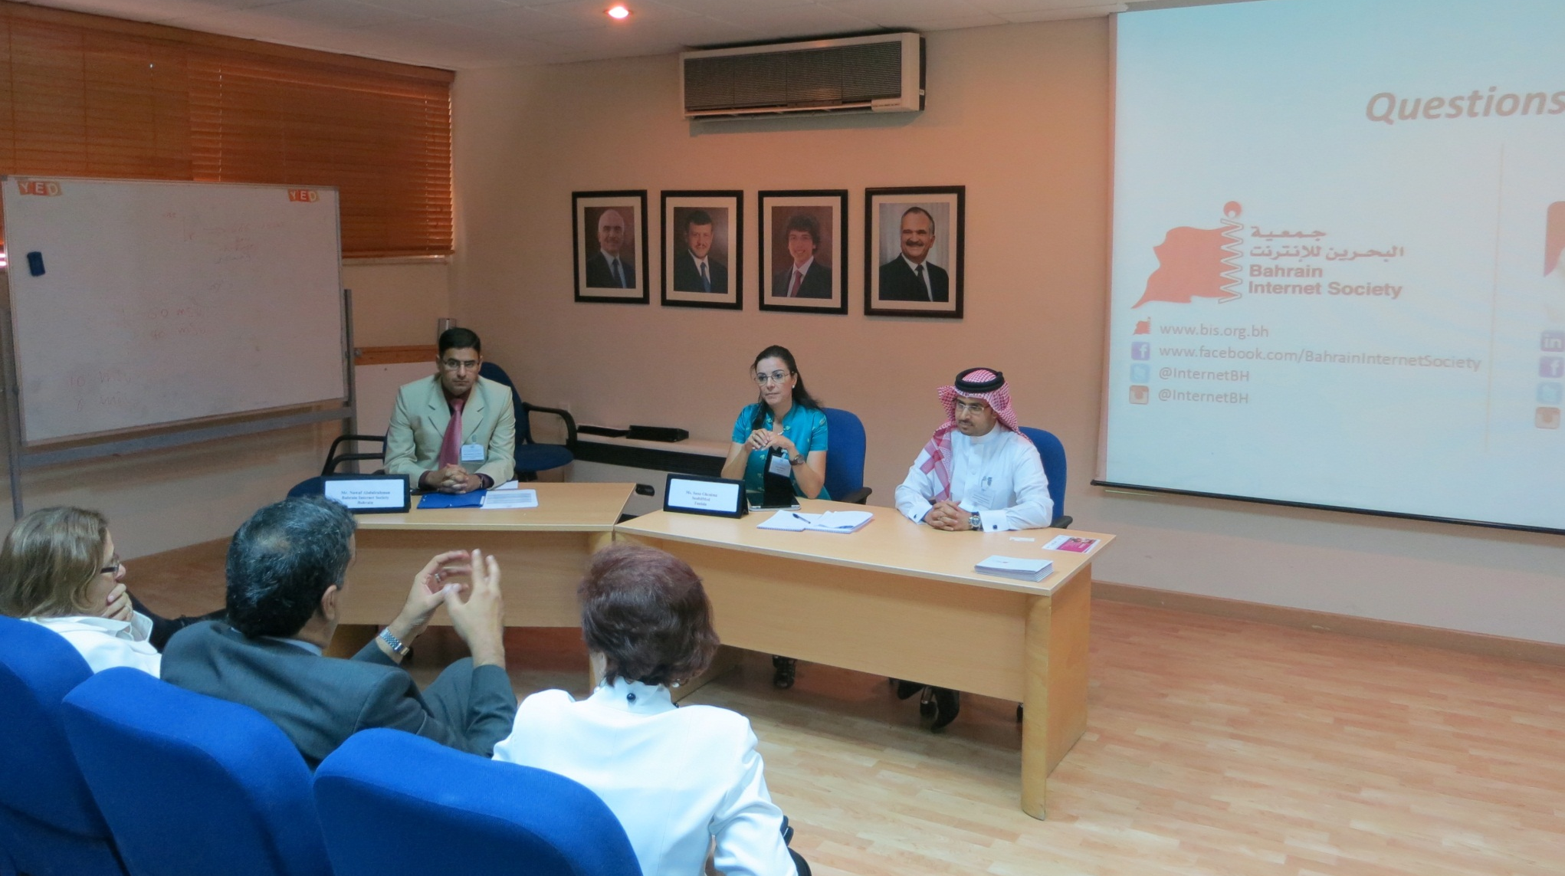
Developing the Arabic Digital Content (with United Nations - ESCWA)

Slide 27

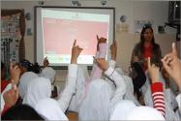
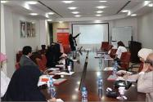
Gulf Internet Week
Is organized annually for the fourth consecutive year coinciding with the Global Internet Day that is announced by the Internet Society (ISOC), the Gulf Internet Week highlights the most important ICT issues facing the Gulf societies at the moment.
The event includes field visits to schools, institutes, majlises, governorates and youth and sport innovation centres.
Website: http://www.gulfinternetweek.com
Partners:
  Ministry of Industry and Commerce
  Kuwaiti Internet Association
  Bahrain ICT Suppliers Trade Association

Slide 28
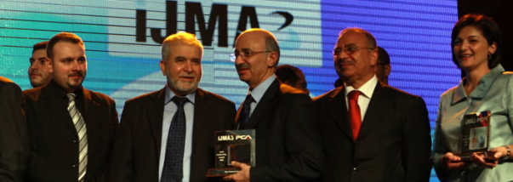

MENA ICT Conference 2010 & Arab GoldenChip Awards
Bahrain Internet Society is a Member of Organizing Committee and Chairman of Arab GoldenChip Awards.
Arab gold awards recognize the most important Arab personalities that contributed to the development of ICT in their countries in the Arab world as a whole.
Website: http://www.menaict.com/v1/

Slide 29
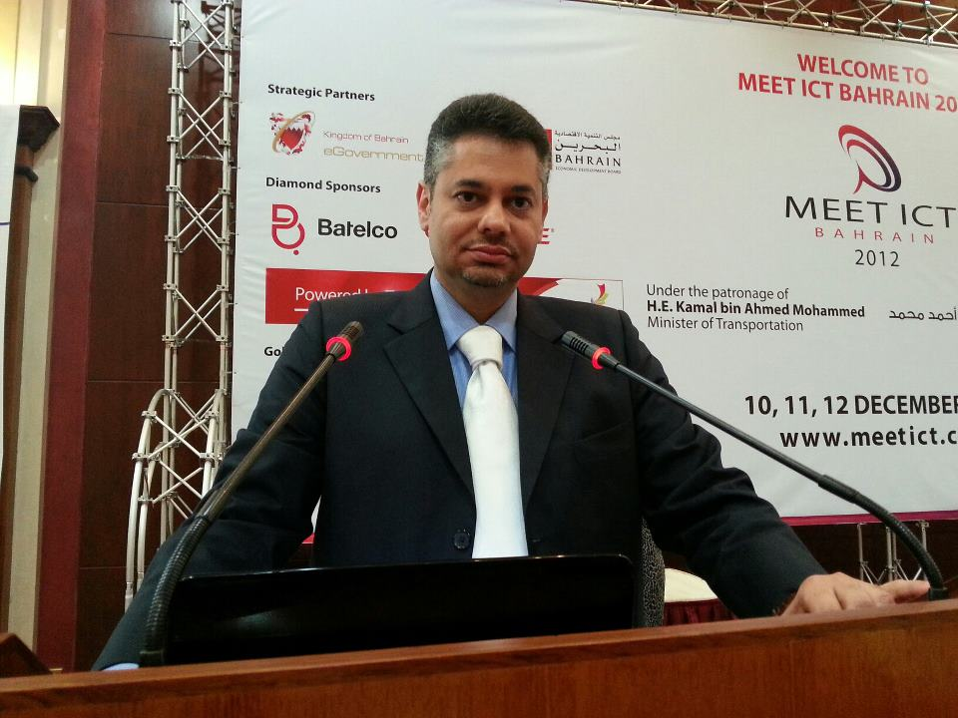

Slide 30


Special Interest Groups
Bahrain IT Team
  Looking after the interest of university students Towards achieving bright Career in ICT
BISTA
  Bahrain ICT Suppliers Trade Association is a body responsible of carrying the vision of making Bahrain a recognized information and communication technology (ICT) hub in the Middle East region.

Slide 31





Engagements
  Bahrain Chapter of the Internet Society
  http://www.internetsociety.org/
  Member of ICANN At-Large
  http://www.atlarge.icann.org/
  Board Member of World Summit Youth Award
  http://www.youthaward.org/
  Member of the Eminent Expert Grand Jury of the World Summit Award
  http://www.wsis-award.org/
  Partner of the Arab eContent Award
  http://www.bea.bh/
  Member of the Consumer Advisory Group by the Telecommunications Regulatory Authority

Slide 32
Current ICANN Involvements
MESWG – Middle East Stragic working group
APRALO – WG's
Capcity Buliding
    ROP
    At-lagre Summit 2

Slide 33
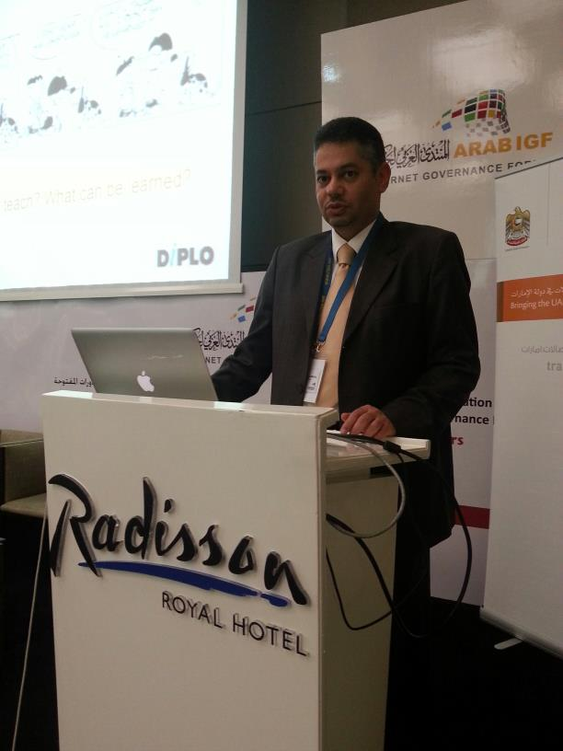

Slide 34
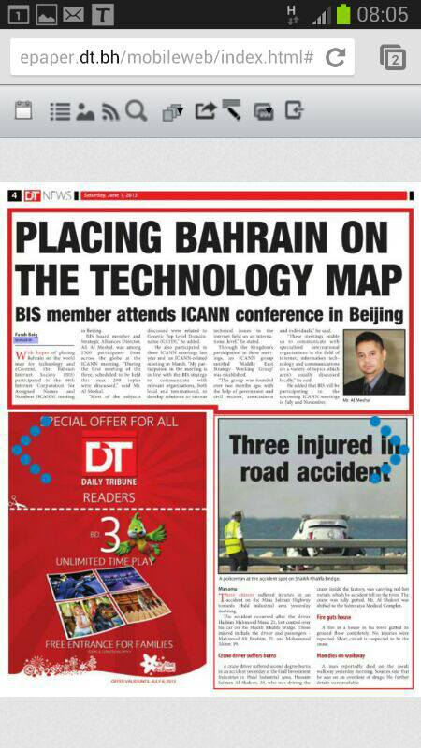

Slide 35
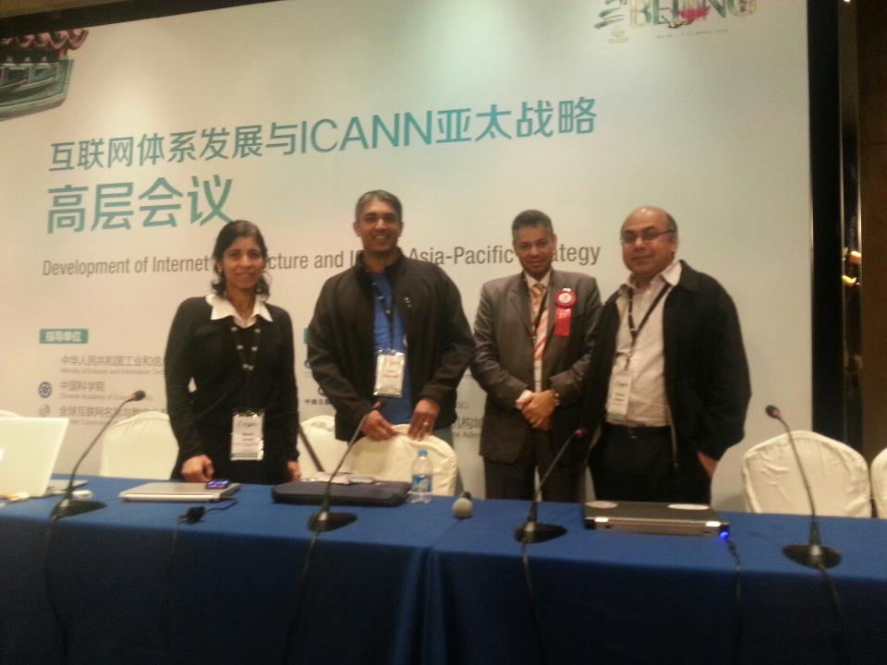

Slide 36
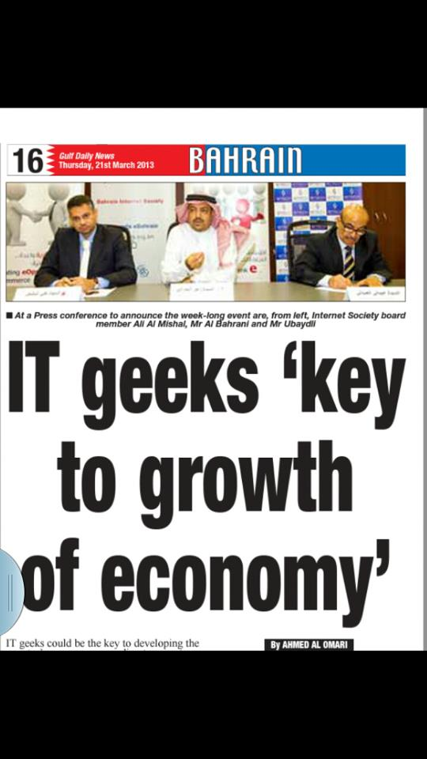

Slide 37
Monthly Events
Beside to the projects, initiatives and conferences, BIS organizes a monthly events for its members, those events highlight and discuss the development of the ICT field nationally, regionally and globally.
Notes:
Objectives
New Election
Achievements
Projects

Slide 38
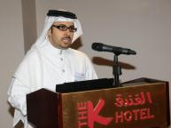
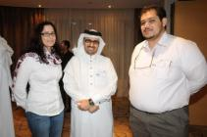
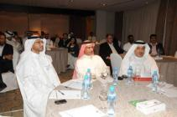
Monthly Events – Reception Event
Notes:
Objectives
New Election
Achievements
Projects

Slide 39
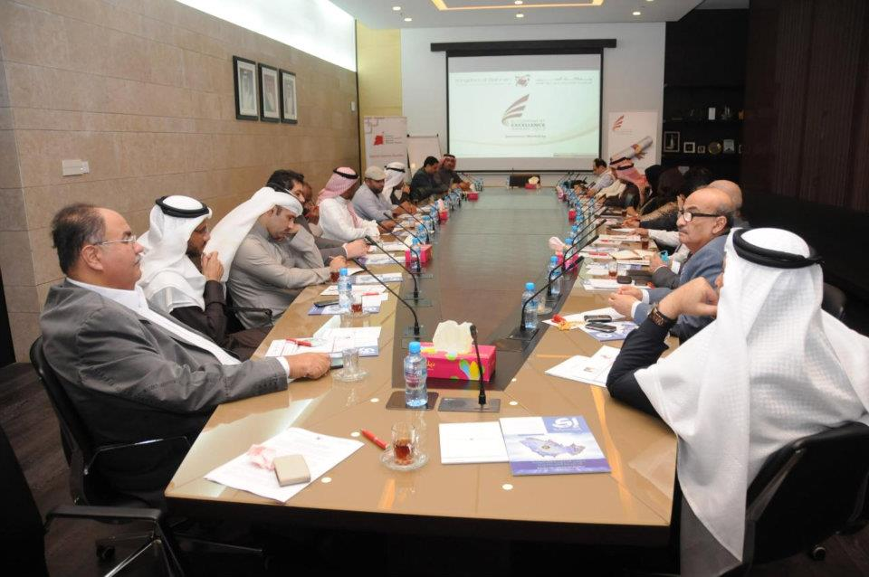
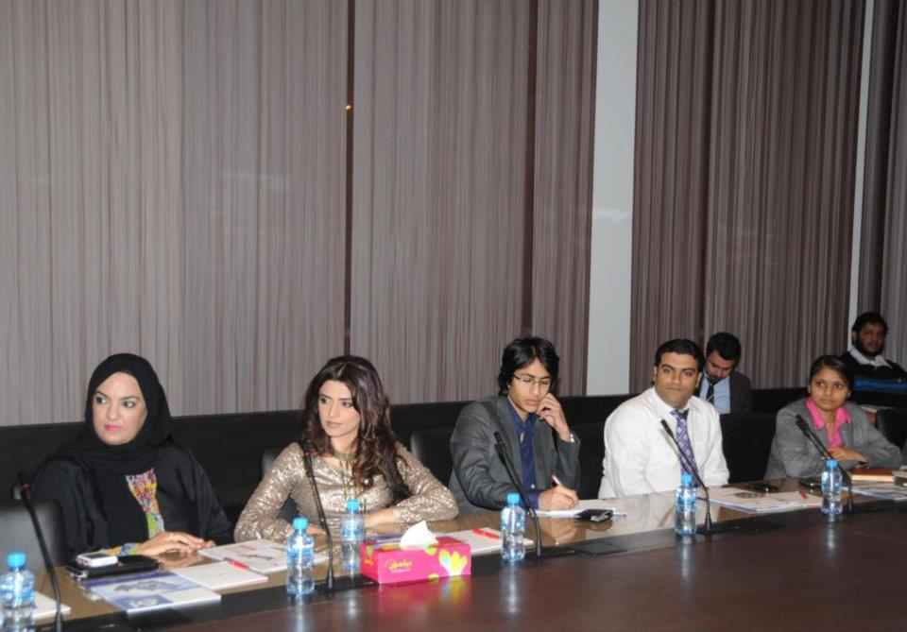
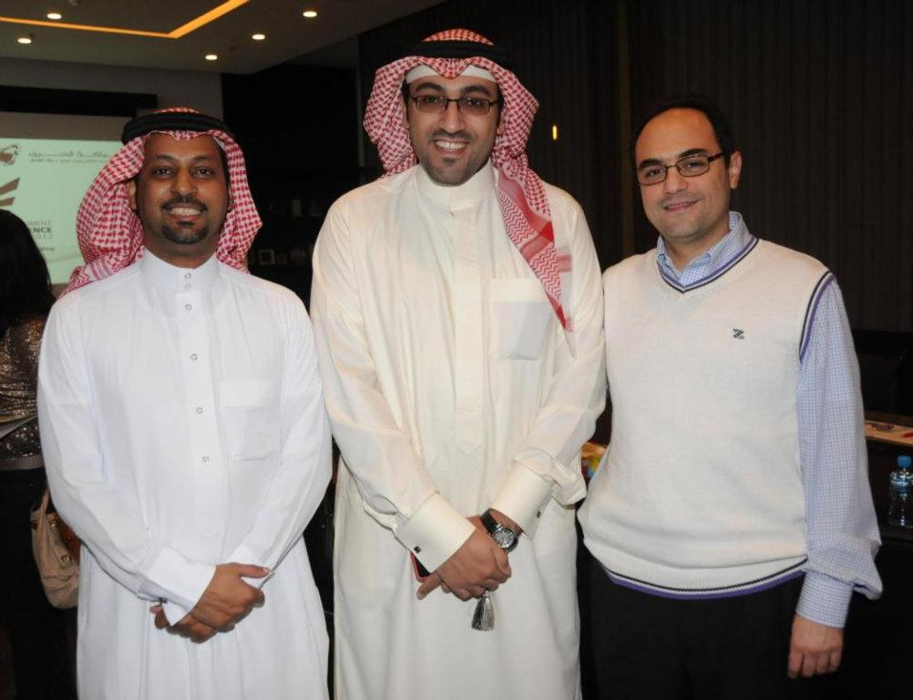
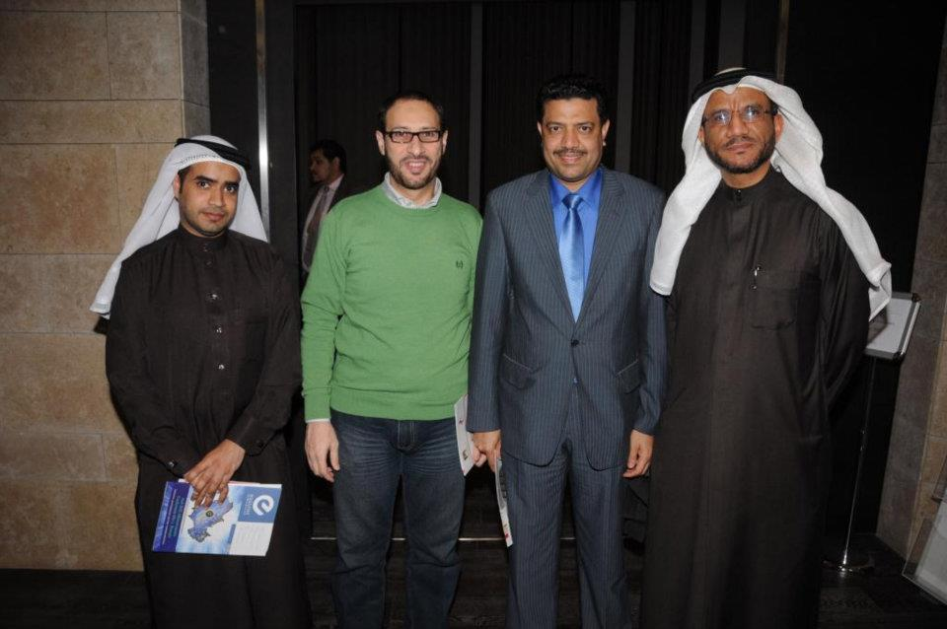
Monthly Events - eGovernment Authority & BIS workshop on Excellence Award 2012
Notes:
Objectives
New Election
Achievements
Projects

Slide 40
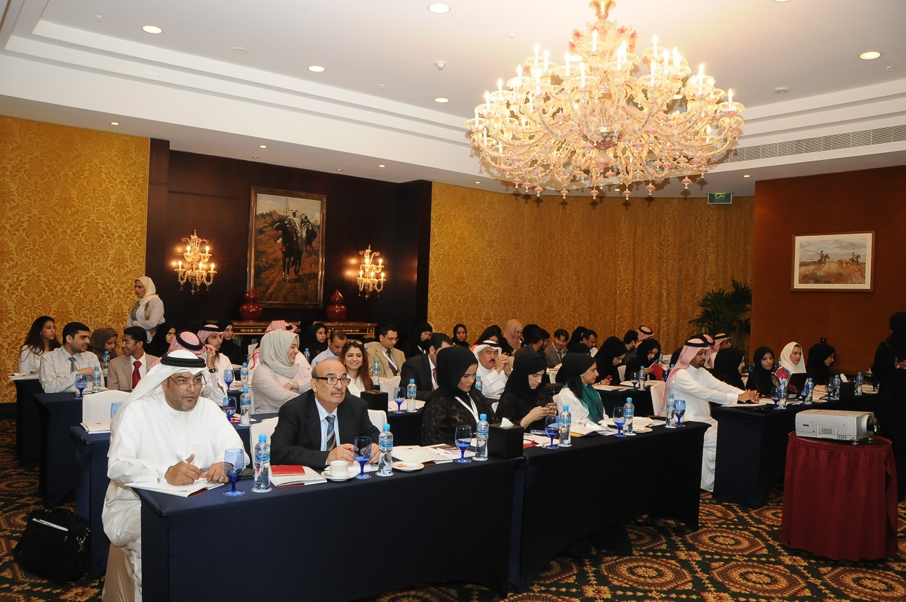
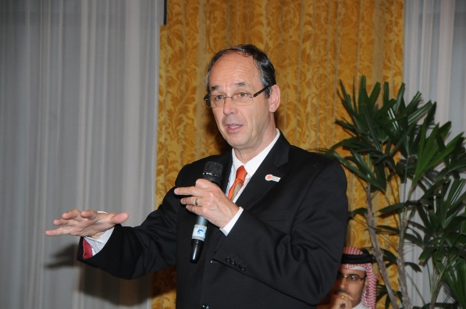
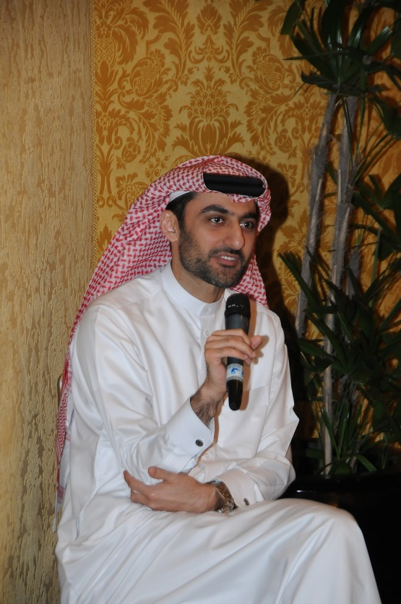
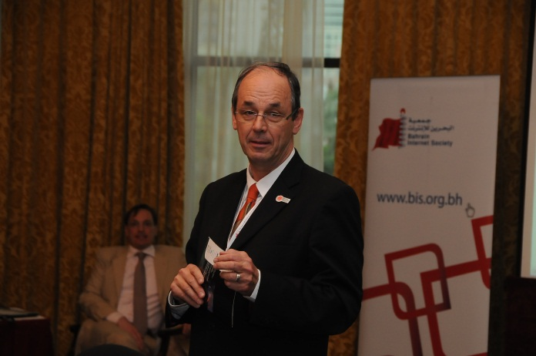
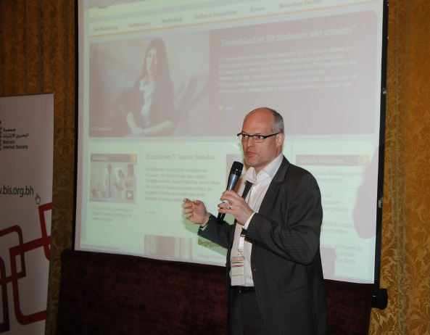
Monthly Events – eContent Workshop
Notes:
Objectives
New Election
Achievements
Projects

Slide 41
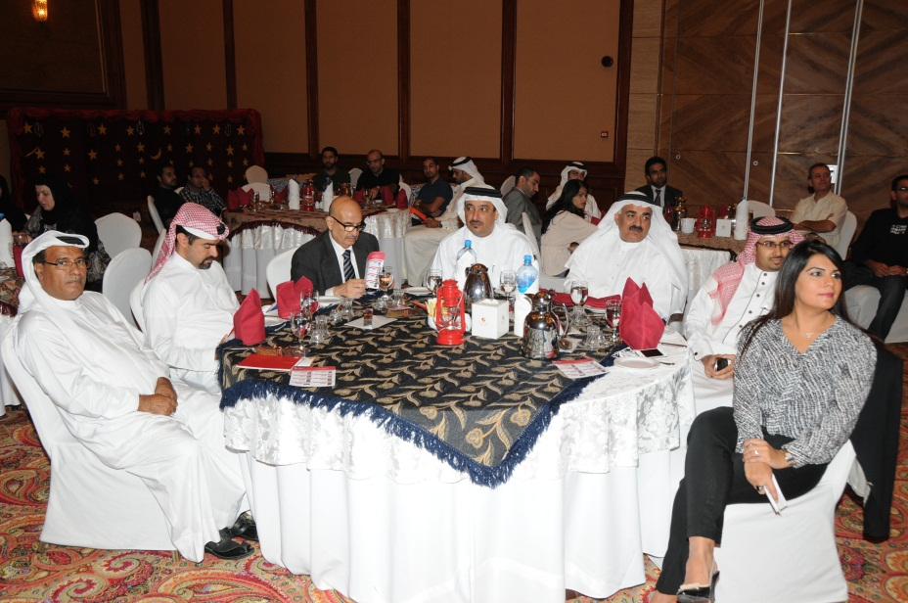
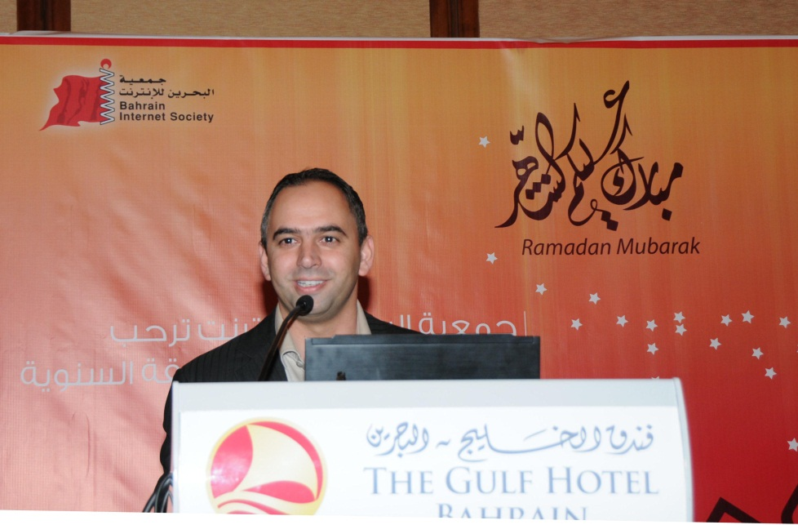
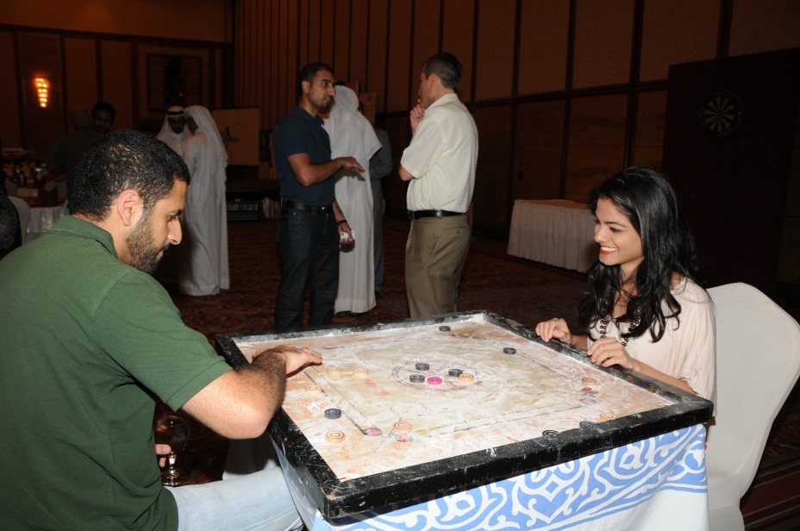
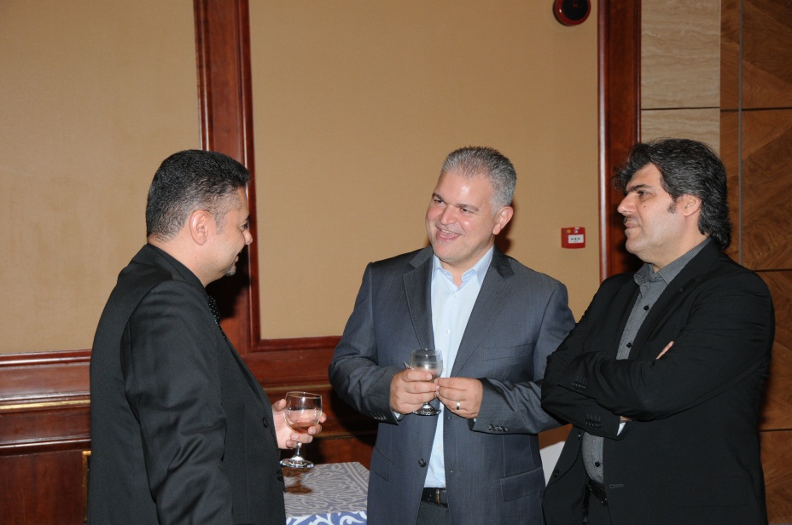
Monthly Events – Ramadan Ghabga
Notes:
Objectives
New Election
Achievements
Projects

Slide 42
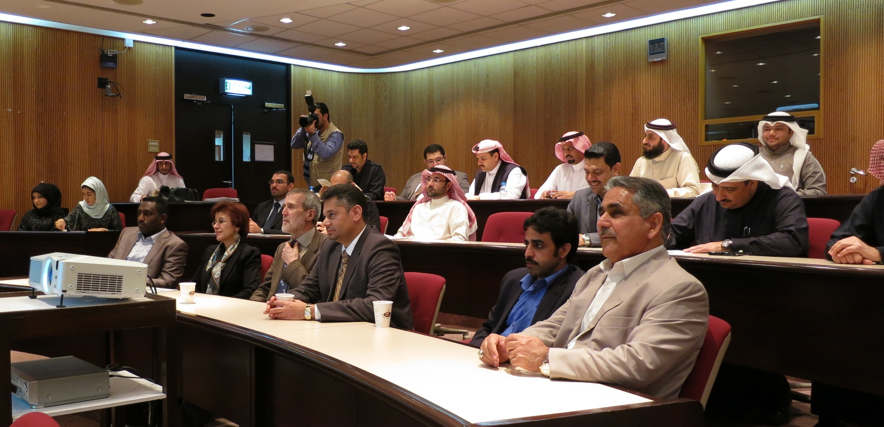
Monthly Events - Consumer Rights in the Telecom Sector
Notes:
Objectives
New Election
Achievements
Projects

Slide 43
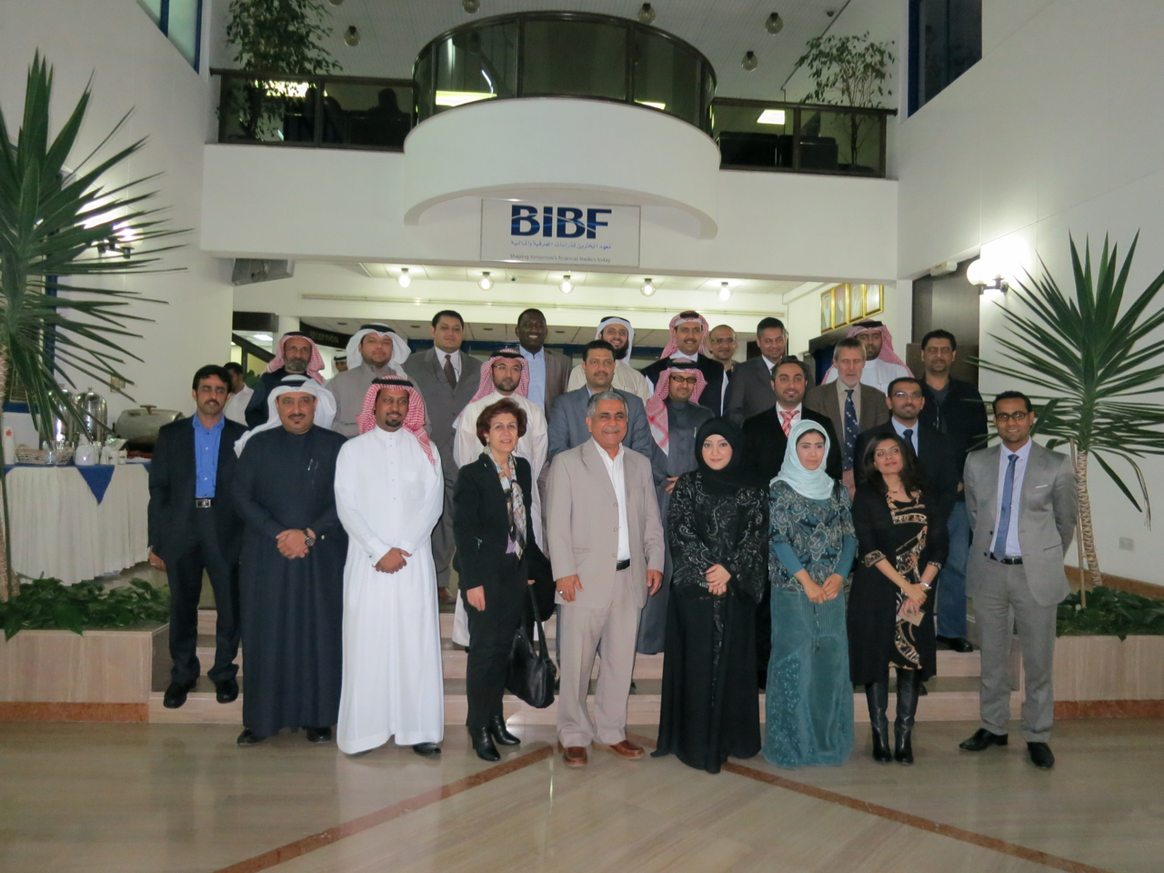

Slide 44
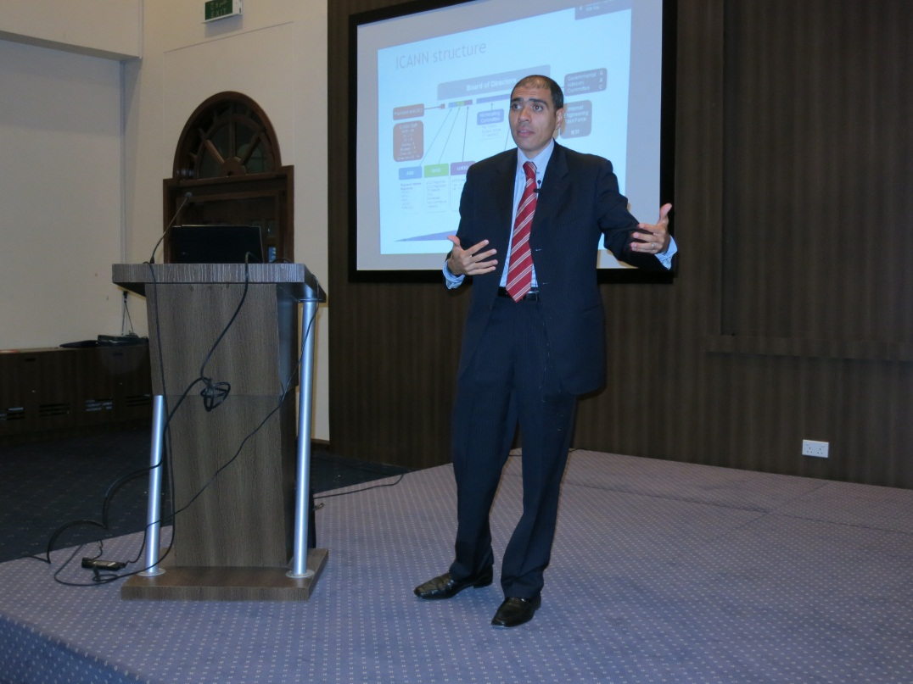
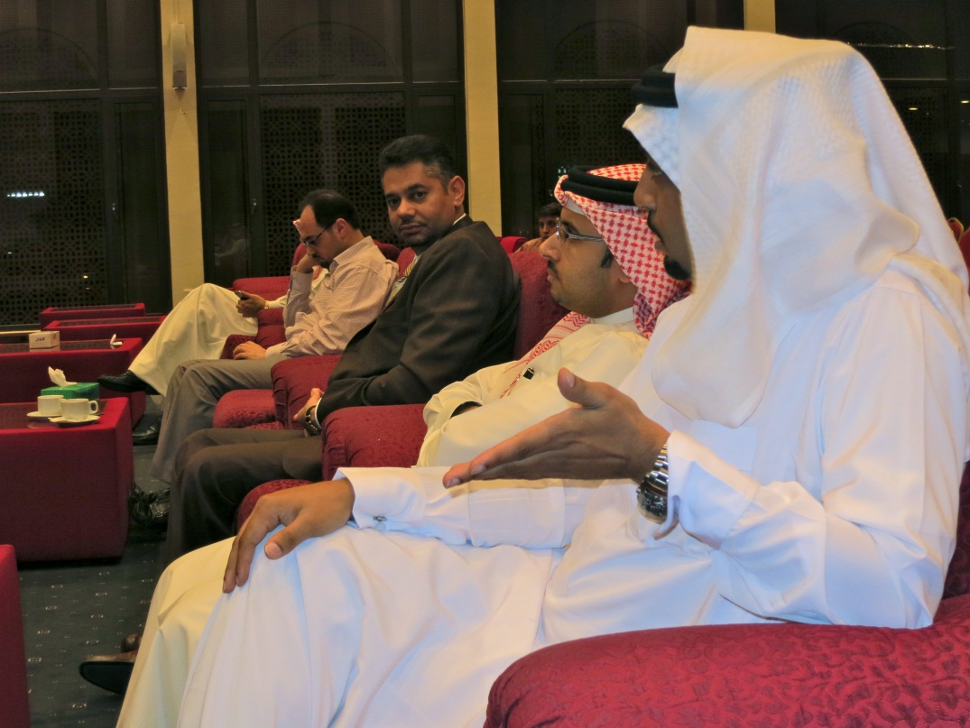
Monthly Events – ICANN Event
Notes:
Objectives
New Election
Achievements
Projects

Slide 45
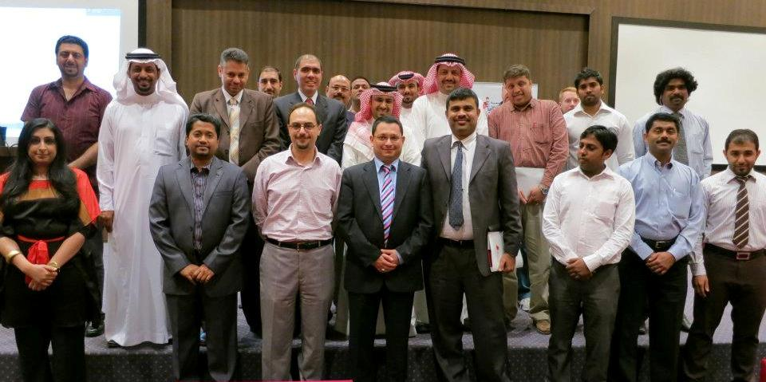

Slide 46
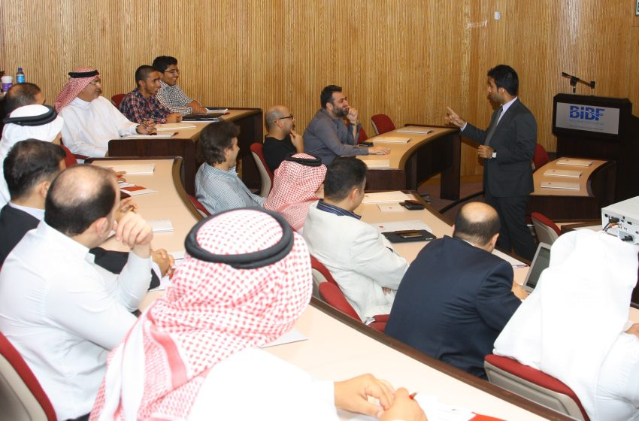
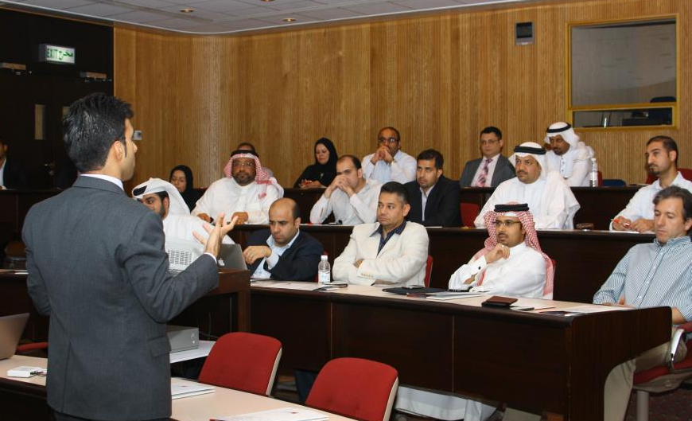
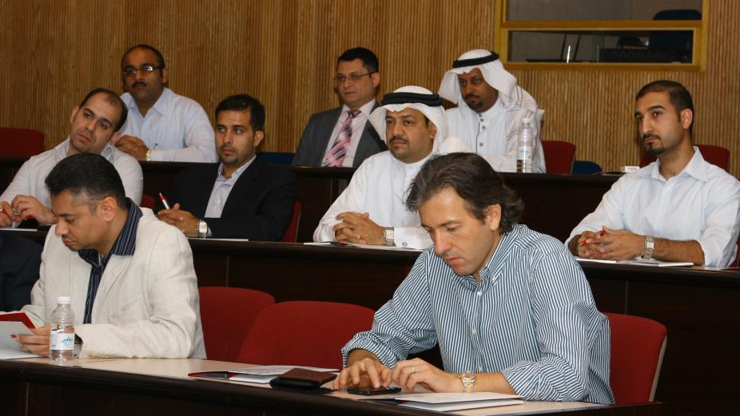
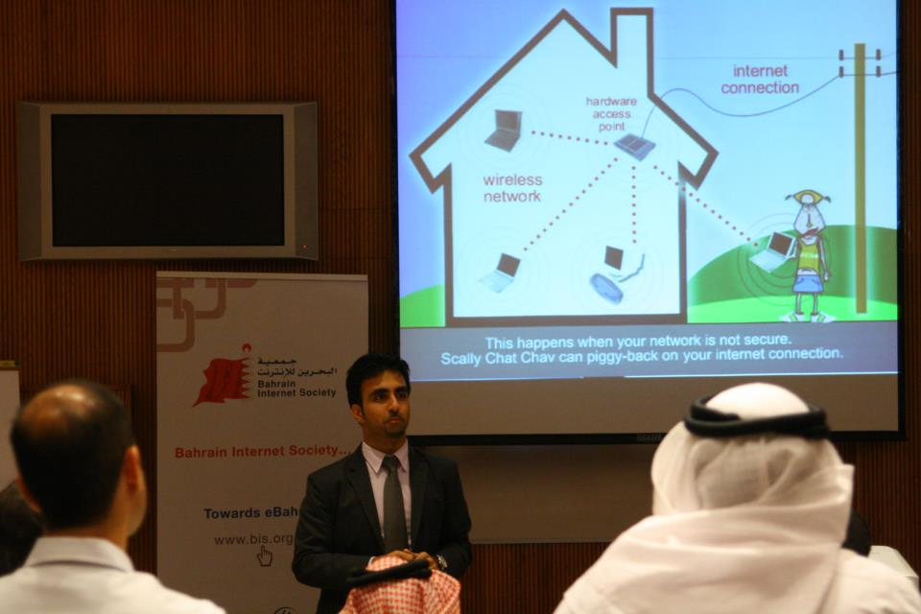
Monthly Events – Social Network Security & Anonymous Attacks
Notes:
Objectives
New Election
Achievements
Projects

Slide 47
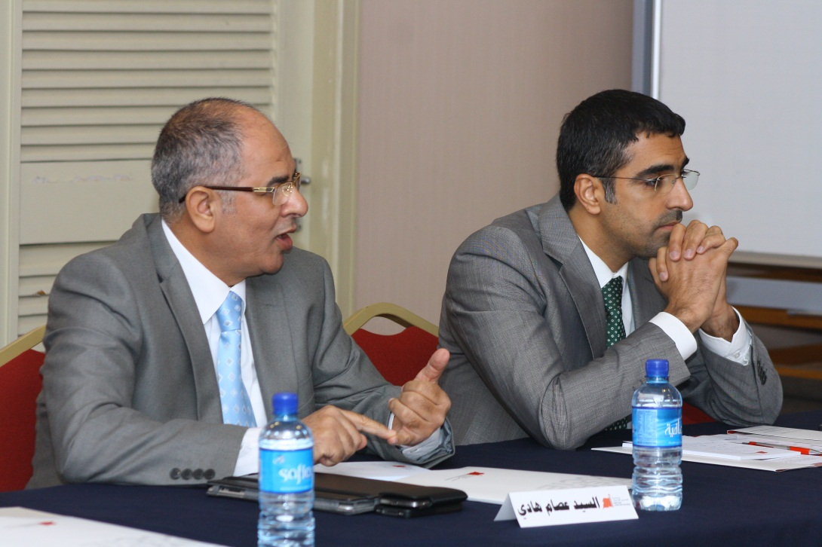

Monthly Events – The Cultural Impacts of the Social Media
Notes:
Objectives
New Election
Achievements
Projects

Slide 48




BIS in the Media
Notes:
Objectives
New Election
Achievements
Projects

Slide 49


BIS Web Presence
  Web 2.0 Website (Recently Launched)
  Facebook Fan Page
  Facebook Group
  Twitter
  Blog
  Forum (Under development)
  LinkedIn
  Google+
  Instagram
Notes:
Objectives
New Election
Achievements
Projects

Slide 50
BIS Committees

Slide 51
The Roles of the Committees
BIS Board
Membership Affairs
Web and Social Media
PR and Communication
Internet Service Advancement
Fund Raising Committee
Projects and Events
Strategic Alliances
Notes:
Objectives
New Election
Achievements
Projects

Slide 52
Upcoming Events

Slide 53


About the Award
It is organized by bi-annually under the patronage of His Highness Shaikh Mohammed bin Mubarak Al Khalifa, Deputy Prime Minister and Chairman of the Supreme Committee for Information and Communication Technology.

Slide 54
Categories
e-Government
e-Business
e-Banking
e-Culture
e-Media
e-Health
e-Learning
e-Science
e-Entertainment
e-Inclusion

Slide 55
Jury Process
Evaluation Criteria
Quality and comprehensiveness of content
Ease of use: functionality, navigation and orientation
Value added through interactivity and multimedia
Attractiveness of design (aesthetic value of graphics/audio)
Quality of craftsmanship (technical realization)
Strategic importance for the global development of the Information Society

Slide 56

Mobile Applications Development Workshop
Notes:
Objectives
New Election
Achievements
Projects

Slide 57
Upcoming Events
NGO Day
MeetICT 2013
eContent Award

Slide 58


www.bis.org.bh
www.facebook.com/BahrainInternetSociety
@InternetBH
@InternetBH

