Slide 1
ICANN At-Large
Roberto Gaetano
APTLD-74 | Tashkent, UZ | 20 September 2018

Slide 2

Summary
What is ALAC and where does it fit in the ICANN model
Relationship between ALAC and the ccTLDs
Future steps
Notes:
This is a simpler agenda slide, the outline for your presentation.

Slide 3
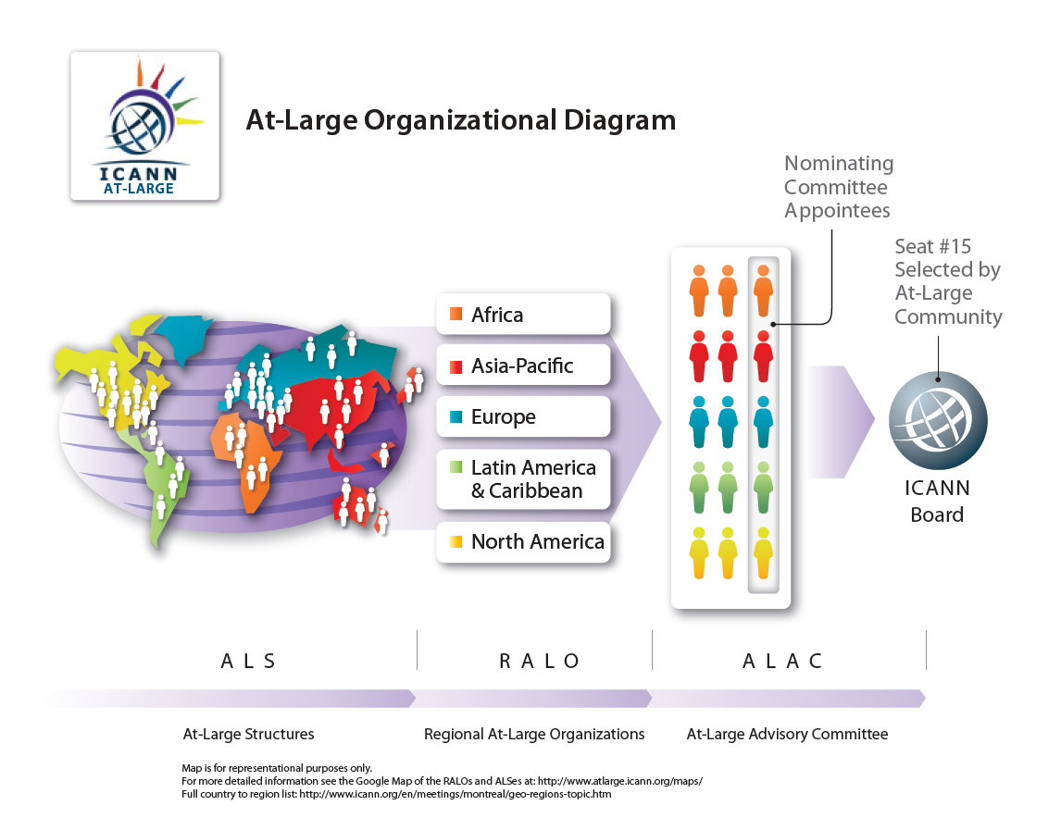
Trebuchet body text
Source: http://www.atlarge.icann.org/orgchart

Slide 4
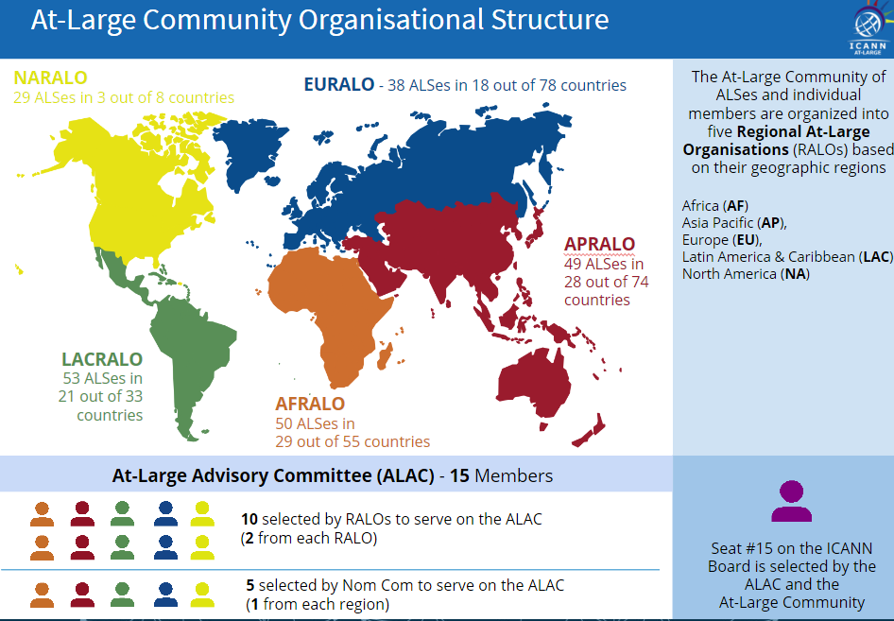
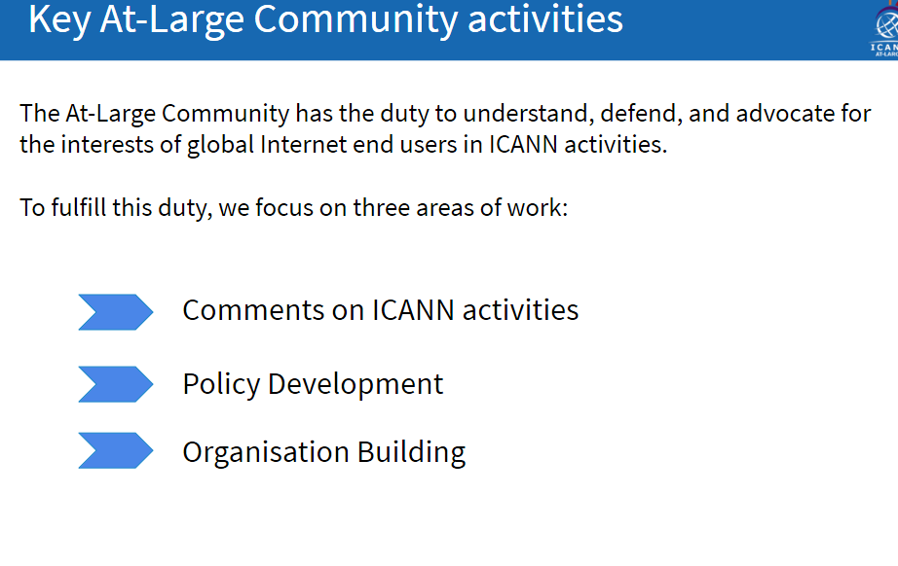
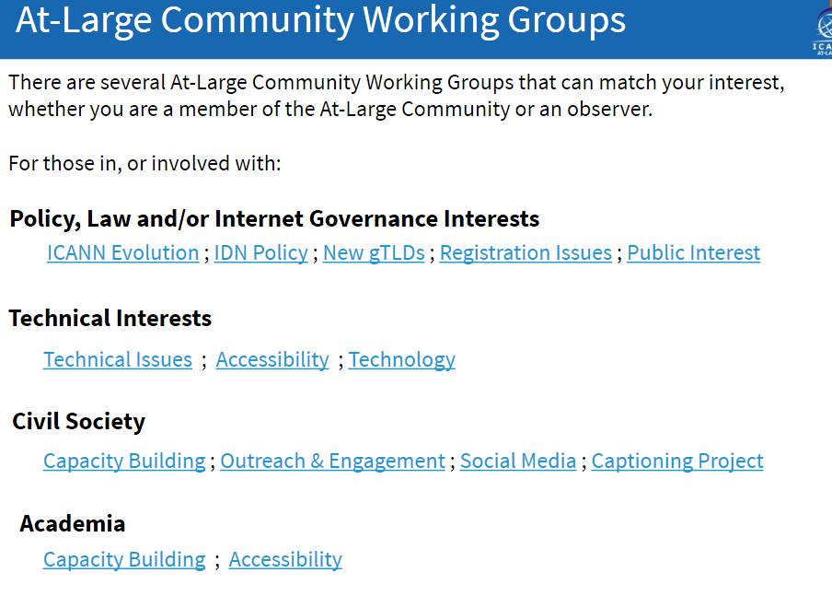
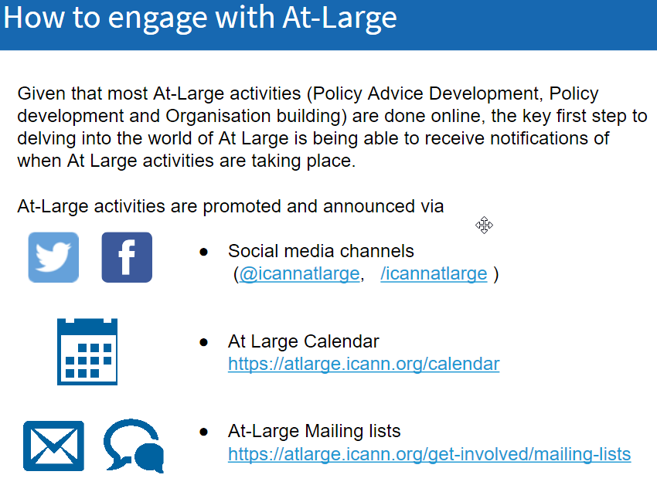
Introduction to At-Large
Notes:
This is a stylized agenda slide for your presentation.
To delete a box, if there are too many boxes, click the edge of the box, ensure the entire box is highlighted, then DELETE.
To update the numbers and text, click inside the circle for the numbers or in the box for the text, revise the text.

Slide 5
Relationship between ALAC and the ccTLDs
MoU signed between APTLD and APRALO in March 2014
              Sharing of Information
              Research
              Meeting Attendance
              Training
              Awareness and Outreach
              Capacity Building
              Appointment of Liaisons
https://www.aptld.org/documents/MOUs/201805/175.html
Other MoUs have followed in other regions
Notes:
This is a simpler agenda slide, the outline for your presentation.

Slide 6
Future steps
Critical analysis of the benefits of the MoU
Common initiatives for capacity building and training
Sharing information about specific topics
Underserved or remote users
Universal Acceptance and IDN
Notes:
This is a simpler agenda slide, the outline for your presentation.

Slide 7






References
Thank You and Questions
Reach us at:
Email: staff@atlarge.icann.org
Website: atlarge.icann.org
twitter.com/ICANNAtLarge
flickr.com/photos/icann
facebook.com/icann.atlarge
youtube.com/user/icannatlarge
slideshare.net/icannpresentations
Notes:
You can adjust the email/web address to whichever email or web address is best suited to your presentation. This should be your final slide.

