Slide 1

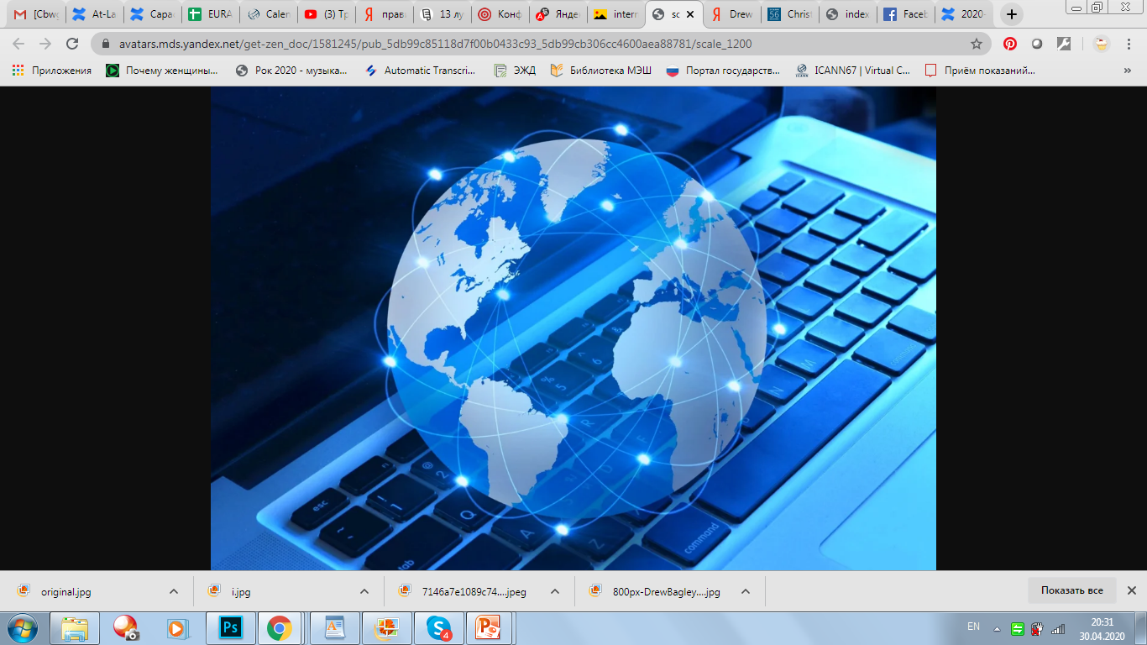
At-Large Capacity Building Webinar
DNS Abuse: An End User Perspective
4 May 2020 at 15:00 UTC

Slide 2


Presenters:
Speak clearly for the best quality of translation.
Participants:
Video function is turned off.
Please keep your microphones muted at all times, until we have the Q&A.
If you raise your hand, the moderator will give you the floor.
Click on CHAT to connect with other participants.
For ALL questions, please use format: <Question:>
Tweet using hashtag #ICANNAtLarge
At-Large Capacity Building Webinar
DNS Abuse: An End User Perspective
ICANN Standards of Behaviour: https://www.icann.org/resources/pages/expected-standards-2016-06-28-en

Slide 3
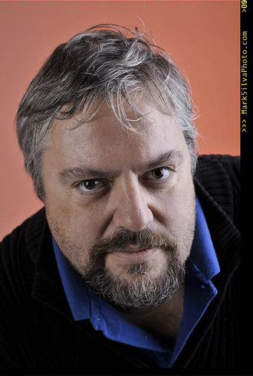
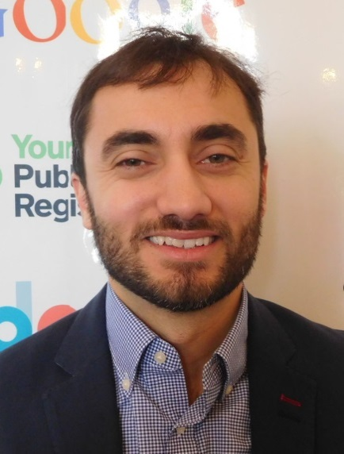
Jonathan Zuck,
Vice Chair of ALAC for Policy.
Executive Director,
Innovators Network Foundation.
At-Large Capacity Building Webinar
DNS Abuse: An End User Perspective
The Guest Speakers
Drew Bagley,
Director of Operations,
The Secure Domain Foundation

