Slide 1

Recommendations for the At-Large
Capacity Building webinars` promotion on Twitter
Filina Natalia
Social Media WG
EURALO Vice-Chair
October, 2020

Slide 2

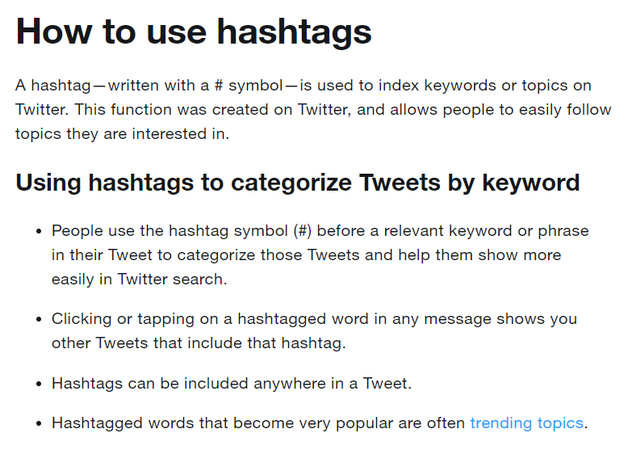
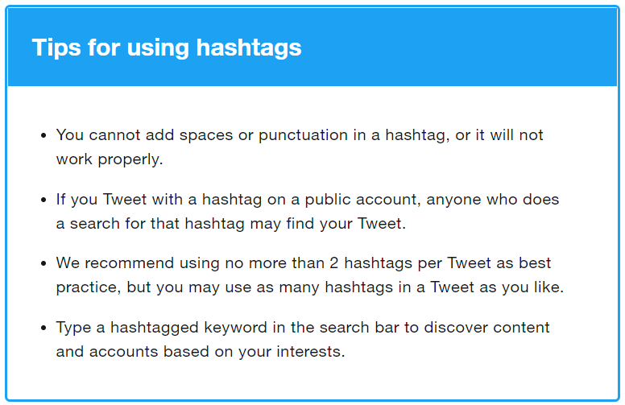
Recommendations for the At-Large Capacity Building webinars` promotions on Twitter
Hashtags
Recommendation from Twitter.com

Slide 3
Recommendations for the At-Large Capacity Building webinars` promotions on Twitter
Hashtags
We help people to find our tweets by #hashtags:
General Related to the Webinar`s topic
#Education
#Webinar
#CapacityBuilding
#DNS
#DNSabuse
#GDPR
#DoH
#DoT
#Geopolitics
#Cybersecurity
#gTLD
#ccTLD
#UniversalAcceptance
We encourage people to follow us (our own hashtag):
Look for our hashtag #AtLargeWebinar!
or
Follow our hashtag #AtLargeWebinar!
but this is not so effective if we haven`t any Capacity Building webinars` records for those who missed webinars.

Slide 4

Recommendations for the At-Large Capacity Building webinars` promotions on Twitter
Content
Text (including #) must be short enough – 280 symbols.
(part of information we put in to the post, the rest part – in to the picture).
We put # in to the text
We tag the Guest Speakers or Moderators if they have Twitter accounts and @ICANNAtLarge
We translate the post in to the languages that will be supported during the webinar (we do the same with #hashtags!)
We make a post 4 days before the webinar and on the day of the webinar
We create the promo cards with minimum information (topic, time, name)
We use the allowed photo of the guest speakers
After the webinar we post the short part of the records (less than 59 sec) to attract more attention

Slide 5
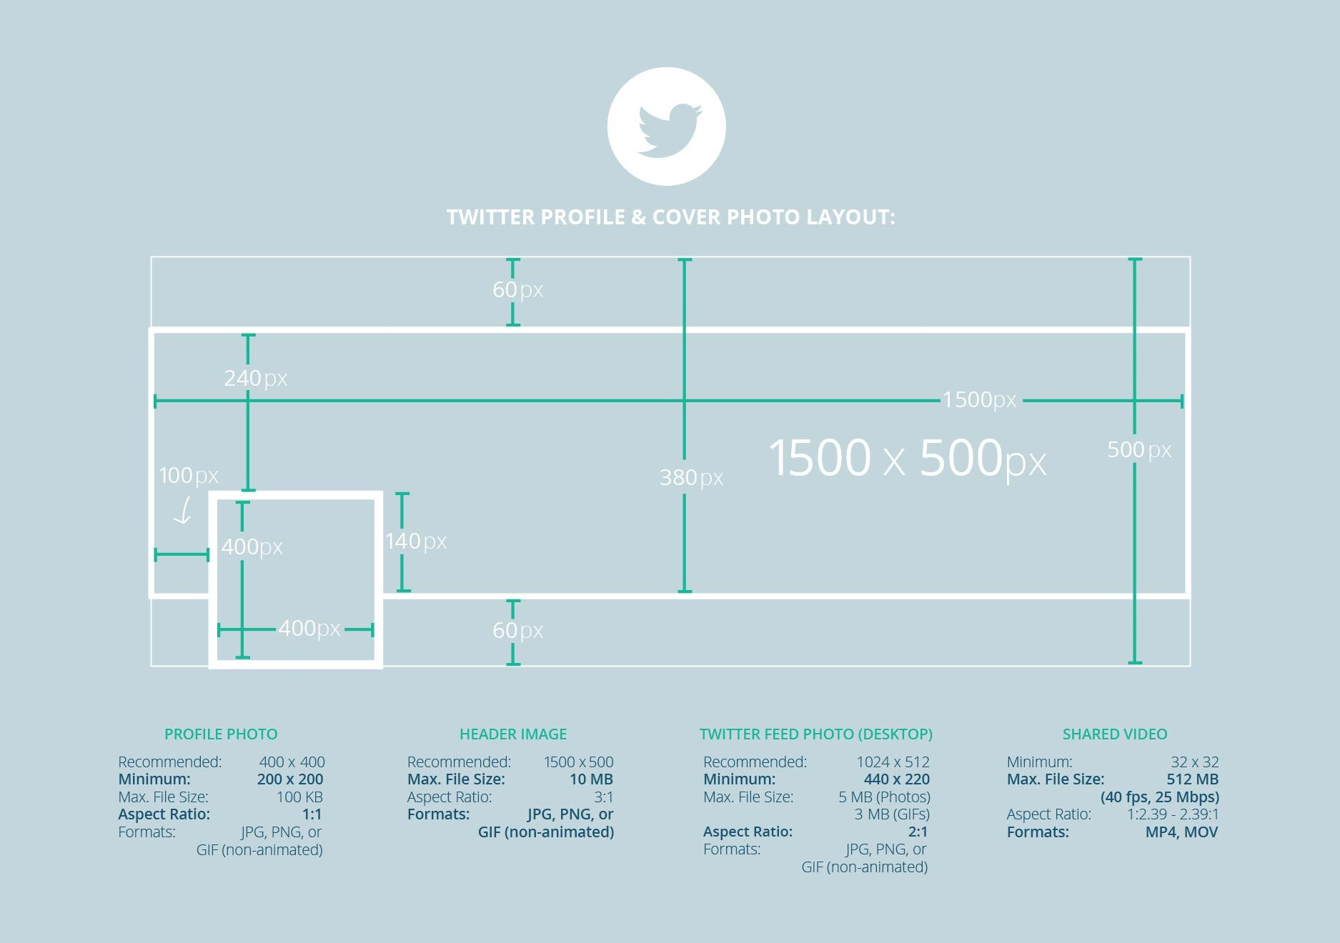
Recommendations for the At-Large Capacity Building webinars` promotions on Twitter
Content
https://www.pinterest.ru/pin/745205069561730705/?autologin=true

