Slide 1


At-Large Capacity Building Webinar
DoH/DoT: Benefits, Drawbacks
and a Way Forward?
7 September 2020, 21:00UTC

Slide 2

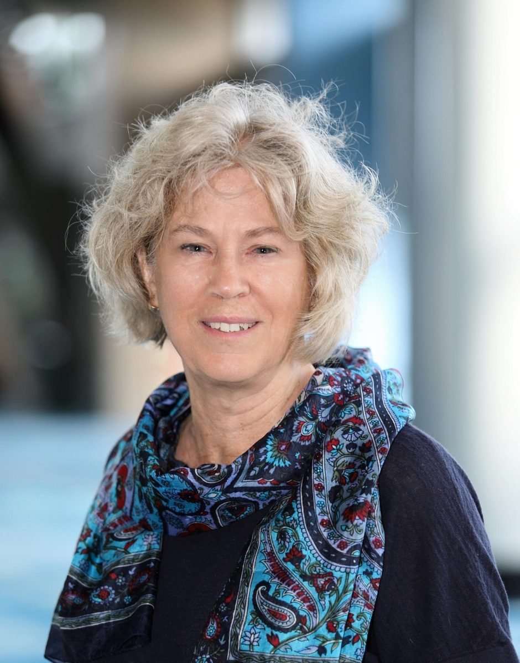
At-Large Capacity Building Webinar
DoH/DoT: Benefits, Drawbacks and a Way Forward?
Holly Raiche
Holly Raiche is on the ALAC Leadership Team, representing ALAC’s Asia-Pacific Regional Organization.
She is a Director and Chair of the Policy Committee of Internet Australia (the Australian Chapter of ISOC).
Holly is also a Director on the Boards of the Australian Communications Consumer Action Network (ACCAN) and the Australian Privacy Foundation.
Holly is an Adjunct Lecturer at the Law Faculty of University of New South Wales in Australia and lectures at the Department of Media and Communications at Sydney University in Internet Cultures and Governance.
Holly has an MA and an LLB, is a non-practicing Solicitor in New South Wales.

Slide 3

Presenter:
Start the recording when you begin your presentation
Speak clearly for the best quality of translation
Participants:
Your audio and video are turned off
Do not turn them ON or play with them, it will interrupt the presenter
Click on chat to connect with other participants
Tweet using hashtag #ICANNAtLarge
At-Large Capacity Building Webinar
DoH/DoT: Benefits, Drawbacks and a Way Forward?
At-Large Capacity Building Webinar
DoH/DoT: Benefits, Drawbacks and a Way Forward?

