Slide 1


Capacity Building Webinar
DNS Abuse:
An End User Perspective.
4 May 2020 at 15:00 UTC for 90 minutes.

Slide 2

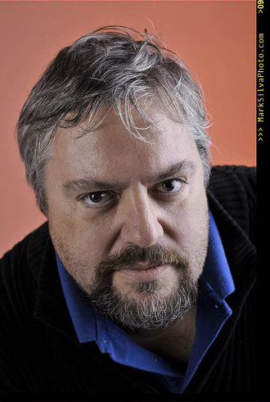
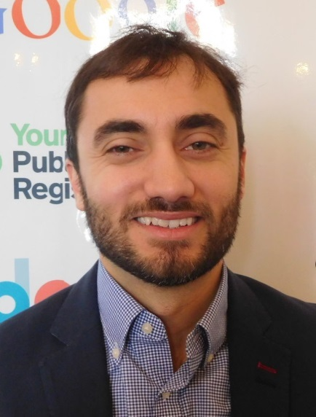
Jonathan Zuck, Vice Chair of ALAC for Policy. Executive Director, Innovators Network Foundation.
At-Large Capacity Building Webinar
DNS Abuse: An End User Perspective
The Guest Speakers
Drew Bagley, Director of Operations, The Secure Domain Foundation

Slide 3

Presenter: Start the recording when you begin your presentation Speak clearly for the best quality of translation Participants: Your audio and video are turned off Do not turn them ON or play with them, it will interrupt the presenter Click on chat to connect with other participants Tweet using hashtag #ICANNAtLarge
At-Large Capacity Building Webinar
DNS Abuse: An End User Perspective

Slide 4
At-Large Capacity Building Webinar
DNS Abuse: An End User Perspective

