Slide 1
Strategizing about the ccNSO

Slide 2
What do we need to do to…
  Serve the needs of our members and broader community?
  Strengthen the ccNSO?

Slide 3
Purpose & value of the ccNSO

Slide 4
Purpose of the ccNSO & value for members
The ccNSO provides a global platform for country code Top Level Domain (ccTLD) Managers to:
  Undertake policy and policy related work,
  Nurture technical cooperation and skill building, share practices and discuss topics of mutual interest and concern,
  Engage with and be informed about other stakeholders in the ICANN environment on topics of mutual interest.
The ccNSO is (1) of (3) ICANN SOs and (1) of (5) DPs and has to carry out related responsibilities required and mandated by the Bylaws.

Slide 5
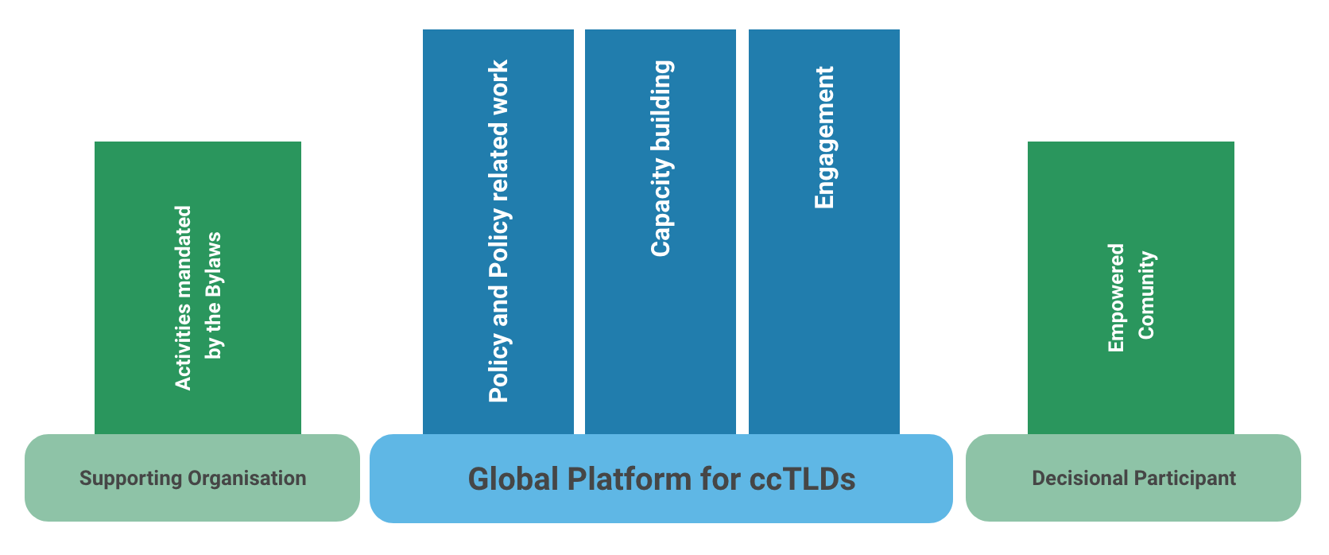
Purpose and Value of the ccNSO

Slide 6
Purpose & value
Do you agree with the purpose and the value as stated?
Is the ccNSO successful in achieving its purpose?
Does the ccNSO provide value to its community?

Slide 7
Delivering on the purpose
Providing value

Slide 8
How do areas of work items relate to the purpose of the ccNSO ?
Policy and policy related work
Cooperation and discussion
Engagement with other stakeholders
Maintain and Improve platform function
Organisational & Administrative Activities

Slide 9
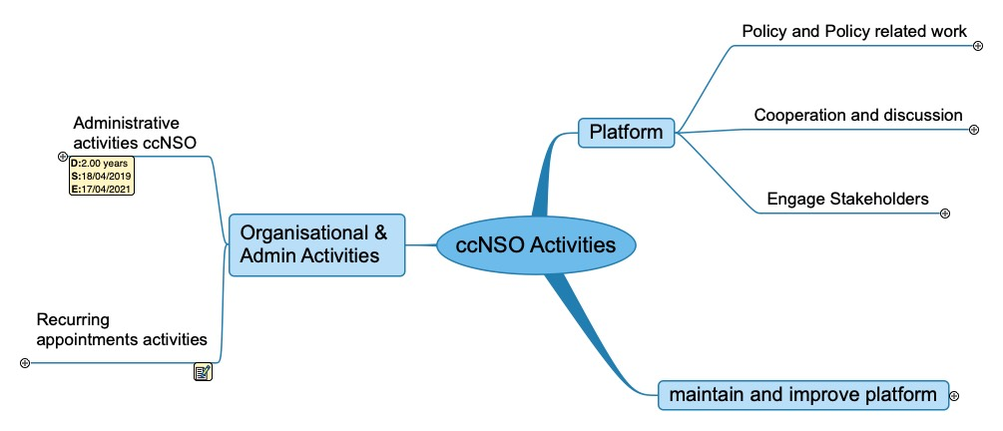

Slide 10
Delivering on the work items

Slide 11
Prioritization of work items:
Level of Importance and Urgency
  What are important items?
    Which work items need to be completed anyway to maintain ccNSO?
    What are the items that determine success of the ccNSO?
    What are the relevant items for ccTLD community/ccNSO?
  What is urgent?
    When does a work item need to be delivered to be of value?
    What is the level of urgency? High <-> Low

Slide 12
Which are of the Areas of work items:
1) Serves the needs of our members and the broader community best?
2) Strengthens the ccNSO?

Slide 13
Delivering on work items
Is improvement of capabilities and competencies needed?

Slide 14
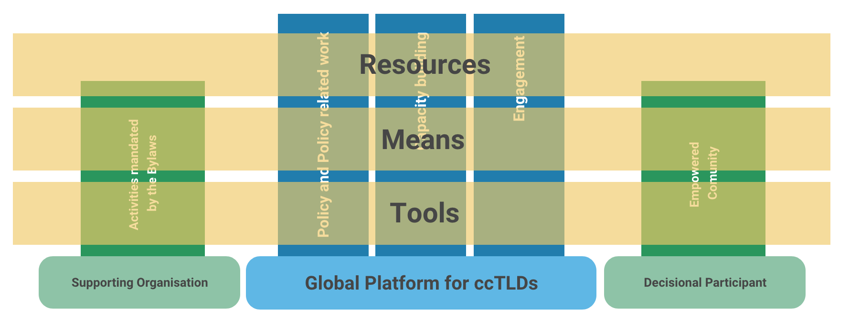
Instruments Necessary to Achieve the Goals

Slide 15
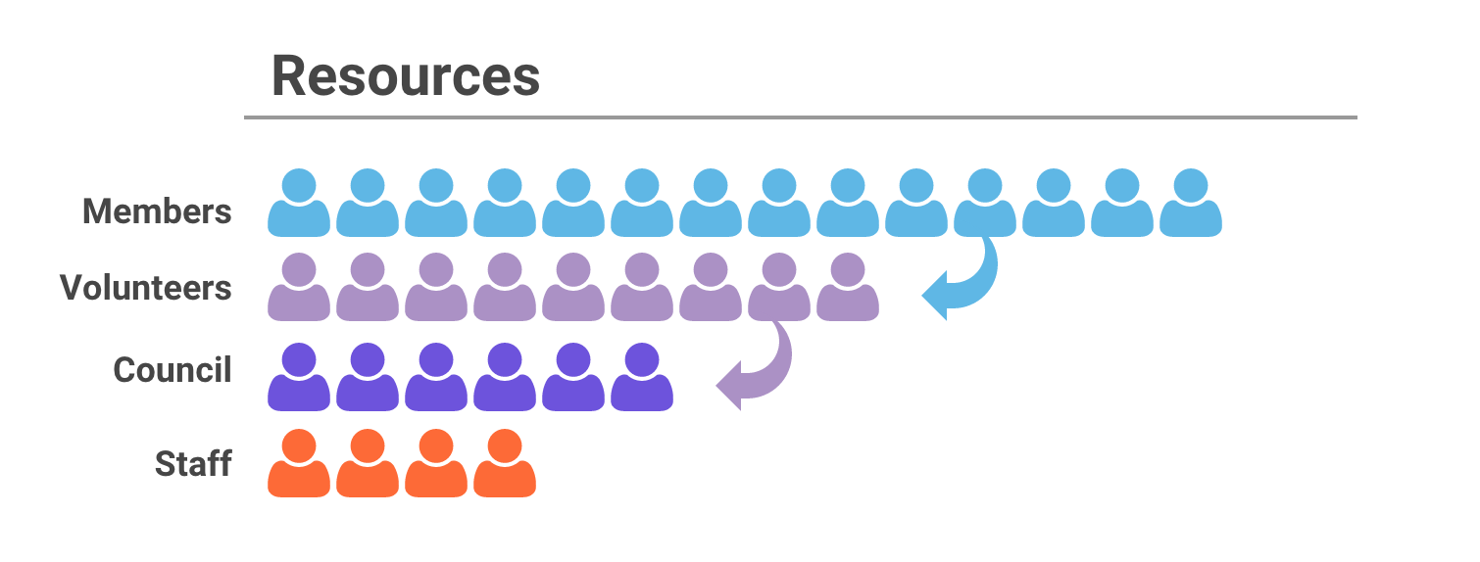

Slide 16
ccNSO Resources
Volunteers: people participating in WG, Committees and Council
  Limited in numbers
  Limited time (3-4 hours per week on average)
  Subset of community members
Staff
  Secretariat, ICANN org subject matter experts (PTI, Legal, GDD, OCTO)

Slide 17
Tools:
ccNSO Website
WIKI space
Mailing lists
Zoom
Newsletter
Email announcements

Slide 18
ccNSO Competencies:
How the resources and tools are organised to deliver on ccNSO activities
WG & Committees
  Intersessional and in person. Limited use of tools, limited participation, interactive
Council
  Intersessional and in person. Limited use of tools, limited participation, interactive
ccTLD community meetings
  attendance ( 120-130 attendees) 50+ ccTLDs
  Format of the meeting focused on in person. Limited use of tools. No transcription, no translation, limited in interaction
Webinars
  Attendance fluctuates
  Presentations, limited in interaction

Slide 19
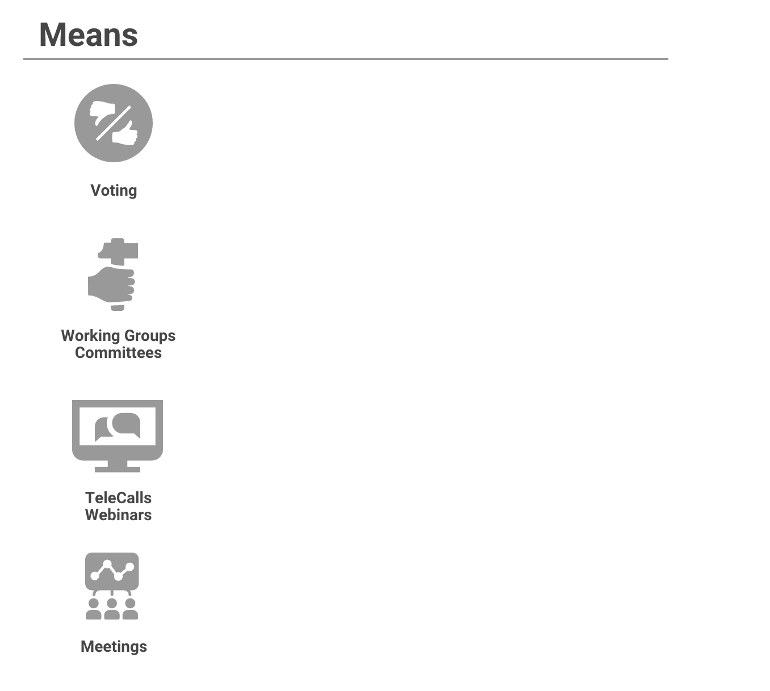
Decision making
Council & Members vote
Operational:
Focused work, practical results
Communication:
To foster collaboration, raise awareness, inform
Information sharing, Engagement:
Tech Day, ccNSO Members Day, WG meetings

Slide 20
What are strengths and weaknesses?
Weaknesses?
  Limited use of potential of on-line tools (whiteboarding, break-out sessions, polling etc.)
  Format of meetings. “Furrow in the road” syndrome. We have done it so long in the same way, changing that way is exceptionally resource demanding
  Leadership of groups
  Participation levels
Strengths?
  Culture of cooperation & collaboration
  Solidarity (ccTLD for ccTLDs)
  Flexibility and Operational focus on organising activities

Slide 21
Strengths and weaknesses of the ccNSO
What do you consider the strengths and weaknesses of the ccNSO?
  Capabilities (Tools and resources)
  Competencies (how we organise of our work)
Which weaknesses need to be addressed first?
What is the most critical weakness, if any?
How should weakness(es) be addressed?
Which strengths can be leveraged?
How can the strength be leveraged?

Slide 22
Environmental Scan
The Opportunities and Threats

Slide 23
Environmental assumptions
Impact pandemic will not go away ->
  impact on behaviors,
  changing role of governments (some of the measures taken now will not go away).
Increased demand for safe and secure on-line services
Recession may/will hit DNS industry
Recession & “Climate change”

Slide 24
What do you see as threats and opportunities for the ccNSO
To achieve the objectives ccNSO?
To be of a value?
To deliver on the Work Items?

Slide 25
So what do we need to:
  Serve the needs of our members and broader community?
  Strengthen the ccNSO?

