Slide 1


Guideline: ccNSO Actions Respecting the Customer Standing Committee

Slide 2

What will change
post transition

Slide 3

Structural Overview
Current Contract
Post Transition
Accountability Mechanisms
from CCWG-Accountability
NTIA
ICANN
Board
Contract
Oversight
IFR
IANA Stewardship
IANA Function Review
IANA Functions
Operator
Legal Separation
ICANN
Post Transition
IANA (PTI)
Reviews
CSC
Board
Customer Standing
Committee
IANA

Slide 4
Purpose & Tasks of the CSC
Ensure continued satisfactory performance of the IANA naming function for the direct customers of the naming services.
Regular monitoring of the performance of the IANA naming function against the IANA Naming Function Contract and IANA Naming Function SOW and through mechanisms to engage with PTI to remedy identified areas of concern.
Notes:
programme working group

Slide 5
Accountability Mechanisms
from CCWG-Accountability
CSC Composition:
Members
2 gTLD registry operators
2 ccTLD registry operators
1 additional TLD representative (non-gTLD and non-ccTLD)
Liaisons
1 Liaison from IANA
1 Liaison from each ICANN Supporting Organization & Advisory Committee (total of 5)
Members + Liaisons = Full slate
ICANN
Board
IFR
IANA Function Review
Legal Separation
Post Transition
IANA (PTI)
Reviews
Special IFR
CSC
Board
Customer Standing
Committee
Notes:
programme working group

Slide 6
Guideline: ccNSO Actions Respecting
the Customer Standing Committee

Slide 7
Selection Process

Slide 8
Selection Criteria
Direct experience and knowledge of the IANA naming function
Analytical skills, ability to interpret quantitative and qualitative evidence, and capacity to draw conclusions purely based on evidence.
Experience in managing and/or participating in committees (e.g. Meeting coordination, reporting, and escalation) in order to contribute meaningfully to CSC processes
Demonstrated ability in relationship management to support diplomatic discussion, consensus driven decision making, and productive negotiation
The candidates have excellent communication skills in order to represent ccTLD interests and to keep the ccNSO and broader ccTLD community informed on progress
Able to work and communicate in written and spoken English.
Notes:
programme working group

Slide 9
Further Requirements
Should commit to actively participate in the activities of the CSC on an on‐going basis
Should be employed or have active backing by a ccTLD manager and should demonstrate the support by the ccTLD manager in respect to the required time commitment to participate actively in the CSC.
Notes:
programme working group

Slide 10
Diversity Criteria
The following diversity criteria should be taken into account:
Geographic regions
Gender diversity
Type, experience and size of ccTLD manager.
Notes:
programme working group

Slide 11
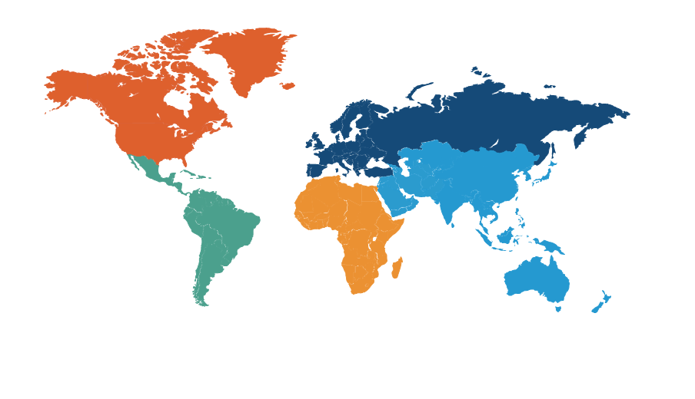
Representatives from any ccTLD can apply
Candidates
Candidate A
Candidate B
Candidate C
Candidate D
Candidate E
...
Notes:
programme working group

Slide 12
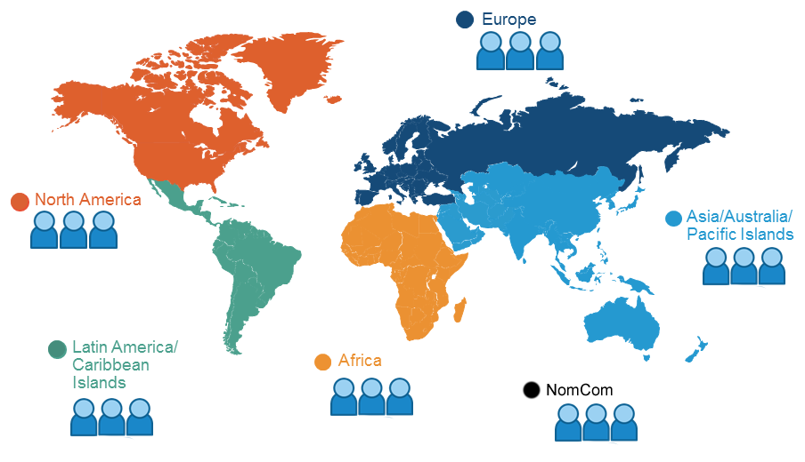
Councillors apply selection criteria and diversity criteria and select two best candidates
Top
1
2
3
4
5
...
Notes:
programme working group

Slide 13
Timeline

Slide 14
The CSC must be adopted by the ccNSO Council and the GNSO Council by 10 August.
Here is the proposed timeline:
Guideline developed and adopted:
16 June
Call for Expression of Interest:
30 June
EoIs submitted:
15 July
CSC (full slate) adopted:
10 August
ccNSO members selected
22 July
ccNSO/GNSO
consultation
23-28 July
ccNSO/RySG
consultation
15-22 July
Notes:
programme working group

Slide 15
Thank you!

