Slide 1

ccNSO Sessions
Pre-ICANN72

Slide 2

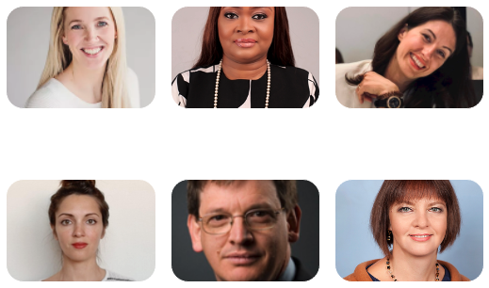
AGENDA ccTLD News Session #1
Wednesday, 6 October 2021| 13-15 UTC
Recordings: https://community.icann.org/display/ccnsowkspc/ccNSO+Webinars
Guðrun Poulsen (.fo), Session Chair
PART 1: Marketing
• The .ng promo experience | Chioma Keke (.ng)
• If I had a million dollars | Dana Ludviga (.lv)
• Promoting .ar web accessibility | Romina Guirado (.ar)
Break
PART 2: Policy, Operations & Finance
• Launch of 2nd level registrations in .au | Bruce Tonkin (.au)
• 3 projects to increase domain name stability & security in .RU/.РФ | Irina Danelia (.ru/.РФ)
• ccTLD voluntary financial contributions | Cecibel Izaguirre (ICANN org)

Slide 3
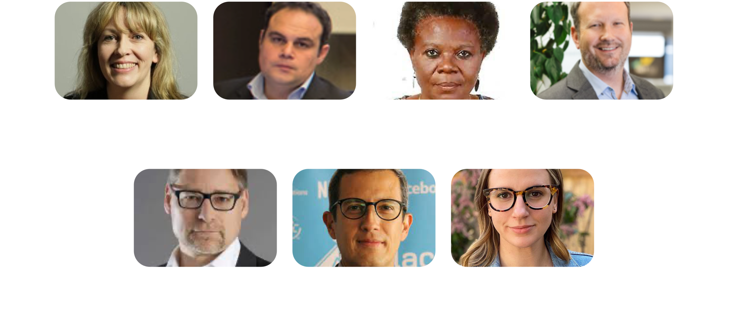
AGENDA ccTLD News Session #2
Thursday, 7 October 2021 | 6-8 UTC
Annaliese Williams (.au), Session Chair
PART 1: Internet Governance
• Laurent Ferrali (ICANN org)
• Mary Uduma (African IGF)
• Jordan Carter (.nz)
Break
PART 2: Internet Governance
• Peter Koch (.de)
• Oscar Robles (LACNIC)
• Alyssa Quinn (.ca)
Recordings: https://community.icann.org/display/ccnsowkspc/ccNSO+Webinars

Slide 4
ccNSO Sessions
During ICANN72

Slide 5
ICANN72 ccNSO Block Schedule
UTC | Mo, 25 Oct | Tue, 26 Oct | Wed, 27 Oct | Thu, 28 Oct
Block 1 (60’) 16:00-17:00 | Tech day | ccNSO Members Meeting: Q&A ccNSO Council candidates |  | Joint session: ICANN Board and ccNSO
Block 2 (90’) 17:30-19:00 | Tech day | ccNSO Members Meeting: ccNSO governance session | Plenary session: Hybrid ICANN meetings | ccNSO Council
Block 3 (90’) 19:30-21:00 | Tech day | SOPC |  | TLD-OPS
Block 4 (90’) 21:30-23:00 |  | Executive Q&A | ccNSO Members Meeting: DNS abuse session (part 1) | Public forum
Block 5 (60’) 23:30-00:30 |  |  | ccNSO Members Meeting: DNS abuse session (part 2) | Public Board AGM 23:30-01:00 UTC

Slide 6

Tech Day
Monday, 25 October | 16-21 UTC
Discuss technical and operational registry topics, security, and other DNS-related work
Read more: https://community.icann.org/x/zgJyCg
Since 2006, Tech Day has been part of ICANN Public Meetings.
It provides a forum for both experienced participants and newcomers to meet and to present and discuss technical and operational registry topics, security, and other Domain Name System-related work. During ICANN72, Tech Day will focus on DNS Security Extensions (DNSSEC), DNS abuse prevention and mitigation, and other topics.

Slide 7
Question and Answer Session: ccNSO Council Candidates
Tuesday, 26 October | 16-17 UTC
How will the new ccNSO Council look like?
Read more: https://community.icann.org/x/hAEuCg
Irina Danelia (.ru), member of the ccNSO Council for the European ICANN geographic region will chair this session.
The 3-year term for five members of the ccNSO Council will end in March 2022. Mid-September 2021, the ccNSO opens a call for nominations to fill those seats.
All candidates that accepted their nominations are kindly invited to participate in the Q&A session, which will provide the ccNSO members and broader ccTLD community an opportunity to interact with the Council candidates.

Slide 8

ccNSO Governance session
Tuesday, 26 October | 17:30-19:00 UTC
ccNSO members and ccNSO Council: what is their role and responsibility?
Read more: https://community.icann.org/x/hAEuCg
ICANN72 marks the 4th ccNSO Governance Session, building on the previous sessions where the ccNSO Council and Members have been discussing the need to update the internal rules of the ccNSO.
The goal of this ICANN72 session is to consult the ccNSO membership on the proposed revised internal Rules of the ccNSO, and to collect feedback. The new Rules will have a direct impact on the governance structure of the ccNSO, specifically on the respective roles and responsibilities of the Council and ccNSO membership.

Slide 9

ccNSO SOPC
Tuesday, 26 October | 19:30-21:00 UTC
How will the ICANN prioritisation framework work in practice?
Read more: https://community.icann.org/x/hAEuCg
The aim of the SOPC is to coordinate, facilitate, and increase the participation of ccTLD managers in ICANN and Public Technical Identifiers strategic, operational planning, and related budgetary processes. The SOPC meets regularly with representatives from ICANN org and other ICANN stakeholders.
The goal of this ICANN72 session is to explore how the ICANN Prioritization Framework could work in practice, from a community perspective. The session will prepare the SOPC and other stakeholders on prioritization, as part of the next operational and financial planning cycle.

Slide 10
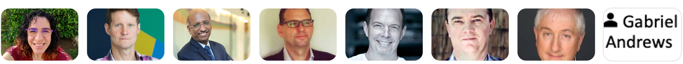
DNS Abuse session
Wednesday, 27 October
Part 1: 21:30-23:00 UTC
Part 2: 23:30-00:30 UTC
What should the ccNSO do with respect to DNS abuse, in addition to what is already happening at the local and regional ccTLD level?
Read more: https://community.icann.org/x/hAEuCg
Session Chair: Alejandra Reynoso (.gt)
Moderator: Nick Wenban-Smith (.uk)
Panellists: Jim Galvin (GNSO), Gabriel Andrews (GAC), John Crain (ICANN org), Kristof Tuyteleers (.be, .brussels), Anil Kumar Jain (.in), Byron Holland (.ca)
The goal of the session is to understand what the ccNSO should do with respect to DNS abuse, in addition to what is already happening at the local and regional ccTLD level. Based on the guidance of the ccTLD community, the ccNSO Council will plan the ccNSO involvement in the discussions pertaining to DNS abuse and related activities that could assist ccTLDs. If a plan moves forward, it will be shared with the community during ICANN73 or an intersessional webinar.

Slide 11
ccNSO Council & ICANN Board
Thursday, 28 October | 16-17 UTC
Participate in the joint session between the ICANN Board of Directors and ccNSO Council
Read more: https://community.icann.org/x/hAEuCg
ccNSO topics:
ccNSO recommended policy on the retirement of ccTLDs: introduction of the policy, its scope, why we believe it is needed. In preparation of a possible implementation process: what are the next steps from a Board perspective, and how does the roadmap look like?
change of Article 10 and Annex B of the ICANN Bylaws to allow the inclusion of interested IDN ccTLD Managers in the ccNSO: what are the next steps of the process?
At the end of ICANN72, Nigel Roberts will be stepping down as member of the ICANN BoD. What are Nigel's views on his years on the Board, the relation between ICANN and the ccTLD community in general, and the ICANN Board and ccNSO specifically?
ICANN Board topic:
how to efficiently identify and work more closely with governments globally, as well as educate, train and interact when it comes to geopolitical issues relating to ICANN’s mission

Slide 12
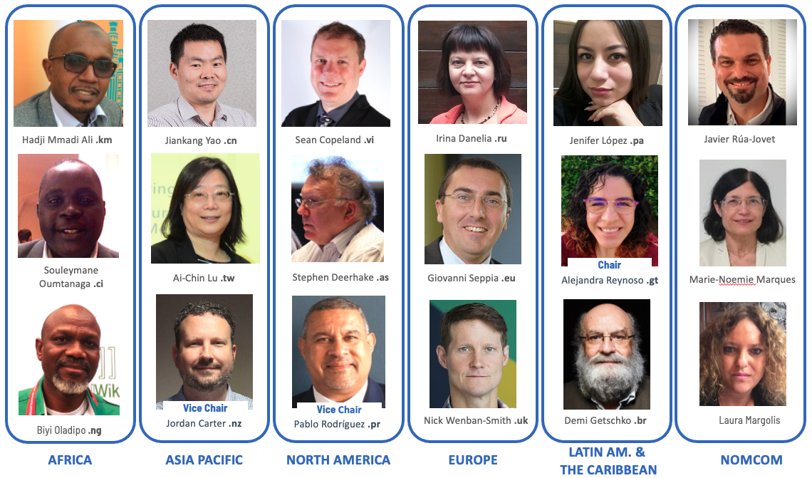
ccNSO Council
Thursday, 28 October | 17:30-19:00 UTC
Read more: https://community.icann.org/x/hAEuCg
The ccNSO Council will have its 177th meeting at ICANN72 on Thursday, 28 October 2021 (17:30-19:00 UTC). All Council meetings are open to observers.
Topics for discussion will include next steps following the ICANN72 ccNSO Members Meeting, DNS abuse session, and the ccNSO request to change ICANN Bylaws to include Internationalized Domain Name (IDN) ccTLD managers in the ccNSO. Additional topics for the ccNSO Council meeting will be made available on the ccNSO Council workspace.

Slide 13

TLD-OPS
Thursday, 28 October | 19:30-21:00 UTC
Read more: https://community.icann.org/x/hAEuCg
TLD-OPS is the incident response community for and by ccTLDs that brings together people who are responsible for the operational security and stability of their ccTLD. The goal of the TLD-OPS community is to enable ccTLD operators worldwide to detect and mitigate incidents that may affect the security and stability of ccTLD services, such as distributed denial-of-service (DDoS) attacks, malware infections, and phishing attacks.
TLD-OPS is fully governed by the ccTLD community through the TLD-OPS Standing Committee, which consists of representatives of ccTLDs and liaisons from the Security and Stability Advisory Committee (SSAC), the Internet Assigned Numbers Authority (IANA), and the ICANN security team. The TLD-OPS Standing Committee will meet during ICANN72 to reflect on its past activities and determine next steps

