Slide 1
Improving the annual work plan of the ccNSO

Slide 2
Purpose & Value of the ccNSO
for the ccTLD and Broader community

Slide 3
Purpose of the ccNSO & Value for members
The ccNSO provides a global platform for country code Top Level Domain (ccTLD) Managers to:
  Undertake policy and policy related work,
  Nurture technical cooperation and skill building, share practices and discuss topics of mutual interest and concern,
  Engage with and be informed about other stakeholders in the ICANN environment on topics of mutual interest.
The ccNSO is (1) of (3) ICANN SOs and (1) of (5) DPs and has to carry out related responsibilities required and mandated by the Bylaws.

Slide 4
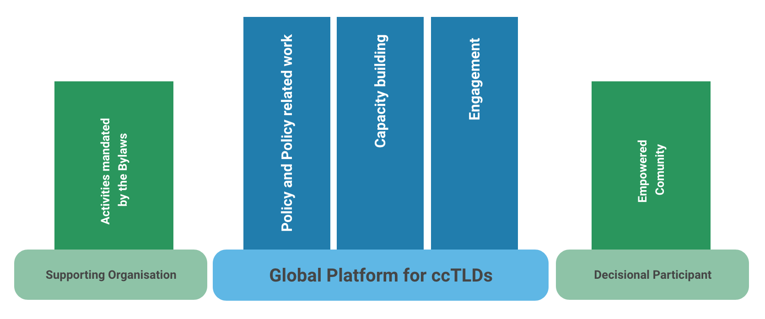
Purpose and Value of the ccNSO

Slide 5
Delivering on the purpose
Providing value

Slide 6
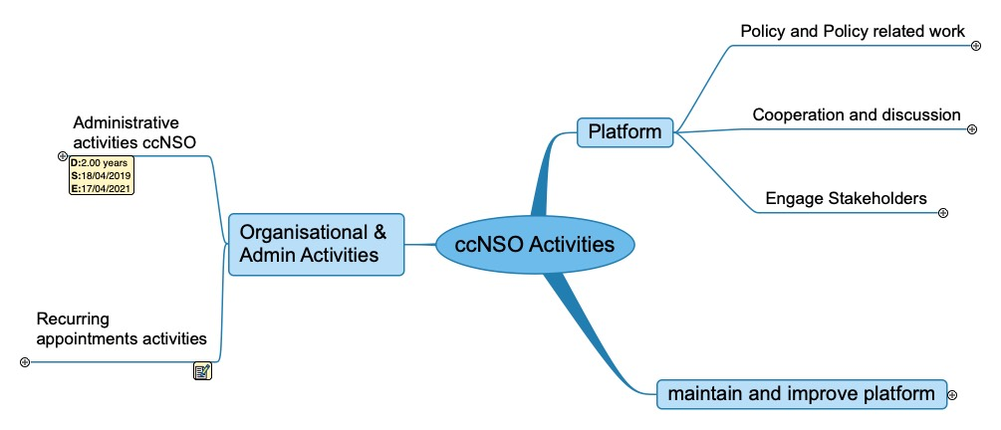
All 2020-2021 work items could be mapped
againts purpose and value statement work areas
(July 2020)

Slide 7
The ccNSO Annual Work Plan items list
ccNSO Guideline, Section 4.1 Work Items. The following ccNSO activities/ work items are covered by the Work plan:
  Administrative activities;
  Recurring activities such as ICANN planning, ccNSO Council elections, ICANN Board selection;
  Policy development and policy related activities;
  ccTLD community related activities;
  ccNSO responses and statements;
  Joint activities (joint working groups)
  Other activities as deemed appropriate by the ccNSO Council.
A brief description, starting date, anticipated end date, and chair/owner will be listed for each work item.
Does not match the purpose and value statement of the ccNSO,
item list needs to be updated

Slide 8
Delivering on the work items

Slide 9
Inclusion of new work items in Work Plan
ccNSO Guideline 5.2.1 Selection of work items for the Work plan
The ccNSO Council will add an item to the Work plan if:
  1) the anticipated item has a high priority as defined in section 5.2.2 below,
  2) completion of the work item, excluding the call for volunteers, will take more than one month, and / or
  3) substantial capacity of volunteers (from the ccTLD community or the ccNSO Council) is needed to complete the item.
The Triage Committee will advise the ccNSO Council to undertake a new activity, if any, in accordance with the method and procedure described in its charter.
If a new work item will not be included in the yearly Work plan, it will become part of the ccNSO Council action items list.

Slide 10
Current method Prioritization of work items:
Step 1: Level of Importance and Urgency
ccNSO Guideline section 5.2.2 To determine the priority of a work item the following aspects will be evaluated by the ccNSO Council:
  1) Urgency (how pressing is the matter, does it need to be resolved in short timeframe, what is the expected response time),
  2) Importance (potential impact on the ccNSO, ccTLD community, or group of ccTLDs, whereby impact could, for example, be political, operational or financial).
Based on this evaluation the ccNSO Council, taking into account the advice of the Triage Committee, will set the priority of the new work item as high, medium, or low.

Slide 11
Current method Prioritization of work items:
Step 2: Relative priority/resourcing
ccNSO Guideline section 5.2.3
After such priority setting, the ccNSO Council compares the priority of the new item with those of other work items to ensure that at least all work items with the highest priority are adequately resourced (for example, with adequate volunteers). In comparing the relative priorities, capacity needed and already assigned will be taken into consideration.

Slide 12
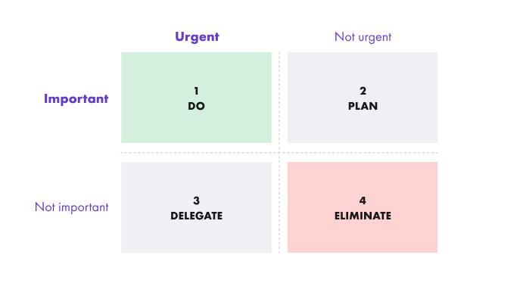
In Short: Eisenhower-Matrix

Slide 13
Alternative Apporach:
Impact and Effort Prioritization
What is an impact effort matrix?
An impact effort matrix is a decision-making tool that assists people to manage their time more efficiently. An organization, team, or individuals assess and prioritize activities based on the level of effort required and the potential impact or benefits the activities will have.

Slide 14
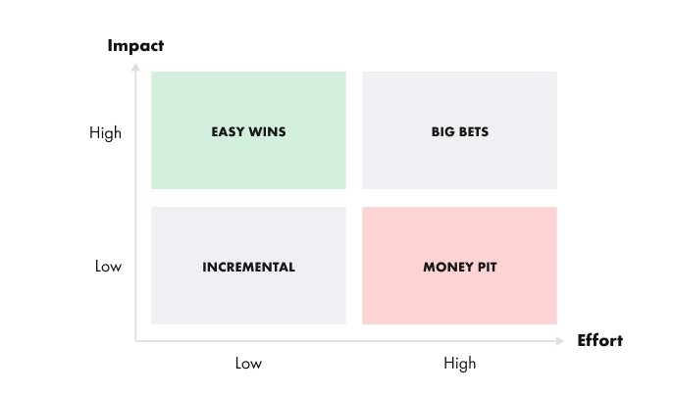

Slide 15
Impact Effort Matrix:
Visual representation of where best to assign time and resources. Activities fall into one of four categories
Quick or Easy wins – Give the best return based on the effort. These tasks have a high value and can be established easily. These should be on the top of your task list.
Major projects or Big Bets – Provide long term returns but may be more complex to execute, may need additional research. These tasks can bring a lot of value but require a lot of effort and tend to be time-consuming.
Fill ins or Incrementals– Don’t require a lot of effort but neither do they offer many benefits. These are tasks that could be easily completed but may not be worth the effort as it does not have much impact on how the business is working
Time sinks or money pit – Time-consuming activities with low impact that should be avoided. These tasks should have the lowest priority or be removed, since they require a lot of effort and have very little value.

Slide 16
What needs to be done next?
Select/develop method of prioritization?
Expand mandate of and invovlement of Triage Committee in developing work plan and keepping it up-to date
Update work plan and adjust Guideline categorization of work areas

Slide 17
QUESTIONS
?

