Slide 1


CCNSO | June 2021

Slide 2

ccNSO Sessions prior to ICANN71
ccTLD Community Webinar for Newcomers
ccTLD News Sessions
  ccTLDs & Security: Regulatory Demands
  DNS Abuse: the ccTLD Experience
Listen to the recordings
https://community.icann.org/x/HBwFBQ

Slide 3
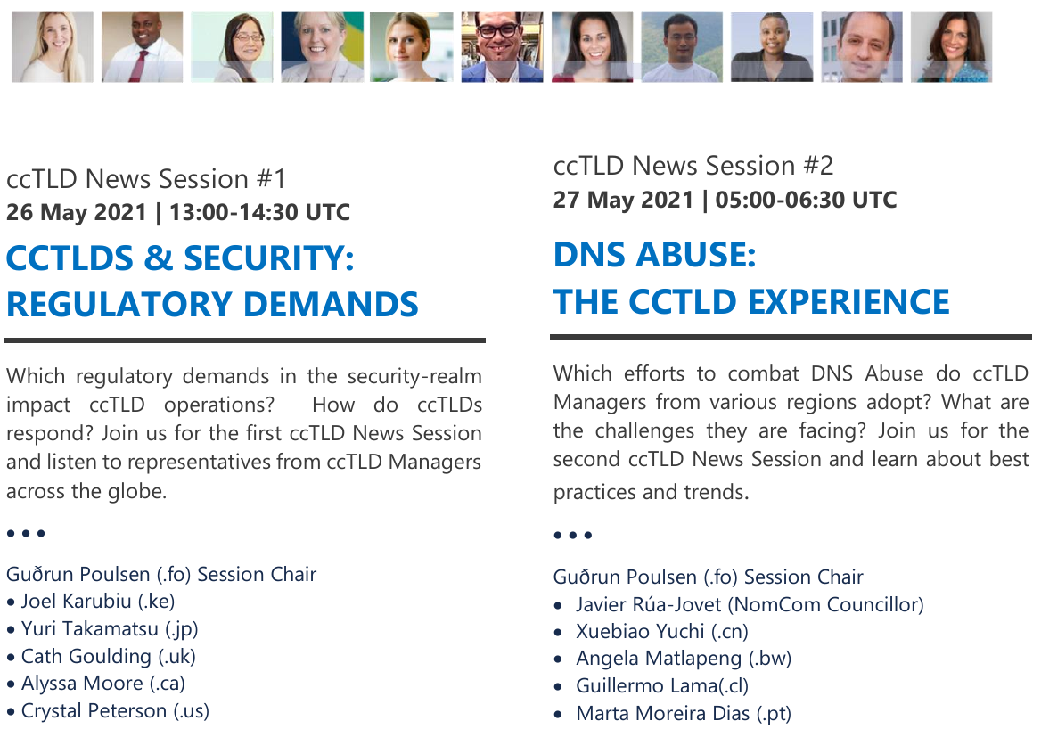
ccTLD News Sessions

Slide 4
ICANN71 ccNSO Block Schedule
UTC | Mo, 14 June | Tue, 15 June | Wed, 16 June | Thu, 17 June
Block 1 (60’) 07:00-08:00 | DNSSEC Workshop | ccNSO MM: Governance Session |  | SOPC
Block 2 (90’) 08:30-10:00 | DNSSEC Workshop | At-Large Session: ccTLD governance models: Testimonies from At-Large end users |  | Plenary: Registrant Protections
Block 3 (90’) 10:30-12:00 | Plenary: Government Regulatory Developments/WHOIS, Data Protection & Cybersecurity | ccNSO MM: Q&A with ccTLD-related ICANN Board | ccNSO MM: Policy Session
Block 4 (90’) 12:30-14:00 | Tech Day | Plenary: Multistakeholder Model / Internet Governance |  | ccNSO Council
Block 5 (60’) 14:30-15:30 | Tech Day |  | CSC/IANA update to the community | Future of ICANN Public Meetings

Slide 5
Decisions and Outcomes by ccNSO Council
Adopted the policy recommendations for ccPDP3 regarding the retirement of ccTLDs. Voting by ccNSO members as a next step
Decided on the ccNSO Council work plan for the next 2 years, and a transition towards quarterly work plans.
Reviewed the ccNSO implementation-related part of the second ccNSO organizational review recommendations, concluding that the ccNSO is not expected to undertake any further efforts.
Discussed how to organize the continuous organizational improvement process and asked the ccNSO Guidelines Review Committee (GRC) to review its mandate
Agreed that starting at its next meeting, it will take a closer look at the potential role of the ccNSO in the ongoing discussion around DNS Abuse.

Slide 6
ICANN71 links
ccNSO Schedule Hub
https://community.icann.org/x/WIG1CQ
ccNSO Members Meeting, including sessions held prior to ICANN71
https://community.icann.org/x/UYG1CQ
Tech Day
https://community.icann.org/x/a4G1CQ

Slide 7
We seek your feedback!
What went well? What can we do better? Any topics you would like to see addressed at ICANN72?
https://www.surveymonkey.com/r/QBRMH92
Deadline: Wednesday, 4 July 2021 (23:59 UTC)

Slide 8
Thank you!
ccnsosecretariat@icann.org

