Slide 1
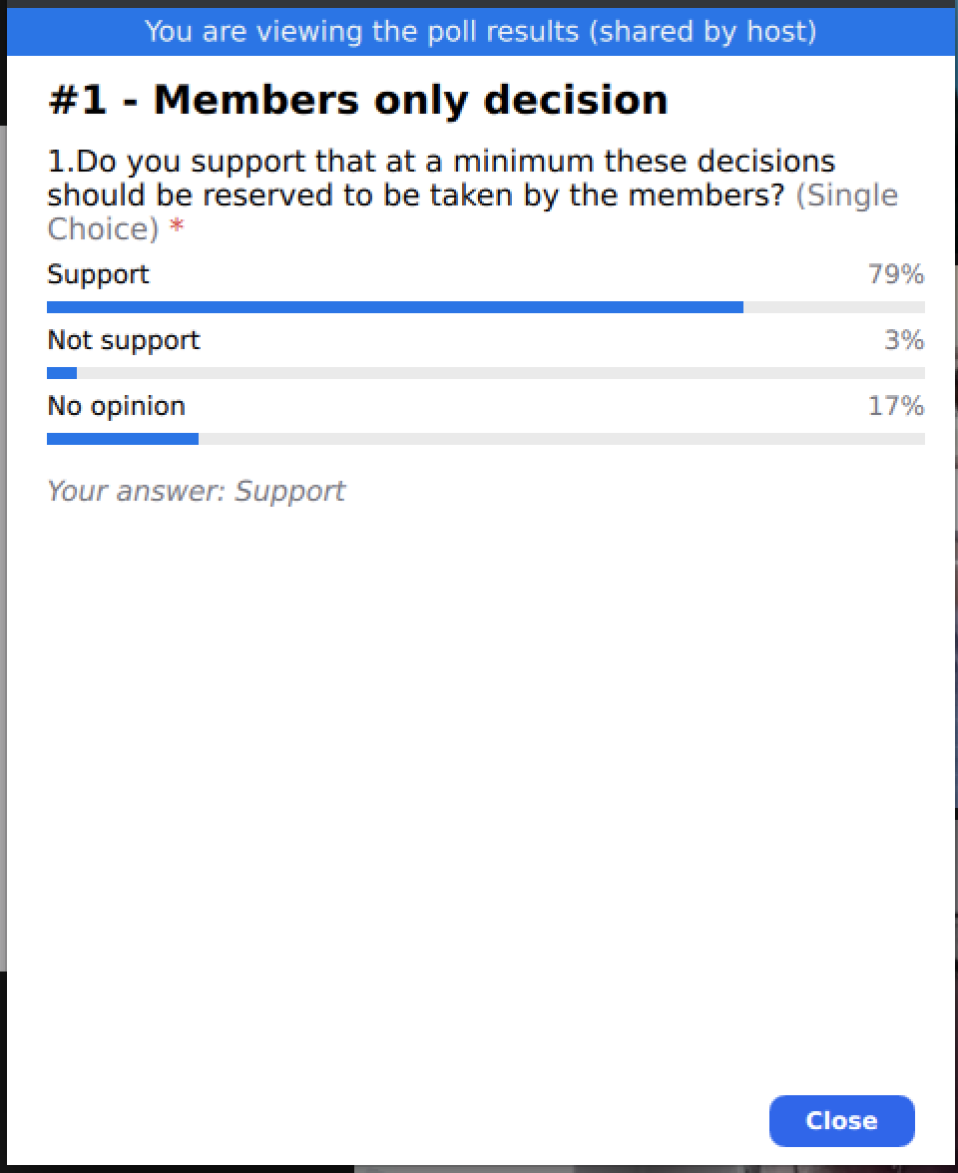
4. Members only decisions, other than explicitly provided in the ICANN Bylaws
PROPOSED TEXT
In addition to the decisions in the Bylaws, which have been reserved to be taken by the ccNSO Membership, the following Resolutions and Decisions are reserved to be taken by the ccNSO Members exclusively: A. Change of the Rules. B. Veto vote on ccNSO Council Resolutions and Decisions as provided for in the Rules. C. Board Seats 11 and 12 elections
What do you think? Poll #1
Item 4 in the Headings document
Notes:
Poll #1: Do you support that at a minimum these decisions should be reserved to be taken by the members?
Response:
Support
Not support
No Opinion

Slide 2
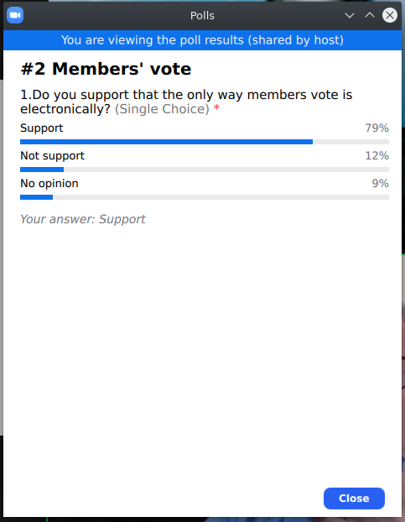
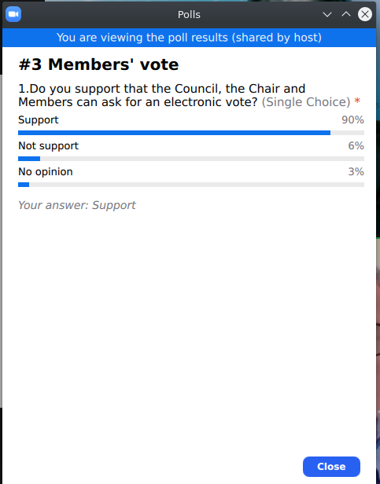
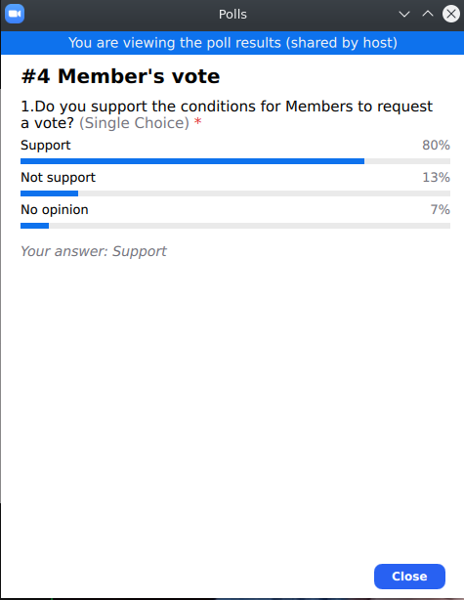
9. Members’ vote - Decision-making
PROPOSED TEXT
The ccNSO Members will always vote electronically. An electronic vote of the Members can be initiated by any of the following: • The ccNSO Council • The Chair of the ccNSO Council • Ten (10) Members of the ccNSO from at least ten (10) different Territories and representing no less than three (3) ICANN Geographic Regions
What do you think? Poll #2, #3 & #4
Item 9 in the Headings document
Notes:
Poll #2: Do you support that the only way members vote is electronically?
Response:
Support
Not support
No Opinion
Poll #3: Do you support that the Council, the Chair and Members can ask for an electronic vote?
Response:
Support
Not support
No Opinion
Poll #4: Do you support the conditions for Members to request a vote?
Response:
Support
Not support
No Opinion

Slide 3
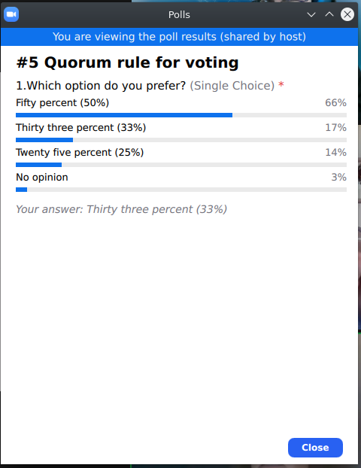
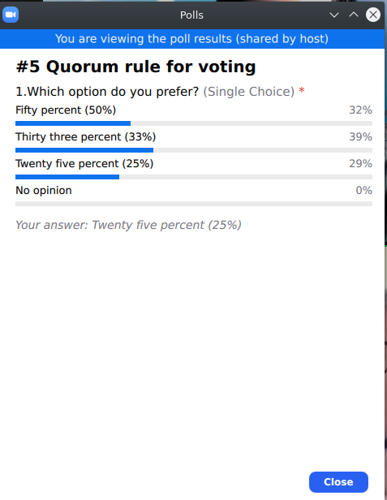
8. Quorum rule for voting
PROPOSED TEXT
The Members’ quorum requirement shall apply only to the Members’ vote. The quorum shall be at least Option 1: FIFTY PERCENT (50%) or Option 2: THIRTY THREE (33%) or Option 3: TWENTY FIVE (25%) of the total Membership of the ccNSO, and at least three (3) Members per ICANN Region. In the event that at least [INSERT THRESHOLD] of the ccNSO Members vote, the vote shall be valid.
What do you think? Poll #5
Item 8 in the Headings document
Notes:
Poll #5: Which option do you prefer?
Response:
Option 1: FIFTY PERCENT (50%)
Option 2: THIRTY THREE (33%)
Option 3: TWENTY FIVE (25%)
No Opinion

Slide 4
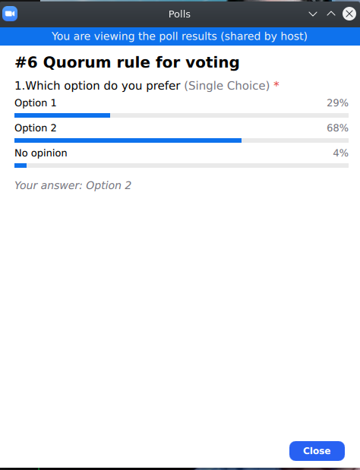
8. Quorum rule for voting
What if quorum is not met in the first round?
PROPOSED TEXT
In the event the quorum is not met: Option 1: The Members will be deemed to have abstained and the status quo remains: ccNSO Council Resolutions and Decisions will become effective, amendment to the Rules will not pass and Members’ decisions will not be taken. Option 2: A second vote will automatically commence 14 calendar days after closure of the first round of voting. The results of the second vote will be valid irrespective of whether the quorum has been met.
What do you think? Poll #6
Item 8 in the Headings document
Notes:
Poll #6: Which option do you prefer?
Response:
Option 1
Option 2
No Opinion

Slide 5
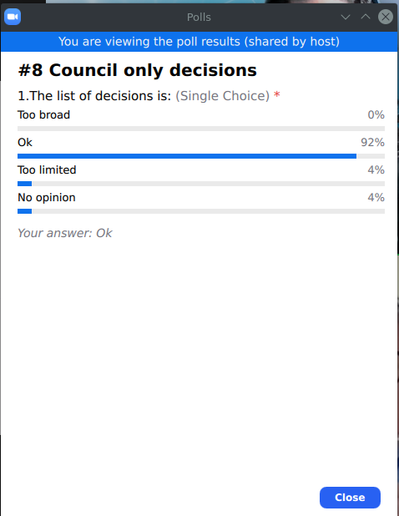
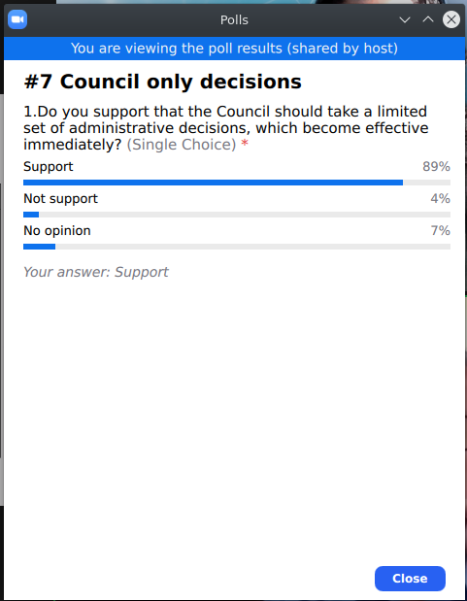
5. Council only decisions, other than explicitly provided in the ICANN Bylaws
PROPOSED TEXT
The following limited set of Resolutions and Decisions are reserved to be taken exclusively by the ccNSO Council, thus the Members Veto Mechanism does NOT apply: A. Administrative Resolutions and Decisions: Appointment of Members to working groups, committees, study groups and cross community working groups. Appointment of liaisons. ccNSO Council meeting schedules, agendas and minutes. Voting on and Processing of Membership applications. Request a call for volunteers. Request the preparation of a timeline for upcoming activities. Request the summary of an activity
Item 5 in the Headings document
What do you think? Poll #7 & #8
Notes:
Poll #7: Do you support that the Council should take a limited set of administrative decisions, which become effective immediately?
Response:
Support
Not support
No Opinion
Poll #8: The list of decisions is:
Response:
Too broad
OK
Too limited
No Opinion

Slide 6
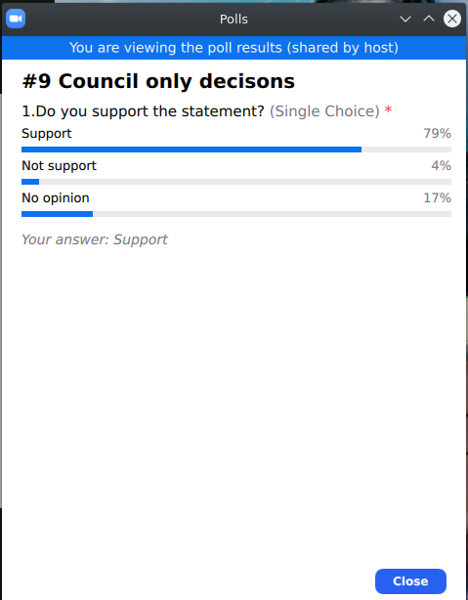
5. Council only decisions, other than explicitly provided in the ICANN Bylaws
PROPOSED TEXT
B. All Resolutions and Decisions as Decisional Participant, with exception of those decisions listed as exclusively to be taken by the ccNSO Membership. Details on the procedures and other aspects of ccNSO as a Decisional Participant are specified in the relevant Operating Procedures.
What do you think? Poll #9
Item 5 in the Headings document
Notes:
Poll #9: Do you support the statement?
Response:
Support
Not support
No Opinion

Slide 7
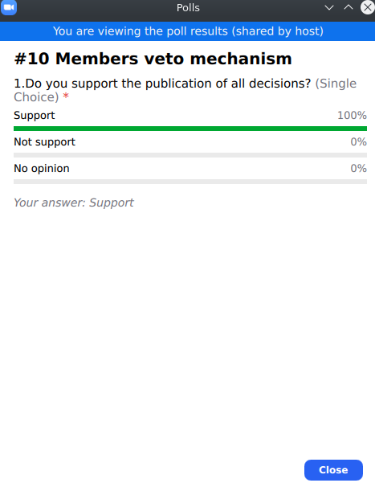
7. Members Veto Mechanism
Effectiveness of Council’s Decisions
PROPOSED TEXT
The ccNSO Council must publish all of its Resolutions and Decisions as soon as possible to the appropriate ccNSO list(s) and on the website of the ccNSO, but in any case within seven (7) calendar days after the Resolution or Decision was passed. Each Resolution and Decision shall include the date it becomes effective.
What do you think? Poll #10
Item 7 in the Headings document
Notes:
Poll #10: Do you support the publication of all decisions?
Response:
Support
Not support
No Opinion

Slide 8
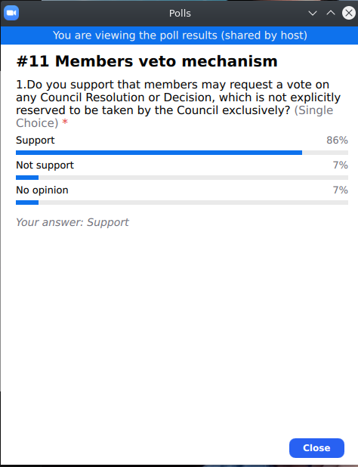
7. Members Veto Mechanism
Effective date of Decisions
PROPOSED TEXT
The effective date is determined as follows: i. Resolutions and Decisions which are exclusively reserved to be taken by the ccNSO Council, upon date of publication. ii. All other Resolutions and Decisions seven (7) calendar days after publication, subject however to the following: Ten (10) Members of the ccNSO from at least ten (10) different Territories and representing no less than three (3) ICANN Geographic regions may request a veto vote on Resolutions and Decisions under ii. The written request (Members’ Notification) must be sent to the ccNSO Secretariat or the ccNSO Council Chair during seven (7) calendar days mentioned under ii.
What do you think? Poll #11
Item 7 in the Headings document
Notes:
Poll #11: Do you support that members may request a vote on any Council Resolution or Decision, which is not explicitly reserved to be taken by the Council exclusively?
Response:
Support
Not support
No Opinion

Slide 9
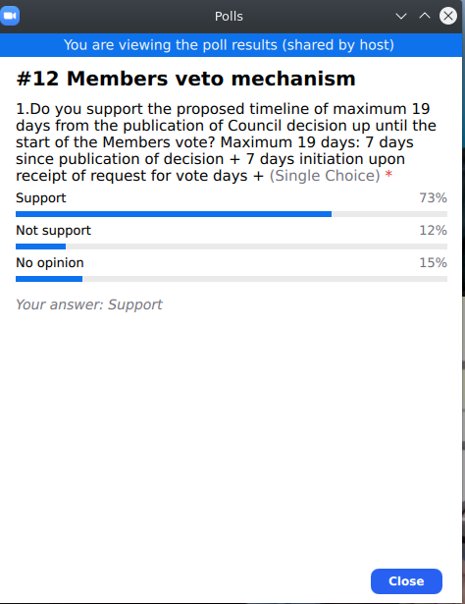
7. Members Veto Mechanism
PROPOSED TEXT
If the ccNSO Council believes the Resolution or Decision should become effective: i. Council will prepare a statement as to why it believes the Resolution or Decision should become effective (Council’s Notification). ii. The ccNSO Council Chair shall send both the Members’ Notification and the Council’s Notification to the Members list and publish both on the ccNSO Website no later than 7 days after receipt of the Members’ Notification. iii. The ccNSO Council Chair or a person designated by the Chair shall initiate an electronic voting process by the ccNSO Members within 7 days upon receipt of the Members’ Notification. iv. The electronic vote by the Members shall start five (5) calendar days after initiation of the vote by the Council. If the Council believes the Resolution or Decision should NOT become effective following the Members’ Notification, the ccNSO Council Chair shall inform the Members accordingly, and the Resolution or Decision shall be rescinded.
What do you think? Poll #12
Item 7 in the Headings document
Notes:
Poll #12: Do you support the proposed timeline of maximum 19 days from the publication of Council decision up until the start of the Members vote?
Maximum 19 days: 7 days since publication of decision + 7 days initiation upon receipt of request for vote days + 5 days to organise the vote
Response:
Support
Not support
No Opinion

Slide 10
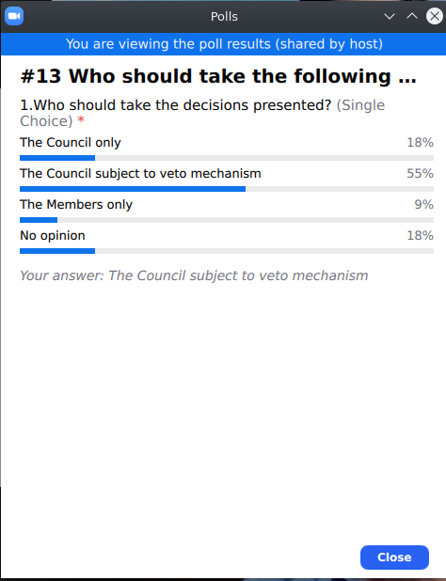
Who should take the following decisions?
PROPOSED TEXT
A Simple Majority Members vote to support a: Board Recall Supported Petition Nominating Committee Director Removal Supported Petition Rejection Action Approval Action An Extraordinary Super Majority Members vote to support a Removal Petition Notice of a Board Member nominated by the ccNSO.
What do you think? Poll #13
Item 4 in the Headings document
Notes:
Poll #13: Who should take the decisions presented?
Response:
The Council only
The Council subject to veto mechanism
The Members only
No opinion

Slide 11
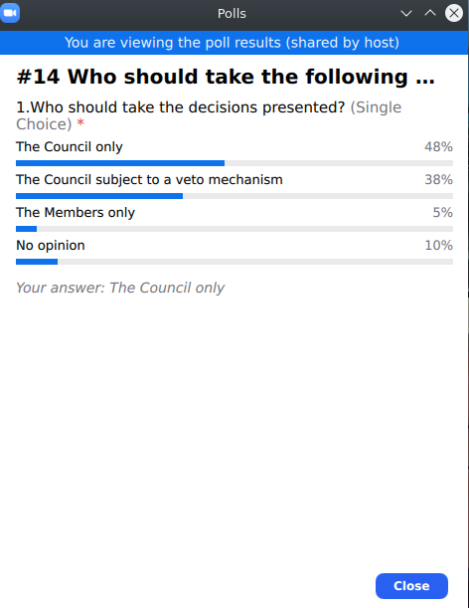
Who should take the following decisions?
PROPOSED TEXT
All Resolutions and Decisions as Decisional Participant, with exception of those decisions listed as exclusively to be taken by the ccNSO Membership. Details on the procedures and other aspects of ccNSO as a Decisional Participant are specified in the relevant Operating Procedures.
What do you think? Poll #14
Item 5 in the Headings document
Notes:
Poll #14: Who should take the decisions presented?
Response:
The Council only
The Council subject to veto mechanism
The Members only
No opinion

Slide 12
Members decisions vs Council decisions
Decisional Participant powers
Members
Final Decisions on:
Support Board Recall Petition
Support NomCom Board member Removal Petition
Support ccNSO appointed Board member removal
Support Rejection Action
Support Approval Action
Council
All administrative Resolutions and Decisions during the various processes.

Slide 13
Thank you for your participation!
GRC Sub-group email: ccnso-grc-sg@icann.org
Wiki: https://community.icann.org/x/OAA_Cg

