Slide 1

Candidate Selection:
Evaluation, Voting, Counting
And Voting again...

Slide 2
We usually have:
Candidates

Slide 3
We usually have:
Candidates
Requirements

Slide 4
We usually have:
Candidates
Requirements
Number of Seats

Slide 5
We receive applications:
Candidate 1
Candidate 2
Candidate 3
Candidate 4
...
Candidate N
N Candidates

Slide 6
Each Councillor ranks the candidates:
1 Candidate A
2 Candidate B
3 Candidate C
4 Candidate D
...
N Candidates

Slide 7
Each Councillor ranks the candidates:
1 Candidate A
2 Candidate B
3 Candidate C
4 Candidate D
...
Candidates X, Y, Z – do not qualify (why?)
N Candidates

Slide 8
Secretariat counts each vote:
1 Candidate A – N points
2 Candidate B – N-1 points
3 Candidate C – N-2 points
4 Candidate D – N-3 points
... ...
Candidates X, Y, Z – 0 points
N Candidates

Slide 9
Secretariat counts all votes:
1 Candidate B
2 Candidate D
3 Candidate E
4 Candidate A
...
N Candidate C
m seats
N Candidates

Slide 10
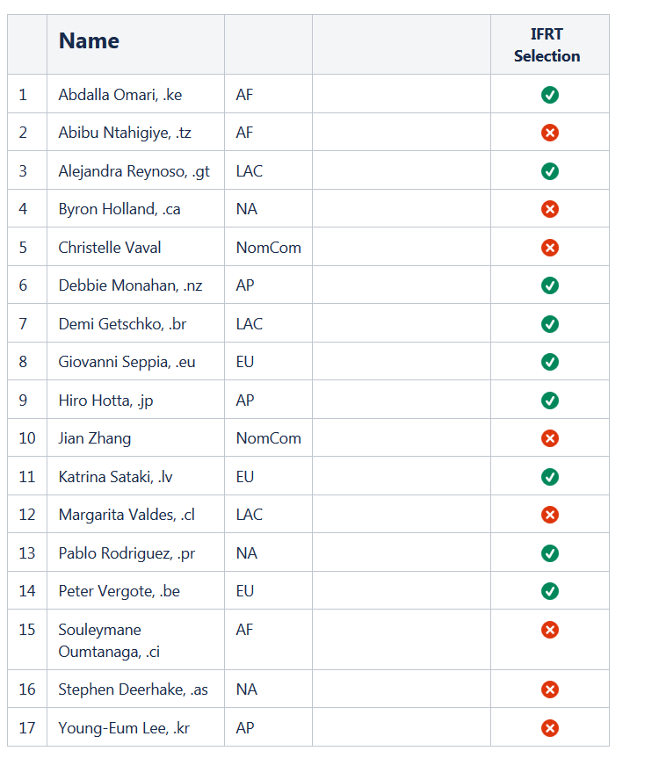
Latest Vote ☹
Only 9 votes!!!

Slide 11
Latest Vote ☹
AF
NA
LAC
AP
EU
1
1
2
2
3

Slide 12

Thank you!

