Slide 1
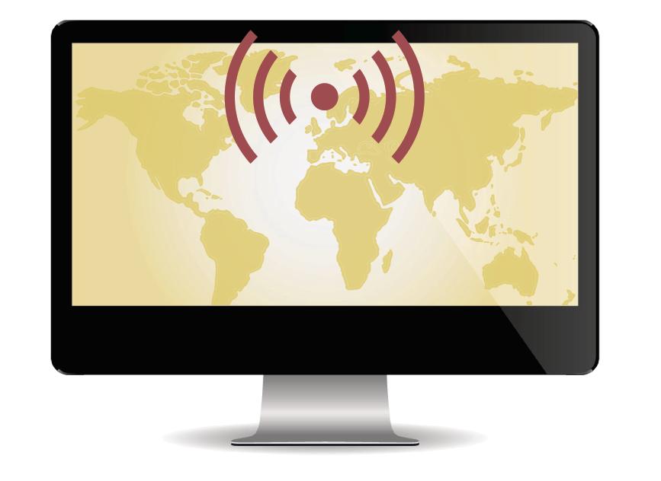

CIGI-IPSOS GLOBAL SURVEY ON
INTERNET SECURITY AND TRUST
© 2014 Ipsos. All rights reserved. Contains Ipsos' Confidential and Proprietary information and may not be disclosed or reproduced without the prior written consent of Ipsos.

Slide 2
Methodology…
This survey was conducted by Ipsos on behalf of the Centre for International Governance Innovation (“CIGI”) between October 7, 2014 and November 12, 2014.
The survey was conducted in 24 countries—Australia, Brazil, Canada, China, Egypt, France, Germany, Great Britain, Hong Kong, India, Indonesia, Italy, Japan, Kenya, Mexico, Nigeria, Pakistan, Poland, South Africa, South Korea, Sweden, Tunisia, Turkey and the United States—and involved 23,326 Internet users.
Twenty of the countries utilized the Ipsos Internet panel system while the other four (Kenya, Nigeria, Pakistan and Tunisia) were conducted by Ipsos Computer-aided Telephone Interviewing (CATI) facilities in each of those countries.
In the US and Canada respondents were aged 18-64, and 16-64 in all other countries.
Approximately 1000+ individuals were surveyed in each country and are weighted to match the online population in each country surveyed. The precision of Ipsos online polls are calculated using a credibility interval. In this case, a poll of 1,000 is accurate to +/- 3.5 percentage points. For those surveys conducted by CATI, the margin of error accuracy is +/-3.1.
BRIC = | Brazil, Russia, India, China
APAC = | Asia Pacific
LATAM = | Latin America

Slide 3
83% believe affordable access to the Internet should be a basic human right…
Q6. How much do you agree or disagree with the following statements? (Select one for each)
Base: All Respondents Total (n=23,376)

Slide 4
83% believe affordable access to the Internet should be a basic human right…
Q6. How much do you agree or disagree with the following statements?
(Select one for each)
Base: All Respondents Total (n=23,376)

Slide 5
INTERNET ACCESS
How important is the Internet to their future when it comes to each of the following?

Slide 6
91% say the Internet is important for their future accessing important information and scientific knowledge…
8. How important is the Internet to your future when it comes to each of the following? (Select one for each)
Base: All Respondents Total (n=23,376)

Slide 7
91% say the Internet is important for their future accessing important information and scientific knowledge…
8. How important is the Internet to your future when it comes to each of the following?
(Select one for each)
Base: All Respondents Total (n=23,376)

Slide 8
87% say the Internet is important for their future personal enjoyment and recreation…
8. How important is the Internet to your future when it comes to each of the following? (Select one for each)
Base: All Respondents Total (n=23,376)

Slide 9
87% say the Internet is important for their future personal enjoyment and recreation…
8. How important is the Internet to your future when it comes to each of the following?
(Select one for each)
Base: All Respondents Total (n=23,376)

Slide 10
85% say the Internet is important for their future social communication…
8. How important is the Internet to your future when it comes to each of the following? (Select one for each)
Base: All Respondents Total (n=23,376)

Slide 11
85% say the Internet is important for their future social communication…
8. How important is the Internet to your future when it comes to each of the following?
(Select one for each)
Base: All Respondents Total (n=23,376)

Slide 12
83% say the Internet is important for their future free speech and political expression…
8. How important is the Internet to your future when it comes to each of the following? (Select one for each)
Base: All Respondents Total (n=23,376)

Slide 13
83% say the Internet is important for their future free speech and political expression…
8. How important is the Internet to your future when it comes to each of the following?
(Select one for each)
Base: All Respondents Total (n=23,376)

Slide 14
81% say the Internet is important for their own economic future and livelihood…
How important is the Internet to your future when it comes to each of the following? (Select one for each)
Base: All Respondents Total (n=23,376)

Slide 15
81% say the Internet is important for their own economic future and livelihood…
8. How important is the Internet to your future when it comes to each of the following?
(Select one for each)
Base: All Respondents Total (n=23,376)

Slide 16
PRIVACY AND SECURITY

Slide 17
Two thirds (64%) are more concerned about their online privacy compared to one year ago…
Q2. How concerned are you about your online privacy compared to one year ago?(Select one)
Base: All Respondents Total (n=23,376)

Slide 18
Two thirds (64%) are more concerned about their online privacy compared to one year ago…
Q2. How concerned are you about your online privacy compared to one year ago?
(Select one)
Base: All Respondents Total (n=23,376)

Slide 19
Half (48%) say their Government does a very good job of making sure the Internet in their country is safe and secure…52% Disagree…
Q6. How much do you agree or disagree with the following statements? (Select one for each)
Base: All Respondents Total (n=23,376)

Slide 20
Half (48%) say their Government does a very good job of making sure the Internet in their country is safe and secure…52% Disagree…
Q6. How much do you agree or disagree with the following statements?
(Select one for each)
Base: All Respondents Total (n=23,376)

Slide 21
Only one third (36%) believe private information on the Internet is very secure…
Q6. How much do you agree or disagree with the following statements? (Select one for each)
Base: All Respondents Total (n=23,376)

Slide 22
Only one third (36%) believe private information on the Internet is very secure…
Q6. How much do you agree or disagree with the following statements?
(Select one for each)
Base: All Respondents Total (n=23,376)

Slide 23
41% believe the chance that they would ever have their personal information compromised on the Internet is so small that it’s really not worth worrying about…
Q6. How much do you agree or disagree with the following statements? (Select one for each)
Base: All Respondents Total (n=23,376)

Slide 24
41% believe the chance that they would ever have their personal information compromised on the Internet is so small that it’s really not worth worrying about…
Q6. How much do you agree or disagree with the following statements?
(Select one for each)
Base: All Respondents Total (n=23,376)

Slide 25
37% share personal information with private companies online all the time and say “it’s no big deal”…
Q6. How much do you agree or disagree with the following statements? (Select one for each)
Base: All Respondents Total (n=23,376)

Slide 26
37% share personal information with private companies online all the time and say “it’s no big deal”…
Q6. How much do you agree or disagree with the following statements?
(Select one for each)
Base: All Respondents Total (n=23,376)

Slide 27
Top Concerns of Users

Slide 28
HACKING PERSONAL INFORMATION

Slide 29
78% are concerned about a criminal hacking into their personal bank accounts…
Q5. How concerned are you about the following? (Select one for each)
Base: All Answering: Total (n=22,671)

Slide 30
78% are concerned about a criminal hacking into their personal bank accounts…
Q5. How concerned are you about the following? (Select one for each)
Base: All Answering: Total (n=22,671)

Slide 31
77% are concerned about someone hacking into their online accounts and stealing personal information like photos and private messages…
Q5. How concerned are you about the following? (Select one for each)
Base: All Answering: Total (n=22,671)

Slide 32
77% are concerned about someone hacking into their online accounts and stealing personal information like photos and private messages…
Q5. How concerned are you about the following? (Select one for each)
Base: All Answering: Total (n=22,671)

Slide 33
MONITORING AND DATA USE BY PRIVATE COMPANIES

Slide 34
74% are concerned about private company monitoring online activities (such as internet surfing habits) and then selling that information for commercial purposes without explicit consent…
Q5. How concerned are you about the following? (Select one for each)

Slide 35
74% are concerned about private company monitoring online activities (such as internet surfing habits) and then selling that information for commercial purposes without explicit consent…
Q5. How concerned are you about the following?
(Select one for each)

Slide 36
  CYBER ATTACKS ON INSTITUTIONS

Slide 37
72% are concerned about important institutions in their country being cyber-attacked by a foreign government or terrorist organization…
Q5. How concerned are you about the following? (Select one for each)

Slide 38
72% are concerned about important institutions in their country being cyber-attacked by a foreign government or terrorist organization…
Q5. How concerned are you about the following?
(Select one for each)

Slide 39
MONITORING AND CENSORING BY GOVERNMENT AND POLICE

Slide 40
64% are concerned about Governments censoring the Internet…
Q5. How concerned are you about the following? (Select one for each)
Base: All Answering: Total (n=23,376)

Slide 41
64% are concerned about Governments censoring the Internet…
Q5. How concerned are you about the following? (Select one for each)
Base: All Answering: Total (n=23,376)

Slide 42
62% are concerned about government agencies FROM OTHER COUNTRIES secretly monitoring their online activities…
Q5. How concerned are you about the following? (Select one for each)
Base: All Answering: Total (n=23,376)

Slide 43
62% are concerned about government agencies FROM OTHER COUNTRIES secretly monitoring their online activities…
Q5. How concerned are you about the following? (Select one for each)
Base: All Answering: Total (n=23,376)

Slide 44
61% are concerned with the police or other government agencies FROM MY COUNTRY secretly monitoring their online activities…
Q5. How concerned are you about the following? (Select one for each)
Base: All Answering: Total (n=23,376)

Slide 45
61% are concerned with the police or other government agencies FROM MY COUNTRY secretly monitoring their online activities…
Q5. How concerned are you about the following? (Select one for each)
Base: All Answering: Total (n=23,376)

Slide 46
RESTRICTING ACCESS TO THE INTERNET BY GOVERNMENT

Slide 47
43% believe GOVERNMENTS OTHER THAN MY OWN will restrict access to the Internet…
Q6. How much do you agree or disagree with the following statements? (Select one for each)
Base: All Respondents. Total (n=23,376)

Slide 48
43% believe GOVERNMENTS OTHER THAN MY OWN will restrict access to the Internet…
Q6. How much do you agree or disagree with the following statements?
(Select one for each)
Base: All Respondents. Total (n=23,376)

Slide 49
34% believe MY GOVERNMENT will restrict access to the Internet…
Q6. How much do you agree or disagree with the following statements? (Select one for each)
Base: All Respondents. Total (n=23,376)

Slide 50
34% believe MY GOVERNMENT will restrict access to the Internet…
Q6. How much do you agree or disagree with the following statements?
(Select one for each)
Base: All Respondents. Total (n=23,376)

Slide 51
Behavior Changes

Slide 52
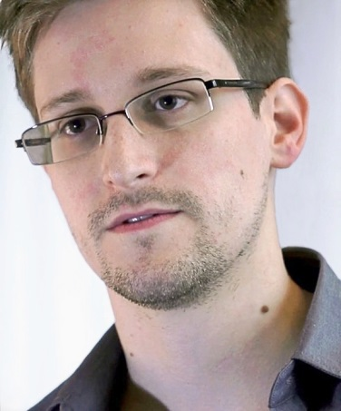
60% have heard about Edward Snowden…
‘Yes’
Q4a. Have you heard anything about Edward Snowden, a US government contractor who leaked documents to the media showing that the US and other national governments have been secretly tapping into personal online accounts to collect information about people around
the world? Base: All Respondents Total (n=23,376)

Slide 53
60% have heard about Edward Snowden…
‘Yes’
Q4a. Have you heard anything about Edward Snowden, a US government contractor who leaked documents to the media showing that the US and other national governments have been secretly tapping into personal online accounts to collect information about people around the world?
Base: All Respondents Total (n=23,376)

Slide 54
Of the 60% who have heard of him, 39% have taken steps to protect their online privacy and security as a result of what he revealed…That’s one quarter (23%) of all users…
‘Yes’
Q4b. Have you taken steps to protect your online privacy and security as a result of what Edward Snowden revealed?
Base: Heard Of Edward Snowden (n=14,411)

Slide 55
Of the 60% who have heard of him, 39% have taken steps to protect their online privacy and security as a result of what he revealed…That’s one quarter (23%) of all users…
‘Yes’
Q4b. Have you taken steps to protect your online privacy and security as a result of what Edward Snowden revealed?
Base: Heard Of Edward Snowden (n=14,411)

Slide 56
Of ALL Internet users, this is what they have changed in behaving online compared to one year ago…
Total
Avoiding certain Internet sites and web applications
Changing your password regularly
Self-censoring what you say online
Changing who you communicate with
Closing Facebook and other social media accounts, etc.)
Using the Internet less often
None of these
Q3. How have you changed anything about how you behave online compared to one year ago?
(Please select all that apply.)
Base: All Respondents Total (n=23,376)

Slide 57
Of ALL Internet users, this is what they have changed in behaving online compared to one year ago…
 | Total | North America | LATAM (Latin America) | Europe | APAC (Asia and Pacific) | G-8 Countries | BRIC (Brazil, Russia, India, China) | Middle East/Africa
Avoiding certain Internet sites and web applications | 43% | 41% | 58% | 42% | 38% | 38% | 49% | 46%
Changing your password regularly | 39% | 37% | 39% | 33% | 40% | 34% | 41% | 43%
Self-censoring what you say online | 28% | 24% | 32% | 18% | 29% | 20% | 32% | 37%
Changing who you communicate with | 18% | 16% | 20% | 11% | 16% | 11% | 21% | 28%
Closing Facebook and other social media accounts, etc.) | 11% | 9% | 9% | 7% | 9% | 7% | 14% | 17%
Using the Internet less often | 10% | 8% | 11% | 6% | 8% | 6% | 11% | 15%
None of these | 24% | 32% | 9% | 32% | 26% | 34% | 15% | 17%
Q3. How have you changed anything about how you behave online compared to one year ago?
(Please select all that apply.)
Base: All Respondents Total (n=23,376)

Slide 58
WHAT USERS WANT

Slide 59
SECURE SERVER
SECURE SERVER

Slide 60
73% want their online data and personal information to be physically stored on a secure server…
Q6. How much do you agree or disagree with the following statements? (Select one for each)
Base: All Respondents. Total (n=23,376)

Slide 61
73% want their online data and personal information to be physically stored on a secure server…
Q6. How much do you agree or disagree with the following statements?
(Select one for each)
Base: All Respondents. Total (n=23,376)

Slide 62
72% want their online data and personal information to be physically stored on a secure server IN MY OWN COUNTRY…
Q6. How much do you agree or disagree with the following statements? (Select one for each)
Base: All Respondents. Total (n=23,376)

Slide 63
72% want their online data and personal information to be physically stored on a secure server IN MY OWN COUNTRY…
Q6. How much do you agree or disagree with the following statements?
(Select one for each)
Base: All Respondents. Total (n=23,376)

Slide 64
TRUST AND GOVERNANCE

Slide 65
TRUST
How much do you trust each of the following to play an important role in running the Internet?

Slide 66
Six in 10 (57%) would trust a combined body of technology companies, engineers, non-governmental organizations and institutions that represent the interests and will of ordinary citizens, and governments…
7. How much do you trust each of the following to play an important role in running the Internet? (Select one for each)
Base: All Respondents Total (n=23,376)

Slide 67
Six in 10 (57%) would trust a combined body of technology companies, engineers, non-governmental organizations and institutions that represent the interests and will of ordinary citizens, and governments…
7. How much do you trust each of the following to play an important role in running the Internet?
(Select one for each)
Base: All Respondents Total (n=23,376)

Slide 68
A slim majority (54%) would trust an international body of engineers and technical experts…
7. How much do you trust each of the following to play an important role in running the Internet? (Select one for each)
Base: All Respondents Total (n=23,376)

Slide 69
A slim majority (54%) would trust an international body of engineers and technical experts…
7. How much do you trust each of the following to play an important role in running the Internet?
(Select one for each)
Base: All Respondents Total (n=23,376)

Slide 70
Half (50%) would trust the United Nations…
7. How much do you trust each of the following to play an important role in running the Internet? (Select one for each)
Base: All Respondents Total (n=23,376)

Slide 71
Half (50%) would trust the United Nations…
7. How much do you trust each of the following to play an important role in running the Internet?
(Select one for each)
Base: All Respondents Total (n=23,376)

Slide 72
Half (49%) would trust International technology companies…
7. How much do you trust each of the following to play an important role in running the Internet? (Select one for each)
Base: All Respondents Total (n=23,376)

Slide 73
Half (49%) would trust International technology companies…
7. How much do you trust each of the following to play an important role in running the Internet?
(Select one for each)
Base: All Respondents Total (n=23,376)

Slide 74
Just under half (47%) would trust their own government...
7. How much do you trust each of the following to play an important role in running the Internet?
(Select one for each)
Base: All Respondents Total (n=23,376)

Slide 75
Just under half (47%) would trust their own government...
7. How much do you trust each of the following to play an important role in running the Internet?
(Select one for each)
Base: All Respondents Total (n=23,376)

Slide 76
Just over one third (36%) would trust the United States…
7. How much do you trust each of the following to play an important role in running the Internet? (Select one for each)
Base: All Respondents Total (n=23,376)

Slide 77
Just over one third (36%) would trust the United States…
7. How much do you trust each of the following to play an important role in running the Internet?
(Select one for each)
Base: All Respondents Total (n=23,376)

Slide 78
Contacts
Fen Hampson,
CIGI Distinguished Fellow
Director of the Global Security & Politics Program
Centre for International Governance Innovation
67 Erb Street West
Waterloo, ON Canada N2L 6C2
Phone: 519-885-2444 ext. 7201
email: fhampson@cigionline.org
John Wright,
Senior Vice President and Managing Director, Global @dvisor
300—160 Bloor Street East
Toronto, Ontario, Canada M4W 1B9
Phone: 416.324.2002
email: john.wright@ipsos.com

