Slide 1

ICANN VISION & FIVE YEAR STRATEGY
Community Engagement in Durban

Slide 2
OVERVIEW
“Creating a New ICANN Five-Year Strategic Plan”
10.30 – 12.00 on Monday, 15 July in Hall 6
This session in Durban will focus on generating discussion and input from a broad cross-section of the ICANN community. It will consist of a brief presentation followed by participant breakout groups working in a workshop-style environment. Each breakout group will be facilitated by members of the community using a common framework of the key challenges facing ICANN in the next five years.
Agenda
Time | Activity
:10 min | Presentation of strategy development process and the community engagement framework
:05 min | Workshop instructions
:75 min | Workshop breakout groups working time

Slide 3
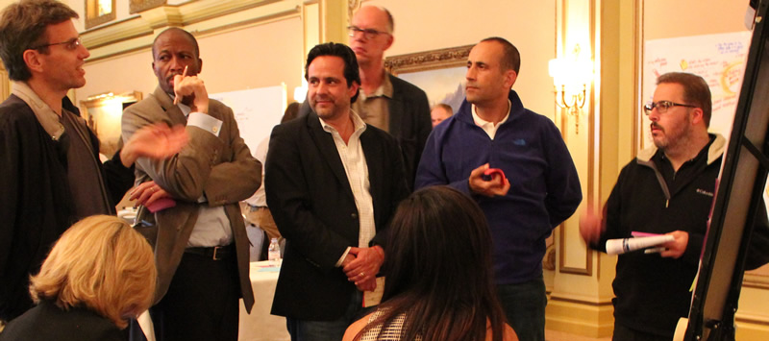
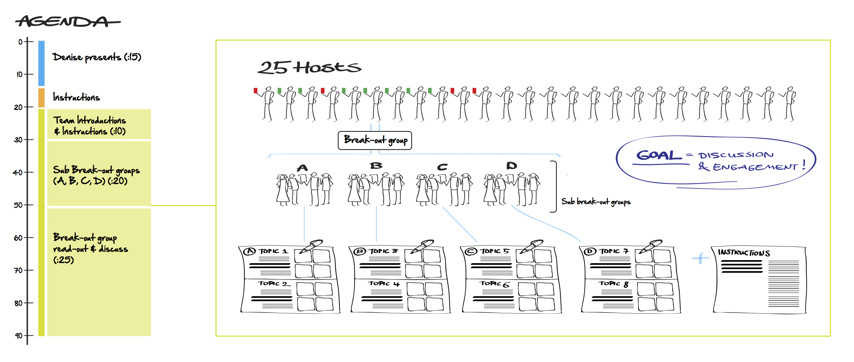
THE WORKSHOP
The workshop is designed to generate discussion and engagement, and can scale to handle 50-500 people in the room.
Participants will work together to discuss the eight broad topics found in the strategic planning engagement framework, and provide written input into the strategy development process.
Group Rapporteurs

Slide 4
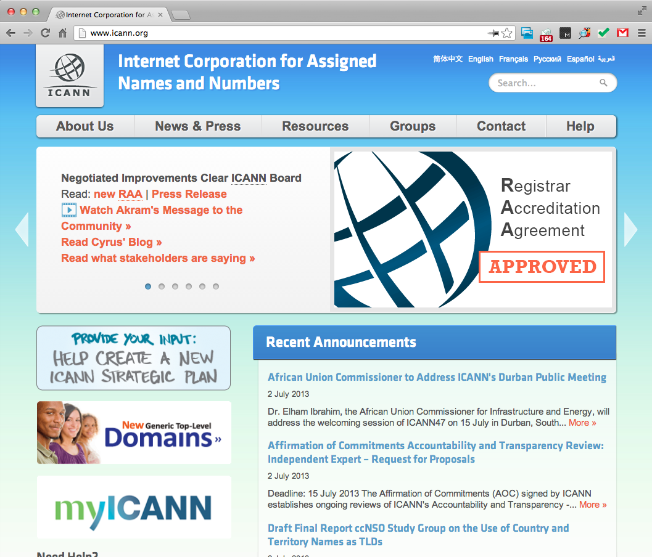
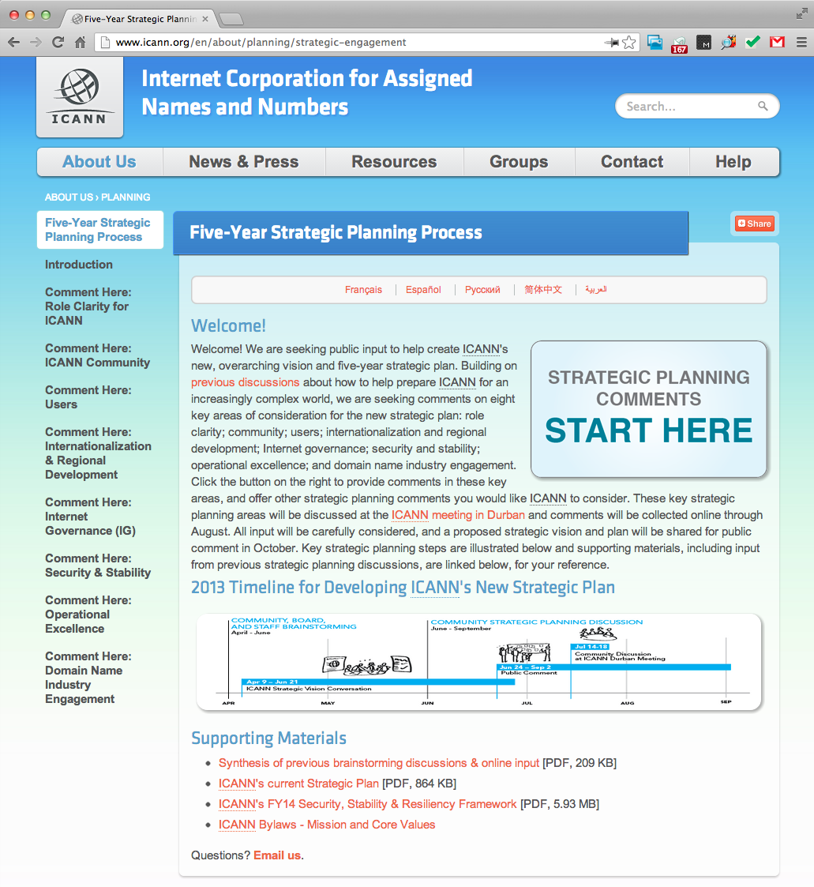
ICANN’s STRATEGIC PLANNING PORTAL
Visit icann.org to link to the strategy planning portal for information, resources, and to provide input.

