Slide 1

ccNSO Highlights ICANN74
June 2022

Slide 2

ccTLD News Session
The link between ccTLDs and their national Cyber Security Ecosystems
Tuesday, 24 May 2022 https://community.icann.org/x/sQh1Cw
Session Chair: Annaliese Williams (.au)
Régis Masse (TLD-OPS Vice Chair)
Calvin Browne (RSP for .za)
Yasuhiro Morishita (.jp)
Luis Carlos Solano (.cr)
Pierre Bonis (.fr)

Slide 3

ccTLD News Session
The impact of the pandemic on ccTLDs
Thursday, 19 May 2022 https://community.icann.org/x/sQh1Cw
Session Chair: Everton Rodrigues (.br)
COVID 19: a force majeure impacting the domain name environment
Marta Dias (.pt)
The Impact of the Pandemic on .GE ccTLD
Sophie Khidasheli (.ge)
New Registry-Registrar Business Practices in response to COVID-19: the .ng experience
Eyitayo Iyortim (.ng)
A study about the Impact of the pandemic on ccTLDs domain names registration in Africa
Hadia Elminiawi

Slide 4
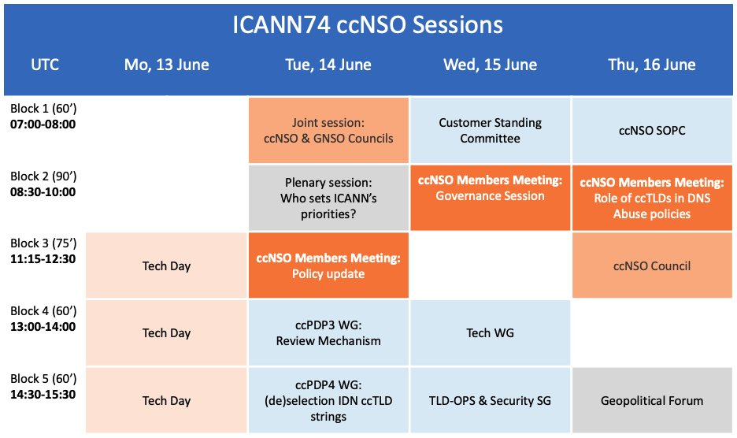

Slide 5

Tech Day
Discussion on technical and operational registry topics, security, and other DNS-related work
Since 2006, Tech Day has been part of ICANN Public Meetings.
It provides a forum for both experienced participants and newcomers to meet and to present and discuss technical and operational registry topics, security, and other Domain Name System-related work.

Slide 6


Joint Session: ccNSO & GNSO Council
During this joint session the ccNSO Council and the GNSO Council discussed topics of common interest, including:
what happens after policy recommendations are accepted by either council,
policy development efforts for IDNs,
the latest developments of Phase 2 of the GNSO Expedited Policy Development Process on the Temporary Specification for gTLD Registration Data, and finally,
developments regarding DNS abuse.

Slide 7
ccNSO Policy Update Session
Two ccNSO Policy Development Process Working Groups provided an update on their progress to date and seek input from the ccTLDs and other community members present on their proposals:
The ccPDP3 Review Mechanism Working Group
policy for a review mechanism with respect to decisions pertaining to the delegation, transfer, revocation and retirement of the delegated Top Level Domains associated with the country codes assigned to countries and territories listed in the ISO 3166-1 and within the framework of the ccNSO Policy Development Process.
The ccPDP4 Working Group on the (de) selection of Internationalised Domain Name ccTLD strings
The ccPDP4 Working Group defines the criteria, process, and procedures for (de)selecting Internationalised Domain Name country code Top Level Domain strings (IDN ccTLDS) associated with the country codes assigned to countries, territories or other areas of geopolitical interest listed in the ISO 3166-1 standard and within the framework of the ccNSO Policy Development Process. The results of this ccPDP4 will eventually replace the IDN ccTLD Fast Track Process.

Slide 8
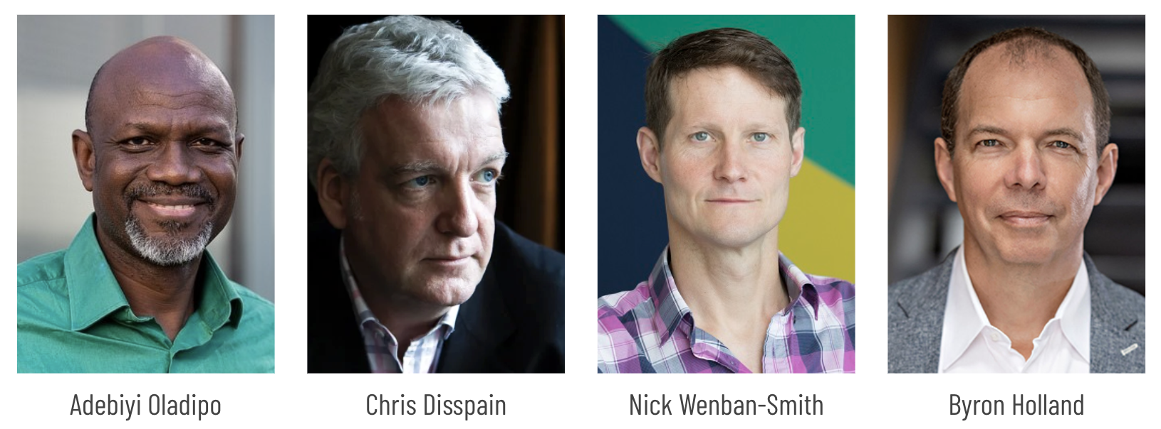
ccNSO Governance session
The focus of the ICANN74 Governance Session was on ccNSO statement of interest and conflict of interest processes. Based on feedback from this session, the sub team of the ccNSO Guidelines Review Committee (GRC) will develop proposals for consideration by the ccNSO Council and ccNSO membership.
In addition, there was a discussion on the impact on existing rules and operating procedures of the inclusion of IDN ccTLD managers as members of the ccNSO.

Slide 9
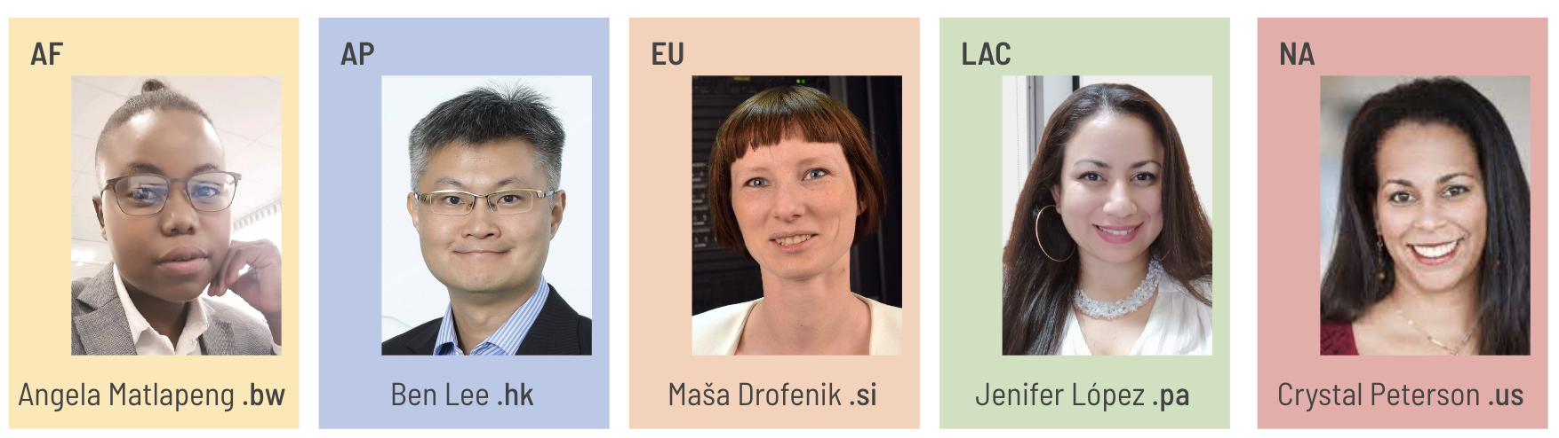
ccNSO DNS Abuse session
Showcasing ccTLDs
The audience was informed about the views of ccTLDs from different geographical regions on DNS Abuse. What are their top priorities? What do they do to mitigate DNS Abuse?
The session serves as useful input for the newly established ccNSO DNS Abuse Standing Committee (DASC), which is the core of the ccTLD community-driven process around DNS Abuse. In keeping with the nature of the ccNSO, the purpose of the Committee is not to formulate any policy or standards, but to raise understanding and awareness of the issues pertaining to DNS Abuse, promote open and constructive dialogue, and ultimately to assist ccTLD Managers in their efforts to mitigate the impact of DNS Abuse.
Session Chair Alejandra Reynoso was joined by two moderators, Nick Wenban-Smith and Tatiana Tropina, and ccTLD representatives from different geographic regions.

Slide 10

ccNSO Council
Agenda highlights:
adopt FY22-24 ccNSO workplan, which details the expected duration of the ccNSO PDPs, community work and ccNSO administrative tasks.
appoint new leadership teams for the ccNSO Internet Governance Liaison Committee and ccNSO Meetings Programme Committee.
adopt the timelines for the ccNSO ICANN Board Seat 11 nomination process and the upcoming ccNSO Council elections.

Slide 11




ccNSO Council
AFRICA
ASIA/AUSTRALIA/PACIFIC
EUROPE
LATIN AMERICA/ CARIBBEAN ISLANDS
NORTH AMERICA
NOMCOM
3 NomCom selected Councillors
The ccNSO members for each Geographic Region annually elect three Council members per region
GNSO
liaison
ALAC
liaison
Regional Organizations
Notes:
The breakdown of the composition is as follows: The ccNSO has 18 councilors, 15 of whom are appointed by ccNSO members and 3 of whom are selected by the ICANN Nominating Committee.
ICANN has five Geographic Regions:
(a) Africa
(b) Asia/Australia/Pacific
(c) Europe
(d) Latin America/Caribbean islands
(e) North America
The ccNSO members for each Geographic Region elect three councilors per region. All councilors are appointed for a three-year term and can be re-appointed. Each year, the Council elects its chair and two vice chairs. The chair of the Council is also chair of the ccNSO.

Slide 12
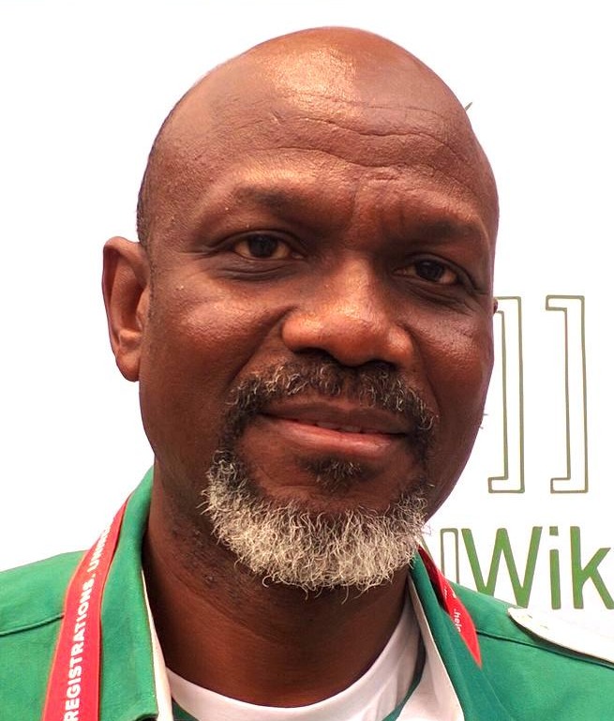
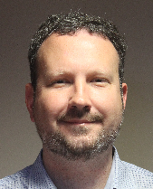
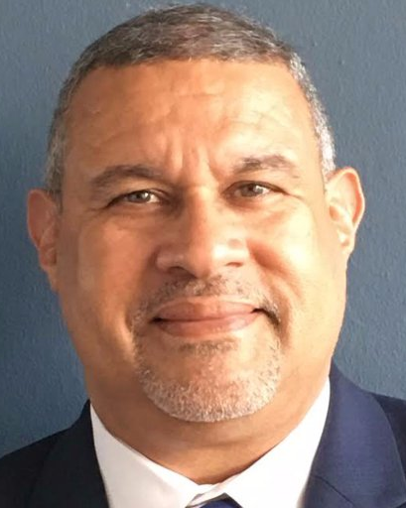
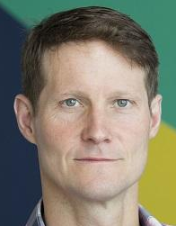
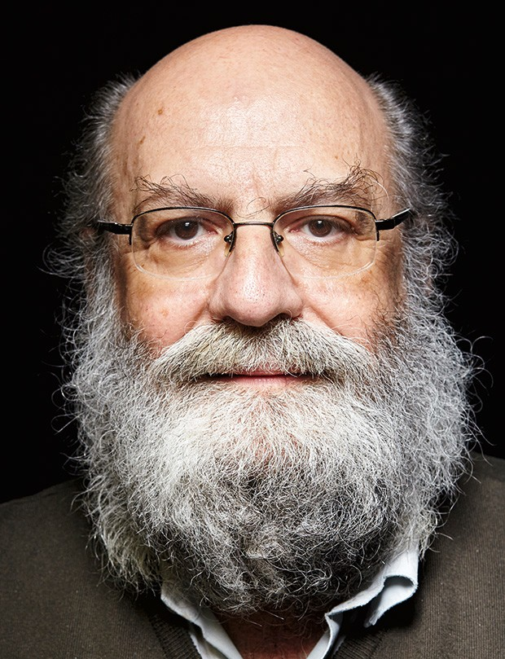
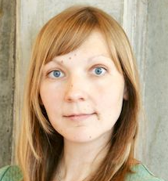
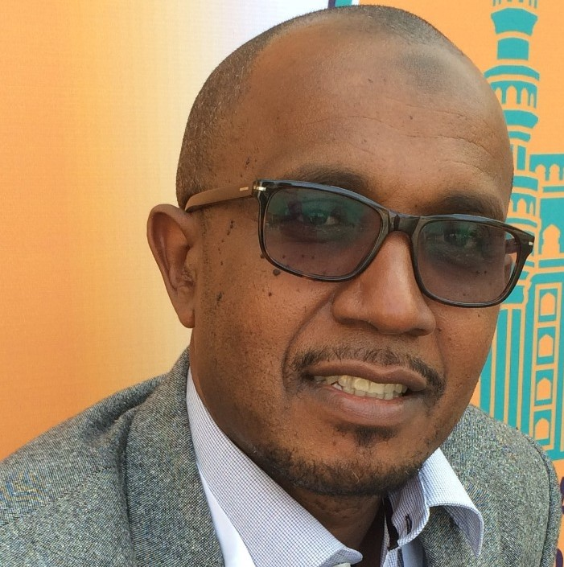
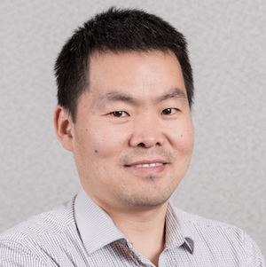

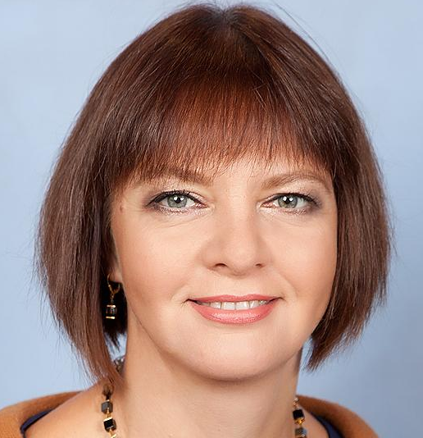
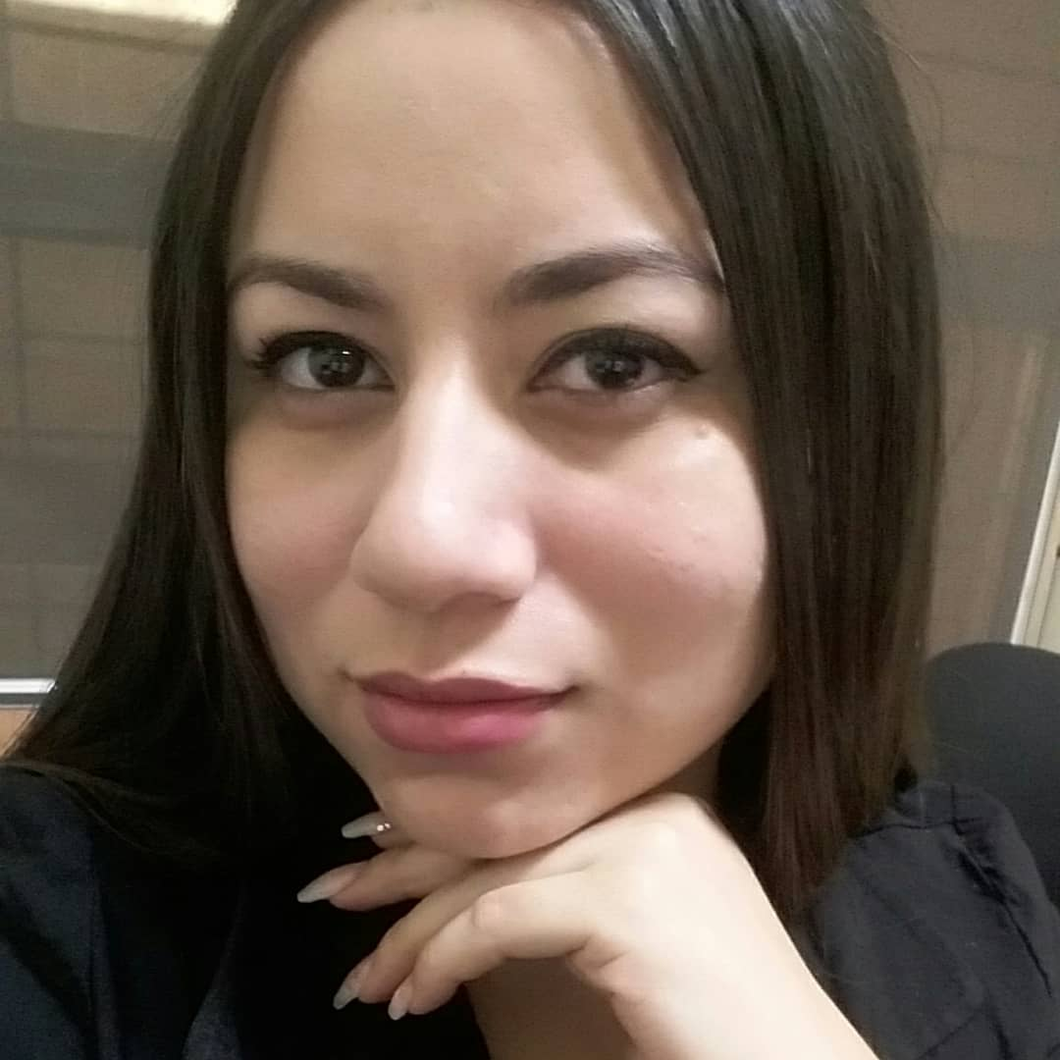
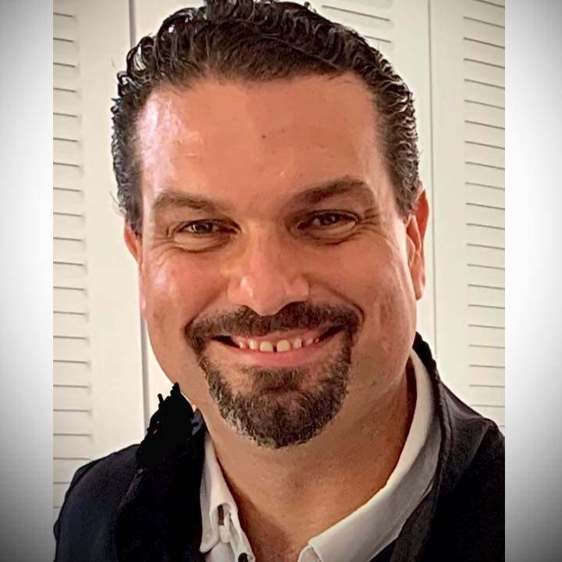
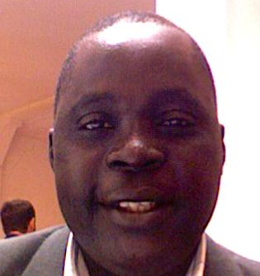
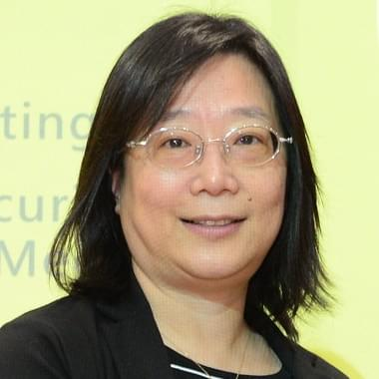

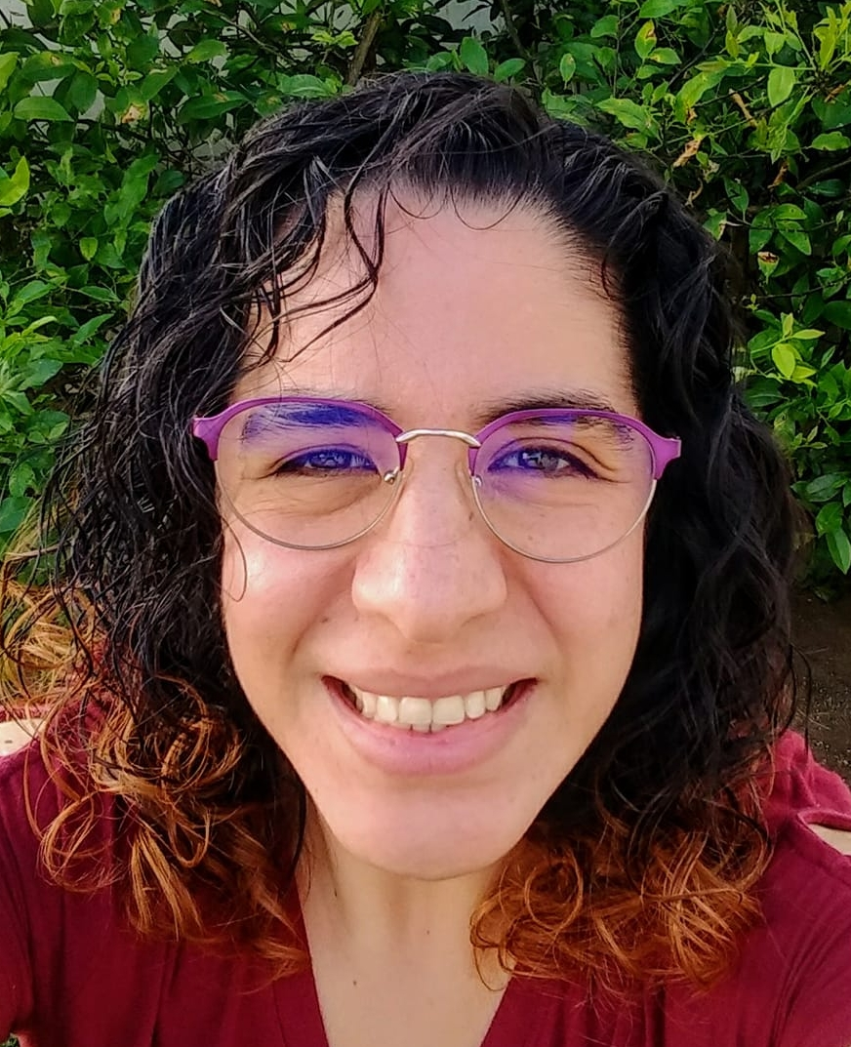
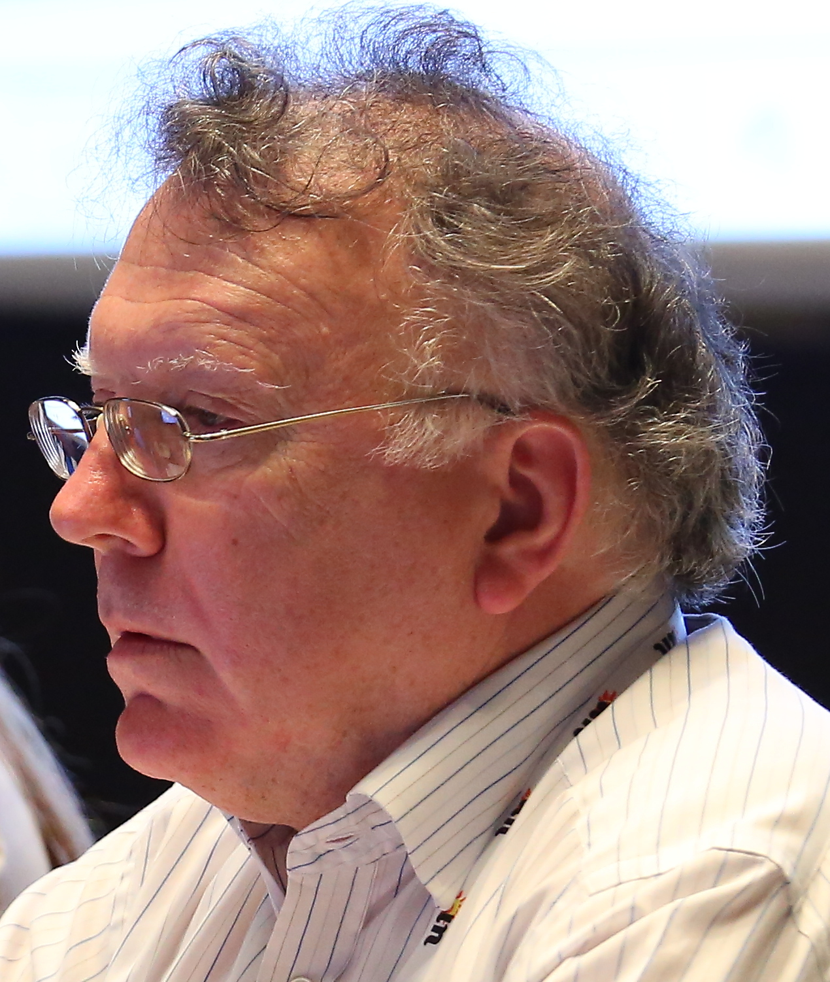
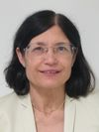
March
2025
Vice Chair
Vice Chair
Tatiana Tropina
AM'24
Biyi Oladipo .ng
Jordan Carter .nz
Pablo Rodríguez .pr
Nick Wenban-Smith .uk
Demi Getschko .br
March
2024
Hadji Mmadi Ali .km
Jiankang Yao .cn
Sean Copeland .vi
Irina Danelia .ru
Jenifer López .pa
Javier Rúa-Jovet AM'23
March
2023
Souleymane Oumtanaga .ci
Ai-Chin Lu .tw
Chair
Marie-Noémi Marques AM'22
Stephen Deerhake .as
Chris Disspain
Alejandra Reynoso .gt
NORTH AMERICA
LATIN AMERICA & CARIBBEAN
AFRICA
ASIA PACIFIC
EUROPE
NOMCOM
Notes:
Current councillors

Slide 13
Contributions by ccTLDs:
Working Groups & Committees
DNS Abuse Standing Committee (DASC)
Outreach and Involvement Standing Committee (OISC)
Strategic and Operational Planning Committee (SOPC)
Meetings Programme Committee (MPC)
ccNSO Internet Governance Liaison Committee (IGLC)
TLD-OPS Standing Committee (TLD-OPS)
Technical Working Group (Tech Day)
Guidelines Review Committee (GRC)
ccPDP3: Retirement WG
ccPDP3: Review Mechanisms WG
ccPDP4: IDN policy WG
Council Triage Committee

Slide 14

Learn more
ccNSO workspace for newcomers:
https://community.icann.org/x/dWHwAw
Consult the Quick Guide to the ccNSO
Enroll in the ICANN Learn Course
Subscribe to the monthly ccNSO newsletter:
https://community.icann.org/x/UgirBQ
ICANN74 ccTLD News Sessions & ccNSO Members Meeting
https://community.icann.org/x/sQh1Cw
Notes:
ccTLD community webinar is especially targeted at those that are new to the ccNSO, or want to learn more about the work of the ccNSO, and how to contribute

