Slide 1
CCWG-Accountability Draft Proposal on Work Stream 1 Recommendations
ccTLD Webinar
9 December 2015

Slide 2
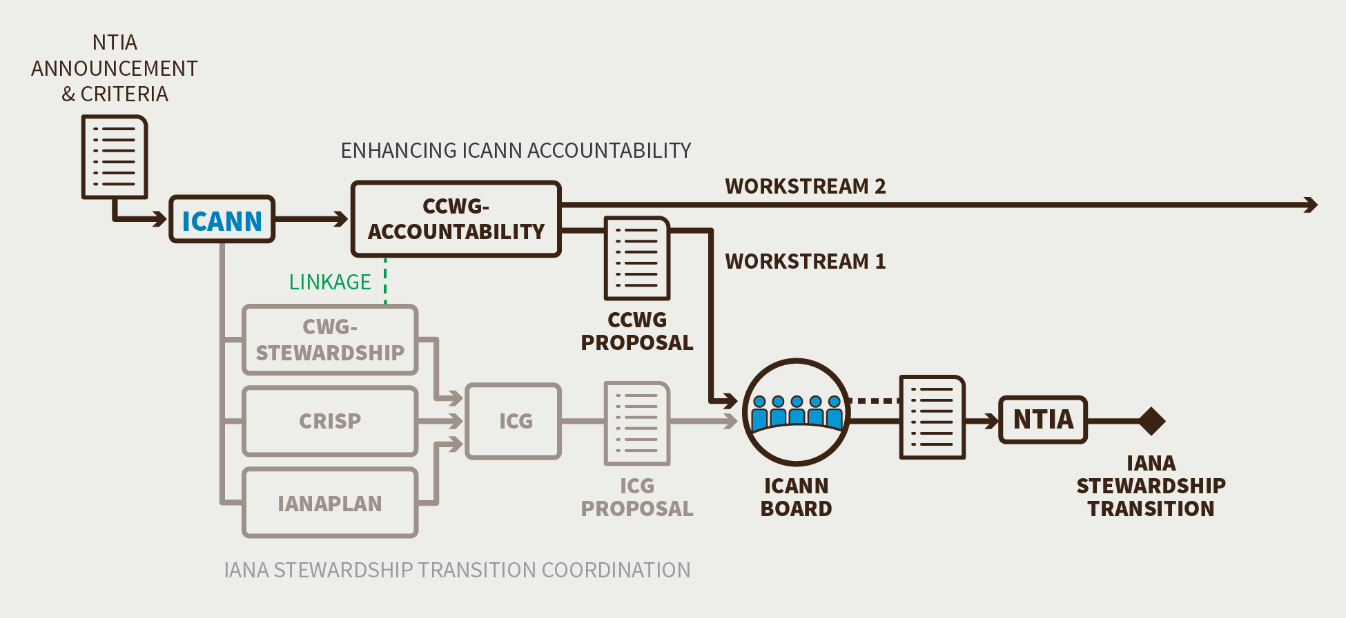
Overview
Over the last year, a working group of ICANN community members has developed a set of proposed enhancements to ICANN’s accountability to the global Internet community. The Draft Proposal of Work Stream 1 Recommendations is both a call for the Chartering Organizations to consider and a public consultation.

Slide 3
Background
To address accountability concerns raised during initial discussions on IANA Stewardship Transition, the ICANN community requested that ICANN’s existing accountability mechanisms be reviewed and enhanced as a key part of the transition process. As a result, the Cross Community Working Group on Enhancing ICANN Accountability (CCWG-Accountability) was convened.
The CCWG-Accountability’s work consists of two tracks:
Goal: The CCWG-Accountability is expected to deliver proposals that would enhance ICANN’s accountability towards all its stakeholders
Work Stream 1: Focused on mechanisms enhancing ICANN accountability that must be in place or committed to within the time frame of the IANA Stewardship Transition
Work Stream 2: Focused on addressing accountability topics for which a timeline for developing solutions and full implementation may extend beyond the IANA Stewardship Transition

Slide 4
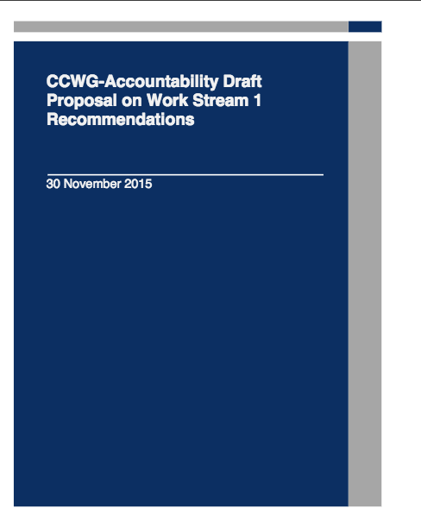
Draft Proposal on Work Stream 1 Recommendations
Structure:
Core proposal (57 pages)
15 detailed annexes of proposed recommendations (including a summary)
10 appendices
Translations to be provided in Arabic, Spanish, French, Russian Chinese and Portuguese
See: https://community.icann.org/x/eLRYAw
Public comment Survey (closes on 21 December): https://www.surveymonkey.com/r/ccwg-acct-draftproposal

Slide 5
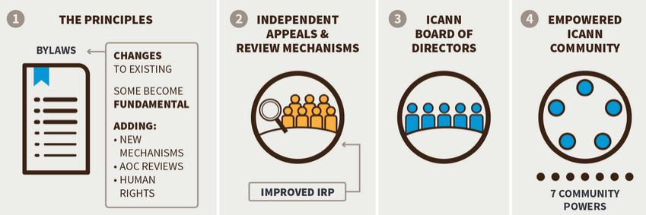
Four Building Blocks
The CCWG-Accountability identified four building blocks that would form the mechanisms required to improve ICANN’s accountability.

Slide 6
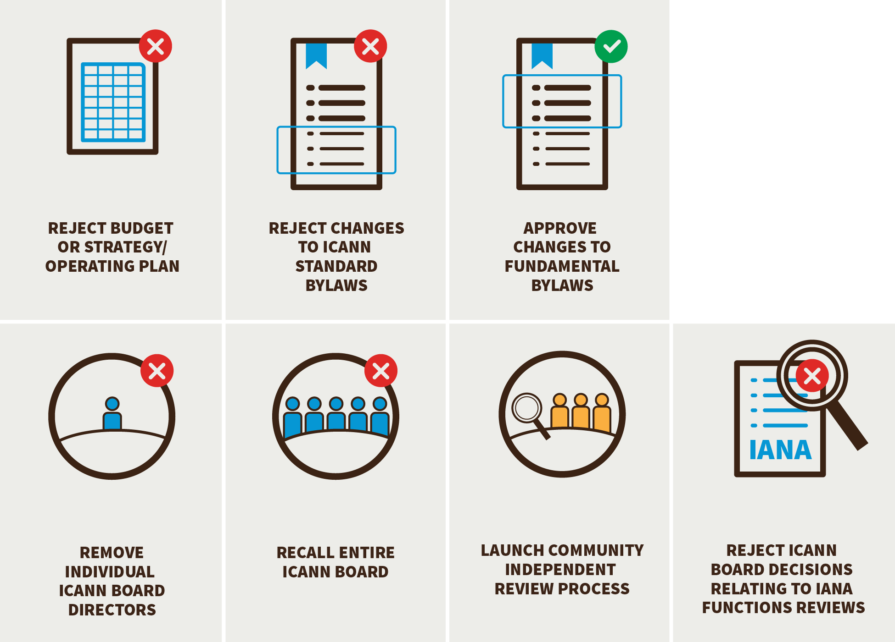
Ensuring Community Engagement in ICANN Decision-making: Seven New Community Powers
The CCWG-Accountability has proposed a set of seven Community Powers designed to empower the community to hold ICANN accountable for the organization’s Principles (the Mission, Commitments, and Core Values).
It is important to note that the powers, as well as the launch of a Separation Cross Community Working Group (as required by the CWG-Stewardship dependencies), can be enforced by using the community Independent Review Process or the Power to recall the entire Board.

Slide 7
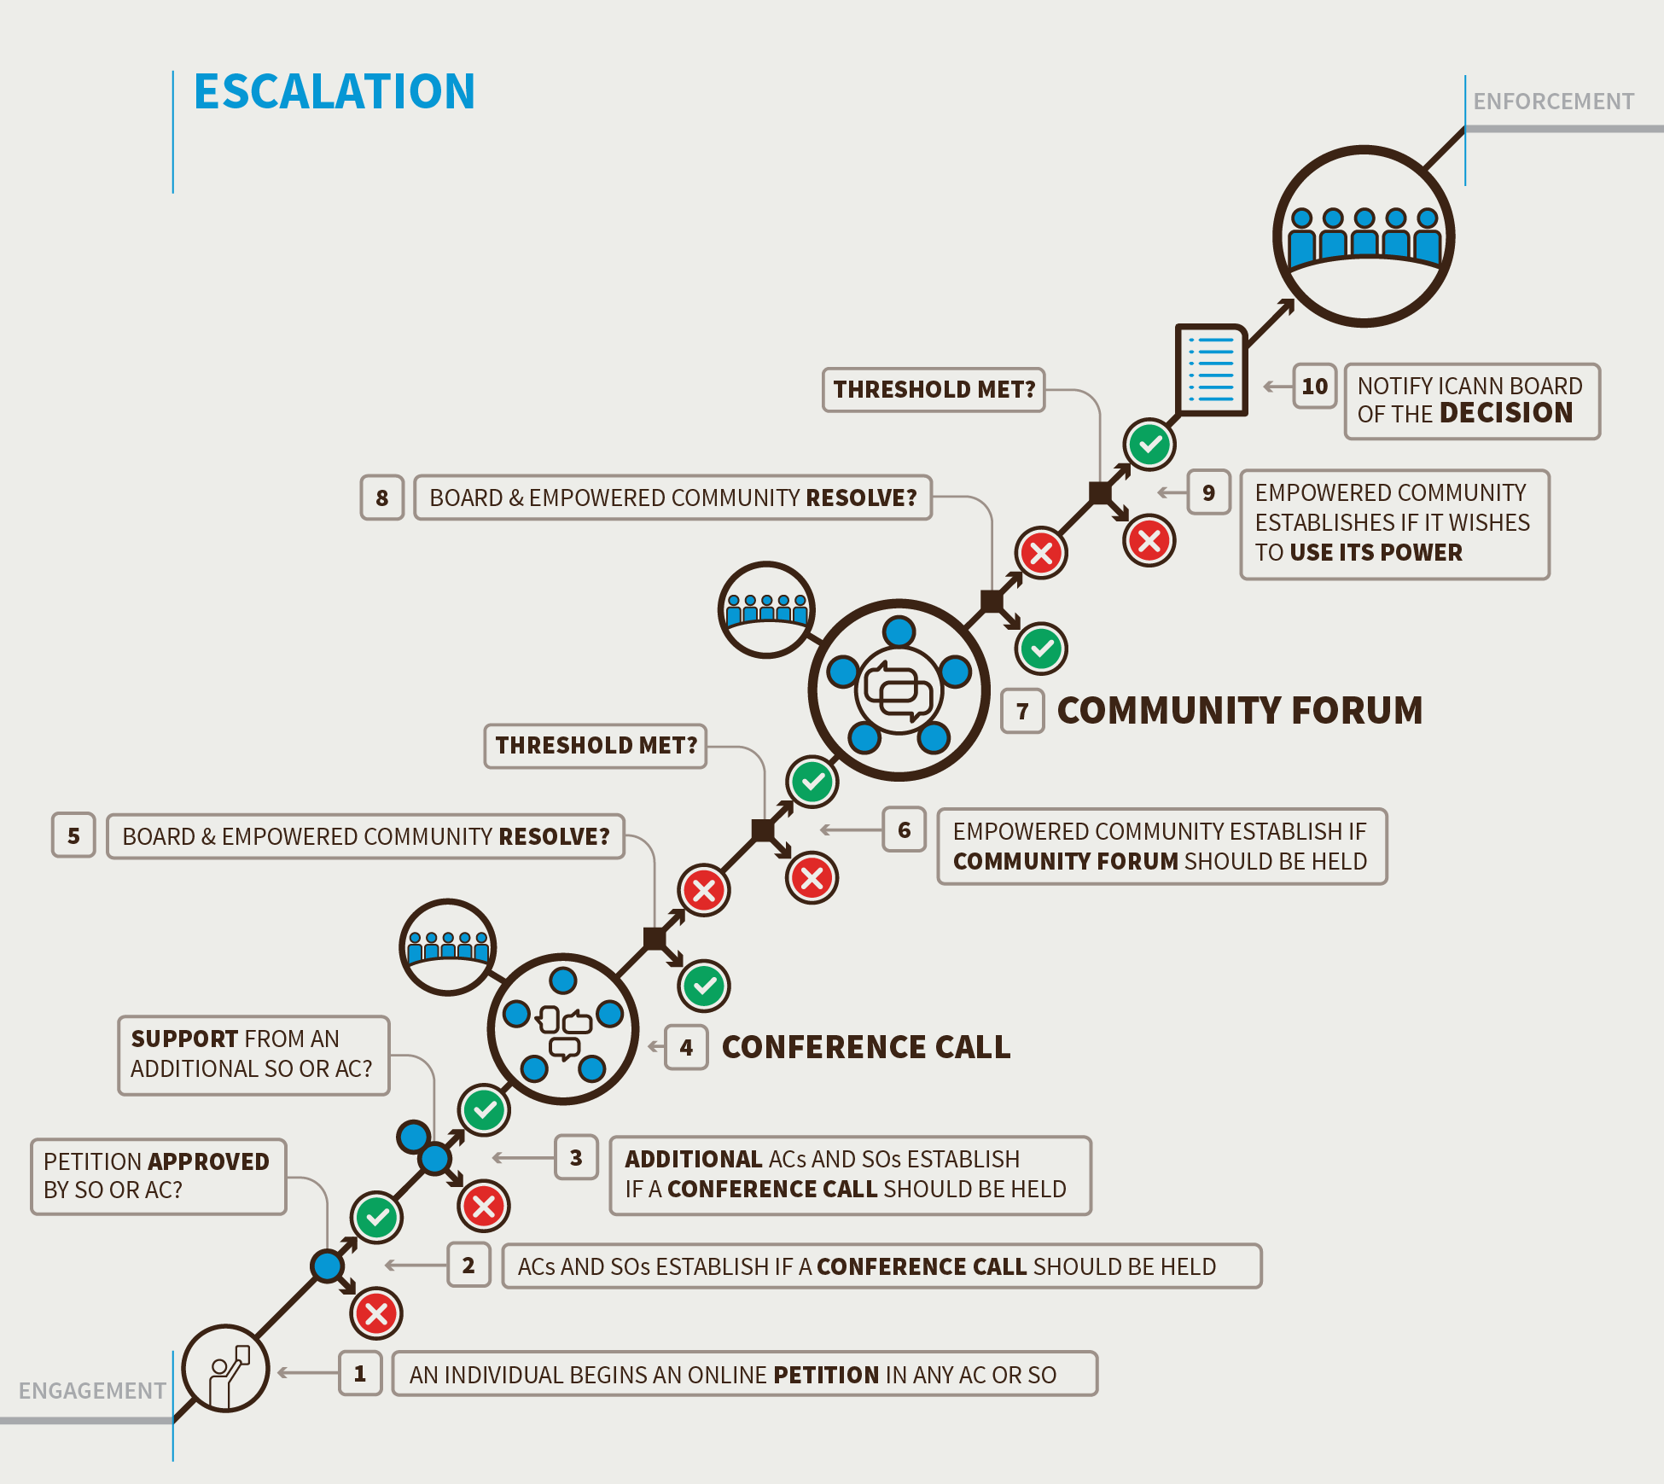
Empowering the Community through Consensus: Engage, Escalate, Enforce
In an effort to prevent disagreements between the community and ICANN Board, the CCWG- Accountability is recommending that ICANN be required to engage with the community on any key decisions it is considering such as Budgets or changing Bylaws.
Should disagreements arise, the CCWG- Accountability is proposing a series of procedures that ensure all sides have the chance to discuss any disagreements and have multiple opportunities to resolve issues before having to resort to the powers of the Empowered Community.

Slide 8
Required Thresholds for Escalation Processes
Required Community Powers | Should a conference call be held? | Should a Community Forum be convened? | Is there consensus support to exercise a Community Power?
1. Reject a proposed Operating Plan/Strategic Plan/Budget | 2 AC/SOs support blocking | 3 AC/SOs support blocking | 4 support rejection, and no more than 1 objection
2. Approve changes to Fundamental Bylaws and Articles of Incorporation | 2 AC/SOs support approval | 3 AC/SOs support approval | 4 support approval, and no more than 1 objection
3. Reject changes to regular bylaws | 2 AC/SOs support blocking | 2 AC/SOs support blocking | 3 support rejection, and no more than 1 objection
4a. Remove an individual Board Director appointed by a Supporting Organization or Advisory Committee | Majority within the appointing AC/SO | Majority within appointing AC/SO | Invite and consider comments from all SO/ACs. 3/4 majority within the appointing AC/SO to remove their director
4b. Remove an individual Board Director appointed by the Nominating Committee | 2 AC/SOs support | 2 AC/SOs support | 3 support, and no more than 1 objection.
5. Recall the entire Board of Directors | 2 AC/SOs support | 3 AC/SOs support | 4 support, and no more than 1 objection
6. Initiate a binding Independent Review Process | 2 AC/SOs support | 2 AC/SOs support | 3 support, and no more than 1 objection. Require mediation before IRP begins
7. Reject ICANN Board decisions relating to reviews of IANA functions, including the triggering of Post-Transition IANA separation | 2 AC/SOs support | 3 AC/SOs support | 4 support, and no more than 1 objection

Slide 9

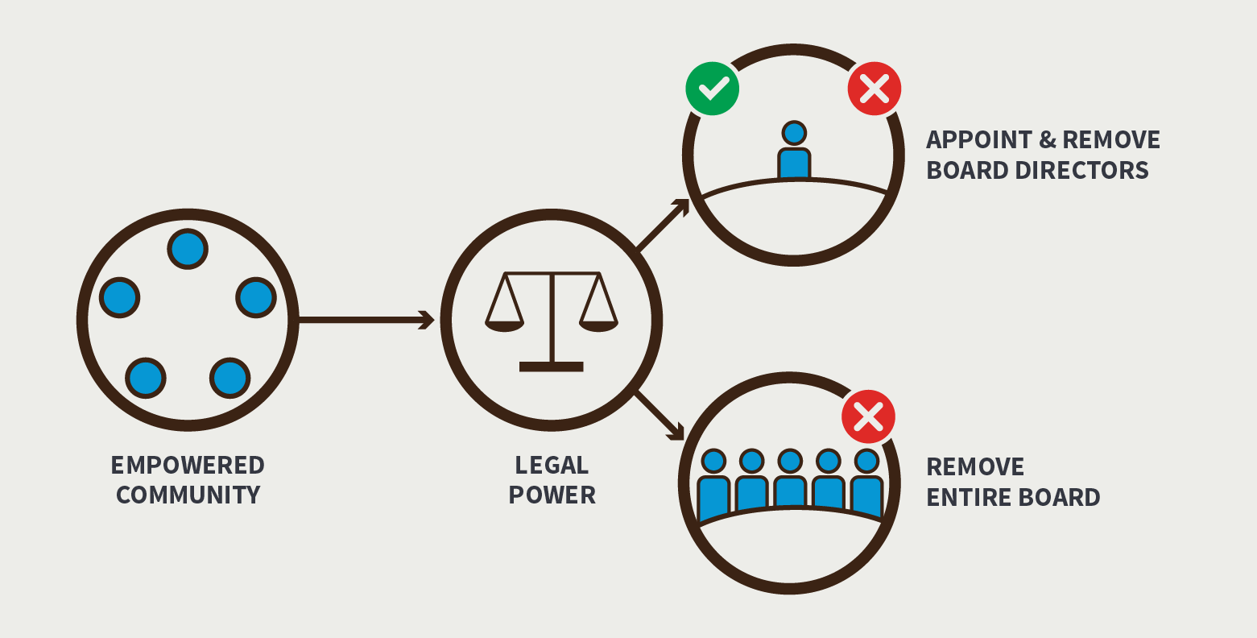
Establishing an Empowered Community for Enforcing Community Powers
Concerns were raised that the “Sole Member” model granted a significant number of powers under California law called “statutory rights.” Commenters expressed concern that these rights, such as the ability to dissolve the corporation, could not be adequately constrained and might have unintended and unanticipated consequences
To address these concerns, the CCWG-Accountability now recommends implementing a “Sole Designator” model. The Sole Designator has the statutory power to appoint and remove individual ICANN Board Directors or the entire Board which is a requirement of the CCWG -Accountability and the CWG-Stewardship. The CCWG- Accountability recommends that the right to inspect be granted to the Sole Designator. Legal counsel informed the group that adopting a “Sole Designator” model could effectively be implemented while meeting the community’s requirements and having minimal impact on the corporate structure of ICANN.

Slide 10
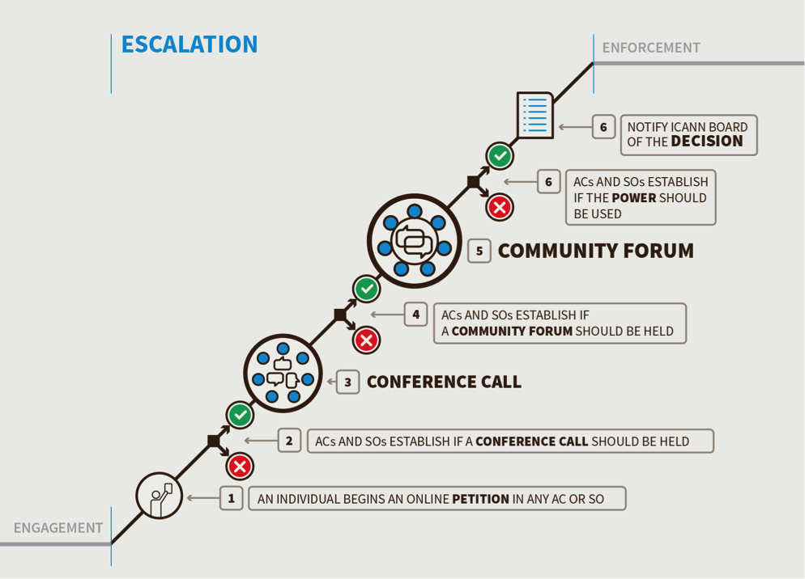
Removal of SO/AC-Appointed Board Director
Additional steps specific to Removal of SO/AC Appointed Director
Chair of appointing SO/AC holds a private call with the Director
Community Forum Chair issues a formal call for comments
SO/ACs publish recommendations within 7 days
Input received is sent to the appointing SO or AC and posted publicly within 7 days
Decision to use power as an Empowered Community (7 days from the conclusion of the Comment period) is the responsibility of the appointing SO or AC only
Appointing SO/AC responsible for naming replacement

Slide 11
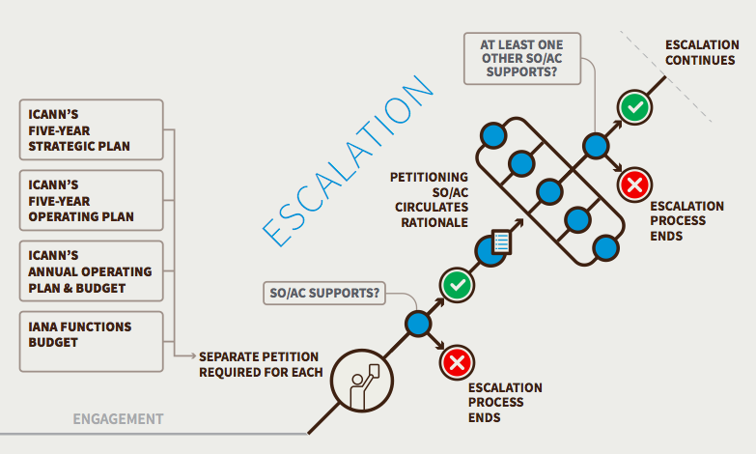
Reject ICANN’s Budget or Strategic/Operating Plans
Additional steps specific to Rejecting ICANN’s Budget or Strategic/Operating Plans
Separate petition required for each Budget or Plan being challenged
Petitioning SO or AC required to provide rationale
Should annual budget be rejected, caretaker budget will be enacted (details are work in progress)
Budget or Strategic/Operating plan could only be challenged if significant issue(s) brought up in the Engagement Phase not addressed prior to approval
IANA Functions Budget to be considered as a separate budget i.e. two distinct processes:
  Use of power to reject the ICANN Budget would have no impact on the IANA Budget, and a rejection of the IANA Budget would have no impact on the ICANN Budget

Slide 12
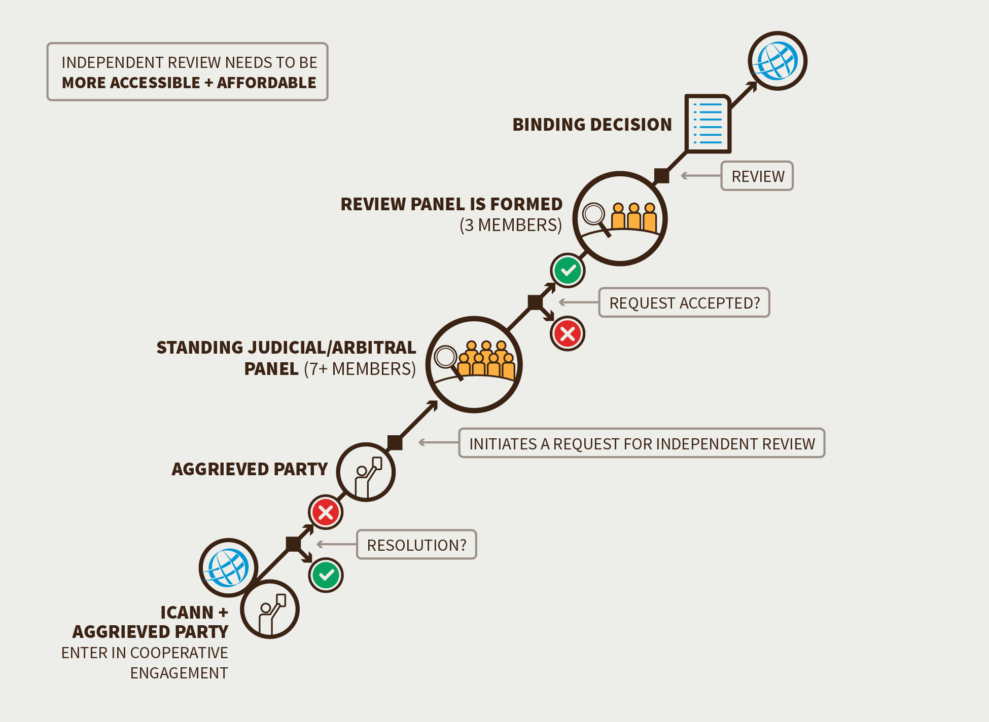
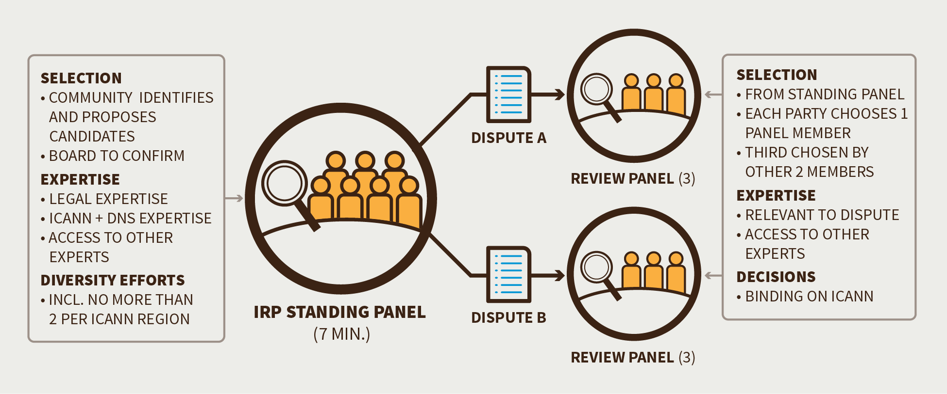
Enhanced Independent Review Process
The overall purpose of the Independent Review Process is to ensure that any ICANN action or inaction does not exceed the scope of its limited technical mission and complies with both its Articles of Incorporation and Bylaws
Exclusion of ccTLD delegations and revocations and numbering decisions

Slide 13
CWG-Stewardship Dependencies
ICANN Budget: Community rights regarding the development and consideration of the ICANN Budget
ICANN Board: Community rights regarding the ability to appoint/remove Directors of the ICANN Board, and recall the entire Board
ICANN Bylaws: Incorporation of the following into ICANN’s Bylaws: IANA Function Review, Customer Standing Committee and the Separation Process
Fundamental Bylaws: All of the foregoing mechanisms are to be provided for in the ICANN Bylaws as Fundamental Bylaws
Independent Review Panel: Should be made applicable to IANA Functions and accessible by managers of top-level domains

Slide 14
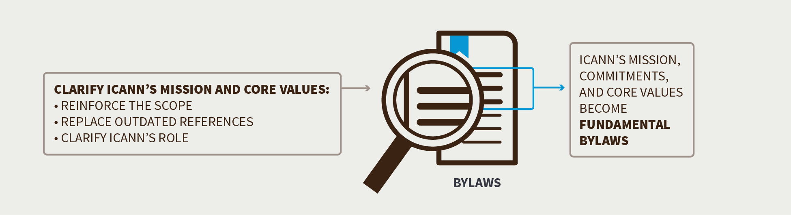
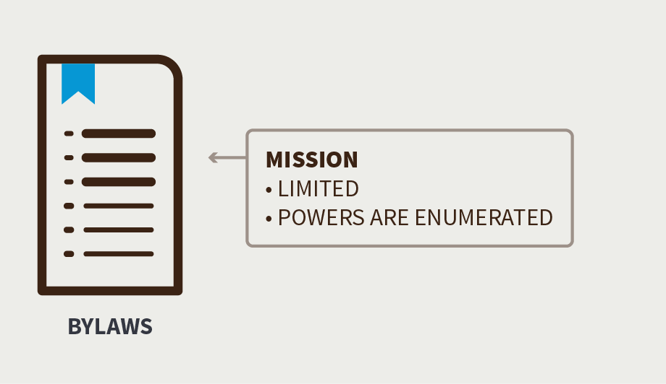
Changing Aspects of ICANN’s Mission, Commitments and Core Values
The CCWG-Accountability recommends:
Clarifying that ICANN shall act strictly in accordance with, and only as reasonably appropriate to achieve its Mission
Updating the ICANN Mission statement to clearly set forth ICANN’s role with respect to names, numbers, root servers, and protocol port and parameters
Clarify that ICANN’s Mission does not include the regulation of services that use the Domain Name System or the regulation of the content these services carry or provide.

Slide 15
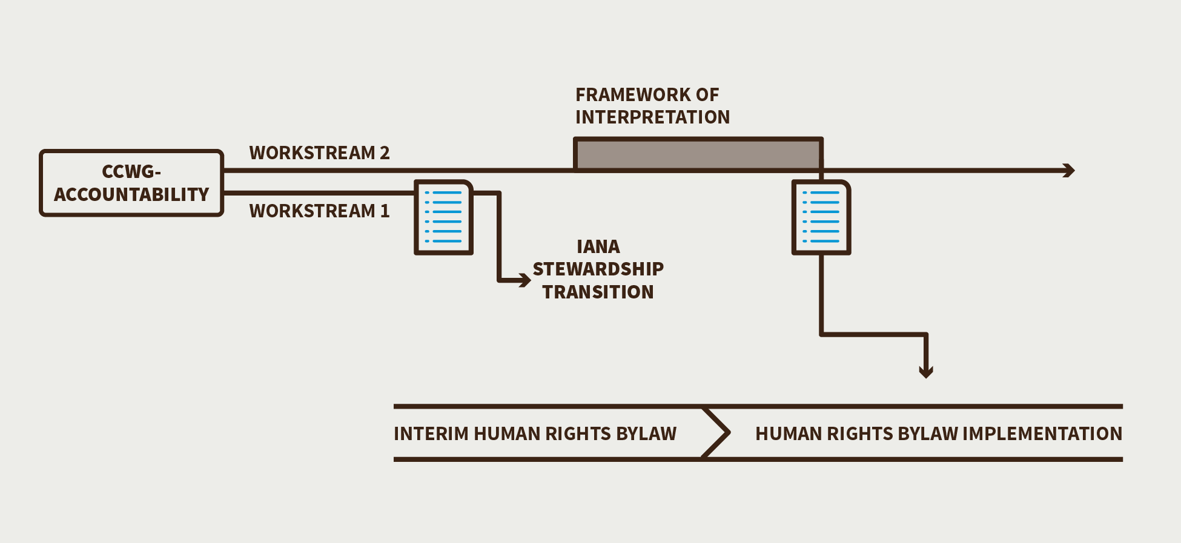
Reaffirming ICANN’s Commitment to Respect Internationally Recognized Human Rights as it Carries out its Mission
Bylaw proposed for adoption will not be fully executed until the Framework of Interpretation is developed
Framework of interpretation to be developed in Work Stream 2
Draft Bylaw text (below)
“Within its mission and in its operations, ICANN will respect internationally recognized human rights. This commitment does not in any way create an obligation for ICANN, or any entity having a relationship with ICANN, to protect or enforce human rights beyond what may be required by applicable law. In particular, this does not create any additional obligation for ICANN to respond to or consider any complaint, request or demand seeking the enforcement of human rights by ICANN.”

Slide 16
Enhancing the Accountability of Supporting Organizations and Advisory Committees
The CCWG-Accountability recommends:
Including review of Supporting Organizations’ and Advisory Committees’ accountability mechanisms as part of Work Stream 1
Reviews be incorporated into existing periodic Structural Reviews
Structural Reviews are intended to review the performance and operation of ICANN SO/ACs

Slide 17
Board Obligations with regards to Governmental Advisory Committee Advice (Stress Test 18)
Proposed amendments to ICANN Bylaws Article XI, Section 2: j.
“The advice of the Governmental Advisory Committee on public policy matters shall be duly taken into account, both in the formulation and adoption of policies. In the event that the ICANN Board determines to take an action that is not consistent with the Governmental Advisory Committee advice, it shall so inform the Committee and state the reasons why it decided not to follow that advice. Any Governmental Advisory Committee advice approved by a full Governmental Advisory Committee consensus, understood to mean the practice of adopting decisions by general agreement in the absence of any formal objection, may only be rejected by a vote of two-thirds of the Board, and the Governmental Advisory Committee and the ICANN Board will then try, in good faith and in a timely and efficient manner, to find a mutually acceptable solution.”

Slide 18
Current CCWG-Accountability Timeline
CCWG issues Formal Update
Send amended report back to Chartering Orgs
21-day Public Comment Period
Draft Proposal for Public Comment
Distribution of staff summary
Deliver Final Report to ICANN Board
Detailed Report
Deadline for WP Analysis
Chartering Org meeting (tentative)
Annexes +
Appendices
Nov 15, 2015
Nov 30, 2015
Dec 21, 2015
Dec 24, 2015
Dec 31,
2015
Jan 7,
2016
Jan 22, 2016
All dates are tentative*

Slide 19
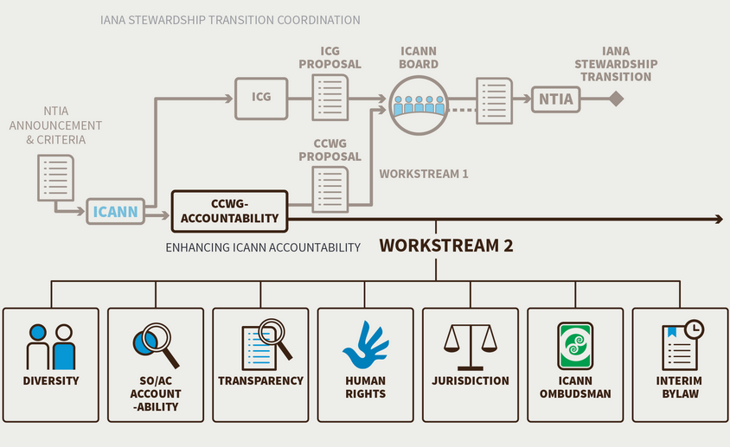
Committing to Further Accountability Work in Work Stream 2
As part of Work Stream 2, the CCWG-Accountability proposes that further enhancements be made to a number of designated mechanisms and processes and to refine the operational details associated with some of its recommendations for Work Stream 1.
It is intended that Work Stream 2 will be completed by the end of 2016.

