Slide 1
MULTI-
STAKEHOLDER GLOBAL GOVERNANCE
CAPACITY
EFFECTIVENESS LEGITIMACY
Project Presentation
ICANN 86, Seville
Jan Aart Scholte, Leiden University
June 2026

Slide 2
MGG PROJECT 2025-2028
based at Leiden University, Netherlands
funded with a grant of €813,000 from the Dutch Research Council (NWO)
research team
  Jan Aart Scholte, coordinator
  Hortense Jongen, senior researcher
  Laura Birbalaite, researcher
  Sarah Anne Stevens, researcher
advisory board (in personal capacity)
  Liliana Andonova and Anakarina Pérez Oropeza regarding FSC
  Sophie Harman and Marijke Wijnroks regarding GFATM
  Milton Mueller and Tripti Sinha regarding ICANN

Slide 3
MOTIVATION OF THE PROJECT
Aim to advance governance of planetary problems to become maximally democratic, effective, fair, peaceful and sustainable
Conventional intergovernmental multilateral global governance is generally falling short in quantity and quality
Multistakeholder constructions prima facie have significant potentials for democratic, effective, fair, peaceful and sustainable governance
But when and how do they realize these potentials in practice?
Knowing this can improve existing MGG and inspire new MGG

Slide 4
CORE QUESTION OF THE PROJECT
Central question:
how can multistakeholder global governance operate well?
how far, and under what circumstances, does multistakeholder global governance at the FSC, GFATM, and ICANN attain capacity, effectiveness, and legitimacy?
Significance:
The first comprehensive detailed systematic comparative analysis of the promises and pitfalls of multistakeholder arrangements for global governance.

Slide 5
MULTISTAKEHOLDER PRINCIPLE
govern through an institutional architecture and policy process that assembles ‘multiple’ parties who ‘have a stake’ in (i.e. affect and are affected by) a given societal problem
an alternative to multilateral architecture that brings together multiple states (e.g. United Nations)
also different from private governance through a business association (e.g. International Organization of Security Commissions)
MGG traces back to the International Labour Organisation (ILO, 1920) and the International Organisation for Standardisation (ISO, 1947)
main spread of MGG since the 1990s

Slide 6
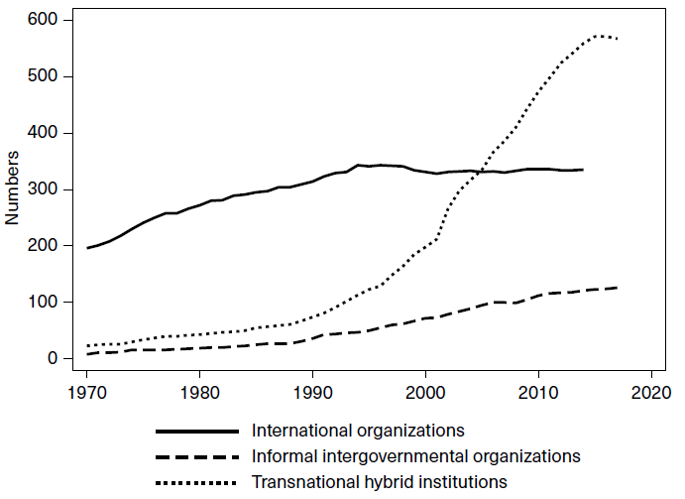

Slide 7
THREE CASE STUDIES
Forest Stewardship Council (FSC, established in 1993) – governs certification of sustainable forestry worldwide
Internet Corporation for Assigned Names and Numbers (ICANN, 1998) – governs the system of unique identifiers for the global internet
Global Fund to Fight AIDS, Tuberculosis and Malaria (GFATM, 2001) – governs campaigns against these diseases worldwide

Slide 8
THREE CASE STUDIES
  three longstanding, highly developed, and widely lauded MGG arrangements → good cases to establish what has worked in the past
  all three borne of the neoliberal heyday of the late twentieth century and face challenging world-order shifts today → good cases to explore what might (need to) change in the future
  different issue-areas (communication, environment, health)
  different organizational setups (including for stakeholder groups)
  different involvements of government
  similar and/or different capacity, effectiveness and legitimacy?

Slide 9
MGG: A GOOD WAY OF GOVERNING?
What types, amounts and qualities of capacity do multistakeholder global governance regimes obtain?
In what ways and to what extents are multistakeholder global governance regimes effective in fulfilling their purposes?
How far and on what grounds do multistakeholder global governance regimes secure legitimacy?
In sum, in what ways, to what degree, and under what conditions are multistakeholder arrangements promising (or not) for governing global challenges?

Slide 10
A DYNAMIC OF TRILATERAL INTERCONNECTION
more capacity (resources) tends to facilitate more effectiveness (results)
more effectiveness (results) tends to attract more legitimacy (approval)
more legitimacy (approval) tends to encourage increases in capacity
which in turn enables still more effectiveness
which in turn generates still more legitimacy
and so on …
although the dynamic can also work in a reverse downward spiral

Slide 11
CAPACITY
LEGITIMACY
EFFECTIVENESS

Slide 12
INTENDED USER IMPACT: WHAT’S IN IT FOR YOU?
sharper understanding and use of key concepts (e.g. ‘effectiveness’, ‘legitimacy’, ‘accountability’) so as better to shape policy to desired ends
carefully collected and analyzed data to establish where MGG is stronger and weaker in respect of capacity, effectiveness and legitimacy – helps to build on what works well and to address what works less well
systematic comparison cross policy fields – become aware of and learn from multistakeholder global governance in other issue-areas
creative proposals for organizational and policy adjustments, thereby stimulating debate and helping to sustain policy dynamism

