Slide 1
CGP Updates
Wei WANG & Kenny HUANG
Chinese Generation Panel

Slide 2
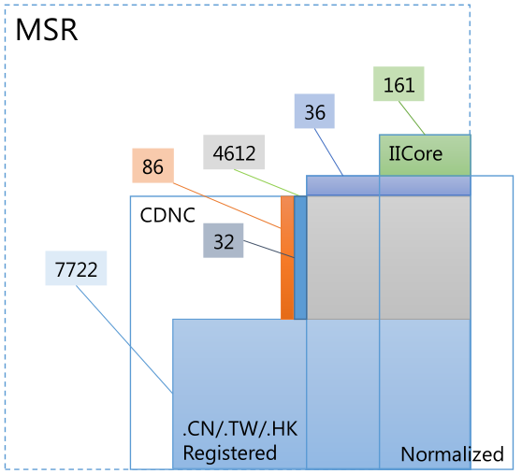
Minimum Shared Set
CGP think a reduction of CDNC table (19559 chars, mainly reflects Chinese language community’s concern)is not enough to support a coordination across three language environment.
As an alternative, MSS is proposed to work as the basis of coordination between C, J and K.

Slide 3
Minimum Shared Set
Historically registered chars under .CN/.TW/.HK
  7722
Normalized Table by government
  4612+36
IICore by Asia countries
  161
variants to normalized table and IICore
  32+86
12649 chars

Slide 4
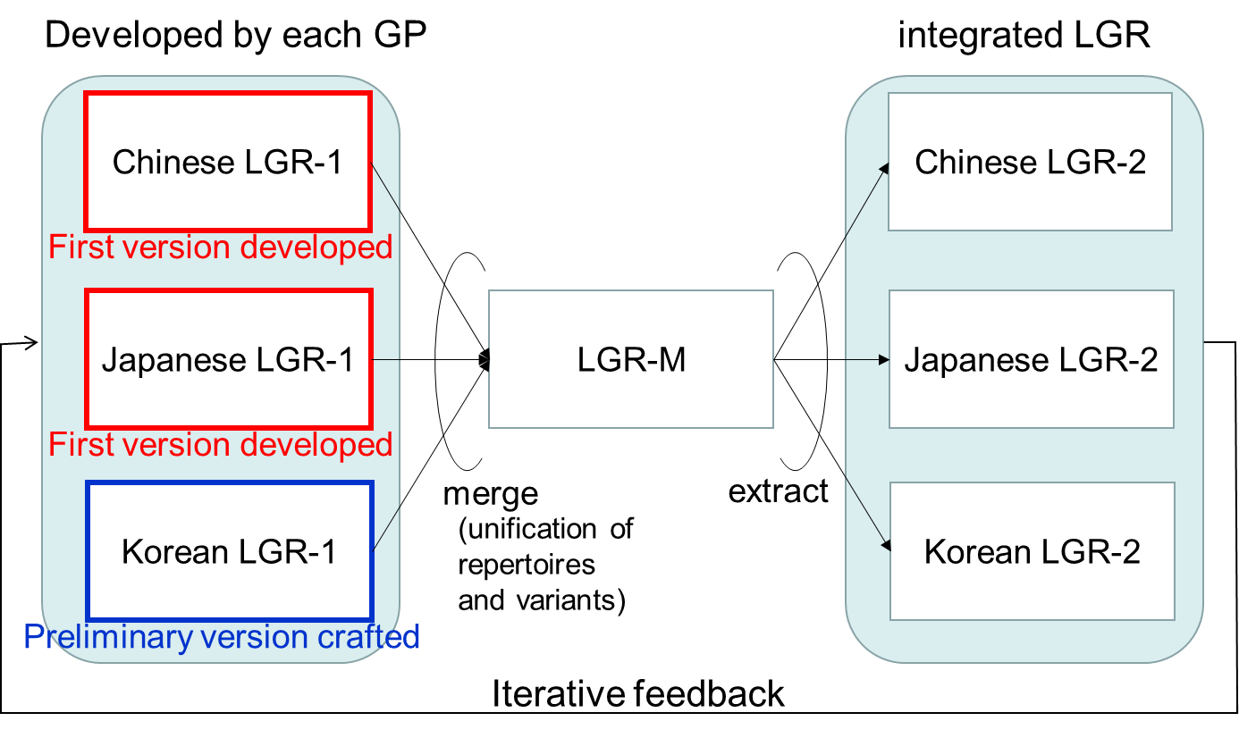
MSS >> CGP LGR-1
In June, CGP and JGP input C LGR-1 (MSS) and J LGR-1, got the same output as LGR-2.

Slide 5
MSS to CDNC+(CGP LGR alpha)
197 under review, TBD
In July, CDNC Taiwan meeting urged to add whole CDNC chars into CGP LGR, to reach consistency between the CDNC SLD operation and future TLD operation.
The 7107 added chars do not conflict with the CGP LGR1 and JGP LGR1, it is a safe extension.
7107 added
12452 confirmed

Slide 6
MSS to CDNC+(CGP LGR alpha)
197 under review, TBD
China mainland, Taiwan and Hong Kong language experts are reviewing 197 chars and their variant chars, this review might change the variant chars setting of 197 chars, and might affect JGP.
This work could be done in Oct.
7107 added
12452 confirmed

Slide 7
The next step: 197 chars review
8262 艢
88B5 袵
894D 襍
8B0C 謌
8F19 輙
945A 鑚
9771 靱
984B 顋
9DC0 鷀
34E4 㓤
3577 㕷
35A1 㖡
35AD 㖭
35BF 㖿
35CE 㗎
35F3 㗳
35FE 㗾
3960 㥠
39F8 㧸
39FE 㧾
3A18 㨘
3A52 㩒
3A67 㩧
3B39 㬹
3DE7 㷧
3DEB 㷫
3E74 㹴
3ED0 㻐
4065 䁥
406A 䁪
40BB 䂻
40DF 䃟
4137 䄷
44EA 䓪
4606 䘆
47F4 䟴
48BC 䢼
65FF 旿
732F 猯
9EB9 麹
4C81 䲁
5227 刧
524F 剏
5605 嘅
6060 恠
6335 挵
656D 敭
681E 栞
7460 瑠
74A2 璢
74C8 瓈
750E 甎
754A 畊
7ADA 竚
The three parties haven't reached consensus on 102 chars, to treat them as independent chars or variant related chars?

Slide 8
The next step: coordination
K LGR
197 chars re-coordinate with JGP.
KGP provided K-LGR v0.3 in September, CGP has not compare C-LGR and K-LGR. We will do it after 197 review and re-coordination of C and J.

Slide 9
Thanks
Q&A

