Slide 1
GDD Update to GNSO
ICANN 54 – Dublin
18 October 2015

Slide 2
Discussion Topics
Program Reviews Status
Policy Implementation Pipeline & Status Update
Feedback & Discussions

Slide 3
Update on New gTLD Program Reviews
GNSO Working Session | 18 October 2015

Slide 4
CCT Review
Competition, Consumer Choice & Consumer Trust (CCT)
Review
GNSO & ALAC-Recommended Metrics
Consumer and registrant surveys
Economic study open for public comment
Program Implementation Reviews
Operations team’s perspective
Published, open for public comment
Rights Protection Mechanisms
Review published incl. public comments
Notes:
Took out TMCH review – note this is a separate effort from CCT review

Slide 5
New since ICANN53
Updated Rights Protection Mechanisms Review (incorporating public comments) published 11 Sep 15
Draft Program Implementation Review published 23 Sep 15
  Open for public comment until 7 Dec 2015
Phase 1 of Registrant Survey published 25 Sep 15
  Phase 1 of economic study on competition in DNS published 28 Sep 15
    Open for public comment until 7 Nov 15
Call for Volunteers for CCT Review Team published 1 Oct 15
  Open for submissions until 30 Oct 15
Currently completing RFP processes to retain qualified providers to conduct Trademark Clearinghouse Independent Review and Root Stability Study
Notes:
Edited to use fewer words

Slide 6
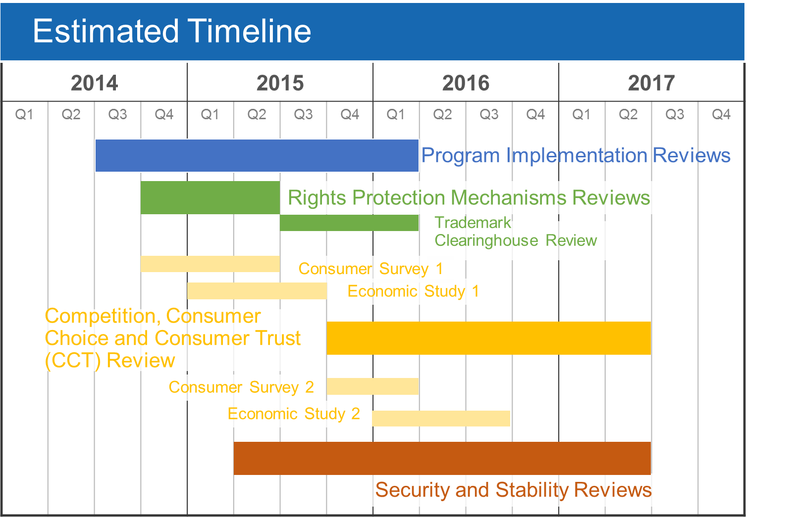
Estimated Review Timeline
Notes:
Use this slide for diagrams or other graphic elements.

Slide 7
Sessions at ICANN54
Day | Session | Time | Location
Monday | New gTLD Program: Reviews & Related Activities | 14:00 | Liffey A
Monday | New gTLD Program: Program Implementation Review Report | 17:00 | Liffey A
Tuesday | Root Stability Study Workshop | 13:00 | Ecocem
Wednesday | CCT Review: Survey & Data Workshop | 08:00 | Wicklow MR3
Notes:
Add links for these sessions

Slide 8
Policy Implementation Pipeline & Framework
Notes:
Breakup your presentation, divide it into sections. This is especially useful if most of your presentation is text.

Slide 9
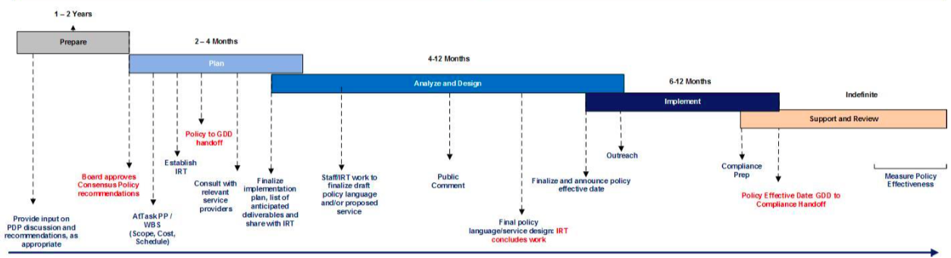
Policy Implementation Pipeline: Framework
Implementation status page available: https://www.icann.org/policy/implementation
Policy Implementation Framework:
Notes:
Have everyone introduce themselves and which project or aspect of the CPIF they’re involved with (Caitlin and Fabien been following)

Slide 10
Policy Implementation Pipeline: Project Status
Inter-Registrar Transfer Policy (IRTP) C
  24 September 2015: Move to “Implement” phase announced
  Projected effective date: 1 August 2016
IRTP D
  Analysis and Design phase
  Projected effective date: January 2017
IGO/INGO Protections
  Planning phase, moving into Analysis and Design
  Projected effective date: July 2016
Thick Whois
  Analysis and Design phase
  Projected effective dates:
    July 2016: Consistent Labeling and Display
    December 2016 – July 2017: Transition from Thin to Thick
Translation and Transliteration of Contact Information
  28 September 2015: Board approved GNSO Council recommendations to develop implementation plan
  “Prepare” to “Planning” transition underway (currently determining project lead)
  Projected effective date: January 2017
Notes:
Put these in order of closest to completion—done 10/12/15 BA

Slide 11
IRTP C Implementation Update
IRTP C
Change of Registrant Policy + FOA Expiration
Key policy changes:
  Registrars obtain consent from New and Prior Registrants during Change of Registrant process
  Inter-registrar transfers blocked for 60 days following change to Registrant
  (unless Registrant opted out of the lock)
  Form of Authorization to expire after 60 days
Announced 24 September 2015
Effective 1 August 2016
Notes:
This slide can be used for text, graphics or any other elements.

Slide 12
IRTP D Implementation Update
IRTP D
Amendments to Transfer Dispute Resolution Policy
Key policy changes:
  enhance reporting by providers & ICANN
  extend the TDRP statute of limitations to 12 mos.
  eliminate registry-level TDRP dispute resolution
Additionally:
  GNSO Council-convened panel to review efficacy IRTP amendments
Current Status:
  IRT has met and discussed all policy changes
  Proposed TDRP and Transfer Policy amendments submitted for public comment shortly after ICANN54
Notes:
This slide can be used for text, graphics or any other elements.

Slide 13
Thick Whois Policy Implementation
Background
Policy Recommendations adopted by the ICANN Board on 7 February 2014
http://www.icann.org/en/groups/board/documents/resolutions-07feb14-en.htm#2.c
Two expected outcomes (policy recommendation #1)
  Transition from thin to thick WHOIS for .COM, .NET and .JOBS
  Consistent labeling and display for all gTLDs per Spec 3 RAA 2013
Decoupling of implementation of the two outcomes in line with Implementation Considerations (Final Report of Thick WHOIS PDP)

Slide 14
Thick Whois Policy Implementation
Status of Consistent Labeling & Display for all gTLDs (CL&D)
Staff completed an Impact Assessment, reviewed by the IRT
Staff and IRT agreed on synchronization of Implementation with RDAP
Staff will discuss Consensus Policy Language with IRT during ICANN 54
Policy Effective date (current assumption): 1 February 2017
Status of Transition from thin to thick for .COM, .NET & .JOBS
Staff released the Legal Review Memo on 8 June 2015 (Review of Law Applicable to the Transition of Data from a Thin to Thick Model)
Staff has started consulting with the IRT and Experts from Affected Parties on implementation details
Staff is currently drafting implementation proposals for further discussion

Slide 15
IGO/INGO Identifiers Protection Policy Implementation
Background
Recommendations adopted in part by the ICANN Board on 30 April 2014
https://www.icann.org/resources/board-material/resolutions-2014-04-30-en#2.a
Current effort focusing on implementation of protections at top and second level for:
  Red Cross Red Crescent Movement Scope 1 identifiers
  IOC Identifiers
  IGOs Scope 1 Identifiers (Full Names)
  INGOs Identifiers (ECOSOC General and Consultative Lists)
Other GNSO Recommendation are part of the reconciliation effort underway between the Board, the GAC and the GNSO.

Slide 16
IGO/INGO Identifiers Protection Policy Implementation
Current Status
Staff has gathered and started working with a GNSO Implementation Review Team (IRT)
Staff will be seeking additional participants form relevant GNSO constituencies (in particular Registries, Registrars and NCSG)
Work is currently focusing on
  Drafting Procedures for protections at the top and 2nd levels
  Gathering IGO Identifiers data (translations as afforded by Policy)
  Gathering INGO Identifiers and contact data
Staff will meet with the IRT during ICANN 54
Policy Effective date (current assumption): 1 February 2017

Slide 17








Thank you
Please contact Brian Aitchison or Karen Lentz with questions:
brian.aitchison@icann.org
karen.lentz@icann.org
twitter.com/icann
gplus.to/icann
facebook.com/icannorg
weibo.com/ICANNorg
linkedin.com/company/icann
flickr.com/photos/icann
youtube.com/user/icannnews
slideshare.net/icannpresentations
Notes:
You can adjust the email/web address to whichever email or web address is best suited to your presentation. This should be your final slide.

