Slide 1
IDN Variant TLD Implementation
IDN Program Update to GNSO
Sarmad Hussain,
Director IDN Program
ICANN 63
21 October 2018

Slide 2
Objectives of This Presentation
Understand IDN variant top-level domains (TLDs) and their status
Review proposed recommendations for managing IDN variant TLDs
Summary of analysis with possible impact on gTLD policy and procedures
Overview of the next steps

Slide 3
Understanding IDN Variant TLDs and Their Current Status
IDN Variant TLD Implementation

Slide 4
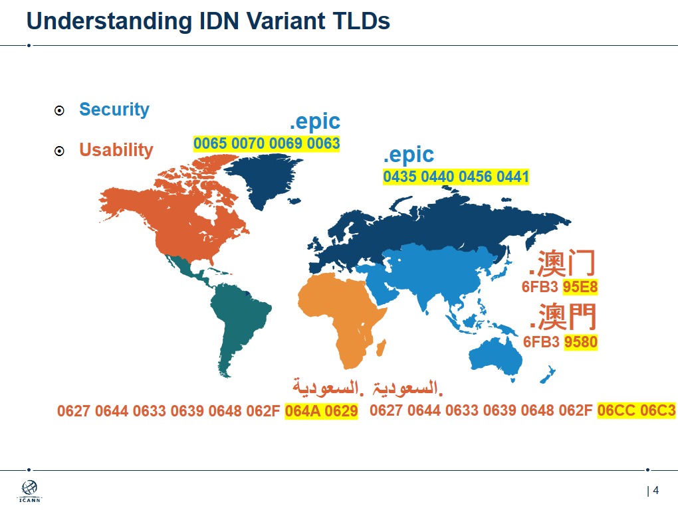
Understanding IDN Variant TLDs
Security
Usability
.epic
0065 0070 0069 0063
.еріс
0435 0440 0456 0441
.澳门
6FB3 95E8
.澳門
6FB3 9580
السعودية.
السعودیۃ.
0627 0644 0633 0639 0648 062F 064A 0629
0627 0644 0633 0639 0648 062F 06CC 06C3
Notes:
Variants = “same” as perceived by the community
Types of variants – visually identical, simplified vs. traditional, stylistic variations
Many other languages, across the world – Latin, Greek, Cyrillic, Arabic, Chinese, Korean, Telugu, Kannada, Devanagari, Gurmukhi, Khmer
Need variants for two reasons – security and usability

Slide 5
Status of IDN Variant TLDs – Background
Variant labels are hard - interpretation of “same” varies across script
On 25 September 2010, the ICANN Board resolved:
  “No variants of gTLDs will be delegated through the New gTLD Program until appropriate variant management solutions are developed.”
Undertook studies on Arabic, Chinese, Cyrillic, Devanagari, Greek, and Latin scripts in 2011 to understand the variant phenomenon
Issues collated in the Integrated Issues Report, IIR (2012) - identified following gaps:
  No definition of IDN variant TLDs
  No IDN variant TLD management mechanism

Slide 6
Status – Definition of Variants
Gap 1: No definition of IDN variant TLDs
  Solution: Define variant labels using Root Zone Language Generation Rules (RZ-LGR)
  Next steps: RZ-LGR-Study Group initiated to review technical implementation
SECURE AND STABLE RESULTS:
INVALID TLD LABEL
LGR Tool
Ethiopic
VALID TLD LABEL
ALL VARIANTS:
Applied-for TLD: t1
ግዕዝ
{
Thai
t1v1
t1v2
t1v3
t1v4
Arabic
ไทย
العربیة
{
Existing TLD: t1
…28
scripts
RZ-LGR
ALLOCATABLE
BLOCKED

Slide 7
Status – Variant Management Mechanism
Gap 2: No IDN variant TLD management mechanism
Solution: ICANN org to work with the community to develop a feasible mechanism
  Recommendations developed by ICANN org
  Recommendations presented to ICANN Board on 22 June 2018
  Recommendations released for public comment on 25 July

Slide 8
Recommendations
IDN Variant TLD Implementation

Slide 9
Framework of Analysis
Dimension
  Root Zone
  Second Level
  Subordinate Zones
Level
  Administrative – who is the entity registering the label
  Policy – what are the conditions on registering the label
  Technical implementation – how are the conditions implemented
Degree
  None – no condition specified
  Minimal – a single constraint
  Intermediate – multiple constraints
  Maximal – complete specification

Slide 10
Overview of Proposed Solution
 | Administrative | Policy | Implementation
Root Zone | Intermediate | Intermediate | Minimal
Second Level | Intermediate | Intermediate | None
Subordinate Zones | None | None | None

Slide 11
Recommendations for IDN Variant TLD Implementation
Root Zone Label Generation Rules (RZ-LGR) the only source for valid TLDs and their variant labels
SECURE AND STABLE RESULTS:
INVALID TLD LABEL
LGR Tool
Ethiopic
VALID TLD LABEL
ALL VARIANTS:
Applied-for TLD: t1
ግዕዝ
{
Thai
t1v1
t1v2
t1v3
t1v4
Arabic
ไทย
العربیة
{
Existing TLD: t1
…28
scripts
RZ-LGR
ALLOCATABLE
BLOCKED

Slide 12
Recommendations for IDN Variant TLD Implementation
Variant TLDs allocated to same entity: {t1, t1v1, …}
TLD Applicants
t = top-level domain label
v = variant label
.t2
.t3
.t2v1
.t1
.t2v2
.t1v1

Slide 13
Recommendations for IDN Variant TLD Implementation
Same label under variant TLDs registered to the same entity: s1.t1 and s1.t1v1
Registrants
t = top-level domain label
s = second-level domain label
v = variant label
s1.t1
s1.t1v1

Slide 14
Recommendations for IDN Variant TLD Implementation
Second-level variant labels under variant TLDs registered to the same entity: s1.t1, s1v1.t1, s1.t1v1 and s1v1.t1v1
Registrants
t = top-level domain label
s = second-level domain label
v = variant label
s1 .t1
s1v1.t1
s1 .t1v1
s1v1.t1v1

Slide 15
Recommendations for IDN Variant TLD Implementation
Variant labels allocatable or activated under variant TLDs not necessarily same
Registrants
t = top-level domain label
s = second-level domain label
v = variant label
s1 .t1
s1v1.t1
s1 .t1v1
s1v1.t1v1

Slide 16
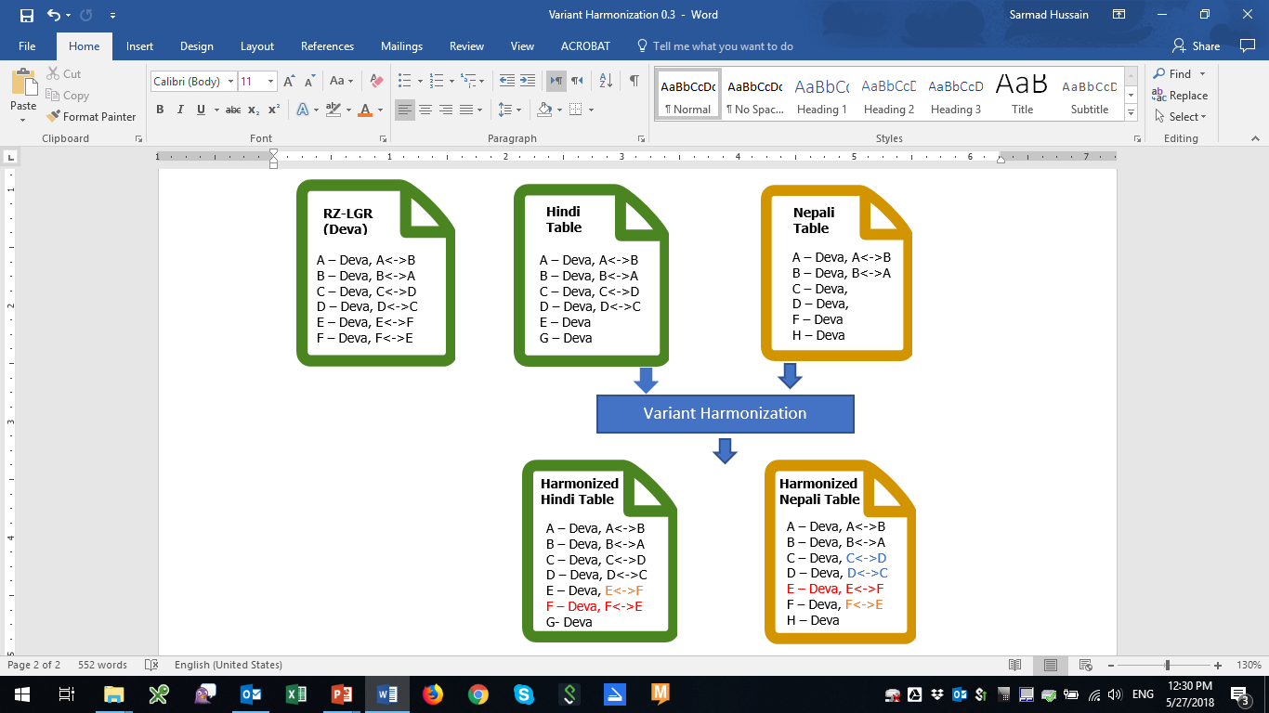
Recommendations for IDN Variant TLD Implementation
Second-level IDN tables under variant TLDs harmonized
Reference t1 t1v1
Hindi and Nepali languages
written in Devanagari script

Slide 17
Recommendations for IDN Variant TLD Implementation
Variant TLDs operated by same registry service providers
TLD Applicants
RSP
.t2
.t3
Registry Service Provider
.t2v1
.t1
.t2v2
.t1v1

Slide 18
Recommendations for IDN Variant TLD Implementation
Variant TLDs deployed at same nameservers
  unless need for different nameservers explicitly justified
TLD Applicants
RSP
.t2
.t3
NS1
.t2v1
.t1
NS2
NS3
.t2v2
.t1v1

Slide 19
Recommendations for IDN Variant TLD Implementation
Existing policies and procedures updated to accommodate these recommendations
All other existing top-level and second-level policies apply, unless identified otherwise
…
IDN ccTLD Fast Track
IDN ccTLD Policy
New gTLD Policy
IDN Guidelines

Slide 20
Summary of Proposed Solution
 | Administrative | Policy | Implementation
Root Zone | Rec.2 Variant TLDs allocated to same entity: {t1, t1v1, …} Rec.7 Variant TLDs operated by same registry service providers | Rec.1 Root Zone Label Generation Rules (RZ-LGR) the only source for valid TLDs and their variant labels | Rec.8 Variant TLDs deployed at same nameservers - unless need for different nameservers explicitly justified
Second Level | Rec.3 Same label under variant TLDs registered to the same entity: s1.t1 and s1.t1v1 Rec.4 Second-level variant labels under variant TLDs registered to the same entity: s1.t1, s1v1.t1, s1.t1v1 and s1v1.t1v1 | Rec.5 Variant labels allocatable or activated under variant TLDs not necessarily same Rec.6 Second-level IDN tables under variant TLDs harmonized | None
Subordinate Zones | None | None | None
Additional Root Zone and Second Level
Rec.9 Existing policies and procedures updated to accommodate these recommendations
Rec.10 All other existing top-level and second-level policies apply, unless identified otherwise

Slide 21
Analysis of the Impact of Recommendations
IDN Variant TLD Implementation

Slide 22
Restricting the Number of Delegated Variant TLDs
Possible to delegate too many variant TLDs
  IDNA 2008, RFC 6912, User Experience Study, SAC 60 and Integration Panel call to minimize allocated variant TLDs
For gTLDs
  Application fee sufficient barrier?
  Detailed analysis in Appendix 3 of the published report
    E.g. all characters in a label from a single language
  Update gTLD Applicant Guidebook accordingly

Slide 23
Adjustments in Registry Services
s1 and any variant s1v1, e.g. s1.t1, s1.t1v1 s1v1.t1, s1v1.t1v1, etc., registered to same registrant
Define mechanism to determine same registrant, e.g. use ROID
Registrar transfer should involve all variant labels at the same time
Harmonize second level IDN Tables across all IDN variant TLDs
Easier to manage if variants registered through the same registrar

Slide 24
Adjustments in Registry Agreements
Separate registry agreement (RA) for each IDN variant TLD being delegated
All variant TLD agreements with the same entity
All registry agreements requiring same Registry Service Provider (RSP)
Amend existing TLD agreement to incorporate recommendations and tie with other variant TLDs being delegated
All RAs for each IDN variant TLDs requires provision that follows same process
  s1 and s1v1 etc. will be registered to same registrant under all variant TLDs
  Second level IDN Tables across all variant TLDs harmonized
  Registry Transition Process and Change of Control
  EBERO for any one in the set must trigger EBERO for all variant TLD

Slide 25
Adjustments in Registration Dispute Resolution
Decisions regarding registration changes for one domain label under a TLD have impacts on:
  Registration of the label and all its variant labels under the TLD
  Registration of the label and all its variant labels under all the variant TLDs
UDRP decision cannot break the same entity – so change for s1.t1 impacts s1.t1v1, s1v1.t1, s1v1.t1v1, etc.
  Transfers of registered label and its variant labels under all variant TLDs
URS not impacted (possibly: webpage updated for s1 under all activated TLD variants)
PDDRP, if it reassigns a TLD, will trigger it for all variant TLD withheld and delegated

Slide 26
Adjustments in String Similarity Review
Process modified to compare a label with
  All delegated or applied­ for strings
  All reserved labels
  All (allocatable and blocked) variants of the above categories
Only compare applied-for label, not all its variants, at the time application
Contention process updated to address collisions with existing labels and their variants

Slide 27
Unaffected Policies and Procedures
Data escrow
RZ-LGR procedures
Domain name life cycles
Two-character rule (ISO 3166 based ccTLDs)

Slide 28
Next Steps
IDN Variant TLD Implementation

Slide 29
Next Steps Leading to the ICANN Board Decision
June 2018 - ICANN org presented the recommendations to ICANN Board
July 2018 - ICANN org released recommendations for public consultation
October 2018 – ICANN org presents recommendations and analysis at a session during ICANN63
January 2019 - Based on community consensus, ICANN org submits the final set of recommendations to ICANN Board for further consideration
March 2019 – ICANN 64 Kobe, Japan - ICANN Board deliberates to adopt the recommendations to forward to ccNSO and GNSO for further consideration

Slide 30






Engage with ICANN
Thank You and Questions
Visit us at icann.org/idn
Email: IDNProgram@icann.org
@icann
linkedin/company/icann
facebook.com/icannorg
slideshare/icannpresentations
youtube.com/icannnews
soundcloud/icann
flickr.com/icann
instagram.com/icannorg

