Slide 1
Registry Models For Safety and Liveness Analysis of the Internet DNS
“All models are wrong, but some are useful” - George E. P. Box, British Statistician
Dr. T V Gopal
Professor
Department of Computer Science and Engineering
College of Engineering, Guindy Campus
Anna University
Chennai – 600 025, INDIA
E-mail: gopal@annauniv.edu
Home Page: https://vidwan.inflibnet.ac.in/profile/57545
Adapted from my earlier presentations without the Associated Mathematics
Proposition: High Degree of Need Based Adaptability in both 2R and 3R Models [Open or Closed] even for the evolving DNS Abuse types.
Ref: ICANN CPWG Meeting 15/16 January 2025

Slide 2
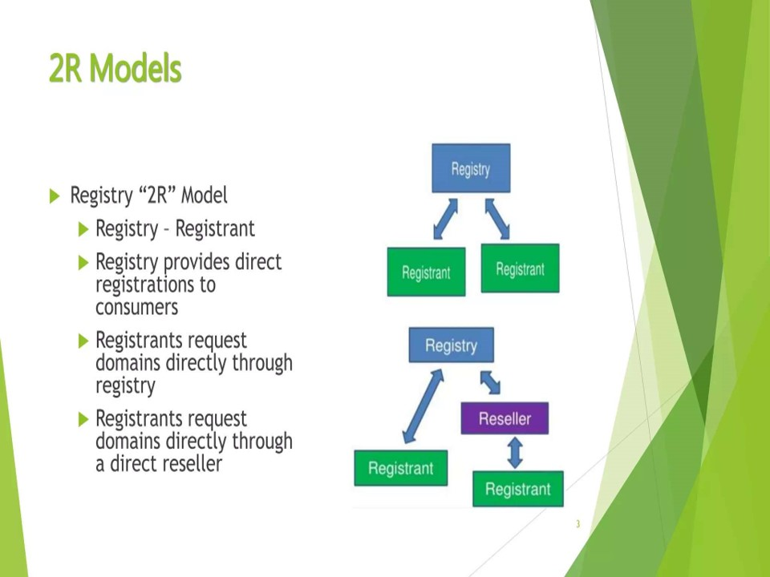
Registry Models for Analysing the Safety and Liveness Properties of Internet DNS
“All models are wrong, but some are useful” - George E. P. Box. British Statistician
Dr. T V Gopal
Professor
Department of Computer Science and Engineering
College of Engineering, Guindy Campus
Anna University
Chennai – 600 025, INDIA
E-mail: gopal@annauniv.edu
Home Page: https://vidwan.inflibnet.ac.in/profile/57545
Excerpted from my earlier presentation without the Mathematics for a Quick Appraisal to ICANN CPWG. Ref: Meeting dated 15 / 16 January 2025
Does Note Scale without Loading the Registry.
Direct Customer Relationship

Slide 3
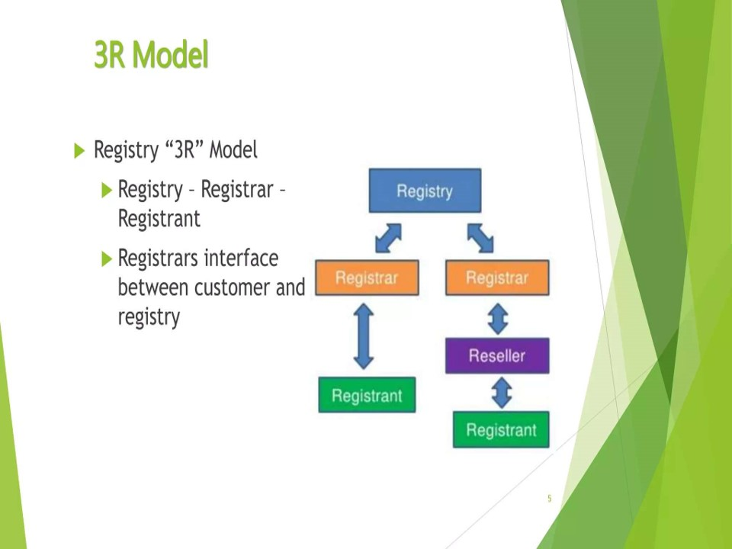
Simple Model to support Multiple Policies and Stakeholders

Slide 4
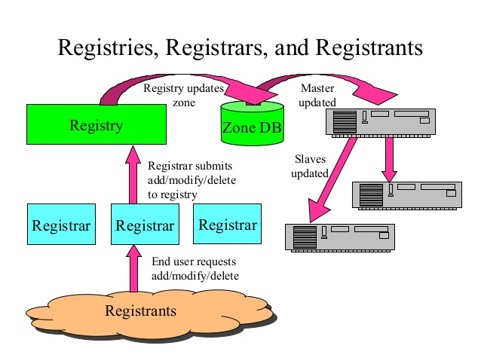
This is no commentary on the Accuracy and Precision of any Data Garnered.

Slide 5
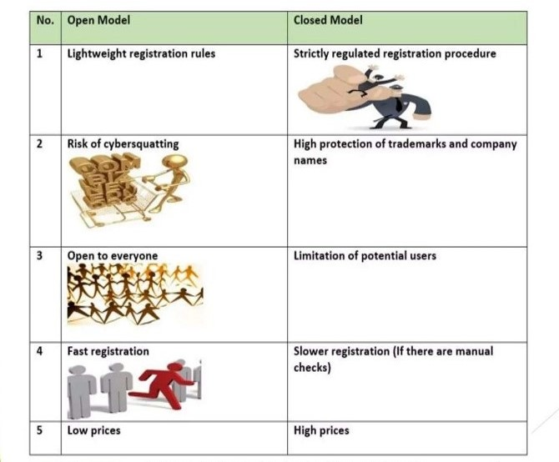
Open and Closed Registry Models
Open Registry:
Anywhere, Anytime & Anyone Registration of Domains
Closed Registry:
Restricted Procedures for Registration of Domains
Note: The Applicant Support Guidebook is more towards CLOSED REGISTRY

Slide 6
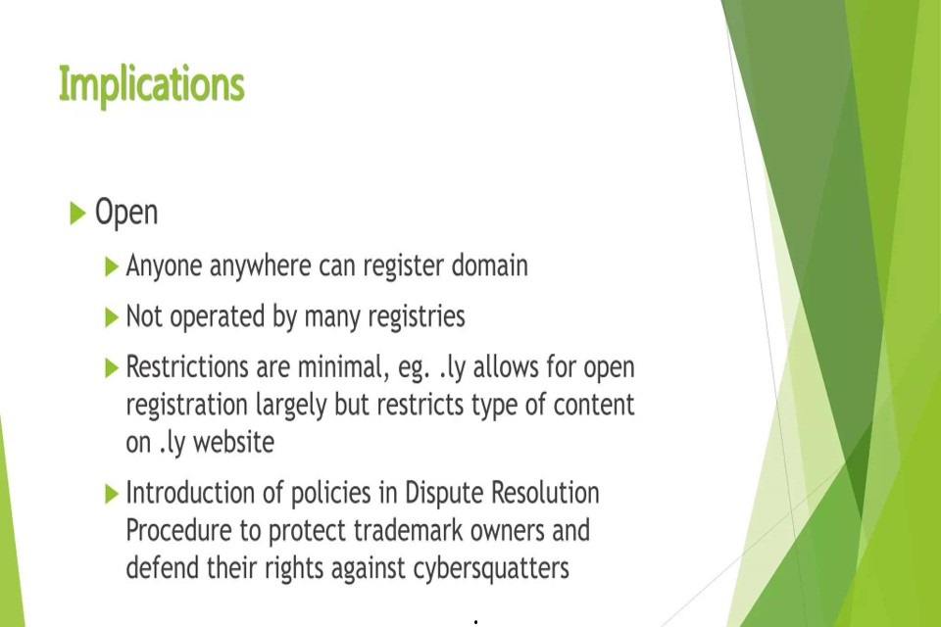

Slide 7
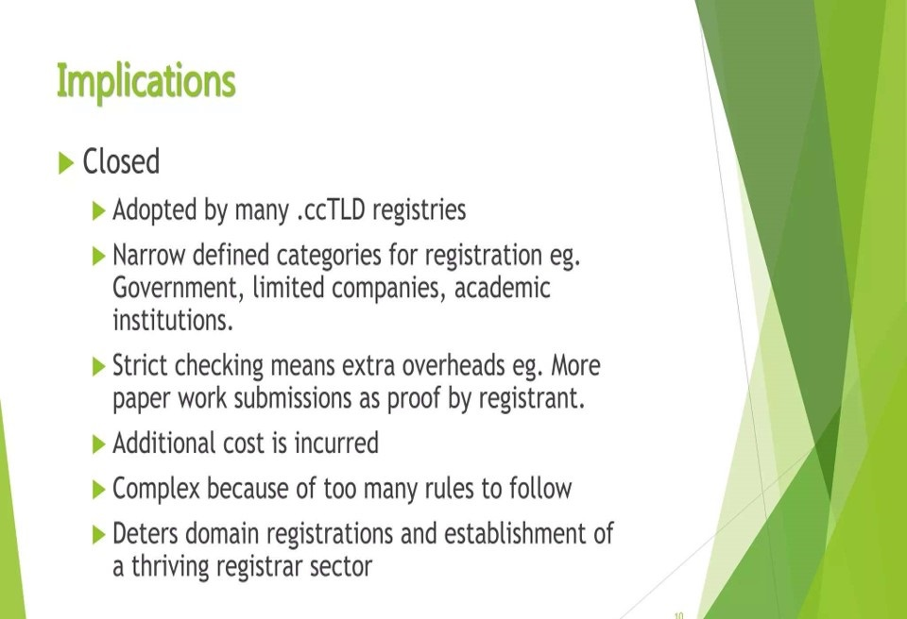

Slide 8
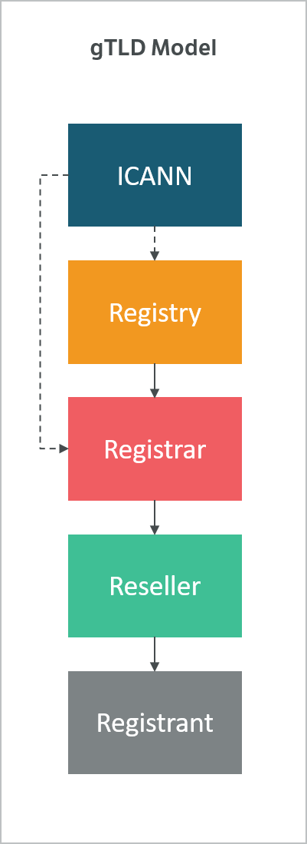

Slide 9
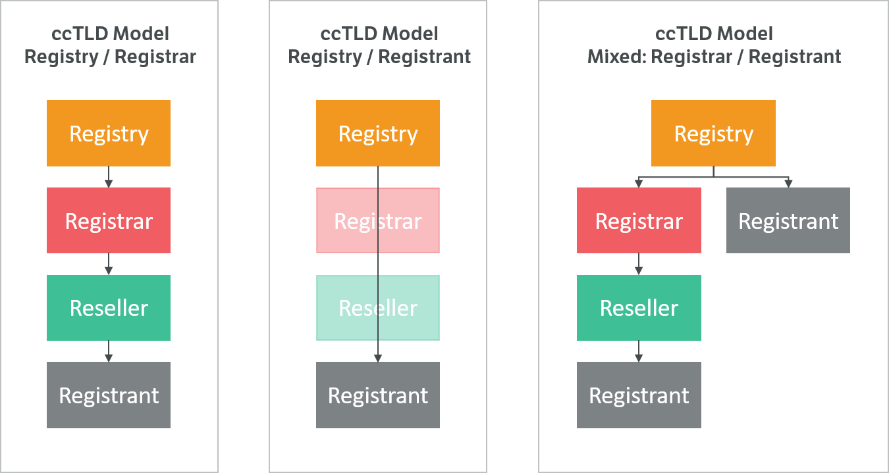

Slide 10
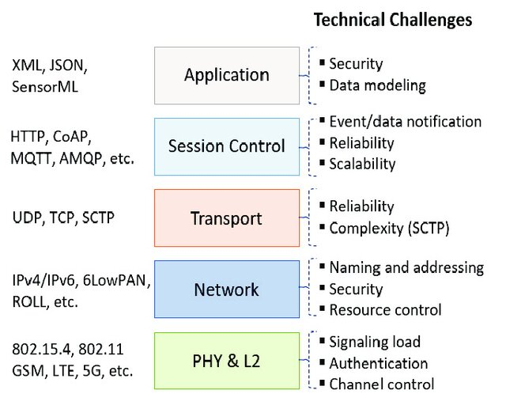
This is the Focus of the Mathematics that is Edited for ICANN

Slide 11
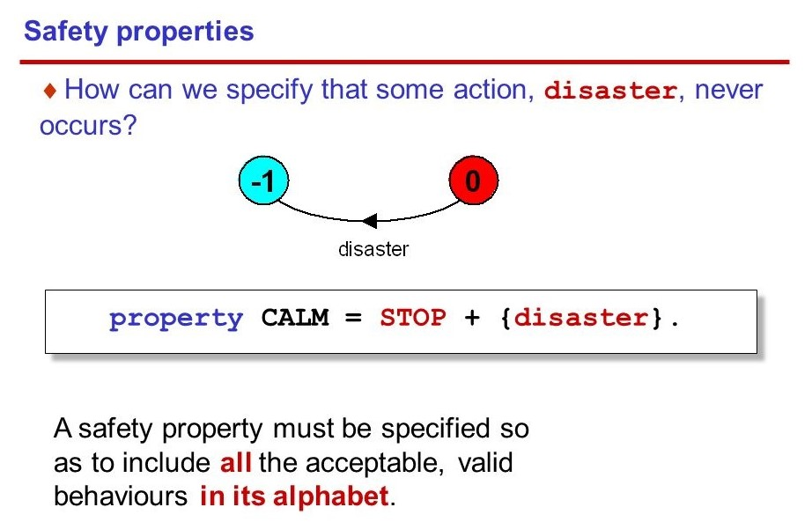

Slide 12
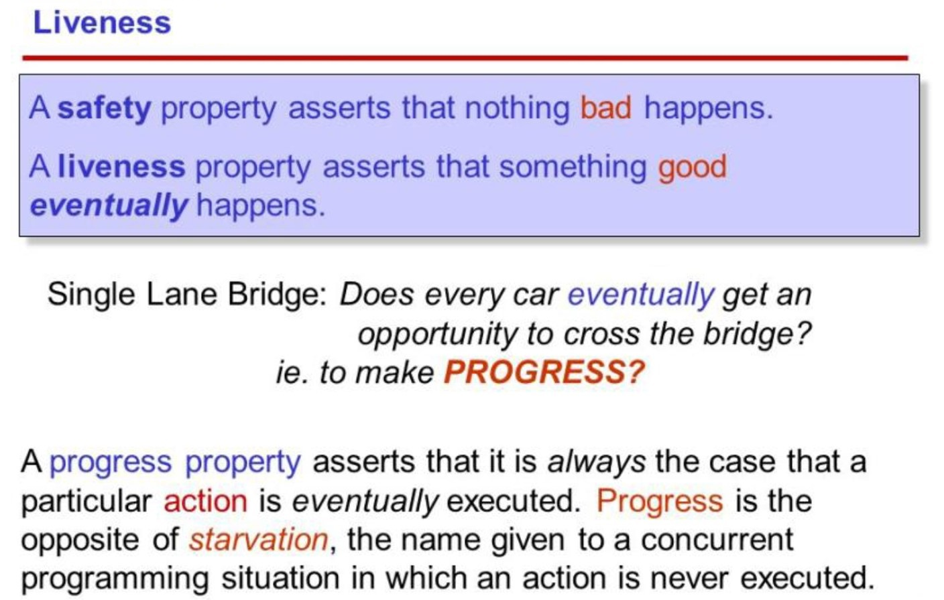

Slide 13
My work moves on into classical theoretical problems such as Producer / Consumer, Readers / Writers and Dining Philosophers to study any Model.
Thank You

