Slide 1



Slide 2
Transition Planning Update
Trang Nguyen | 28 June 2016

Slide 3
Agenda
Opening Remarks (Jonathan Robinson/Lise Fuhr)
Implementation Planning Update (Trang Nguyen)
Q&A
Closing Remarks (Jonathan Robinson/Lise Fuhr)
Notes:
This is a simpler agenda slide, the outline for your presentation.

Slide 4
Opening Remarks
Lise Fuhr and Jonathan Robinson
Notes:
Breakup your presentation, divide it into sections. This is especially useful if most of your presentation is text.

Slide 5
Implementation Planning Update
Notes:
Breakup your presentation, divide it into sections. This is especially useful if most of your presentation is text.

Slide 6
Implementation Planning Timeline – Proposals Delivered in March 2016
Completed
Remaining
 | Nov ‘15 | Dec ‘15 | Jan ‘16 | Feb ‘16 | Mar ‘16 | Apr ‘16 | May ‘16 | Jun ‘16 | Jul ‘16 | Aug ‘16 | Sep ‘16
ICANN
55
ICANN
56
Track 1
Root Zone Management System (RZMS) changes & parallel testing
90%
+40%
10%
Root Zone Maintainer Agreement (RZMA)
95%
+90%
5%
Track 2
Service Level Expectations (SLEs) for Naming Community
75%
+60%
25%
Service Level Agreements (SLAs) with the Number Community
95%
+50%
5%
IETF MoU Supplemental Agreement
95%
+50%
5%
Post-Transition IANA (PTI)
50%
+40%
50%
Root Zone Evolution Review Committee (RZERC)
60%
+55%
40%
Customer Standing Committee (CSC)
70%
+65%
30%
IANA Intellectual Property Rights (IPR)
35%
+25%
65%
IANA Operational Escalation Processes
90%
+80%
10%
Track 3
ICANN Bylaws
✔
+90%
ICANN Articles of Incorporation
50%
50%
Independent Review Process (IRP) Enhancements
5%
95%
Reconsideration Request Enhancements
5%
95%
Empowered Community
5%
95%
Implementation of the post-transition Financial Planning Process
50%
50%
Progress since ICANN 55
Notes:
Look for different ways to display your data or text by using alternatives to simple bullets.
To adjust the number in the arrow to text or another number, click on the text box around the number, revise.
To add an arrow, click on the arrow, ensure the arrow is highlighted, COPY and PASTE and move to the desired placement, or DELETE if there are too many arrows.

Slide 7
PTI Overview
Board
Officers
Staff
5 directors
3 from ICANN or PTI staff
2 by ICANN NomCom
Jonathan Robinson and Lise Fuhr to serve as interim directors
Abide by Conflict of Interest and Code of Conduct
Appointed by PTI Board
PTI President (seconded from ICANN at time of transition)
Treasurer (ICANN direct shared resource)
Secretary (ICANN direct shared resource)
Seconded from ICANN to PTI
After transition, ICANN will work to put in place benefits, systems and processes
Once in place, PTI will be required to offer employment to seconded employees and new hires
Legal Status
Services
Operations
Affiliate of ICANN
ICANN is sole member
Domiciled in California
501(c)(3) tax status
Name
Number
Protocol Parameters
Other current IANA services
At time of transition, resources required to support PTI’s operations and legal status will be provided by ICANN and the cost charged to PTI
PTI Board may review arrangement post transition

Slide 8
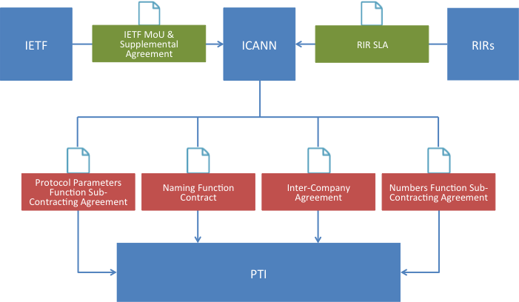
ICANN-PTI Contractual Relationship

Slide 9
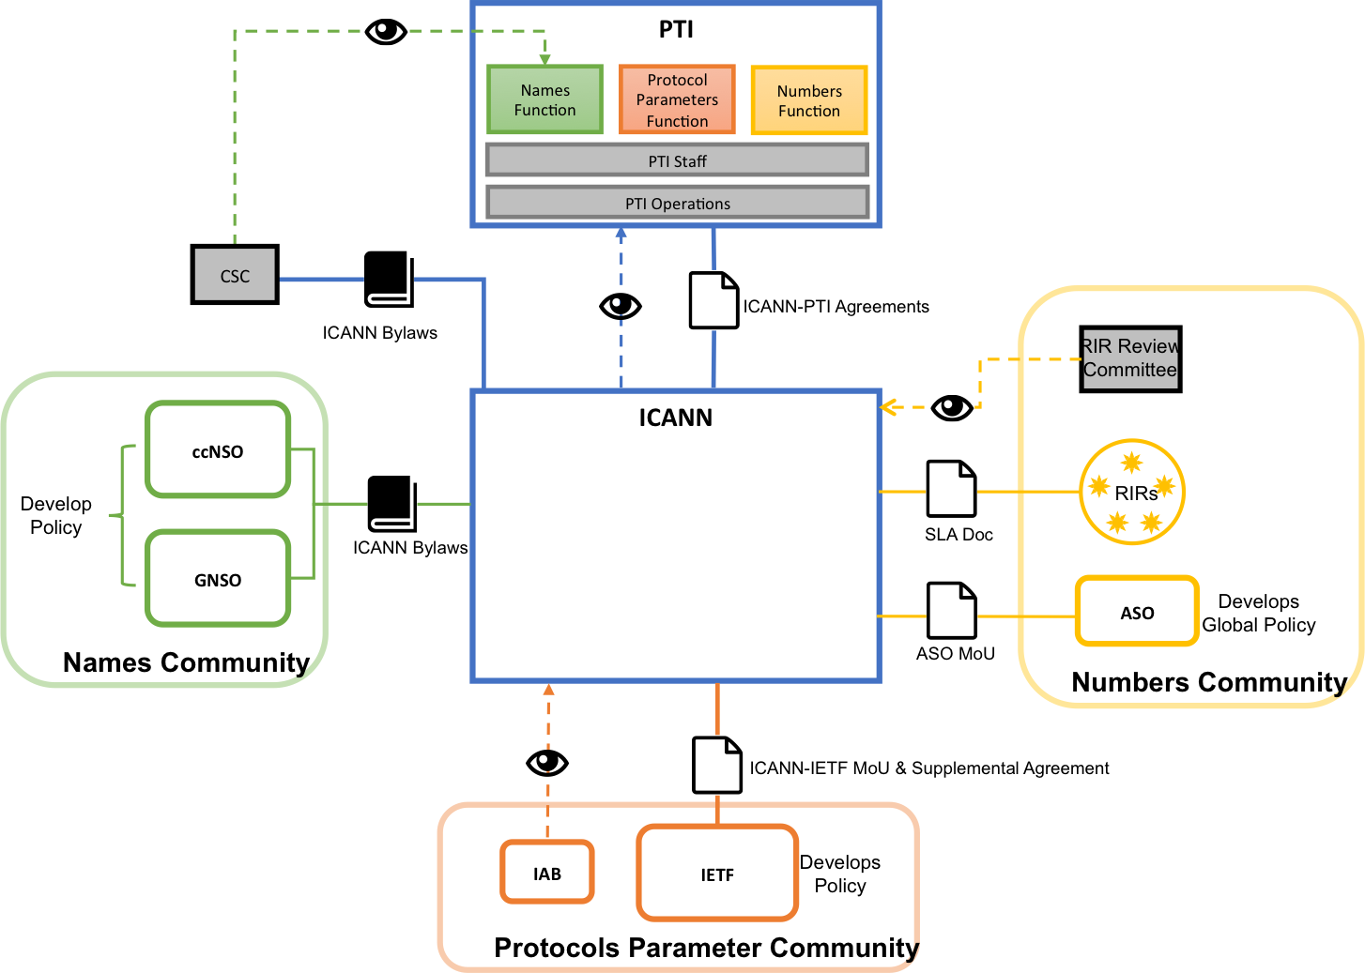
Post-Transition Landscape

Slide 10
Names SLEs
Names SLEs Implementation Phases
Polishing developments
Developing proposal for community review
Proposed performance targets will be shared with CWG’s SLE workgroup in July.
Once they have been agreed upon with the community, SLAs will be included in the ICANN-PTI naming function contract.

Slide 11
Customer Standing Committee (CSC)
Composition
Purpose
Members
  2 ccTLDs
  2 gTLDs
  Optional 1 representative from .ARPA, .MIL, or .GOV
Liaisons
  optional 1 liaison from each organization below:
    GNSO (RrSG or NCPH)
    ALAC
    NRO or ASO
    GAC
    RSSAC
    SSAC
  PTI
Monitor performance of PTI against Names SLAs. May also recommend changes to SLAs.
Undertake actions to address poor performance including escalation to ccNSO and GNSO.
As necessary, propose changes to IANA naming services or operations to enhance the provision of the naming services.
Status & Next Step
1 June 2016: ICANN requested appointment of candidates
22 July 2016: Deadline for appointments
10 August*: ccNSO & GNSO Councils’ final approval of CSC membership composition
*Tentative date
Notes:
Icons or text are editable, change/add to your preference.

Slide 12
Root Zone Evolution Review Committee (RZERC)
Composition
Purpose
ICANN Board
SSAC
RSSAC
ASO
IETF
RySG
ccNSO
RZM
PTI
Review and provide input regarding proposed architectural and operational changes to the root zone.
As determined necessary by the committee, propose architectural and operational changes to the Root Zone for consideration by the ICANN Board.
Act as a consultation body for ICANN during the RFP process for the Root Zone Maintainer, if needed.
Status & Next Step
IOTF reviews Charter
CWG reviews Charter
30-day public comment
ICANN Board approves Charter
ICANN requests appointments
RZERC formed
Notes:
Icons or text are editable, change/add to your preference.

Slide 13
IANA IPR
On-going coordination and collaboration between operational communities
Operational Communities working on finalizing the IANA IPR framework
Contracts will need to be drafted
iana.org operational arrangement and approval processes need to be agreed-to

Slide 14
Engage and Contribute
Public Comment
  Root Zone Evolution Review Committee Charter https://www.icann.org/public-comments/draft-rzerc-charter-2016-06-10-en
  ICANN Restated Articles of Incorporation https://www.icann.org/public-comments/draft-restated-articles-incorporation-2016-05-27-en
Volunteer
  Customer Standing Committee
  https://www.icann.org/en/stewardship-implementation/customer-standing-committee-csc
Participate in, or Follow Discussions
  CWG-Stewardship Mail List cwg-stewardship@icann.org
  Implementation Oversight Task Force (IOTF) Mail List iotf@icann.org
  IANA IPR Mail List iana-ipr@nro.net

Slide 15
Q&A
Notes:
Breakup your presentation, divide it into sections. This is especially useful if most of your presentation is text.

