Slide 1
FY17 Planning – USG Transition
Xavier Calvez | DT-O call | 18 November 2015

Slide 2
USG Transition – Expected OP&B impacts
1
Creation of Post-Transition IANA
New Legal entity, receiving the IANA operations
2
Transfer of IANA Operations into PTI
Assumptions to be established for Personnel, Assets, Systems, …
Costs of all contributing resources to be included in PTI financials
3
Creation of new processes (incl. costs) for IFR, CSC
IFR (IANA Functions Review)
CSC (Customer Standing Committee)
New accountability mechanisms
4
Bylaws writing
Community powers: Operational impacts to be determined
Notes:
Look for different ways to display your data or text by using alternatives to simple bullets.
To adjust the number in the arrow to text or another number, click on the text box around the number, revise.
To add an arrow, click on the arrow, ensure the arrow is highlighted, COPY and PASTE and move to the desired placement, or DELETE if there are too many arrows.

Slide 3
FY17 Planning: approach to PTI/IANA
ICANN
PTI
NOW
IANA Department
+ Shared resources
+ Allocated Overheads
FUTURE
IANA Department
+ Shared resources
+ Allocated Overheads
+ IFR / CSC
BASE CASE
NO CHANGE
Further Separation of indirect and support functions, with high level impacts
ALTERNATIVE

Slide 4
FY17 Planning: approach to PTI/IANA
No LATER than
15 Jan.
No EARLIER than
30 Apr
Assumptions
Separate Legal entity
Direct resources
Shared resources
Overheads allocation
Assets
IFR / CSC processes
PLANNING: Minimum info required
None
Standard IANA department budget
Base: Projects/costs for each contributing dept. Alternative: High-level estimates of cost changes.
High-level estimates
High-level estimates
High-level estimates
IMPLEMENTATION: More detailed mini. info required
Legal form, bylaws, board composition, officers,…
Names, positions, job descriptions, benefits plan, full activity list, SOW, SLE,…
Detailed activity list, full costing details, deliverables and service levels for Management fee agreement,…
Detailed activity list, full costing details, deliverables and service levels for Management fee agreement,…
Detailed asset list, Fair value evaluation (external), Asset purchase agreement,…
Detailed operating processes, membership composition, members names,…

Slide 5
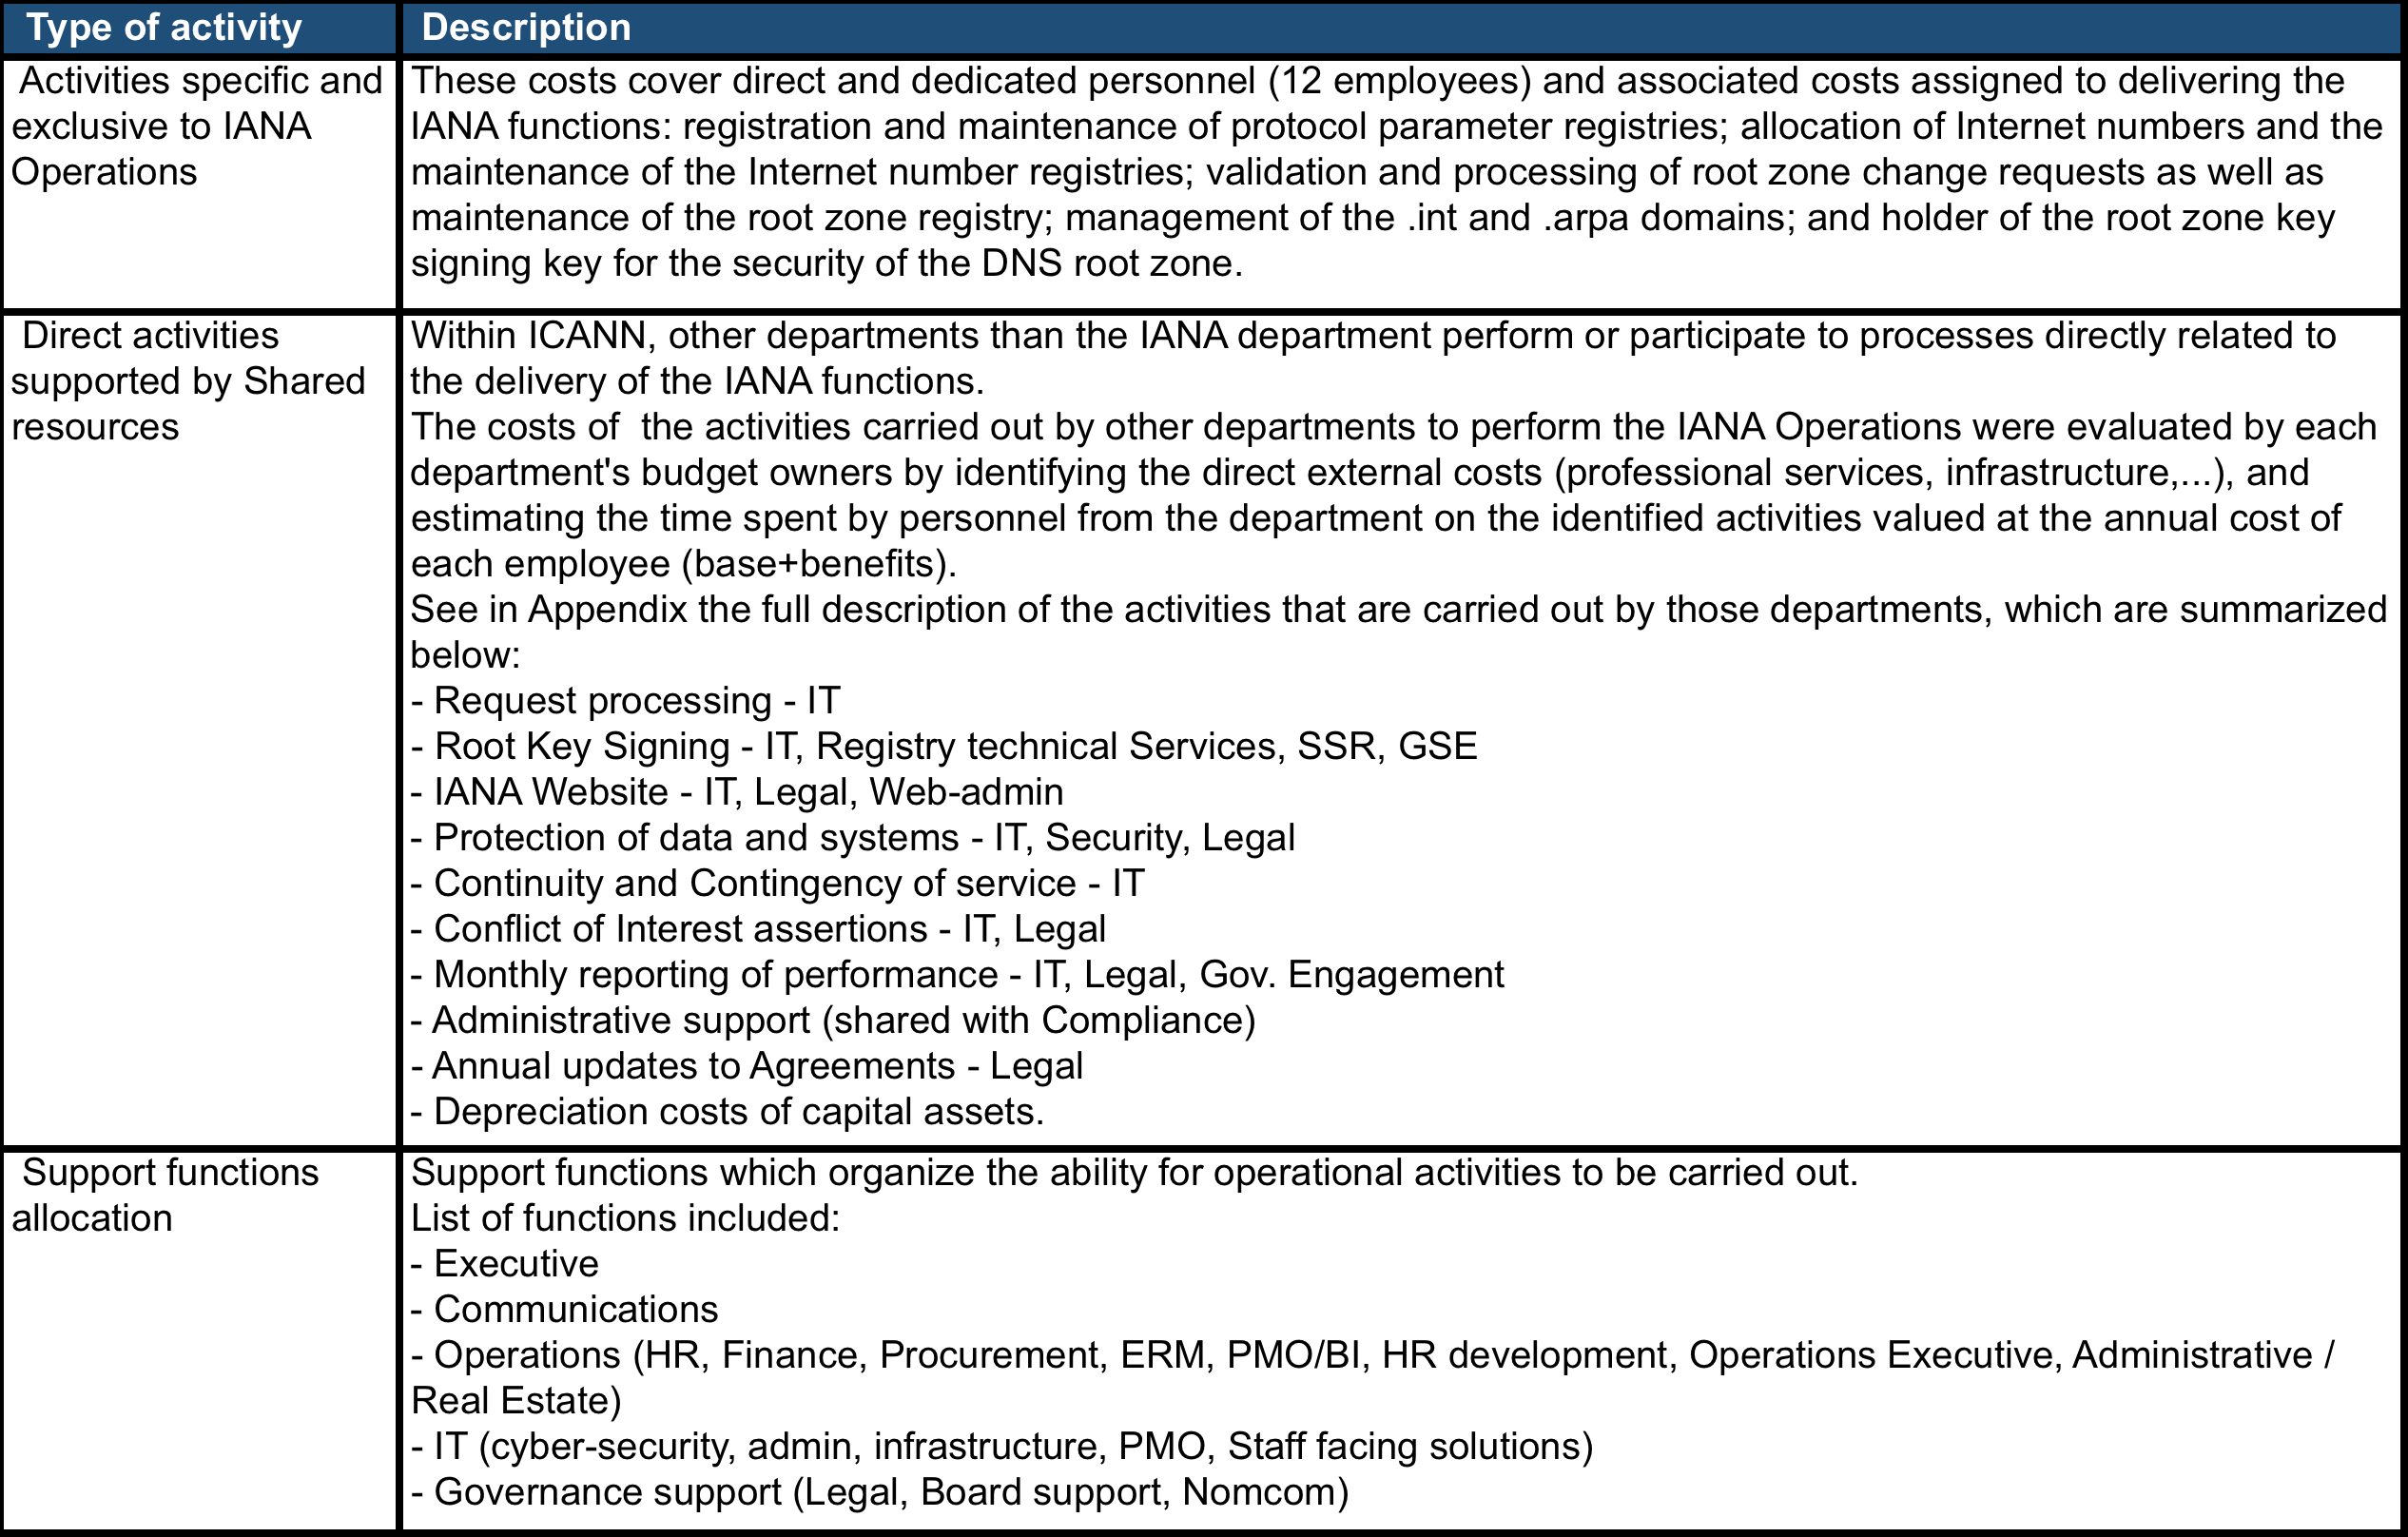
Overview of IANA operations: separated/integrated

