Slide 1
Enhancing ICANN Accountability
Istanbul March, 2015

Slide 2
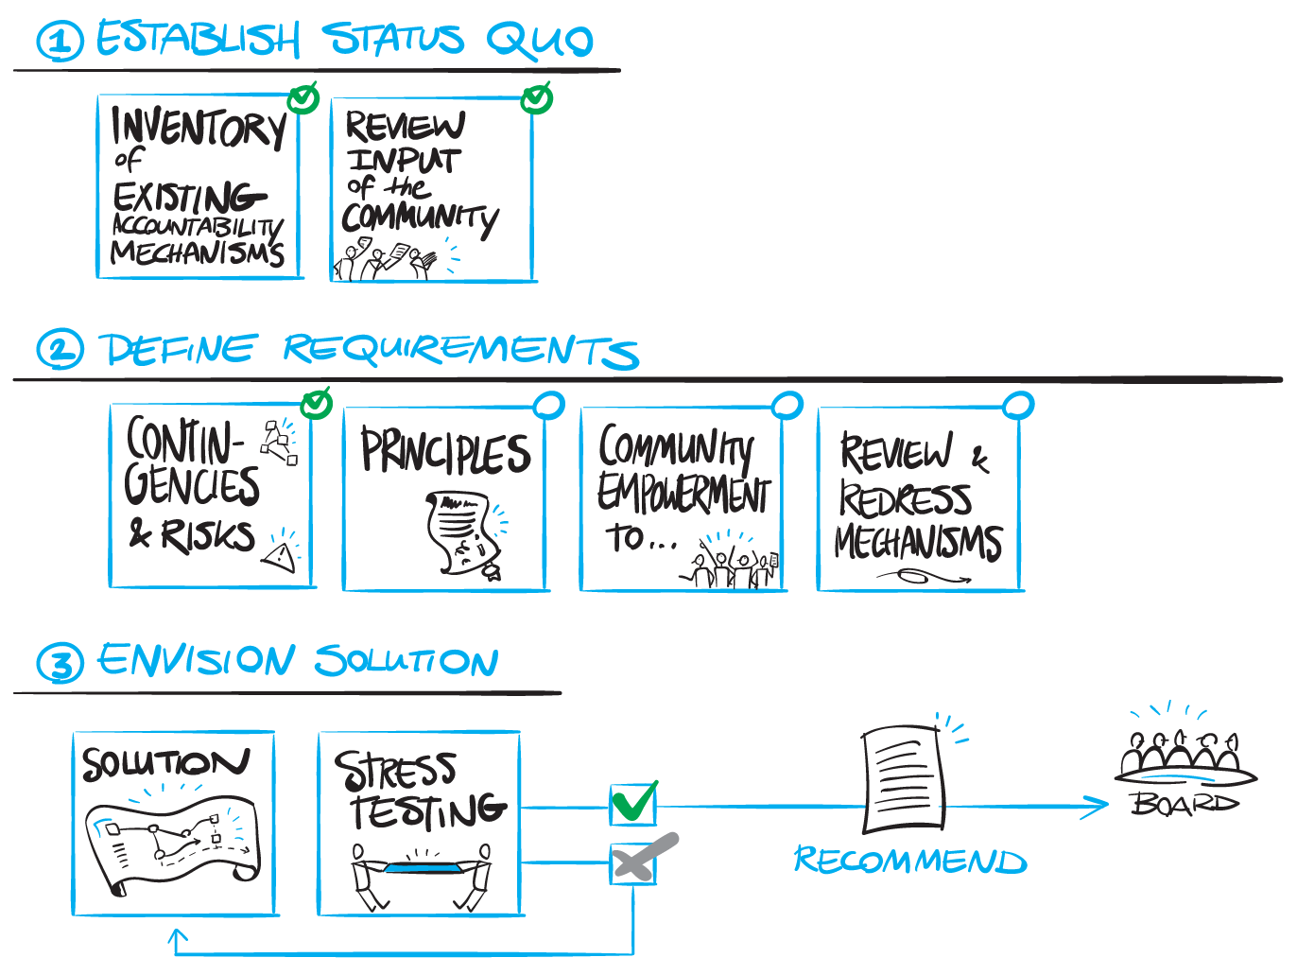
Singapore
Notes:
Use this slide for diagrams or other graphic elements.

Slide 3
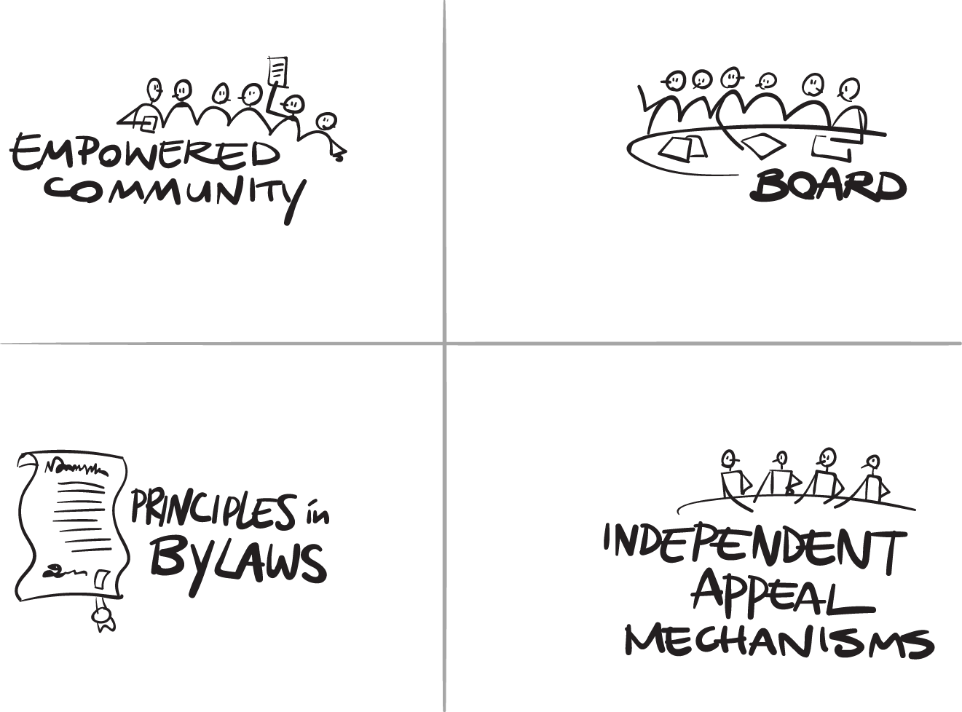


Key components
Notes:
Use this slide for diagrams or other graphic elements.

Slide 4
Powers
Board Removal
Ability to veto or block bylaw changes
Ability to review and return budget for rectification
Power to approve changes to fundamental bylaws
Notes:
Use this slide for diagrams or other graphic elements.

Slide 5
Mechanisms*
Current mechanisms (ATRT, IRP, Ombudsman)
IRP (revamped)
Standing Community Committee
Modifying corporate structure
Community Veto
*Currently work in progress and under consideration
Notes:
Use this slide for diagrams or other graphic elements.

Slide 6
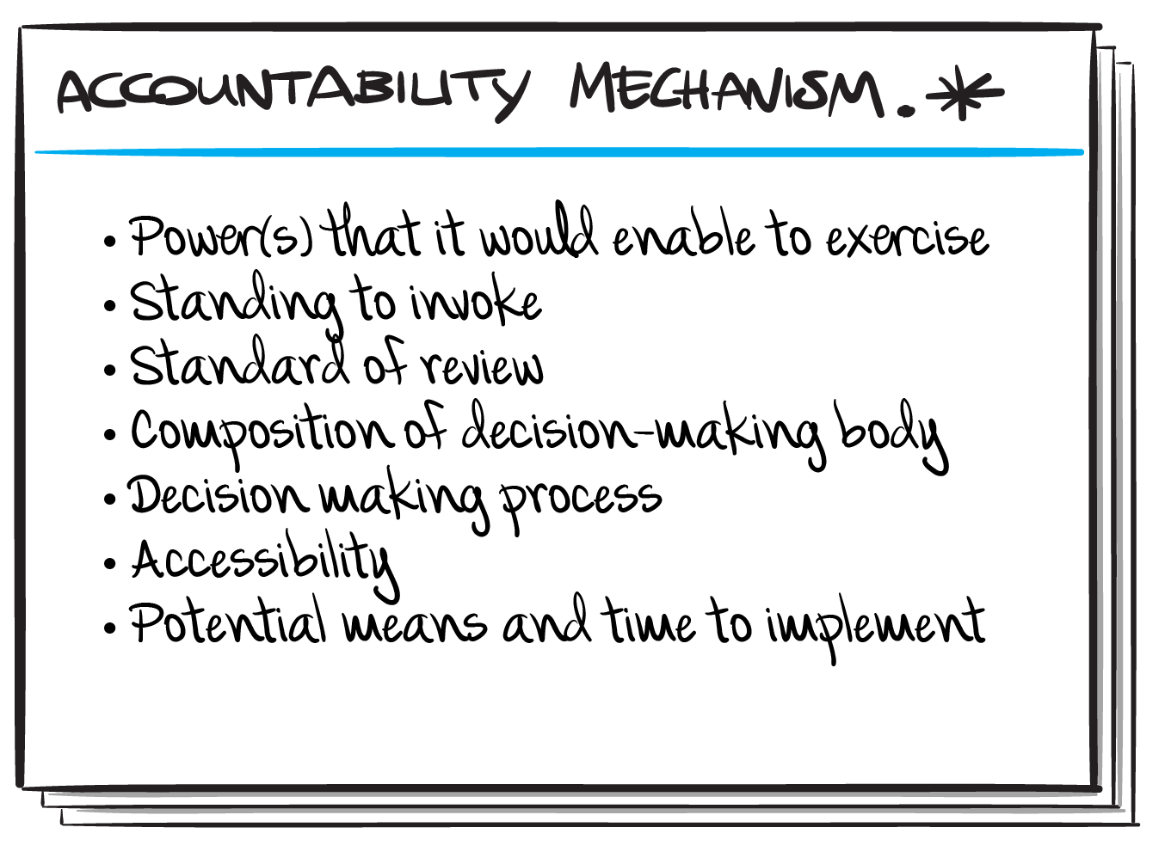
Template for mechanisms
Notes:
Use this slide for diagrams or other graphic elements.

Slide 7
Next steps
Work with legal advisors
Continue to refine mechanisms
Continue to stress test proposals under consideration
Issue a first document for public comment before BA
Notes:
Use this slide for diagrams or other graphic elements.

Slide 8
Follow our Activities!
For more information on scope and membership, to view CCWG-Accountability drafts, activities, to read/listen to meeting archives
Enhancing ICANN Accountability Wiki
https://community.icann.org/category/accountability
Notes:
Use this slide for diagrams or other graphic elements.

