Slide 1
Cyrillic Generation Panel Update
Душан Стојичевић
Dusan Stojicevic
Chair, Cyrillic GP
Notes:
Breakup your presentation, divide it into sections. This is especially useful if most of your presentation is text.

Slide 2
Agenda – Proposal for Cyrillic Script RZ LGR
1
2
3
Introduction and Background
Methodology
Results
4
5
6
Issues in
MSR-2
Next steps
IP Feedback and Discussion
Notes:
This is a stylized agenda slide for your presentation.
To delete a box, if there are too many boxes, click the edge of the box, ensure the entire box is highlighted, then DELETE.
To update the numbers and text, click inside the circle for the numbers or in the box for the text, revise the text.

Slide 3
Introduction – Script of LGR
ISO 15924 Code: Cyrl
ISO 15924 English Name: Cyrillic
Latin transliteration of native script name: Cyrillic
Maximal Starting Repertoire (MSR) version: MSR-2

Slide 4
Background on Script and Principle Languages
Based on Early Cyrillic, from First Bulgarian Empire in 9th century AD
Used for languages across Eastern Europe and north and central Asia
Basis of alphabets in languages, past and present, especially those of Slavic origin, and non-Slavic languages influenced by Russian
Used by more than 250 million people as the official script for their languages, about half from Russia
With the accession of Bulgaria to the European Union in 2007, Cyrillic became the third official script of the European Union, in addition to the Latin and Greek scripts

Slide 5
Background on Script and Principle Languages
Derived from Uncial script, augmented by letters from older Glagolitic alphabet, including some ligatures. Additional letters used for Old Church Slavonic sounds not found in Greek
Named in honor of Byzantine brothers, Saints Cyril and Methodius, who created the Glagolitic alphabet
Believed to be developed by disciples of Cyril and Methodius
Individual languages and groups using Cyrillic script
  Indo-European Caucasian
  Sino-Tibetan Chukchi and Kamchatka
  Mongolian Tungus
  Turkic Ural
  Individual - Aleutian, Nivkhs, Ket, Eskimos, Yukaghir languages

Slide 6
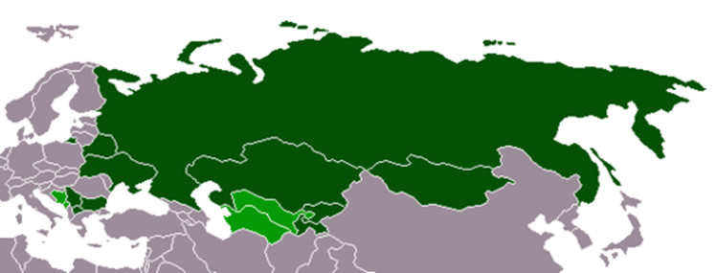
Geographic Territories Spread of Cyrillic
South Eastern part of Europe (Serbia, Montenegro, Macedonia, Bulgaria, Bosnia and Herzegovina)
Eastern Europe (Belorussia, Ukraine, Russia)
Central Asia (Kazakhstan, Turkmenistan, Uzbekistan, Kyrgyzstan, Tajikistan, Mongolia)
 | is the only official orthography
 | is the only official orthography, but others are recognized for national or regional languages

Slide 7
Methodology
According to work plan in the proposal for Cyrillic script GP
Initially language based repertoire compiled, based on second level IDN tables used by different ccTLDs, including the .su ccTLD which contained inventory for languages currently spoken in Russia
Language repertoires collated in a face to face meeting in Istanbul on 25-26 Nov. 2016.
Continued to use the mailing list to share and finalize documents
Consulted with Integration Panel (IP), including on crucial query regarding inclusion of U+02BC MSR for Ukrainian and Belarusian

Slide 8
Development Process – Inclusion Principle
Any code point which is a letter in established contemporary use in a language

Slide 9
Development Process – Exclusion Principles
Any code point DISALLOWED by IDNA 2008 protocol
Any code point representing a security or stability issue, which cannot be resolved at any other stage of the analysis (i.e., stage of determining code points, variants or whole label rules)
Any code point not listed in the MSR or listed in the MSR and deprecated or not recommended for use in Unicode Standard
Any code point representing technical signs only or that does not meet the inclusion criterion

Slide 10
Development Process – Exclusion Principles
The generation panel lacked sufficient information on the usage
The generation panel could only ascertain the use for such languages that had an EGIDS rating higher than five (6 or above), as per the “Guidelines for Developing Script-Specific Label Generation Rules for Integration into the Root Zone LGR”
The generation panel had data on the use of code points, but where Integration Panel explicitly expressed disagreement on the validity and relevance of such data in separate communications

Slide 11
Code Point Repertoire
# | Unicode CP | Glyph | Unicode Name | Lang. using CP | EGIDS value | Ref.
1 | 04EB | ӫ | CYRILLIC SMALL LETTER BARRED O WITH DIAERESIS | Khanty | Khanty 6b | Rule 6 http://www.omniglot.com/ writing/khanty.htm
2 | 04ED | ӭ | CYRILLIC SMALL LETTER E WITH DIAERESIS | Sami | Sami 8b | Rule 6
3 | 04DB | ӛ | CYRILLIC SMALL LETTER SCHWA WITH DIAERESIS | Khanty | Khanty 6b | Rule 6 http://www.omniglot.com/ writing/khanty.htm
4 | 04C2 | ӂ | CYRILLIC SMALL LETTER ZHE WITH BREVE | Gagauz | Gagauz 5 | Rule 5 http://www.omniglot.com/ writing/gagauz.htm Gagauz alphabet not in Cyrillic from 1996
5 | 04CC | ӌ | CYRILLIC SMALL LETTER KHAKASSIAN CHE | Khakas | Khakas 5 | Rule 5 http://www.omniglot.com/ writing/khakas.htm
6 | 04CF | ӏ | CYRILLIC SMALL LETTER PALOCHKA | Khakas | Khakas 5 | Rule 5 http://www.omniglot.com/ writing/khakas.htm
7 | 045D | ѝ | CYRILLIC SMALL LETTER I WITH GRAVE | Historical sign |  | Rule 6
8 | 0450 | ѐ | CYRILLIC SMALL LETTER IE WITH GRAVE | Stressed sign |  | Rule 6
84 code points recommended for inclusion
8 code points recommended for exclusion
(shown in the table)

Slide 12
Cyrillic Script Variants
No variants in Cyrillic script
  Some code points visually confusable
    not considered as variants by the Cyrillic community
    provide table of confusable code points, so organizations can use as needed

Slide 13
Cross-Script Variants
Decided to limit these to homoglyphs
Included code points which are homoglyphs in the lower case but not homoglyphs in the upper case
  Only lower case because upper case disallowed in IDNA 2008
  Decision made in consultation with IP (“the IP, at this point, does not require that upper case homoglyphs are included”)
Cyrillic GP found cross-script variants with:
  Armenian
  Greek
  Latin
Cyrillic GP did not find cross-script variants with Georgian

Slide 14
Cross-Script Variants – with Armenian Script
Armenian GP indicates three (3) variants with Cyrillic script
Opinion of Cyrillic GP that only one (1) homoglyphic variant
Other two (2) not identical, so included in confusables table
Armenian glyph | Armenian code point | Cyrillic glyph | Cyrillic code point
օ | 0585 | о | 043E

Slide 15
Cross-Script Variants – with Greek Script
Cyrillic has three (3) homoglyphic variants with Greek script
Greek glyph | Greek code point | Cyrillic glyph | Cyrillic code point
κ | 03BA | к | 043A
ο | 03BF | о | 043E
φ | 03C6 | ф | 0444

Slide 16
Cross-Script Variants – with Latin Script
Cyrillic has following homoglyphic variants with Latin from MSR-2
  Confusables listed separately
Latin glyph | Latin code point | Cyrillic glyph | Cyrillic code point
a | 0061 | a | 0430
c | 0063 | c | 0441
e | 0065 | е | 0435
o | 006F | о | 043E
i | 0069 | і | 0456
j | 006A | ј | 0458
l | 006C | ӏ | 04CF
p | 0070 | р | 0440
s | 0073 | ѕ | 0455
y | 0078 | у | 0443
x | 0079 | х | 0445
ä | 00E4 | ӓ | 04D3
ë | 00EB | ё | 0451
æ | 00E6 | ӕ | 04D5
ǝ | 01DD | ә | 04D9

Slide 17
Discussion of Issues in MSR-2
Ukrainian and Belarusian languages have “apostrophe” (U+02BC) as a letter – not punctuation sign
  IP response
Montenegro has two new chars in national scripts (Latin and Cyrillic); ccTLD to implement them at second level
  Not yet in Unicode
Old Church Cyrillic script
  Not in second level use, it should not be used for root zone
Using upper case and lower case Unicode code points in Cyrillic as problem of the confusion during visualization
  Need to address that

Slide 18
Timeline
Aug
2014
Dec
2015
Nov
2016
Feb
2017
Mar
2017
Dec
2015
Next steps
Formation of Cyrillic GP
Proposal for the GP for the Cyrillic Script LGR for the Root Zone
Finished
Work on a
Proposal for a Cyrillic Script Root Zone LGR
Proposal for a Cyrillic Script Root Zone LGR
IP Feedback on Cyrillic Script Root Zone LGR
To Summarize
It took Cyrillic GP two and a half years to get to the stage with final proposal. But, the work has been done according to the dates defined in original Working plan
Notes:
To adjust the length and width of the arrow, click on the arrow, grab a corner, and lengthen or shorten, depending on your preference.
To add a bubble, click on the bubble, ensure it is fully highlighted, COPY and PASTE. Then drag the bubble to your preferred placement.
To delete a bubble, click on the bubble, ensuring it is highlighted and click DELETE. If you make a mistake, go to your top bar on PP and click EDIT, UNDO

Slide 19
Next Steps
Short phase (planned for this session)
  Finalize proposal, based on IP feedback
  Finalize XML and test data files
  Issue the LGR for public comment
After public comment phase
  Finalize the LGR proposal to include community feedback
Long term phase
  Address new code points included in the MSR in the future
    if needed in the root zone LGR, GP to re-convene and create additional proposal

Slide 20
Members of Cyrillic GP
Alex Khmyl (Belarus) | Nelly Stoyanova (Bulgaria)
Alexei Sozonov (Russia) | Nodir Mirzoev (Tajikistan)
Almaz Bakenov (Kyrgyz Republic) | Oleksandr Tsaruk (Ukraine)
Daniel Kalchev (Bulgaria) | Pavel Gusev (Kazakhstan)
Dmitry Belyavskiy (Russia) | Predrag Lesic (Montenegro)
Dmitry Kohmanyuk (Ukraine) | Sanja Simonova (Macedonia)
Dušan Stojičević (Serbia, chair) | Sergey Povalishev (Belarus)
Enkhbold Gombo (Mongolia) | Tattu Mambetalieva (Kyrgyzstan)
Iliya Bazlyankov (Bulgaria) | Yashar Hajiyev (Azerbaijan)
Kadamjon Safiev (Tajikistan) | Yuliya Morenets (Russia)
Mirjana Tasić (Serbia) | Yurii Kargapolov (Ukraine)
Nazgul Kurmanalieva (Kyrgyzstan) | Yuriy Honcharuk (Ukraine)

Slide 21
IP Feedback
Procedural point on value of incomplete submission
  IP needs machine-readable LGR and test labels including invalid labels, to use tools for reviewing proposals, such as mechanically verifying that they are proper subsets of the MSR, or comparison against other data sets
  With no variants other than cross-script homoglyphs and no WLE rules, the IP reverse-engineered XML for analysis
  File shared with Cyrillic GP who may use it in any way to assist the GP in creating an XML to accompany next submission
  Generation Panels consider no draft "complete" without formal specification of LGR according to RFC 7940

Slide 22
IP Feedback
Other procedural points on style of submission
  References in the main repertoire table be numbered, e.g. [106] to match the XML - sample XML prepared by IP
  IP submitted XML file to the GP, as example satisfying RFC 7940 and IP’s formatting requirements - GP could review and complete
  HTML version also attached – generated mechanically from XML

Slide 23
IP Feedback
Other substantive points on style of submission
  Section 5.4 “Code points excluded” refers to “Rules”. “Exclusion principles” in section 5.2? Should consistently refer to as “principles” or “Exclusion principles”
  Preferable if GP state explicitly which languages it reviewed, and which are, finally, supported by LGR

Slide 24
IP Feedback
Other substantive points on style of submission
  In point 6 of section 5.2, exclusion if a language has EGIDS rating higher than 5 (i.e. 6 or above).
    Implies languages with EGIDS 5 or below included
    Root Zone LGR to cover score of 4 and below
    For languages with EGIDS 5, review needed to determine support in LGR
    Not clear which languages considered and which finally supported
    When supporting such border-line (EGIDS-5) languages, expect reasoning behind decision, with citation of evidence
  If code point for a language of EGIDS 4 excluded, expect to be discussed with specific details

Slide 25
IP Feedback
Specific inadequacies or obscurities in proposed repertoire
  In section 5.4, the status of the following code points from MSR-2 are not substantiated
    04ED SMALL LETTER E WITH DIAERESIS : No reference is supplied. Perhaps the LGR could refer to https://en.wikipedia.org/wiki/Kildin_Sami_orthography
    04C2 SMALL LETTER ZHE WITH BREVE: Substantiated with “Rule 5” (presumably: Principle 5 – lack of sufficient information). However, the note states that the language is no longer written in Cyrillic (with a time-out in 1996)
      Included as optional code point (“for extended use”) in Reference Second Level LGR for Ukrainian. Good if Cyrillic GP could comment to resolve any perceived differences

Slide 26
IP Feedback
  In section 5.4, the status of the following code points from MSR-2 are not substantiated
    04CF SMALL LETTER PALOCHKA: Excluded but widely used in provincial and educational languages. For example, Wikipedia [Palochka] notes used in several languages with EGIDS 4 or smaller, for example Adyghe 2, Chechen 2, Avar 3, Dargwa 4, Ingush 4, Lak 4, Lezgian 4, Tabassaran 4, as well as Abaza 5, and perhaps Kabardian 5.
      GP give detailed account of reasoning behind decision to exclude 04CF

Slide 27
IP Feedback
  In section 5.4, the status of the following code points from MSR-2 are not substantiated
    Code point from MSR-2 neither included nor listed as excluded
    0525 CYRILLIC SMALL LETTER PE WITH DESCENDER
    (per Unicode encoded for Abkhaz, included language)

Slide 28
IP Feedback
  In section 5.4, the status of the following code points from MSR-2 are not substantiated
    Following code points omitted
    0450 ѐ CYRILLIC SMALL LETTER IE WITH GRAVE
    045D ѝ CYRILLIC SMALL LETTER I WITH GRAVE
      In reference second-level LGRs - for Bulgarian and Macedonian
      For Bulgarian only marginal – i.e. “available for extended use”
      For Macedonian, requested for addition to the Unicode with evidence for their use: http://www.unicode.org/wg2/docs/n1323.pdf (10MB)
      May nevertheless be valid reason for treating differently in Root Zone LGR. If so, differences be described in LGR proposal
      decision to exclude these code points be briefly described

Slide 29
IP Feedback
  In section 5.4, the status of the following code points from MSR-2 are not substantiated
4. 04C2 ӂ CYRILLIC SMALL LETTER ZHE WITH BREVE
The third, 04C2, is used apparently only in two languages:
Gagauz and Moldovan. Gagauz (EGIDS 5) is primarily spoken in Moldova, but uses Cyrillic only in Russia, Ukraine and Kazakhstan;
Moldovan, though official in Moldova (hence EGIDS 1), uses Cyrillic characters in Transnistria only.

Slide 30
IP Feedback
Armenian homoglyphs
  Not include as cross-script homoglyphs mapped in the Armenian LGR
    0448 CYRILLIC SMALL LETTER SHA
    04BB CYRILLIC SMALL LETTER SHHA Based on [Procedure] the integrated LGR
  RZ LGR will contain union of variants defined in the individual LGRs
Other homoglyphs
  Section 6.2.4 lists 04CF SMALL LETTER PALOCHKA, though not in repertoire

Slide 31
Cyrillic Script Root Zone LGR: IP Feedback
Conclusion
  IP’s general impression that well-constructed LGR, a serious contribution to managing use of vast Cyrillic alphabet within the Root Zone
  IP requests GP to provide the missing files and some of the essential rationale as itemized

Slide 32
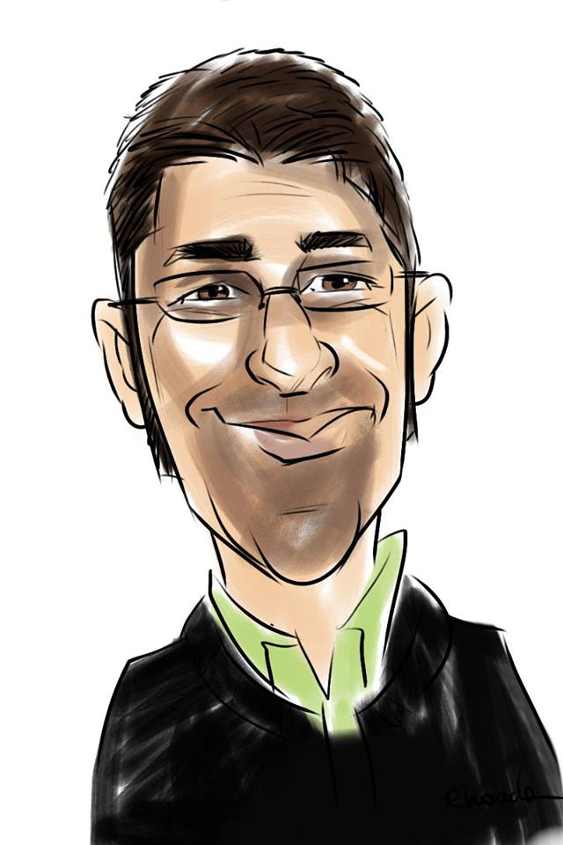
Thanks!
Dušan Stojičević
Душан Стојичевић
dusan@dukes.in.rs
stojicevic@gransy.com
Notes:
Insert a 364 x 395 pixels photo.

Slide 33
Cyrillic Generation Panel Update
Душан Стојичевић
Dusan Stojicevic
Chair, Cyrillic GP
Notes:
Breakup your presentation, divide it into sections. This is especially useful if most of your presentation is text.

Slide 34
Introduction – Script of LGR
ISO 15924 Code: Cyrl
ISO 15924 English Name: Cyrillic
Latin transliteration of native script name: Cyrillic
Maximal Starting Repertoire (MSR) version: MSR-2

Slide 35
Background on Script and Principle Languages
Based on Early Cyrillic, from First Bulgarian Empire in 9th century AD
Used for languages across Eastern Europe and north and central Asia
Basis of alphabets in languages, past and present, especially those of Slavic origin, and non-Slavic languages influenced by Russian
Used by more than 250 million people as the official script for their languages, about half from Russia
With the accession of Bulgaria to the European Union in 2007, Cyrillic became the third official script of the European Union, in addition to the Latin and Greek scripts

Slide 36
Geographic Territories Spread of Cyrillic
South Eastern part of Europe (Serbia, Montenegro, Macedonia, Bulgaria, Bosnia and Herzegovina)
Eastern Europe (Belorussia, Ukraine, Russia)
Central Asia (Kazakhstan, Turkmenistan, Uzbekistan, Kyrgyzstan, Tajikistan, Mongolia)
 | is the only official orthography
 | is the only official orthography, but others are recognized for national or regional languages

Slide 37
Methodology
According to work plan in the proposal for Cyrillic script GP
Initially language based repertoire compiled, based on second level IDN tables used by different ccTLDs, including the .su ccTLD which contained inventory for languages currently spoken in Russia
Language repertoires collated in a face to face meeting in Istanbul on 25-26 Nov. 2016.
Continued to use the mailing list to share and finalize documents
Consulted with Integration Panel (IP), including on crucial query regarding inclusion of U+02BC MSR for Ukrainian and Belarusian

Slide 38
Code Point Repertoire
# | Unicode CP | Glyph | Unicode Name | Lang. using CP | EGIDS value | Ref.
1 | 04EB | ӫ | CYRILLIC SMALL LETTER BARRED O WITH DIAERESIS | Khanty | Khanty 6b | Rule 6 http://www.omniglot.com/ writing/khanty.htm
2 | 04ED | ӭ | CYRILLIC SMALL LETTER E WITH DIAERESIS | Sami | Sami 8b | Rule 6
3 | 04DB | ӛ | CYRILLIC SMALL LETTER SCHWA WITH DIAERESIS | Khanty | Khanty 6b | Rule 6 http://www.omniglot.com/ writing/khanty.htm
4 | 04C2 | ӂ | CYRILLIC SMALL LETTER ZHE WITH BREVE | Gagauz | Gagauz 5 | Rule 5 http://www.omniglot.com/ writing/gagauz.htm Gagauz alphabet not in Cyrillic from 1996
5 | 04CC | ӌ | CYRILLIC SMALL LETTER KHAKASSIAN CHE | Khakas | Khakas 5 | Rule 5 http://www.omniglot.com/ writing/khakas.htm
6 | 04CF | ӏ | CYRILLIC SMALL LETTER PALOCHKA | Khakas | Khakas 5 | Rule 5 http://www.omniglot.com/ writing/khakas.htm
7 | 045D | ѝ | CYRILLIC SMALL LETTER I WITH GRAVE | Historical sign |  | Rule 6
8 | 0450 | ѐ | CYRILLIC SMALL LETTER IE WITH GRAVE | Stressed sign |  | Rule 6
84 code points recommended for inclusion
8 code points recommended for exclusion
(shown in the table)

Slide 39
Cyrillic Script Variants
No variants in Cyrillic script
  Some code points visually confusable
    not considered as variants by the Cyrillic community
    provide table of confusable code points, so organizations can use as needed

Slide 40
Cross-Script Variants
Decided to limit these to homoglyphs
Included code points which are homoglyphs in the lower case but not homoglyphs in the upper case
  Only lower case because upper case disallowed in IDNA 2008
  Decision made in consultation with IP (“the IP, at this point, does not require that upper case homoglyphs are included”)
Cyrillic GP found cross-script variants with:
  Armenian
  Greek
  Latin
Cyrillic GP did not find cross-script variants with Georgian

Slide 41
Cross-Script Variants – with Armenian Script
Armenian GP indicates three (3) variants with Cyrillic script
Opinion of Cyrillic GP that only one (1) homoglyphic variant
Other two (2) not identical, so included in confusables table
Armenian glyph | Armenian code point | Cyrillic glyph | Cyrillic code point
օ | 0585 | о | 043E

Slide 42
Cross-Script Variants – with Greek Script
Cyrillic has three (3) homoglyphic variants with Greek script
Greek glyph | Greek code point | Cyrillic glyph | Cyrillic code point
κ | 03BA | к | 043A
ο | 03BF | о | 043E
φ | 03C6 | ф | 0444

Slide 43
Cross-Script Variants – with Latin Script
Cyrillic has following homoglyphic variants with Latin from MSR-2
  Confusables listed separately
Latin glyph | Latin code point | Cyrillic glyph | Cyrillic code point
a | 0061 | a | 0430
c | 0063 | c | 0441
e | 0065 | е | 0435
o | 006F | о | 043E
i | 0069 | і | 0456
j | 006A | ј | 0458
l | 006C | ӏ | 04CF
p | 0070 | р | 0440
s | 0073 | ѕ | 0455
y | 0078 | у | 0443
x | 0079 | х | 0445
ä | 00E4 | ӓ | 04D3
ë | 00EB | ё | 0451
æ | 00E6 | ӕ | 04D5
ǝ | 01DD | ә | 04D9

Slide 44
Next Steps
Short phase (planned for this session)
  Finalize proposal, based on IP feedback
  Finalize XML and test data files
  Issue the LGR for public comment
After public comment phase
  Finalize the LGR proposal to include community feedback
Long term phase
  Address new code points included in the MSR in the future
    if needed in the root zone LGR, GP to re-convene and create additional proposal

Slide 45
Members of Cyrillic GP
Alex Khmyl (Belarus) | Nelly Stoyanova (Bulgaria)
Alexei Sozonov (Russia) | Nodir Mirzoev (Tajikistan)
Almaz Bakenov (Kyrgyz Republic) | Oleksandr Tsaruk (Ukraine)
Daniel Kalchev (Bulgaria) | Pavel Gusev (Kazakhstan)
Dmitry Belyavskiy (Russia) | Predrag Lesic (Montenegro)
Dmitry Kohmanyuk (Ukraine) | Sanja Simonova (Macedonia)
Dušan Stojičević (Serbia, chair) | Sergey Povalishev (Belarus)
Enkhbold Gombo (Mongolia) | Tattu Mambetalieva (Kyrgyzstan)
Iliya Bazlyankov (Bulgaria) | Yashar Hajiyev (Azerbaijan)
Kadamjon Safiev (Tajikistan) | Yuliya Morenets (Russia)
Mirjana Tasić (Serbia) | Yurii Kargapolov (Ukraine)
Nazgul Kurmanalieva (Kyrgyzstan) | Yuriy Honcharuk (Ukraine)

Slide 46
Thanks!
Dušan Stojičević
Душан Стојичевић
dusan@dukes.in.rs
stojicevic@gransy.com
Notes:
Insert a 364 x 395 pixels photo.

