Slide 1



Slide 2
Community Forum on a Proposed Fundamental Bylaw Amendment
Community Forum moderated by:
The Empowered Community Administration
Board representative:
Chris Disspain
27 June 2017

Slide 3
Overview of the Empowered Community and the Empowered Community Administration
1. Who and what is the Empowered Community?
The Empowered Community is the mechanism through which ICANN's Supporting Organizations(SOs) and Advisory Committees (ACs) can organize under California law to legally enforce community powers.
The community powers and rules that govern the Empowered Community are defined in the ICANN Bylaws and Articles of Incorporation.
There are five Decisional Participants in the Empowered Community – the Address Supporting Organization (ASO), the Country Code Names Supporting Organization (ccNSO), the Generic Names Supporting Organization (GNSO), the At Large Advisory Committee (ALAC), and the Governmental Advisory Committee (GAC)
2. Who and what is the Empowered Community Administration?
The Empowered Community Administration is the administrative body through which the Empowered Community acts. Each of the Decisional Participants of the Empowered Community designates one representative to the Empowered Community Administration.

Slide 4
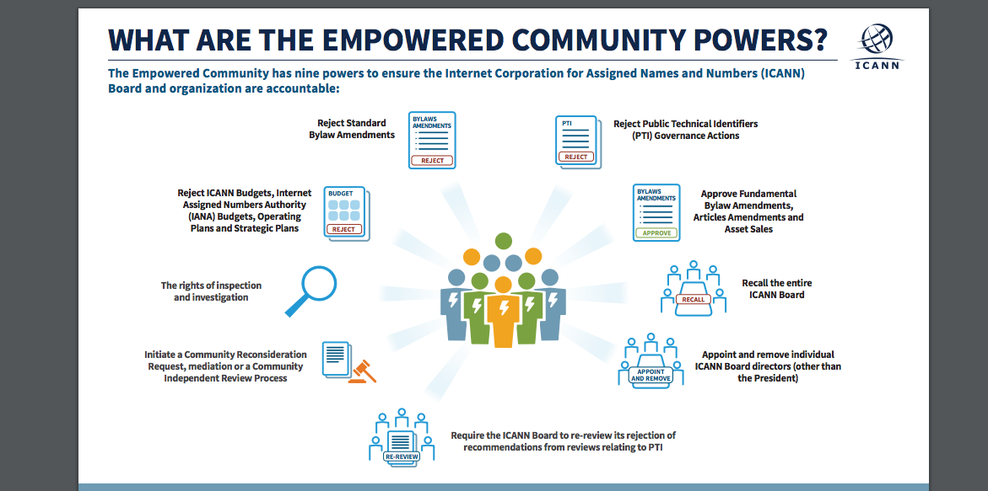

Slide 5
Approval Action Particulars for the proposed Fundamental Bylaw amendment:
21 Day Decision period starting at the conclusion of ICANN 59
  Decision Period commences 22.00 UTC, ends at 06.59 UTC on 21 July 2017
Community Approval requires:
    - At least 3 AC/SO’s approve
    - No more than 1 AC/SO disapproves

Slide 6
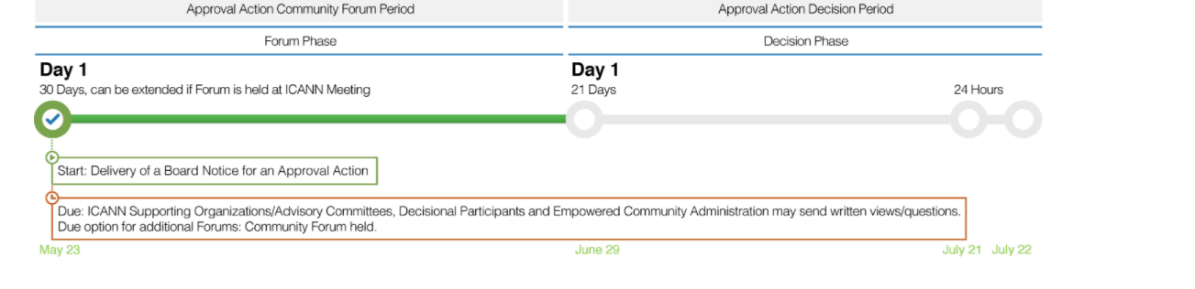
Timeline for Approval Action & Decision on the Proposed Bylaw Amendment:

Slide 7
Empowered Community Administration Role
Strictly Clerical
  NOT DECISION MAKING!
  We push paper around
    From ICANN Secretary to Decisional Participants
    From Decisional Participants to ICANN Secretary
  We count votes from AC/SO’s and report the result to the ICANN Secretary

Slide 8
Proposed Bylaw and Related Documents
Proposed Bylaw:
https://www.icann.org/en/system/files/files/proposed-amend-bylaws-article4-section-4-2-31mar17-en.pdf
Draft Revised Board Governance Committee Charter:
https://www.icann.org/en/system/files/files/proposed-amend-bgc-charter-31mar17-en.pdf
Draft Board Accountability Mechanisms Committee Charter:
https://www.icann.org/en/system/files/files/proposed-bamc-charter-31mar17-en.pdf
More information on the Empowered Community process for an Approval Action: https://www.icann.org/en/ec/proposed-fundamentals-bylaws-changes-move-gov-committee

