Slide 1

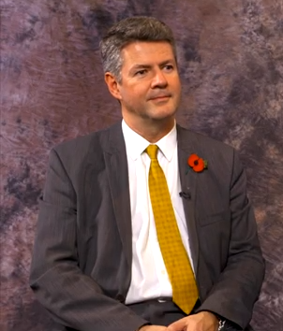
EURALO newsletter, June 2020
EURALO news
Dear EURALO members,
we would like to start this June newsletter edition with a fantastic news and take again the opportunity to congratulate Olivier Crépin-Leblond (a former Chair and Vice Chair of ICANN's At-Large Advisory Committee and Board member and former EURALO Chair) on the well-deserved award:
Olivier Crepin-Leblond is the recipient of the 2020 Community Excellence Award*!
Let us cite the ICANN news: “The selection panel of representatives from ICANN Supporting Organizations and Advisory Committees recognized Crépin-Leblond's dedication to ICANN's multistakeholder model and long record of substantial contributions to the ICANN community. The panel noted his energy, enthusiasm, and willingness to engage across the diverse ICANN community contributed to his effective facilitation of community dialogues.
He has participated in a number of key ICANN policy development processes and working groups and was a member of the 2010 Nominating Committee. Long active in the Internet governance ecosystem, he is the Chair of the United Kingdom chapter of the Internet Society, a founder and Board member of the European Dialogue on Internet Governance (EuroDIG), and the current co-Chair of the Cross-Community Working Group on Internet Governance.
Crépin-Leblond is the founder of Global Information Highway, an Internet policy, services, and equipment consultancy.
*The Community Excellence Award honors members of the ICANN community who have invested in consensus-based solutions and contributed in a substantive way to policymaking within the ICANN ecosystem.

Slide 2
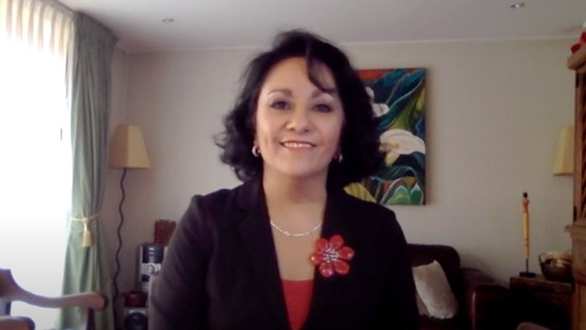
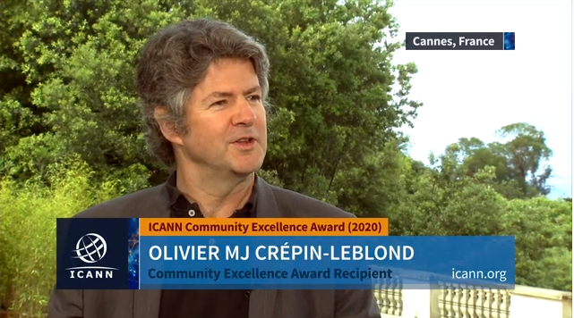
EURALO newsletter, June 2020
EURALO news
ICANN Community Excellence Award Selection Panelist Margarita Valdés discusses the process for choosing the 2020 recipient, Olivier MJ Crépin-Leblond https://bit.ly/37WnRsX
We also invite you to watch the interview with Olivier Crépin-Leblond:

Slide 3
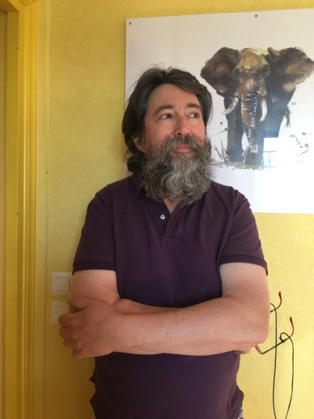
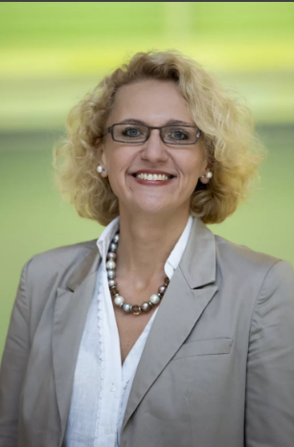
EURALO newsletter, June 2020
EURALO news
Please note that we have very convenient tool:
The spreadsheet of expertise of EURALO ALS representatives and individuals. The great opportunity to indicate your expertise in different fields and professional area connected to ICANN interests. All EURALO ALSs representatives and members have got the link by email.
We kindly recommend you to join the monthly calls for the latest
EURALO and At-Large
community updates.
The most recent EURALO Monthly calls took place
on 16 June and 7 July 2020
Don't forget about the unique opportunity to visit the magnificent At-Large Capacity Building webinars. We kindly remind you that we are waiting for you not only as attendees, but also as speakers!
https://community.icann.org/display/atlarge/At-Large+Capacity+Building+Working+Group

Slide 4
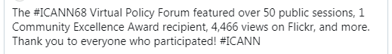
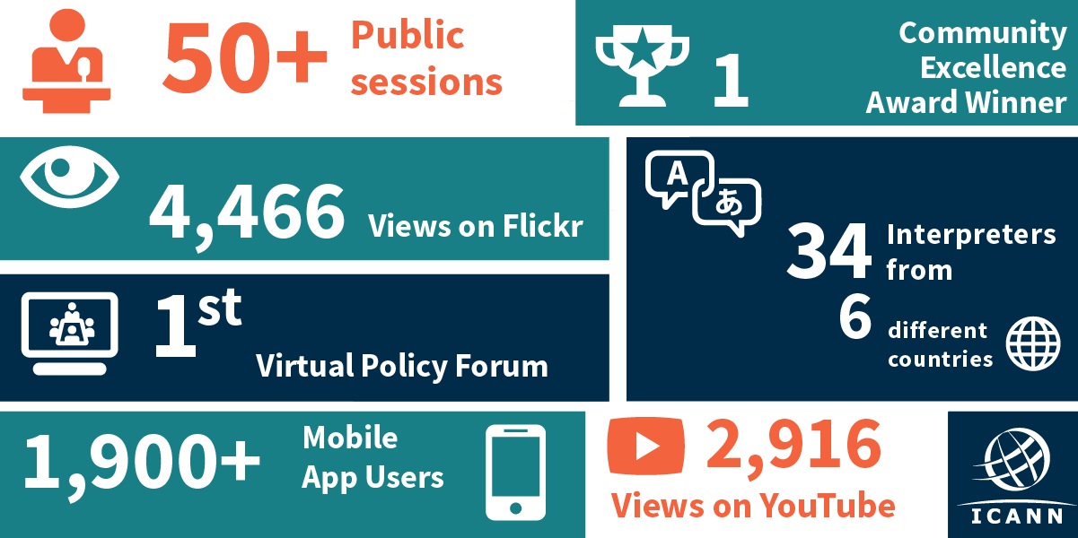
EURALO newsletter, June 2020
ICANN68
The most significant ICANN event in June 2020 – ICANN68. We thank you to everyone who participated in the Virtual Policy Forum and made this meeting a success!
The ICANN68 policy forum scheduled for 22-25 June 2020 , which was to be held in Kuala Lumpur, Malaysia, was the second virtual meeting to be held only through remote participation.
With an increasing number of countries issuing stay-at-home, lockdown, or social-distancing orders to its citizens to slow the spread of COVID-19, gatherings and international travel are effectively on pause for the foreseeable future. The health and safety of ICANN's community is a top priority, and as such, convening ICANN68 as an in-person meeting is no longer feasible.

Slide 5

EURALO newsletter, June 2020
ICANN68 - ALAC
Dear EURALO members, If you missed the VIRTUAL POLICY FORUM ICANN68 or want to catch up on sessions you didn’t get to attend go to the site https://68.schedule.icann.org/
to browse the schedule, view transcripts, watch video recordings, listen to audio recordings.
At-Large ICANN68 sessions:
Monday, 22 June At-Large Leadership Session: Welcome to ICANN68, At-Large Talking Points and Policy Platform
At-Large Policy Session: DNS Abuse: COVID-19 and End-user Issues
At-Large: PICS and PICDRP: What's the Right Path Forward?
Tuesday, 23 June
Joint AFRALO-AfrICANN Meeting
At-Large Policy Session: New gTLD Applicants: Expanding the Circle
Wednesday, 24 June
At-Large Policy Session: DNS Abuse: Setting an Acceptable Threshold
At-Large Regional Leaders Meeting
Thursday, 25 June
At-Large Policy Session: Aligning UA and IDNs with the Multilingual Internet: End-user perspectives
At-Large Leadership Wrap Up
To get more information please visit https://community.icann.org/display/atlarge/At-Large+Meetings+-+Monday%2C+22+June+2020
The highlights of the ICANN68 Virtual Policy Forum will be discussed via Readout webinars provided ICANN GSE team. At-Large leaders from each region will participate actively. More information regarding schedule of Readout webinars will be announced soon.

Slide 6
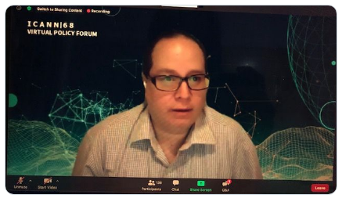
EURALO newsletter, June 2020
ICANN68 - ALAC
During the ICANN68 plenary session on “Advancing Policy Work in the Current Environment,” the community heard from the Supporting Organization and Advisory Committee (SO/AC) chairs on how they plan to prioritize their respective community's work for the foreseeable future and learned more about the Draft Proposal for Phased Return to Face-to-Face Meetings.
Just issued for community feedback, the proposal was prepared by ICANN org based on initial suggestions from the SO/AC chairs. It proposes a strategy that emphasizes partnership and collaboration between the ICANN community and ICANN org in order to ensure a measured and safe return to large-scale physical meetings and is intended as a basis for further conversations with the ICANN community. ICANN org will continue to provide up-to-date assessment reports for each potential meeting location for community review and update the framework as needed.
The draft proposal can be read here.
León Sánchez, Vice-Chair of the ICANN Board, addresses the ALAC /At-Large community during their ICANN68 Leadership Wrap Up session: https://go.icann.org/3dkU66a

Slide 7
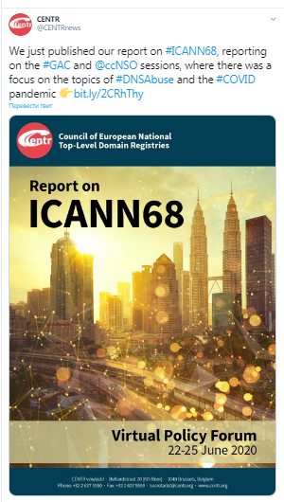
EURALO newsletter, June 2020
ICANN68
CENTR Report on ICANN68

Slide 8
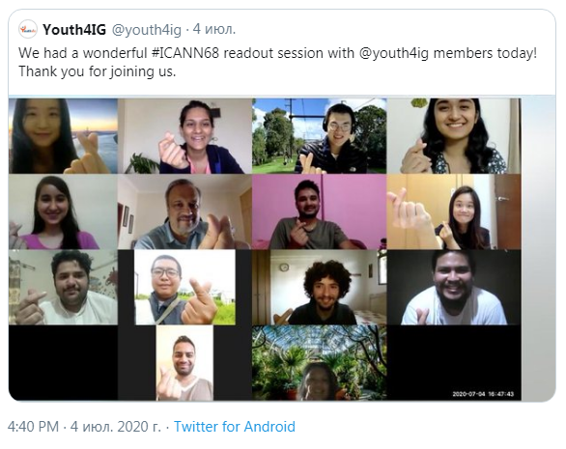
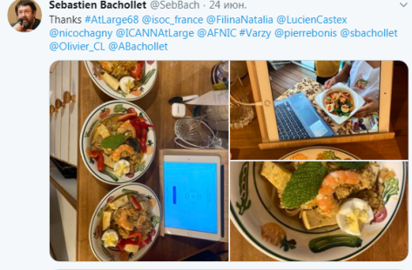
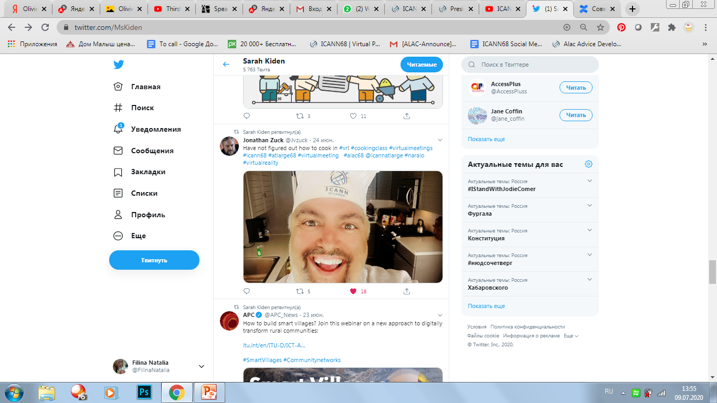

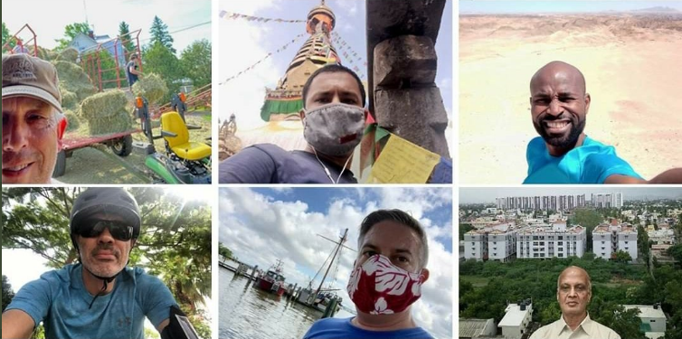
EURALO newsletter, June 2020
ICANN68
Master class of Malaysian food cooking, organized by At-Large!
ICANN68 Readout session for YOUTH!
The topic of COVID19 became not only the topics of major ICANN68 discussions, but also made the ICANN68 social media news feed original.
We strongly recommend you to keep the distance and wear masks!

Slide 9
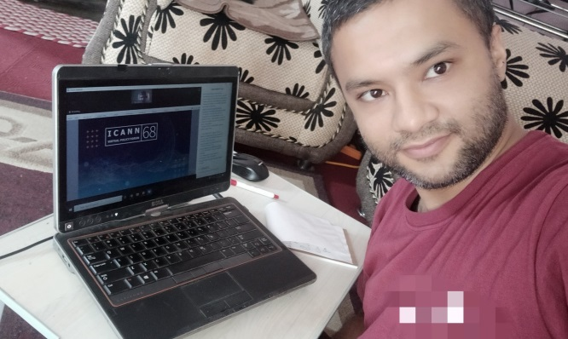
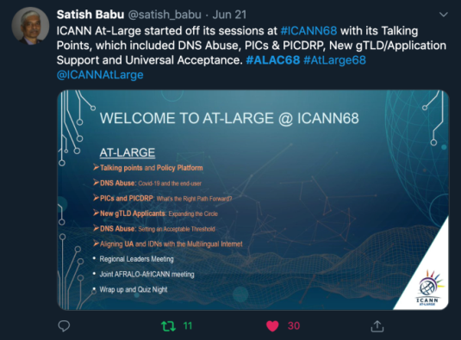
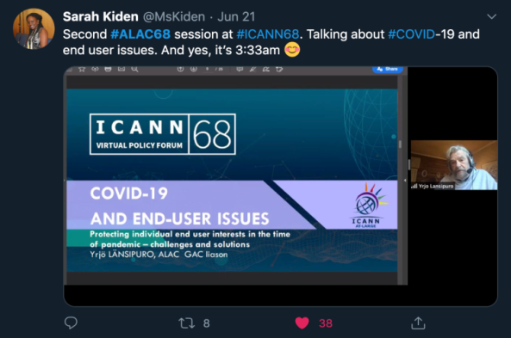
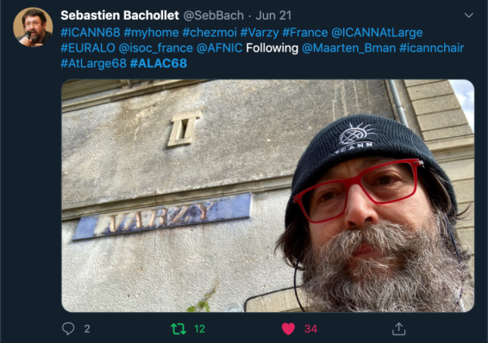
EURALO newsletter, June 2020
ICANN68
We thank Shreedeep Rayamajhi (SMWG Chair ICANN68) and all members of Social Media WG and our activists for their incredible preparation and coordination of the community's work in social networks during ICANN68!
Congratulations to all At-Large winners of ICANN68 Social Media Working Group Twitter Competitions!!!
3 – Sarah Kiden (AFRALO)
2 – Satish Babu (APRALO)
1 – Sebastien Bachollet (EURALO)

Slide 10
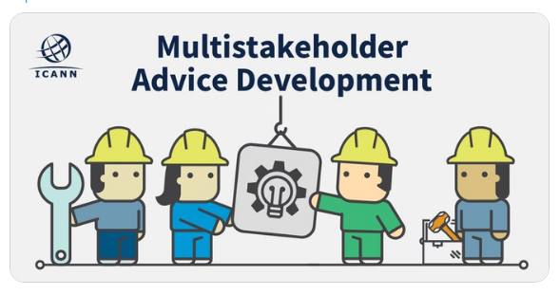
EURALO newsletter, June 2020
ALAC news
All of EURALO and the At-Large community are invited to contribute to ICANN public comment proceedings.
For more information, please visit the
At-Large Policy Advice Development Page
We welcome you to read and participate:
ADOPTED At-Large Workspace: Initial Report of the Expedited Policy Development Process (EPDP) on the Temporary Specification for gTLD Registration Data Team – PHASE 2
COMMENT At-Large Workspace: At-Large Policy Platform
DRAFTING At-Large Workspace: Latin America and Caribbean (LAC) Regional Strategic Plan for FY2021-2025
At-Large Workspace: Third Accountability and Transparency Review Team (ATRT3) Final Report
At-Large Workspace: Enhancing the Effectiveness of ICANN’s Multistakeholder Model – Next Steps
VOTE
At-Large Workspace: ccNSO PDP3: Initial Proposals for Process to Retire ccTLDs
TBC
At-Large Workspace: Label Generation Rules for the Root Zone Version 4 (RZ-LGR-4)
How does multistakeholder advice development work at ICANN?
Check out our infographic to learn about the process https://go.icann.org/30ZpAfO

Slide 11
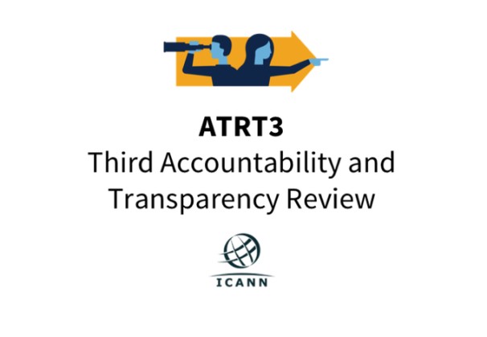
EURALO newsletter, June 2020
ALAC news
Webinar Invitation: Third Accountability and Transparency Review Team (ATRT3) Final Report
29 June 2020
The third Accountability and Transparency Review Team (ATRT3) invites the community to participate in a webinar on its Final Report [PDF, 3.92 MB]. There are two opportunities to participate:
15 July 2020 at 15:30-16:30 UTC
16 July 2020 at 07:00-08:00 UTC
During the webinar, the ATRT3 will present an overview of the recommendations in its Final Report and answer questions. Details on how to attend are available here.
Background
The ATRT3 Final Report contains five recommendations with regard to ICANN accountability and transparency in the following areas:
Prioritization of review and Cross-Community Working Group on Enhancing ICANN Accountability, Work Stream 2 (WS2) recommendations.
Amending Specific and Organizational Reviews.
Accountability and transparency relating to Strategic and Operational Plans including accountability indicators.
Public input.
Assessment of the implementation of ATRT2 recommendations.
On 16 June 2020, the ATRT3 Final Report [PDF, 3.92 MB] was issued for Public Comment to inform Board action on the ATRT3's final recommendations. The Public Comment proceeding will close at 23:59 UTC on 31 July 2020.

Slide 12
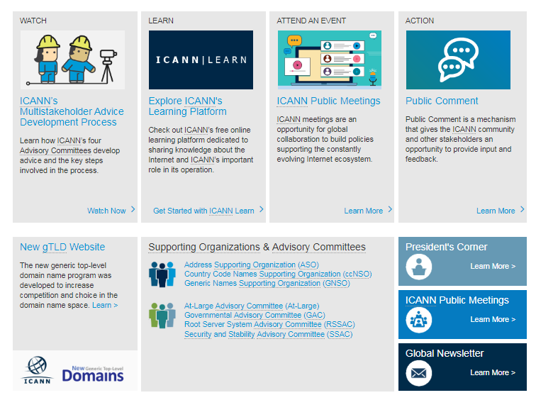
EURALO newsletter, May 2020
ICANN updates
We would like to pay your attention to the updated version of ICANN website. It has become more convenient for getting the last news, learning more about current and future events, educational opportunities and moments where your input in the decision-making process is needed.
Visit icann.org/

Slide 13
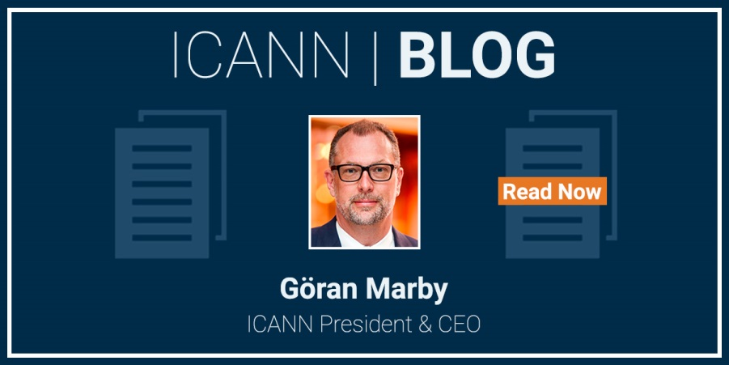
EURALO newsletter, June 2020
ICANN updates
18 June 2020
ICANN announced the release of updated Domain Name Marketplace Indicators through the ICANN Open Data
27 June 2020
The Governmental Advisory Committee (GAC) of the Internet Corporation for Assigned Names and Numbers (ICANN) issued the GAC Communiqué – ICANN68 Virtual Policy Forum. It is available for review here.
Previous GAC advice and past communiqués are available at https://gac.icann.org.
16 June 2020
ICANN Signs Memorandum of Understanding with the Global Cyber Alliance
11 June 2020
ICANN69 to be Held as Virtual Public Meeting
Read The ICANN blog about:
- how we all have a responsibility to combat systemic racism and injustice. https://go.icann.org/2Nsse5w
the organizational changes coming to ICANN org https://go.icann.org/2Y0HuvB

Slide 14
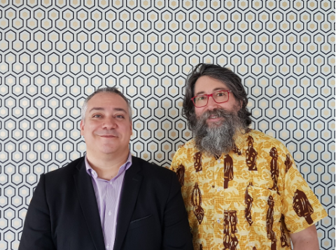
EURALO newsletter, June 2020
ALSs updates and European regional activities, Outreach
and Engagement work of Euralo members
ISOC FRANCE The Afnic Annual General Meeting held on 1 July 2020 reappointed 2 elected members of the Board of Trustees, one Users’ representative and one Registrars’ representative. Gandi SAS, represented by Mr Arnaud Franquinet, Chief Operating Officer, to the Registrar Consultative Committee. Internet Society France, represented by Mr Sébastien Bachollet, to the User Consultative Committee. OUR Congratulations!
https://www.afnic.fr/en/about-afnic/news/general-news/12102/show/gandi-and-isoc-france-elected-to-the-afnic-board-of-trustees.html
Virtual 12-14 May 2020

Slide 15
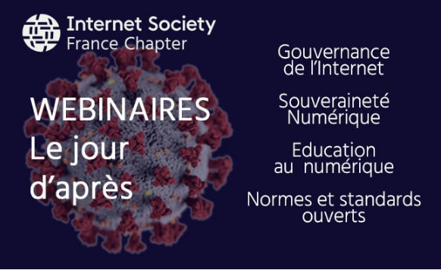
EURALO newsletter, June 2020
ALSs updates and European regional activities, Outreach
and Engagement work of Euralo members
Through a series of webinars, ISOC FRANCE
invited you to think about today in terms of digital sovereignty, Internet governance methods, the digital education or open standards. The series of webinars will also be presented at the Internet governance Forum in France 2020.
June 9 at 18: 30 "What is Internet Governance in the light of the Covid19 crisis?" with Sébastien Bachollet, honorary President of Internet Society France (EURALO Chair), Olivier Crepin-Leblond, President of Internet Society UK (honorary Ex EURALO Chair) and Esther Ngom, President of Internet Society Cameroon.
June 16 at 19: 30: "Digital sovereignty rethink" with Lucien Castex, co-President of FGI France
June 23 at 18: 30 . "Shaping digital education for all" with Nicolas Chagny, President of Internet Society France and CEO of WebForce3
July 1 at 18: 30: "Promoting norms and standards discovered during the crisis and foreseeing FGI France 2020“ https://www.isoc.fr/webinaires-jour-apres/
Virtual 12-14 May 2020

Slide 16
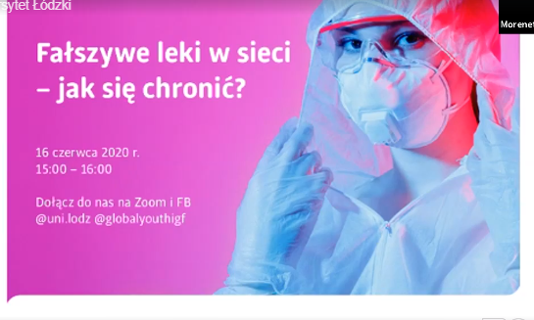


EURALO newsletter, June 2020
ALSs updates and European regional activities, Outreach
and Engagement work of Euralo members
TaC (Together against cybercrime International) and Yuliya Morenets - Founder TaC and Youth IGF movement
As part of the Youth IGF Movement held series of excellent Online talks in different countries dedicated to the spread of counterfeit medicines and launched a new Youth IGF TV project - high-level interview on the topics "Youth in Digital era and Cybersecurity"
The webinars are attended by members and leaders of Euralo, At-Large, ISOC and our ALSs. this is a great example of synergia and excellent leadership in attracting the younger generation to the discussion of IG.
We invite you to watch the recording of the webinar, which was moderated and curated by Joanna Kulesza in Poland.
All webinars and online talks can be found on the Facebook page facebook.com/globalyouthigf/
Virtual 12-14 May 2020

Slide 17
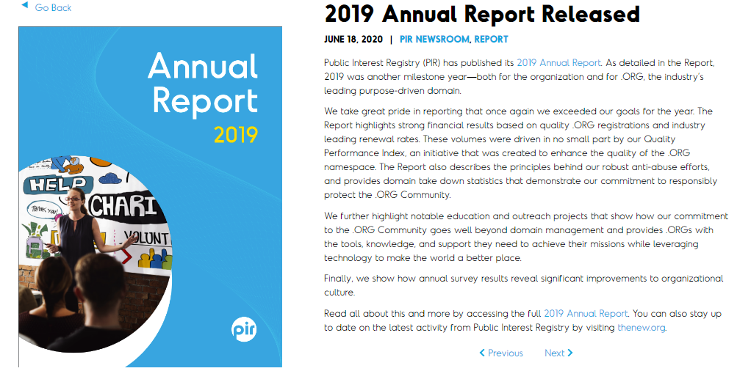
EURALO newsletter, June 2020
ALSs updates and European regional activities, Outreach
and Engagement work of Euralo members
INGO European Media Platform (EMP)
On June 7, 2019 the Diplomatic Academy of Ukraine hosted the presentation of “Integrating Ukraine into the European Digital Single Market: transforming impediments into the windows of opportunity” project outcomes. The event was attended by the representatives of Government Office for European and Euro-Atlantic Integration, the National Commission for the State Regulation of Communications and Informatization, the Ministry of Foreign Affairs, the State Agency on E-Governance, the Ukrainian Consumers’ Union, biggest mobile carriers and internet providers, as well as experts and civic activists. A resolution was adopted based on the roundtable discussion.
http://eump.org/media/2019/19-06-ua2dsm.pdf
Industry news
Virtual 12-14 May 2020
https://thenew.org/2019-annual-report-released/

