Slide 1
GNSO-GAC Liaison Overview
12 October 2014
Mason Cole

Slide 2
Mason’s Background
ICANN Leadership
Secretary, RrSG (2008-2009)
Chair, RrSG (2009-2011)
GNSO Councilor (2011-2013)
GNSO Council Vice Chair (2012-1013)
Current Working Group Roles
Implementation Advisory Group for Competition, Consumer Choice and Consumer Trust
Cross Community WG on Use of Country Codes and Territory Names
GNSO New gTLDs Subsequent Rounds Discussion Group

Slide 3
Purpose of Liaison Role
Objectives
Facilitate flow of information between GNSO and GAC
Particularly to ensure the GAC informed
So he GAC can determine when “public policy” implications exist
Assist with engagement of GAC in GNSO processes
Methods
Neutrally and objectively represent and communicate GNSO policy work
Provide timely updates to the GAC on GNSO policy development activities
Guide the GAC in opportunities for early engagement in GNSO work
Ensure the GAC’s ongoing understanding of GNSO methods and processes
Provide GNSO with regular updates on GAC activities, specifically in so far as these relate to issues of interest to the GNSO
Work closely with GAC-GNSO Consultation Group to develop early engagement mechanics

Slide 4
Questions
How does the GAC learn about opportunities for policy input?
Where / when can the GAC provide policy input?
How does the GAC go about providing that input?

Slide 5
How does the GAC learn about opportunities for policy input?
Announcements from GNSO Secretariat
Requests for input from GNSO PDP Working Groups
Participation in GNSO Working Groups
GAC Early Engagement Policy Documents https://gacweb.icann.org/dispaly/gacweb/GAC+Early+Engagement+Policy+Documents) – monthly
GNSO Background Briefings (e.g. http://gnso.icann.org/en/correspondence/background-briefing-13mar14-en.pdf) – issued monthly?
Policy Update https://www.icann.org/resources/pages/update-2014-02-20-en) – monthly
Policy Update Webinar (takes place prior to every ICANN meeting) – 3 times/year

Slide 6
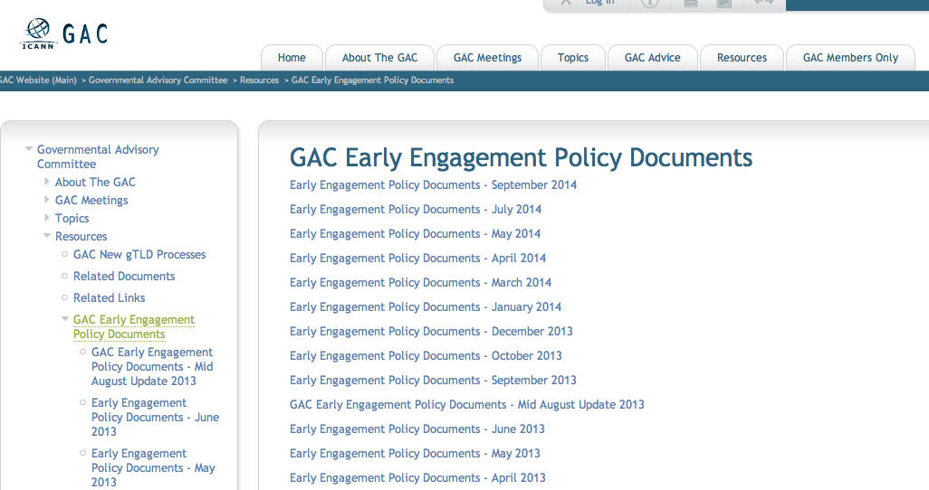
How does the GAC learn about opportunities for policy input?

Slide 7
Information Provided to the GAC
GAC Survey reveals members don’t suffer from lack of information
Difficulty is prioritization of information
Should be assisted in future by:
GNSO liaison to the GAC
Work of CG on enhanced day-to-day cooperation

Slide 8
The Liaison
Liaison is not the total solution
Primarily an information conduit from GNSO to GAC
Work still to be done by the CG to assist GAC
GAC must identify ways to effectively engage with the GNSO

Slide 9
Overall ecosystem
GNSO policy development is active
PDPs run in parallel
Multiple vehicles for informing GAC, including the Liaison
Multiple opportunities for GAC engagement
Need methodology for providing GAC input

Slide 10
THANK YOU

