Slide 1
GAC-GNSO Consultation Group On GAC Early Engagement in GNSO PDP
12 October 2014
Los Angeles Progress Report

Slide 2
Overview
Background
Status update from GAC / GNSO CG
Two work tracks
Outcomes from survey
Expectations of a Liaison
Desired outcomes for ICANN 51
Discussion and further work plans
Placeholder

Slide 3
Background
GAC-GNSO Consultation Group (CG)
To address GAC early engagement in GNSO Policy Development Process (PDP)
Early engagement identified by both Accountability and Transparency Review Teams (ATRT1 Rec. 12, ATRT2 Rec. 10.2)
Group commenced work Q1 2014
Two work tracks - Day-to-day co-ordination - PDP engagement

Slide 4
Work Track I (Team 1)
Mechanisms for day-to-day ongoing cooperation
First recommendation implemented as pilot project for FY2015: GNSO Liaison to the GAC
Focus is now on:
GAC / GNSO Chairs regular interaction
Rethinking recurring joint meetings
Early awareness & notification

Slide 5
Work Track II (Team 2)
GAC early engagement in GNSO PDP
Look at 6 phases of the current GNSO PDP
Issue Scoping
Initiation
Working Group
Council Deliberations
Board Vote
Implementation
Initial focus on early phases i.e. 1 & 2

Slide 6
Survey of GAC members
On-line survey for GAC members => 29 responses
Evaluated mechanisms for:
Awareness, usefulness and possible improvement)
Policy Update – monthly
GAC Early Engagement Policy Documents – monthly
Policy Update Webinar (takes place prior to every ICANN meeting) – 3 times/year
Requests for input from GNSO PDP WGs – ongoing basis
Participation in GNSO WGs – ongoing basis
Announcements from GNSO Secretariat – ongoing basis
GNSO Background Briefings - Just prior to each ICANN meeting

Slide 7
Survey: Issues Identified
Volume of activities
Number of simultaneous PDPs
Timeline
Lack of both understanding and/or ability to participate in GNSO working groups
Frequency of GNSO working group meetings
(some twice a week for months, others every two weeks) makes it difficult for bureaucrats to participate

Slide 8
Survey: Suggestions
Highlight Public Policy aspect of a given issue
Indicate relationship between a policy initiative and existing GAC advice
More frequent policy updates
Direct engagement with and follow-up with the GAC, GAC Executive and Secretariat
Make clear what stage the GNSO work is in, which relates to the issue of knowing when/how to contribute
Regular feedback on outcome of PDP process, including a summary of previous processes
More inter-committee relationships

Slide 9
Survey: Suggestions (Continued)
Home page quick link to "Main Policy Activities“
Highlighting policy activities which require liaison with and significant inputs from the GAC and expected potential degree of interest - e.g. GAC should be aware / discussion with GAC expected / requires GAC public policy input
GAC website mirror this description of cross-community policy interest and provide links to the GNSO summaries

Slide 10
GNSO Liaison to the GAC
Mason Cole appointed
Pilot - one year starting at ICANN 51 (LA)
Evaluated after one year

Slide 11
Looking ahead
Consultation Group to review input received in Los Angeles (Open F2F meeting from 18h30 – 19h30 in Constellation)
Continue implementation of pilot project for the GNSO Liaison to the GAC
Further develop recommendations for other items aiming to present for future GAC / GNSO review / approval

Slide 12
Desired outcomes
Feedback and discussion of the work of the CG
Shared understanding and expectation of GNSO Liaison to the GAC
Agreement on route ahead

Slide 13
Questions & Discussions

Slide 14
Overview
Background
Work Track 1 – Regular Interaction Includes GNSO Liaison to the GAC
Work Track 2 – Engagement with GNSO PDP
Early Awareness & Notifications Includes output from Survey of GAC
Look Ahead
Questions & Discussion

Slide 15
A. GAC/GNSO Chairs Regular Interaction
Proposed approach: Regular calls between GAC and GNSO Chairs, as well as GNSO liaison as appropriate
As deemed necessary, regular calls may include:
GAC vice chairs
GAC topic leads
GNSO issue/PDP leads

Slide 16
A. GAC / GNSO Chairs Regular Interaction
Action 2 for ICANN51 Seek to obtain GAC and GNSO feedback on:
The suggested approach
Suggested frequency of calls?
…

Slide 17
B. Rethinking Recurring Joint Meetings
Identify ahead of time topics of mutual interest
Provide updates on status of PDP WGs ahead of time (e.g. webinar?)
Focus meetings on identified questions / concerns
Share identified questions / concerns with GNSO liaison in advance to facilitate f2f meeting discussion
Invite GNSO topic leads as necessary
Provide new members with short overviews (for example one-pager)

Slide 18
B. Rethinking Recurring Joint Meetings
Action 3 for ICANN51 Seek to obtain GAC and GNSO feedback on:
The suggested approach
…

Slide 19
Ideas being explored
Streamlining and prioritizing early awareness & notification
GAC ‘Quick look’ mechanism; establish whether issue has potential public policy implications, flag as such at early stage
Additional support to allow GAC to provide timely input
Ensure that any GAC positions / advice are included in the Preliminary Issue Report
GAC could consider creation of Triage committee

Slide 20
C. Early Awareness/Notifications
Action 4 for ICANN51 Seek to obtain GAC and GNSO feedback on / approval for:
…

Slide 21
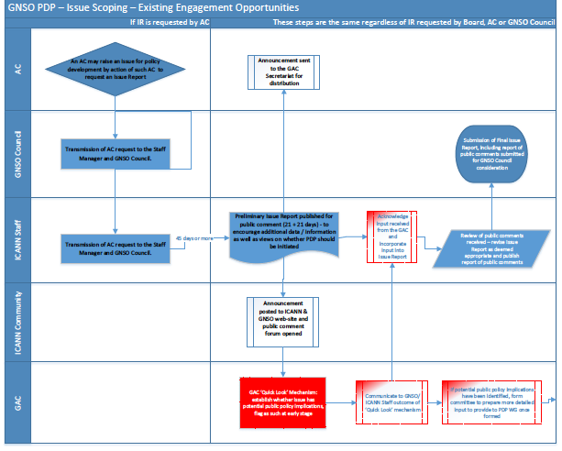
Issue Scoping – Existing & Possible new Engagement Opportunities

