Slide 1
Method 1

Slide 2
BR Statement on Domain Validation
Domain Name Registrant:
  Sometimes referred to as the “owner” of a Domain Name, but more properly the person(s) or entity(ies) registered with a Domain Name Registrar as having the right to control how a Domain Name is used, such as the natural person or Legal Entity that is listed as the “Registrant” by WHOIS or the Domain Name Registrar.
3.2.2.4. Validation of Domain Authorization or Control
  This section defines the permitted processes and procedures for validating the Applicant's ownership or control of the domain
9.6.1. CA Representations and Warranties
  Right to Use Domain Name or IP Address:
  That, at the time of issuance, the CA (i) implemented a procedure for verifying that the Applicant either had the right to use, or had control of, the Domain Name(s) and IP address(es) listed in the Certificate’s subject field and subjectAltName extension (or, only in the case of Domain Names, was delegated such right or control by someone who had such right to use or control); (ii) followed the procedure when issuing the Certificate; and (iii) accurately described the procedure in the CA’s Certificate Policy and/or Certification Practice Statement;
Different concepts introduced:
  ownership of the Domain
  the right to use the Domain Name or delegated the right to use by someone who had such right to use
  control of the Domain Name or delegated the control by someone who had control
Notes:
Ownership has been baked in through the life time of verifying domains.
CA’s used to require a the Registrant information be updated to show ownership
Ownership is used to mitigate risk to high risk domains
Ownership is used to all wildcard to be issued to a wildcard with a public suffix

Slide 3
Certificate Request
Will only address OV request where the CA is not the Domain Name Registrar
Typical OV Certificate Request will contain:
  FQDNs
  CSR (may be submitted later)
  Certificate Requester (name, title, phone number, email address) which is an Applicant Representative as they sign/submit certificate request or approve certificate request
  Organization (name and address)
Practice
  Require an Organization Contact (name, title, phone number, email address) who must be an employee of the Organization
  Organization Contact is an Application Representative as they will sign the Subscriber Agreement
  Organization Contact must approve issuance of the certificate
Notes:
Applicant Representative: A natural person or human sponsor who is either the Applicant, employed by the Applicant, or an authorized agent who has express authority to represent the Applicant: (i) who signs and submits, or approves a certificate request on behalf of the Applicant, and/or (ii) who signs and submits a Subscriber Agreement on behalf of the Applicant, and/or (iii) who acknowledges the Terms of Use on behalf of the Applicant when the Applicant is an Affiliate of the CA or is the CA.

Slide 4
BR 3.2.2.4.1 Requirements
Validating the Applicant as the Domain Contact
  Confirming the Applicant's control over the FQDN by validating the Applicant is the Domain Contact directly with the Domain Name Registrar
  Authenticate the Applicant's identity under BR Section 3.2.2.1
  Authenticate the authority of the Applicant Representative under BR Section 3.2.5
Practice
  Re-order the process as follows:
  Identity - Authenticate the Applicant's identity under BR Section 3.2.2.1
  Domain - Confirming the Applicant's control over the FQDN by validating the Applicant is the Domain Contact directly with the Domain Name Registrar
  Authority - Authenticate the authority of the Applicant Representative under BR Section 3.2.5
Notes:
For domain validation the 3 steps are only required for Method 1; however, the same 3 steps must be performed for all OV certificates.
Domain Contact: The Domain Name Registrant, technical contact, or administrative contract (or the equivalent under a ccTLD) as listed in the WHOIS record of the Base Domain Name or in a DNS SOA record, or as obtained through direct contact with the Domain Name Registrar.
Domain Name Registrant: Sometimes referred to as the “owner” of a Domain Name, but more properly the person(s) or entity(ies) registered with a Domain Name Registrar as having the right to control how a Domain Name is used, such as the natural person or Legal Entity that is listed as the “Registrant” by WHOIS or the Domain Name Registrar.

Slide 5
Identity
BR 3.2.2.1
  Subject identity shall includes name and address for the Applicant’s existence or operation
  Identity and address can be verified by:
    A government agency in the jurisdiction of the Applicant’s legal creation, existence, or recognition;
    A third party database that is periodically updated and considered a Reliable Data Source;
    A site visit by the CA or a third party who is acting as an agent for the CA; or
    An Attestation Letter.
Practice
  Use a QIIS, QGIS or QTIS to confirm identity and address
  Why?
    QIIS, QGIS and QTIS are well defined in the EV Guidelines and will meet the government agency or Reliable Data Source requirements
    Data can be used for both OV and EV
    Reduces delay of on-site or attestation letter
Notes:
Reliable Data Source: An identification document or source of data used to verify Subject Identity Information that is generally recognized among commercial enterprises and governments as reliable, and which was created by a third party for a purpose other than the Applicant obtaining a Certificate.

Slide 6
Domain
BR 3.2.2.4.1
  Match Applicant with Domain Contact directly with the Domain Name Registrar
  Note Applicant could be Parent, Subsidiary or Affiliate per BR 3.2.2.4 - For purposes of domain validation, the term Applicant includes the Applicant's Parent Company, Subsidiary Company, or Affiliate.
Practice
  Use Applicant verified Identity
  Match Identity name with Registrant organization name
  Registrant name could be incomplete (e.g., missing “Inc.”) or a parent, subsidiary or affiliate
  Registrant name must be validated using address or other unique information from registry
  If Registrant name is a parent, subsidiary or affiliate, then association to the Applicant must be verified (e.g., Hoover’s)
Notes:
BR 3.2.2.4 - For purposes of domain validation, the term Applicant includes the Applicant's Parent Company, Subsidiary Company, or Affiliate.

Slide 7
Authority
BR 3.2.5
  Use Reliable Method of Communication (RMOC)
  Sources from 3.2.2.1 can be used to verify RMOC
  Authenticity of request can be verified with Applicant Representative or with an authoritative source within the Applicant’s organization (main business offices, corporate offices, HR, information technology offices, or other)
Practice
  Certificate request has an Applicant Representative which is an employee of the Applicant and must sign the Subscriber Agreement
  Use QIIS, QGIS or QTIS to confirm RMOC
    Do not use Domain Name Registrar contact information as the Registry is not consider RMOC due to self provided information
  Contact Applicant Representative to confirm issuance of a certificate with a specific FQDN(s) to the certificate requester
Notes:
Domain Name Registrar: A person or entity that registers Domain Names under the auspices of or by agreement with: (i) the Internet Corporation for Assigned Names and Numbers (ICANN), (ii) a national Domain Name authority/registry, or (iii) a Network Information Center (including their affiliates, contractors, delegates, successors, or assigns).
Reliable Method of Communication: A method of communication, such as a postal/courier delivery address, telephone number, or email address, that was verified using a source other than the Applicant Representative.
Subscriber Agreement: An agreement between the CA and the Applicant/Subscriber that specifies the rights and responsibilities of the parties.

Slide 8
BR 3.2.2.4.1 Validating the Applicant as a Domain Contact
Buypass CA
Confirming the Applicant's control over the FQDN by validating the Applicant is the Domain Contact directly with the Domain Name Registrar.
The method is to be used only for OV/EV (and possibly IV)
How does Buypass interpret this?
  as validating that the Applicant is the Domain Name Registrant, i.e. by validating the Applicant’s ownership of the Domain
How does Buypass use the method?
  We have a properly validated organization as required by EVG/BR
  The authorization to issue the certificate to the organization have been granted by an authorized representative according to EVG/BR
  If we are able to verify that the organization “equals” the Domain Name Registrant, the organization (the Applicant) owns the Domain and we are allowed to issue

Slide 9



Buypass pre-conditions for using Method 1
Buypass CA
Applicant
The Applicant’s identity (i.e organization name and registration number) and address are validated against governmently controlled registries used in Northern Europe (e.g. European Business Registers – EBR)
  We consider this information to be trustworthy
We verify the Applicants’s authorization to issue the certificate using a Verified/Reliable Method of Communication according to EVG/BR. The Method of Communication is based on a phone number, an email address or a postal address – always using a Reliable Data Source independent of WHOIS
We do not allow the use of Applicant's Parent Company, Subsidiary Company, or Affiliate for the purpose of domain validation
Organization Name: <org name>
Registration Number: <org no>
Organization Address: <ord addr>
Phone number: <phone no>
Email address: <email>

Slide 10



Buypass validates the Applicant as the Domain Name Registrant
Buypass CA
Applicant
Domain Name Registrant
Equals?
Organization Name: <org name>
Registration Number: <org no>
Organization Address: <ord addr>
Name: <org name>
{ Number: <org no> }
Address: <org addr>

Slide 11
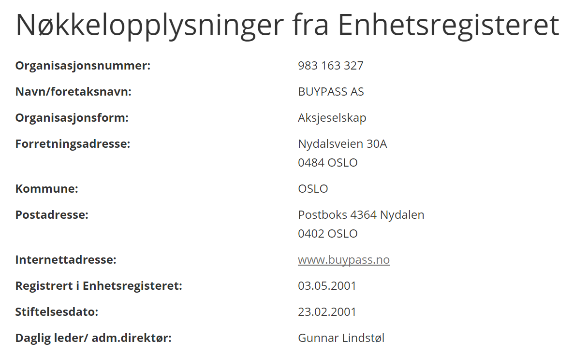
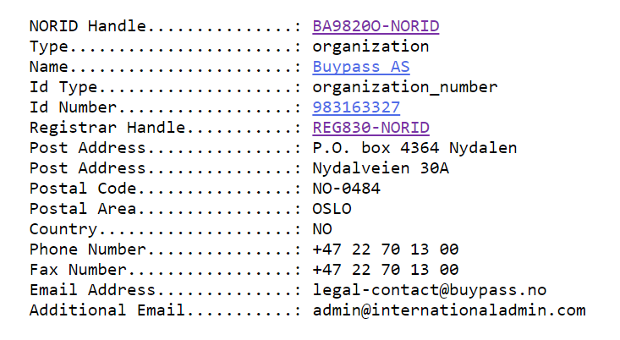

Example - Buypass AS as domain owner for buypass.no
Buypass CA
Applicant
Domain Name Registrant
Equals?

Slide 12
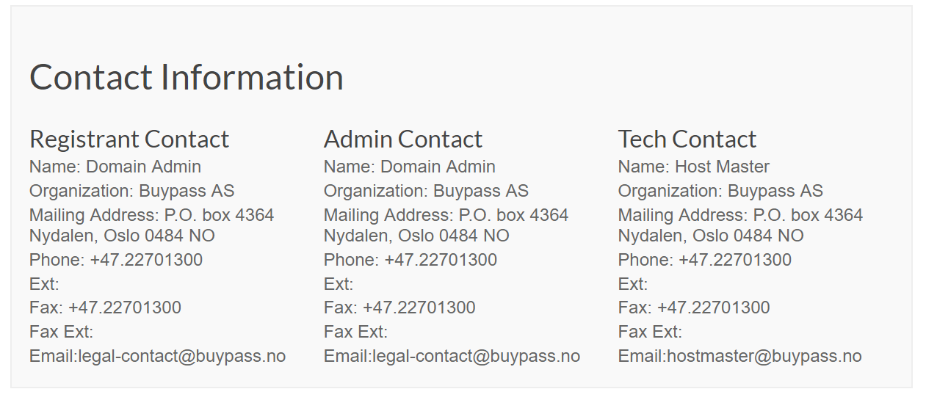
Example: Buypass AS as domain owner for buypass.com
Buypass CA
Applicant
Domain Name Registrant
Equals?

Slide 13



Authorization to issue vs right to use domain
Buypass CA
Applicant
Domain Name Registrant
Equals
Ok to issue
Ok to use domain
Authorized representative
Domain Contact

Slide 14
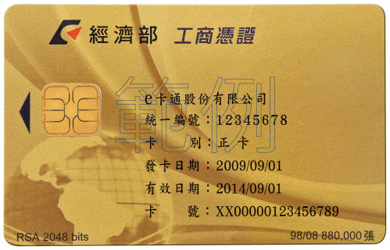
Identity and Domain Validation
Chunghwa Telecom
Identity
  Taiwan has a standard process to identify a legal entity such as a company, a government agency or a foundation
  For a company two different seals are used: 1) for the company and 2) is for the chairman/owner of the company.
  Document with both seals is a legal effective document
  Seals and other information (such as the names, registration number (Tax Uniform Number), address) of the legal entity are retained by the government officials or notaries who have verified the identity of legal entity, the chairman/owner and the seals via face by face.
  Company can also use a smartcard with certificate (issued by the government) to sign document electronically.
  Taiwan has QGIS and QTIS. And we also check address, name, registration number of the applicant through the QTIS or QGIS.
Method 1
  Domain name’s ownership verified by WHOIS lookup
  If the domain name’s ownership are identical to the company, there is no reason that we should not issue the certificate to the company. (The company owns the domain name and “the company” (not individual) applies for SSL certificate.).

Slide 15
Mozilla Survey Feedback
26 of 54 CA’s use Method 1
Practices:
  Applicant Representative is the Registrant where the Registrant has been verified by another member of the Applicant
  Require perfect match of Applicant and Registrant by 1)identity and business address or 2) identity and organization number
  Verify identity using (QIIS), QGIS or QTIS
  Use Method 1 and Method 5 for the same verification
  Match Applicant and Registrant by both name and country
  Contact Applicant per BR 3.2.5 using information from QIIS, QGIS or QTIS
  Use only to issue to affiliate companies of the CA

Slide 16
Method 1 Threats
Registrant is not the Applicant
  Mitigated by verifying the Registrant to match the Applicant
Applicant Representative is not permitted to approve domain use
  Mitigated by requiring the Applicant Representative to be an employee of the Applicant and to sign the Subscriber Agreement
  Mitigated by requiring authorization to represent the Applicant be confirmed by RMOC
Applicant has not proven control of the domain
  Mitigated by confirming that the Applicant owns the domain, has signed the Subscriber Agreement, and have authorized certificate issuance

Slide 17
Enhancement Suggestions
State both requirement and acceptable methods
  Requirement: Validate the Applicant is the Domain Name Registrant directly with the Domain name Registrar
  Method (one of the following methods):
    Validate Applicant per BR 3.2.2.1 and match to the name and address of the Registrant
    Validate Applicant per BR 3.2.2.1 and match to the name and organization number or registration number of the Registrant
    Validate Applicant per BR 3.2.2.1 and match the name to the Registrant and confirm that the CA has been authorized to issue per CAA
Update 3.2.2.1 to ensure sound data sources such as QIIS, QGIS and QTIS
Update 3.2.5 to ensure the Applicant Representative has signed the Subscriber Agreement or has been authorized by the signer of the Subscriber Agreement

Slide 18
Thanks

