Slide 1
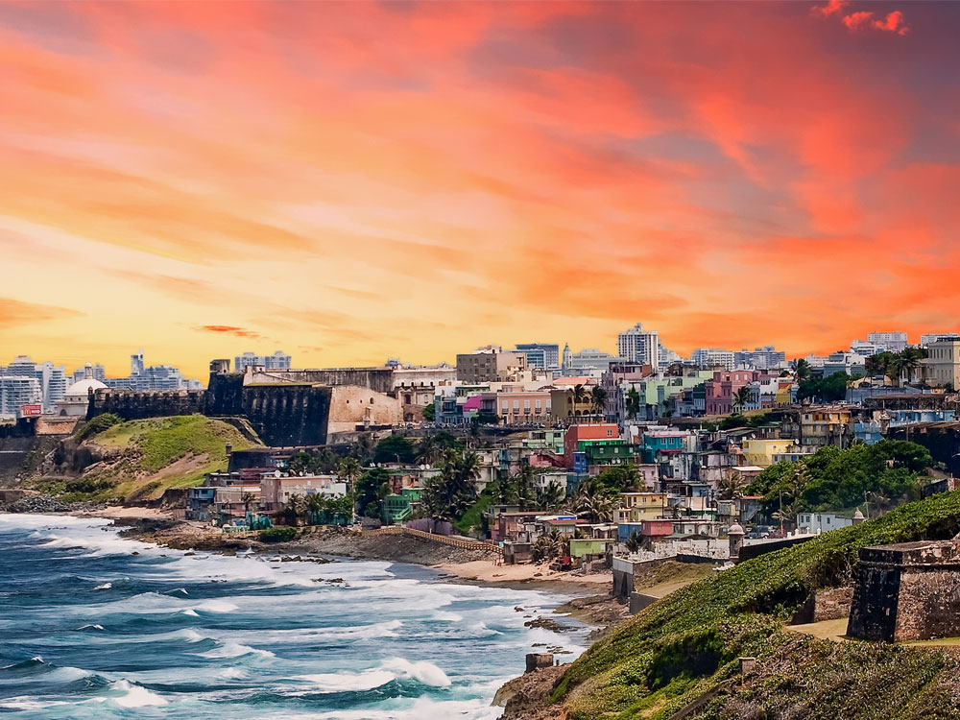


Slide 2
Next-Generation gTLD
Registration Directory Service (RDS) to replace WHOIS PDP WG
Face-to-Face Working Group Meeting
Wednesday 14 March (15.15-18.30 Local Time)
ICANN 61

Slide 3
Agenda: Wednesday 14 March
1
2
3
Introductions
& SOI Updates
Quick Review
of Meeting Goals and Saturday progress
Entities identified or contacted using gTLD registration data (cont’d)
Deliberate on remaining possible purposes for processing registration data
4
5
Confirm action items & proposed decision points

Slide 4
WG Member Introductions and SOI Updates
Agenda Item #1

Slide 5
Quick Review of
Meeting Goals and
Saturday progress
Agenda Item #2

Slide 6
Goals for this meeting
As the WG has deliberated on these Charter Questions:
  Who should have access to gTLD registration data and for what purposes?
  What data should be collected, stored, and disclosed for those purposes?
We may be constraining our thinking by deliberating on existing WHOIS data elements, assuming today’s (often implicit) definitions, without clearly-stated expectations of the entities identified and/or contacted using registration data
To address these concerns and enable more effective deliberation, purpose drafting teams were asked to re-convene to answer the following questions:
  Who associated with the domain name registration needs to be identified and/or contacted for each purpose?
  What is the objective achieved by identifying and/or contacting each of those entities?
  What might be expected of that entity with regard to the domain name?
On Saturday, four DTs presented their answers to the full WG: today, the other three DTs will present their answers.
Time permitting, results will be put to use at the end of today’s session, where we will resume deliberation on possible purposes and associated data

Slide 7
Summary of entities to be identified or contacted for each possible purpose
Purpose | Tech Issue Resolution | DNS Research | DN Management | Individual Internet Use | DN Certification | DN Purchase Sale | ICANN Contractual Enforcement | Regulatory Enforcement | Legal Action | CA/DA Investigation | CA/DA Notification | CA/DA Reputation
Identify
- DN Owner
- Registrar
- Registry
- PP
- Hosting provider
- DNS Admin
- DN User
- 3rd parties
Contact
- DN Owner
- Registrar
- Registry
- PP
- Hosting provider
- DNS Admin
- DN User
- 3rd parties
Objective
- Notify
- Request Action
- Verify ID
- Use ID
- Confirm
Expectations of Contacted Entity
- Investigate
- Respond
- Resolve
- Have right and/or ability to take action
Table available in PDF form: https://go.icann.org/2FNLdWe

Slide 8
Entities Identified or Contacted using gTLD Registration Data (Cont’d)
Agenda Item #3

Slide 9
DT#5: Regulatory Enforcement and ICANN Contractual Enforcement
Mailing list address: gnso-rds-pdp-5@icann.org
Mailing list archive: http://mm.icann.org/pipermail/gnso-rds-pdp-5/
Coordinated by: Chuck Gomes
Members: Elizabeth Bacon, Theo Geurts, Steve Metalitz, Krishna Seeburn, Farell Folly, Bastiaan Goslings, Kathy Kleiman
DT5 Answers (to be introduced by Farell and Beth):
  https://community.icann.org/download/attachments/79431882/DT5FinalAnswersfortheRegulatoryPurpose.pdf
  https://community.icann.org/download/attachments/79431882/DT5FinalAnswersfortheICANNContractualCompliancePurpose.pdf

Slide 10
DT#6: Legal Actions
Mailing list address: gnso-rds-pdp-6@icann.org
Mailing list archive: http://mm.icann.org/pipermail/gnso-rds-pdp-6/
Coordinated by: Chuck Gomes
Members: Paul Keating, Roger Carney, Vicky Sheckler, Farzaneh Badii, Griffin Barnett, Juan Manuel Rojas
DT6 Answers (to be introduced by Griffin):
https://community.icann.org/download/attachments/79431882/DT6FinalAnswersfortheLegalActionsPurpose.pdf

Slide 11
DT#7: Criminal Investigation/DNS Abuse Mitigation – Investigation, Notification, and Reputation
Mailing list address: gnso-rds-pdp-7@icann.org
Mailing list archive: http://mm.icann.org/pipermail/gnso-rds-pdp-7/
Coordinated by: Marika Konings
Members: Richard Leaning, Marc Anderson, Kiran Malancharuvil, Ayden Ferdeline, Rod Rasmussen, Raoul Plommer
DT7 Answers (to be introduced by Marc):
https://community.icann.org/download/attachments/79431882/DT7AnswerstoQuestions-7March2018.pdf

Slide 12
Deliberate on remaining possible purposes for processing gTLD registration data
Agenda Item #4

Slide 13
Refer to Drafting Team Outputs
Refer to definitions produced by Drafting Teams in November 2017:
  DT5: ICANN Contractual Enforcement PDF and DOC
  DT4: Domain Name Purchase/Sale PDF and DOC
Starting with ICANN Contractual Compliance (DT5) and Domain Name Purchase/Sale (DT4), for each possible purpose, let’s consider:
  Is this a legitimate purpose for processing registration data?
  If so, what data (including contact data) is necessary for this purpose?
  Is that data already collected for another (compatible) purpose?

Slide 14
DT5 - ICANN Contractual Enforcement
Drafting Team’s Purpose Summary:
Information accessed to enable ICANN Compliance to monitor and enforce contracted parties’ agreements with ICANN.
Data:
ICANN organization may require the following data elements to check ICANN contractual compliance
  Registrant Name
  Registrant Street
  Registrant Email
  Name Server
  Domain Status
  Log files and, … other records associated with the Registration containing dates, times, and time zones of communications and sessions, including initial registration
  Updated Date
  Registry Expiry Date
DT5 Output: https://community.icann.org/download/attachments/74580010
/DT5%20Final%20Deliverable%20for%20the%20Contactual%20Enforcement%20Purpose%20%28Use%20Case%29%20-%208%20Nov%2017%20%28002%291.pdf

Slide 15
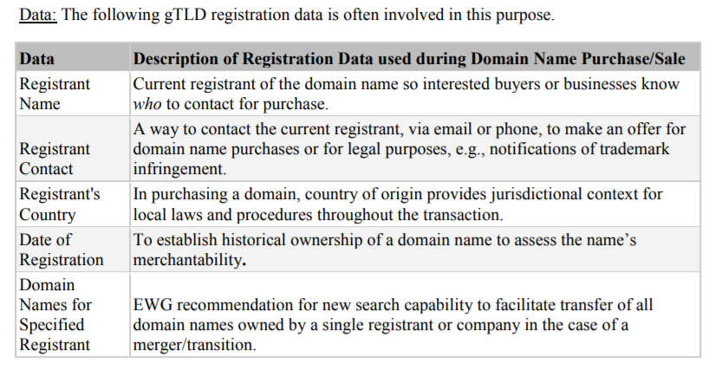
DT4 - Domain Name Purchase/Sale
Drafting Team’s Purpose Summary:
Information to enable contact between the registrant and third-party buyer to assist registrant in proving and exercising property interest in the domain name and third-party buyer in confirming the registrant's property interest and related merchantability.
DT4 Output: https://community.icann.org/download/attachments/74580010/
DraftingTeam4-DNPurchaseSale-Purpose-v9-clean.pdf

Slide 16
Confirm action items and proposed decision points
Agenda Item #5

Slide 17
Links to Meeting Materials & Background Slides
Agenda Item #6

Slide 18
Sessions at ICANN61 and Further Information
RDS PDP WG sessions at ICANN61:
Saturday March 10, 2018 (8.30-12.00 local time)
Wednesday March 14, 2018 (15.15-18.30 local time)
Background information:
Background Docs: https://community.icann.org/x/QIxlAw
Phase 1 Docs: https://community.icann.org/x/p4xlAw
Latest RDS PDP Newsletter:
RDS PDP - Newsletter - March 2018
Working Group Charter:
https://community.icann.org/x/E4xlAw
Working Group online wiki space (with meeting transcripts, call recordings, draft documents and background materials):
https://community.icann.org/x/rjJ-Ag

Slide 19

Thank You and Questions
Reach us at:
Email: gnso-rds-pdp-wg@icann.org
Website: http://tinyurl.com/ng-rds

Slide 20
Additional Materials
for Reference

Slide 21
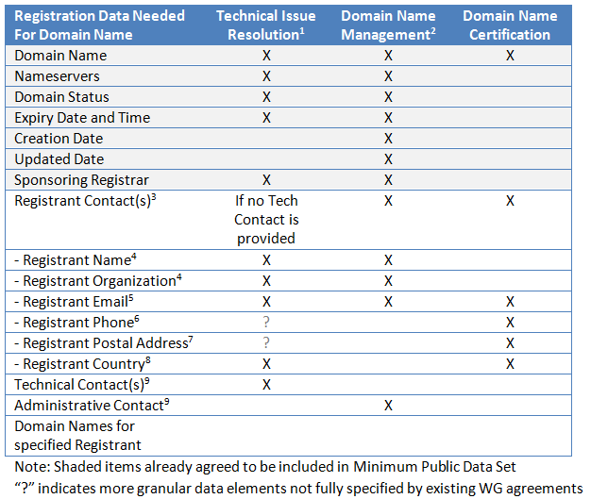
Summary of previous registration data agreements

Slide 22
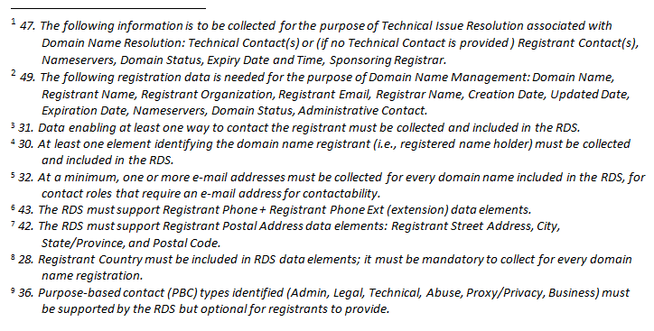
Related WG Agreements (footnoted on previous slide)
Source: https://community.icann.org/download/attachments/79432604/KeyConceptsDeliberation-WorkingDraft-13Feb2018.pdf

Slide 23
Admin ID: 5372809-ERL
Admin Name: EXAMPLE REGISTRANT ADMINISTRATIVE
Admin Organization: EXAMPLE REGISTRANT ORGANIZATION
Admin Street: 123 EXAMPLE STREET
Admin City: ANYTOWN
Admin State/Province: AP
Admin Postal Code: A1A1A1
Admin Country: EX
Admin Phone: +1.5555551212
Admin Phone Ext: 1234
Admin Fax: +1.5555551213
Admin Fax Ext:
Admin Email: EMAIL@EXAMPLE.TLD
Tech ID: 5372811-ERL
Tech Name: EXAMPLE REGISTRAR TECHNICAL
Tech Organization: EXAMPLE REGISTRAR LLC
Tech Street: 123 EXAMPLE STREET
Tech City: ANYTOWN
Tech State/Province: AP
Tech Postal Code: A1A1A1
Tech Country: EX
Tech Phone: +1.1235551234
Tech Phone Ext: 1234
Tech Fax: +1.5555551213
Tech Fax Ext: 93
Tech Email: EMAIL@EXAMPLE.TLD
Name Server: NS01.EXAMPLEREGISTRAR.TLD
Name Server: NS02.EXAMPLEREGISTRAR.TLD
DNSSEC: signedDelegation
DNSSEC: unsigned
>>> Last update of WHOIS database: 2009-05-29T20:15:00Z <<<
Example WHOIS Record
From Registry Agreement
Domain Name: EXAMPLE.TLD
Domain ID: D1234567-TLD
WHOIS Server: whois.example.tld
Referral URL: http://www.example.tld
Updated Date: 2009-05-29T20:13:00Z
Creation Date: 2000-10-08T00:45:00Z
Registry Expiry Date: 2010-10-08T00:44:59Z
Sponsoring Registrar: EXAMPLE REGISTRAR LLC
Sponsoring Registrar IANA ID: 5555555
Domain Status: clientDeleteProhibited
Domain Status: clientRenewProhibited
Domain Status: clientTransferProhibited
Domain Status: serverUpdateProhibited
Registrant ID: 5372808-ERL
Registrant Name: EXAMPLE REGISTRANT
Registrant Organization: EXAMPLE ORGANIZATION
Registrant Street: 123 EXAMPLE STREET
Registrant City: ANYTOWN
Registrant State/Province: AP
Registrant Postal Code: A1A1A1
Registrant Country: EX
Registrant Phone: +1.5555551212
Registrant Phone Ext: 1234
Registrant Fax: +1.5555551213
Registrant Fax Ext: 4321
Registrant Email: EMAIL@EXAMPLE.TL
D
https://newgtlds.icann.org/sites/default/files/agreements/agreement-approved-31jul17-en.pdf

