Slide 1



Slide 2
Community Session - Next-Generation gTLD Registration Directory Service (RDS) to replace WHOIS
RDP PDP WG | ICANN56 | 27 June 2016

Slide 3

Agenda
1
2
3
Introduction to the Next-Gen
RDS PDP
PDP Work Plan and Near-Term Opportunities for Early Input
Next-Gen RDS:
Today’s Gaps, Tomorrow’s Policy Framework
4
5
Next Steps
To Learn More
Notes:
This is a stylized agenda slide for your presentation.
To delete a box, if there are too many boxes, click the edge of the box, ensure the entire box is highlighted, then DELETE.
To update the numbers and text, click inside the circle for the numbers or in the box for the text, revise the text.

Slide 4
Introduction to the
Next-Gen RDS PDP
Agenda Item #1
Notes:
Breakup your presentation, divide it into sections. This is especially useful if most of your presentation is text.

Slide 5
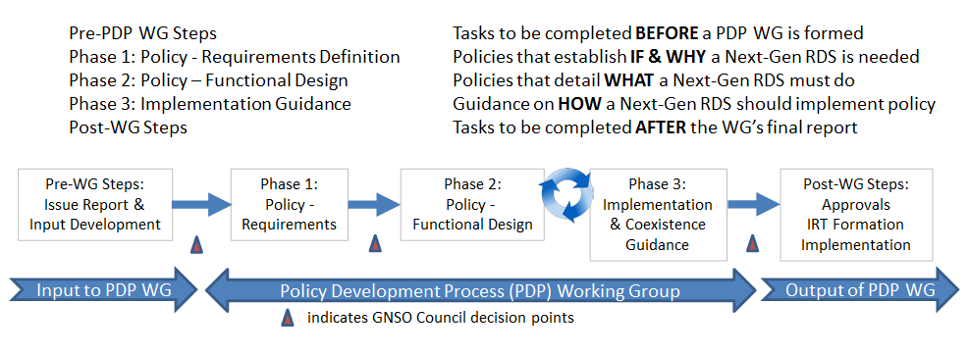
Introduction
This PDP has been tasked with defining the purpose of collecting, maintaining and providing access to gTLD registration data and considering safeguards for protecting that data.
The charter organizes this WG’s tasks into three phases

Slide 6
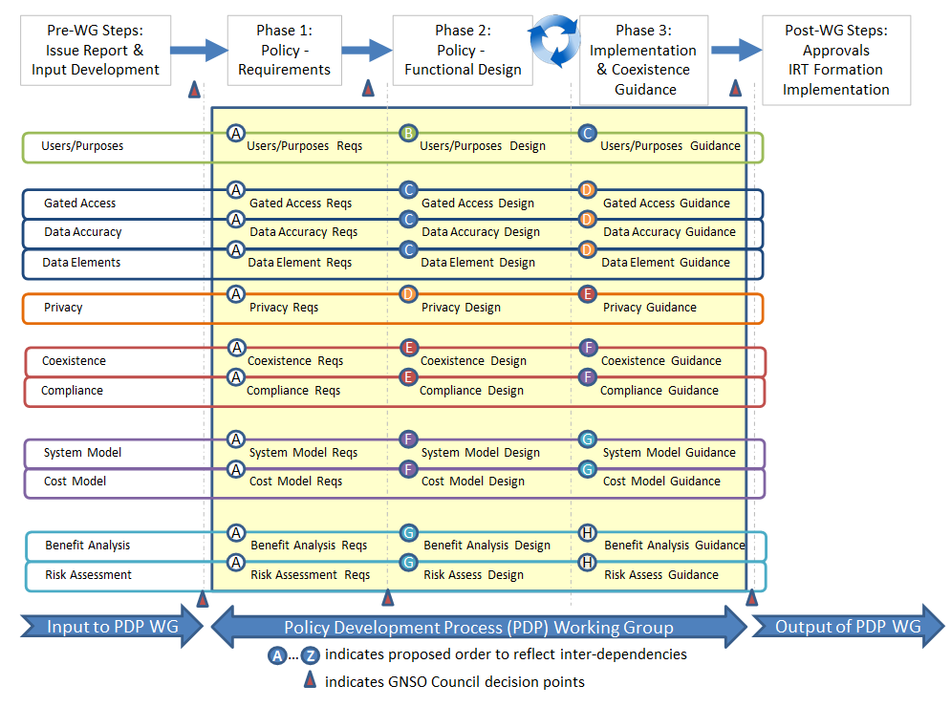
With questions to be addressed in each phase

Slide 7
During Phase 1, this WG will
Attempt to reach consensus on the following questions (at a minimum):
What are the fundamental requirements for gTLD registration data? When addressing this, the PDP WG should consider, at a minimum, users and purposes and associated access, accuracy, data element, and privacy requirements
Is a new policy framework and next-generation RDS needed to address these requirements?
  If yes, what cross-cutting requirements must any next-generation RDS address, including coexistence, compliance, system model, and cost, benefit, and risk analysis requirements
  If no, does the current WHOIS policy framework sufficiently address these requirements? If not, what revisions are recommended to the current WHOIS policy framework to do so?

Slide 8
PDP Work Plan and
Near-Term Opportunities for Early Input
Agenda Item #2
Notes:
Breakup your presentation, divide it into sections. This is especially useful if most of your presentation is text.

Slide 9
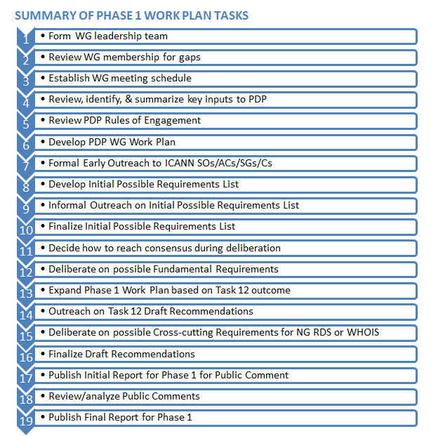

PDP Work Plan
PHASE
We are here
Work Plan posted at:
https://community.icann.org/x/oIxlAw

Slide 10

Near-term Opportunities for Early Input
Formal Early Outreach: 11 May – 16 June
  ICANN SO/ACs & GNSO SG/Cs additions to Key Inputs
  Responses now being reviewed by WG -- https://community.icann.org/x/pYxlAw
Informal Outreach: 11 June – 28 June
  ICANN SO/ACs & GNSO SG/Cs additions to
  Initial Possible Requirements List
  Input requested at this session and WG’s F2F session:
  Tuesday 28 June 08:00-10:30 -- http://sched.co/7GqJ
Additional opportunities planned throughout Phase 1, including
  Public Comment on proposed responses to Fundamental Questions and if a Next-Gen RDS is needed to replace WHOIS
  Public Comment on Initial Phase 1 Report

Slide 11
Next-Gen RDS:
Today’s Gaps, Tomorrow’s Policy Framework
Agenda Item #3
Notes:
Breakup your presentation, divide it into sections. This is especially useful if most of your presentation is text.

Slide 12
We are seeking YOUR input
This PDP WG is expected to establish consensus requirements for gTLD registration directory services, using them to determine if and why a next-generation RDS is needed, and then establish a new policy framework to support those requirements.
All community members that collect, store, provide, or use registration data using WHOIS today have an interest in the outcome of this PDP!
This session provides all interested parties with an opportunity to voice your concerns about WHOIS and needs for gTLD registration data, helping to augment and shape the possible requirements to be deliberated upon by this WG.

Slide 13

RDS PDP Charter Questions
Registration
Data Elements
What data should be collected, stored, and disclosed?
Users and Purposes
Who should have access to gTLD registration data and why (for what purposes)?
Privacy
What steps are needed to protect data and privacy?
Gated Access
What steps should be taken to control data access for each user/purpose?
Registration
Data Accuracy
What steps should be taken to improve data accuracy?
Cross-Cutting Questions
Coexistence, Compliance, System Model, Cost, Benefits, Risks, Other?

Slide 14
Help us identify Possible Requirements
What possible requirements must a new policy framework for
gTLD registration data and directory services address?
  Where does WHOIS fall short today?
  What requirements should a new RDS policy satisfy?
We are seeking a broad spectrum of real-life examples –
please share your own views to inform WG deliberation!
WG members will offer examples to kick off discussion
To leave adequate time for many different examples, let’s try to
  Spend no more than one minute sharing each example
  Avoid repetition and distribute examples across our charter questions, focusing on fundamental charter questions

Slide 15
What’s a Possible Requirement?
What about today’s WHOIS system would YOU like to see changed or maintained?
  “WHOIS lacks mechanisms for access control, integrity, and confidentiality.” -- RFC 3912, Privacy & Gated Access
What expectations do YOU have for gTLD registration data or gTLD registration directory services?
  “gTLD registration data [must be] collected, validated, and disclosed for permissible purposes only.” -- EWG Report, Data Elements
What topics do YOU want the RDS policy framework to address?
  “There is a critical need for policy asserting the purpose of collecting and maintaining registration data.” -- SAC051, User/Purpose
  “Accuracy policies should apply to all registration data without regard to whether internationalized or ASCII data.” -- SAC051, Data Accuracy
These are just a few examples, taken from input documents

Slide 16
Offer your own suggestions!
Registration
Data Elements
What data should be collected, stored, and disclosed?
Users and Purposes
Who should have access to gTLD registration data and why (for what purposes)?
Privacy
What steps are needed to protect data and privacy?
Gated Access
What steps should be taken to control data access for each user/purpose?
Registration
Data Accuracy
What steps should be taken to improve data accuracy?
Cross-Cutting Questions
Coexistence, Compliance, System Model, Cost, Benefits, Risks, Other?

Slide 17
Record participant’s suggestions
Related Charter Question(s) | Suggested additional possible requirements

Slide 18

Your opinion?
After this PDP WG considers fundamental questions and deliberates on possible requirements that it may recommend, it has been tasked with using those to try to reach consensus on this foundational question:
Based on YOUR requirements,
what do YOU think?
Is a next-generation RDS needed to support
gTLD registration data and
directory service requirements?

Slide 19
Next Steps
Agenda Item #4
Notes:
Breakup your presentation, divide it into sections. This is especially useful if most of your presentation is text.

Slide 20
RDS PDP WG meeting on 28 June
The majority of this WG meeting is expected to focus upon using available inputs to develop a comprehensive and inclusive list of possible requirements for gTLD registration data and directory services
During this session, the WG will focus on making progress on near-term tasks outlined in our work plan
This meeting will be open to WG members, WG observers and guests
To learn more, visit:
http://icann562016.sched.org/event/7GqJ

Slide 21
To Learn More
Agenda Item #5
Notes:
Breakup your presentation, divide it into sections. This is especially useful if most of your presentation is text.

Slide 22

To prepare for this session
RDS PDP WG Wiki: https://community.icann.org/x/rjJ-Ag
PDP WG Charter: https://community.icann.org/x/E4xlAw
PDP WG Membership: https://community.icann.org/x/I4xlAw
RDS PDP - Monthly Update - May 2016.pdf
RDS PDP Beginner’s Tutorial (2 February 2016)
Key Inputs: https://community.icann.org/x/QIxlAw
Phase 1 Docs: https://community.icann.org/x/p4xlAw
including Draft 3: RDS PDP Initial List of Possible Requirements for gTLD registration data and directory services (10 June 2016)

Slide 23

To learn more
Thank You and Questions
Reach us at:
Email: gnso-rds-pdp-wg@icann.org
Website: http://tinyurl.com/ng-rds
Notes:
You can adjust the email/web address to whichever email or web address is best suited to your presentation. This should be your final slide.

