Slide 1
WebEx Participant Guide
Steps to join and participate in a WebEx Meeting
Sara Caplis
WebEx Participant Guide
26 March 2018

Slide 2
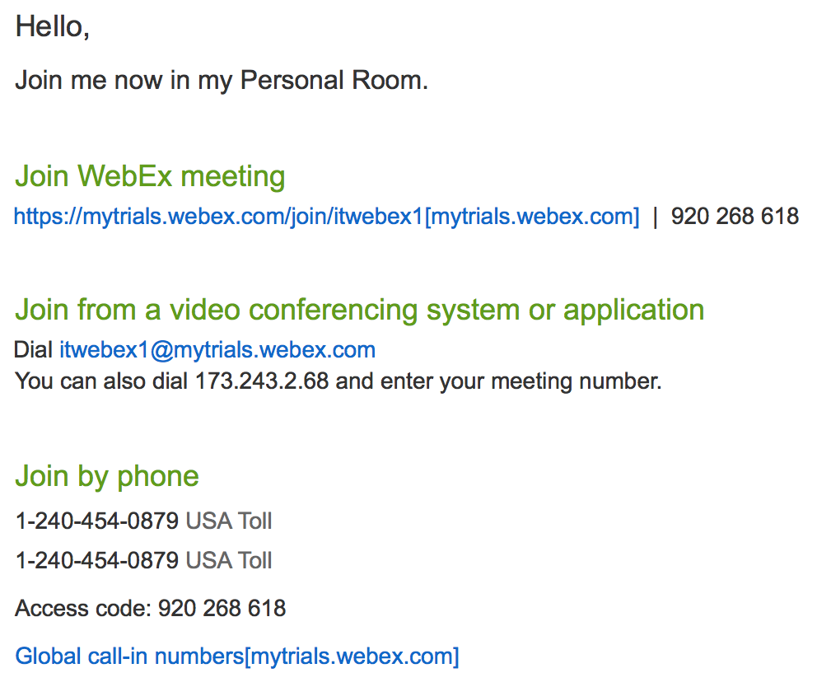
Meeting Invite
The WebEx Meeting invite may have several views dependent on how the meeting is scheduled by the Host. The invite will have the link needed to join the meeting room as seen below in a simple Webex invite.
Click here to join the meeting
Teleconferencing
informationis listed here. Please note, your invite might include additional/alternate bridge information that you may wish to join instead such as Adigo or Verizon.

Slide 3
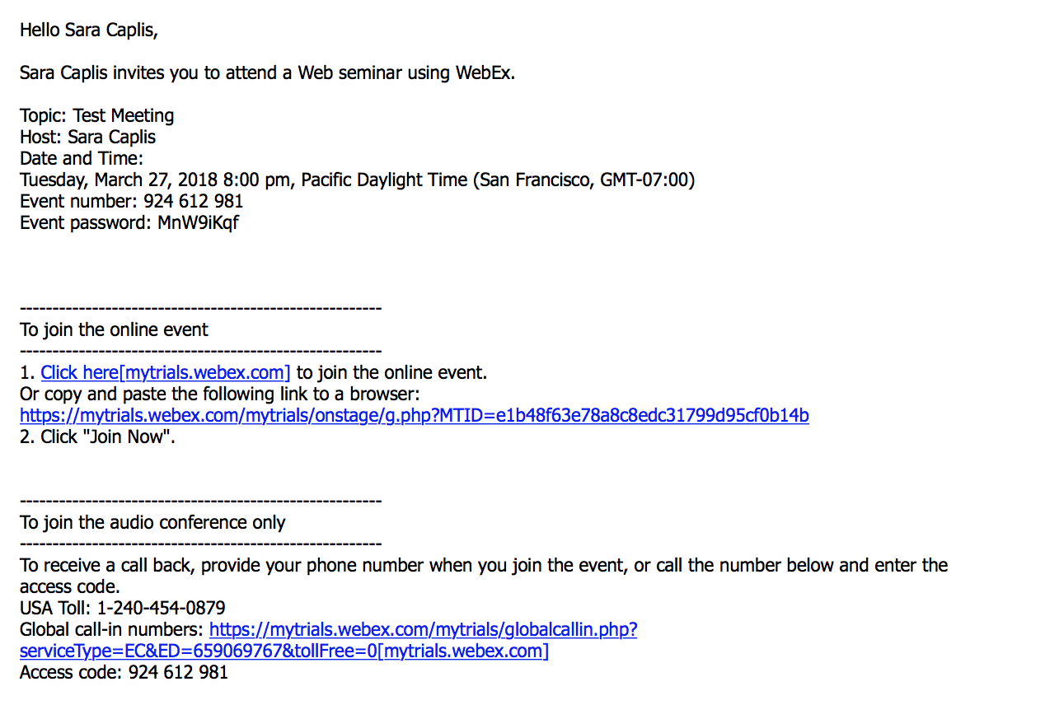
Meeting Invite
The WebEx Meeting invite may have several views dependent on how the meeting is scheduled by the Host. The invite will have the link needed to join the meeting room. More complex invites might look like the one seen here.
This section contains
meeting information,
the event number, and
event password.
Click here to join the meeting
Teleconferencing
Information is listed here. Please note, your invite might include additional/alternate bridge information that you may wish to join instead such as Adigo or Verizon.

Slide 4
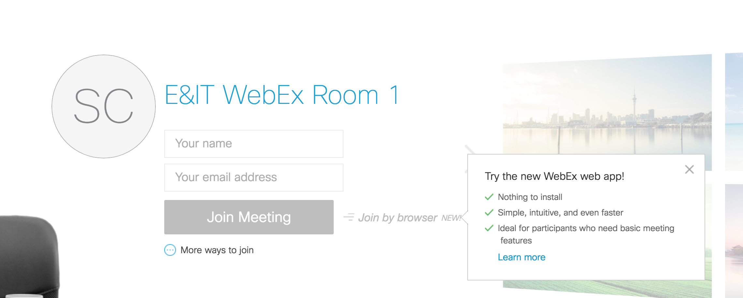
Log into WebEx as a Participant
Clicking on the link will open the WebEx log in page which will look one of two ways.
Enter your name and email address and select how you’d like to join the meeting.
If you select “Join Meeting” your computer will download the WebEx client.
If you don’t wish to download anything, select ”Join by browser.”
Keep in mind, key functions may be lost if you use the browser only.
Join using client
Join using browser

Slide 5
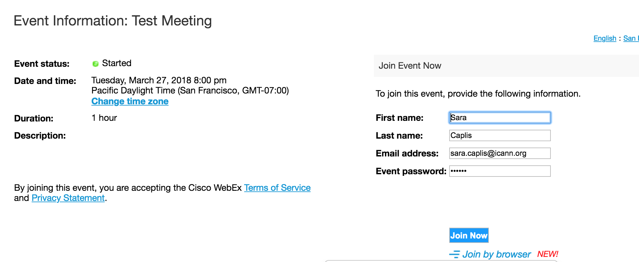
Log into WebEx as a Participant
Clicking on the link will open the WebEx log in page which will look one of two ways.
Enter your name and email address and select how you’d like to join the meeting.
If you select “Join Meeting” your computer will download the WebEx client.
If you don’t wish to download anything, select ”Join by browser.”
Keep in mind, key functions may be lost if you use the browser only.
Join using client
Join using browser

Slide 6
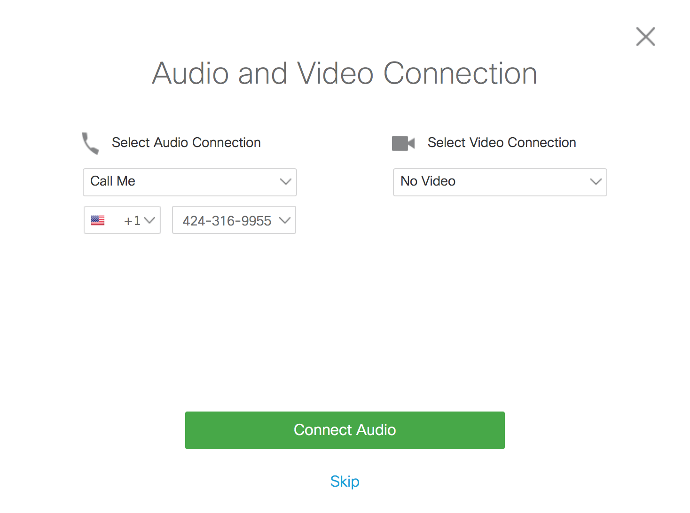
Connecting Audio and Video
After joining the meeting you will be given several options to connect your audio and/or video. Options may vary depending on the Meeting Host’s preferences. Use the drop down menu to make your selection.

Slide 7
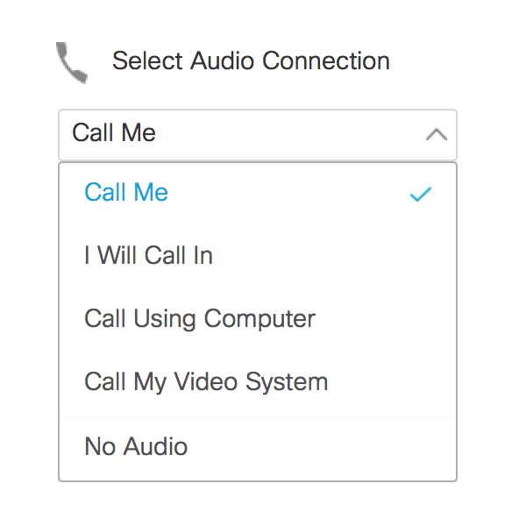

Connecting Audio
Select how you would like to connect your audio to the conference room. The list of options may be different depending on the Host’s preferences.
Call me will allow you to enter your phone information for a dial out.
I will call in will show you the phone bridge information so you can dial into the bridge from your phone.
Call Using Computer will connect your computer’s microphone to the room.
Call My Video System will allow and external video system to connect to the room.
No Audio will allow you to view the session only.
If none of the options in the drop down menu work for you, check your invite to find out if dial in information is provided from PGI, Adigo, or Verizon and dial in using that information.
After you have selected how you will join, click

Slide 8
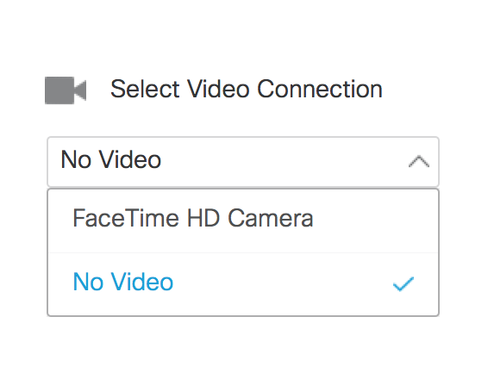

Connecting Video
Select how you would like to connect your video to the conference room. The list of options may be different depending on the Host’s preferences.
Selecting your cameras computer (FaceTime HD Camera in this case) will allow others to see you when you speak.
Selecting “No Video” will not provide others with access to your camera.
After you have selected how you will join, click

Slide 9
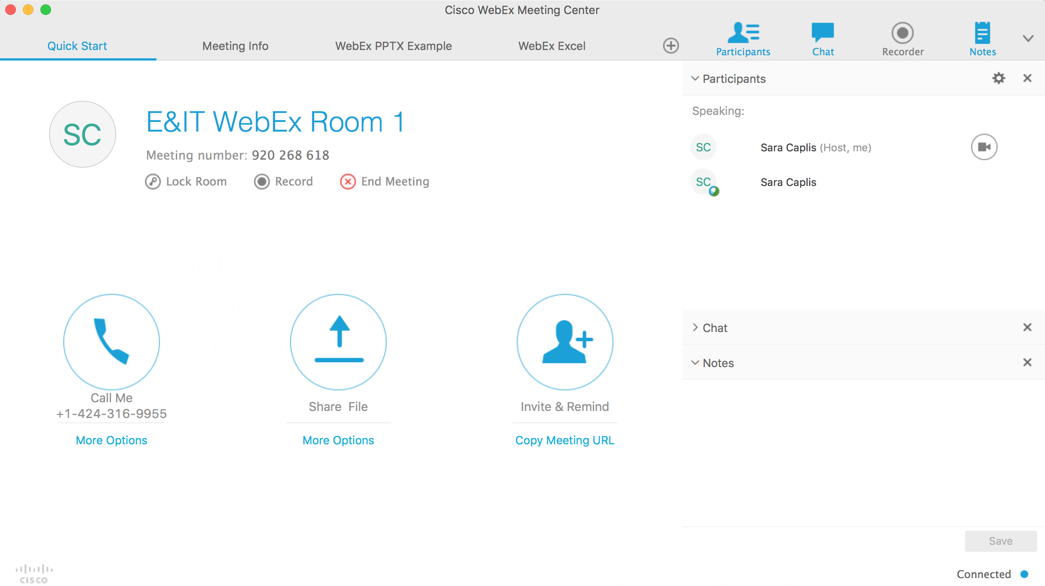
Participating in the Meeting
The participant view of the meeting will look something like this:
Select Participants,
Chat, or Notes from this
side of the navigation bar
to add them
to the left hand side of
your screen.
Please note:
The Notes feature is not
available for all sessions
and a Whiteboard is used
In it’s place.
Users can not view the
contents of chat pod
which occurred prior to
their entry into the
Session.
Various room
information and documents can be viewed by clicking on the titles in this navigation bar. In this example the host has uploaded a PowerPoint and Excel file. Ability to view and advance the documents independent of the host depends on the
Host’s preferences.

Slide 10
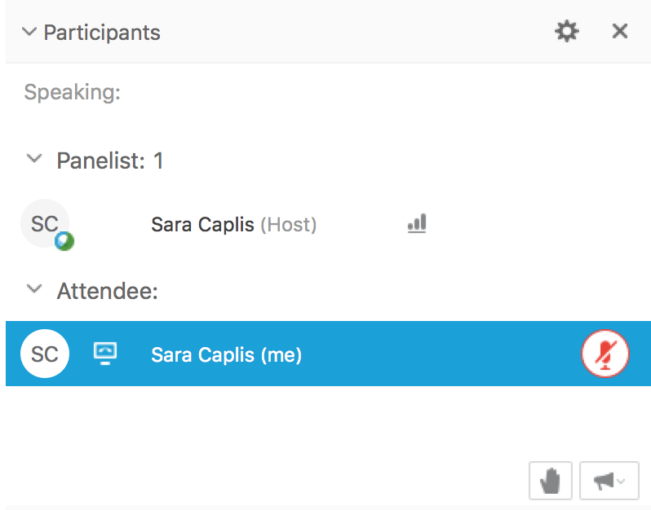
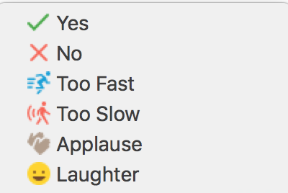
Participating in the Meeting
Depending on the Host’s preferences, participants will be able to mute and unmute themselves, share their webcam, raise their hand to ask a question, submit feedback via emoji, chat with the group or individuals, etc. Here are some examples of what you may see:
Mute and unmute your audio
Feedback emojis can
be accessed by clicking
the megaphone.
Raise your hand

Slide 11
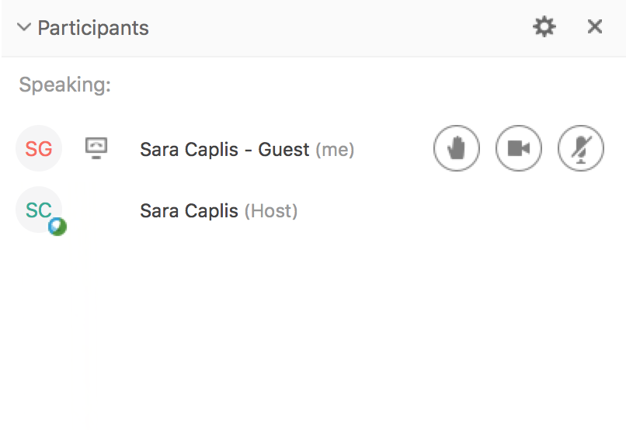
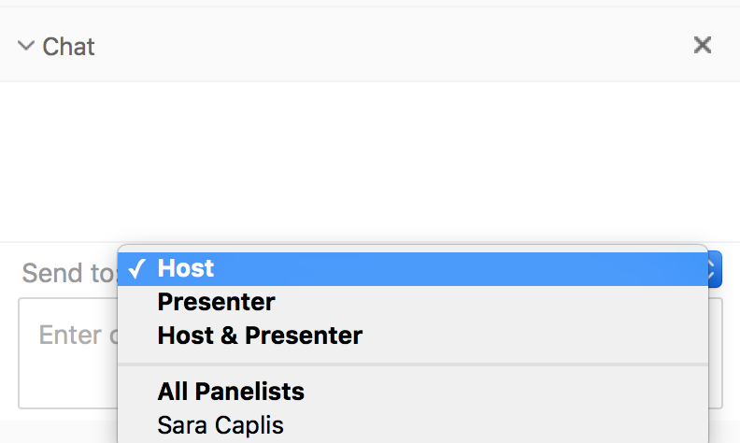
Participating in the Meeting
Depending on the Host’s preferences, participants will be able to mute and unmute themselves, share their webcam, raise their hand to ask a question, submit feedback via emoji, chat with the group or individuals, etc. Here are some examples of what you may see: mo
More options available in a different style meeting. This participant can mute and unmute their audio, turn on their webcam and raise their hand.
The chat pod has a drop down menu showing options of
who a participant can chat with. This can range from
the entire group to individual private chats, depending
on the Host’s preferences.

Slide 12






Engage with ICANN
Thank You and Questions
Visit us at icann.org
Email: email@icann.org
@icann
facebook.com/icannorg
youtube.com/icannnews
flickr.com/icann
linkedin/company/icann
slideshare/icannpresentations
soundcloud/icann

