Slide 1
National Arbitration Form Uniform Rapid Suspension System COMPLAINTS
Procedural Questions?
domaindispute@adrforum.com

Slide 2
How to Use This Demo
It’s best if you watch this as a PowerPoint Presentation, as there are arrows and boxes that will pop up to point things out, but if you can’t, that’s fine too.
Some slides have detailed information in the Notes. Regardless of how you view the Demo, please review the Notes Pages.
Contact us if you have procedural questions. We cannot tell you if you have a good case or what your best options are, but we can tell you how to access our portal!

Slide 3
The Uniform Rapid Suspension System
Costs are low; this system relies upon users to do a lot of “self-service” and upon automation of routine document transmission.
Interaction with our portal is *required*
Case coordinators are still available as a resource.
Validation at filing means the system won’t work until there are new gTLDs in the root. We have work arounds in place in case our vendor can’t get the new gTLDs in fast enough.

Slide 4
Filing a URS Complaint

Slide 5
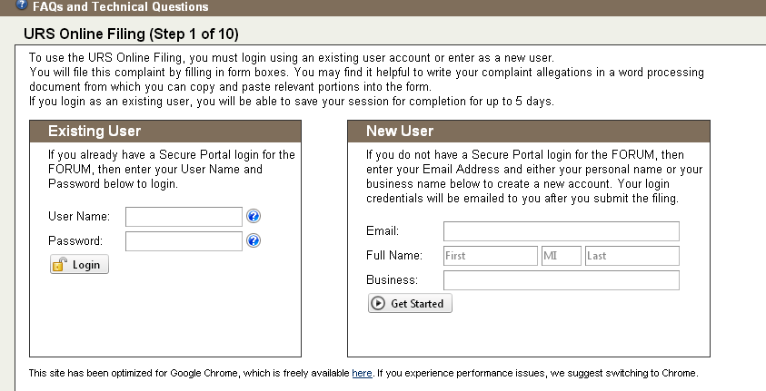
Online Filing
From http://domains.adrforum.com
Select URS from the Policies dropdown. Select Online Filing.
If you have a username and password from UDRP, log in.
If you do not have a username and password from UDRP, sign up here (see note)
Notes:
You can enter your name or your business name or both. If you enter both, the system will use the business name as the Username. The format of the Username will be XXBusinessNameAsYouEnterIt. If you only enter a personal name, your Username will be FMLast. An empty Middle Initial will become “X”. Once you create your account name, you can always contact us to add or amend the business name.
If you are an attorney, consider if you will be sharing an account with other firm members or if you will have your own before you set up a username. Usernames are unique.
Contact any case coordinator for assistance, or email domaindispute@adrforum.com.

Slide 6
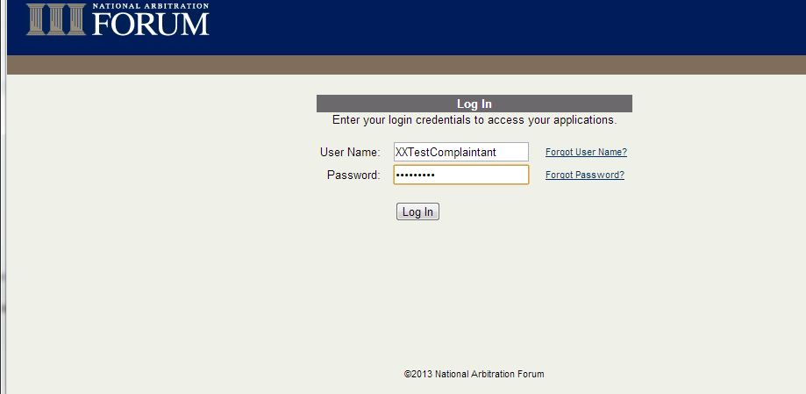
Log in
If you want to log in through your portal, first log into your portal account.
If you forgot your password, a reset will be emailed to you, watch your spam folder.

Slide 7
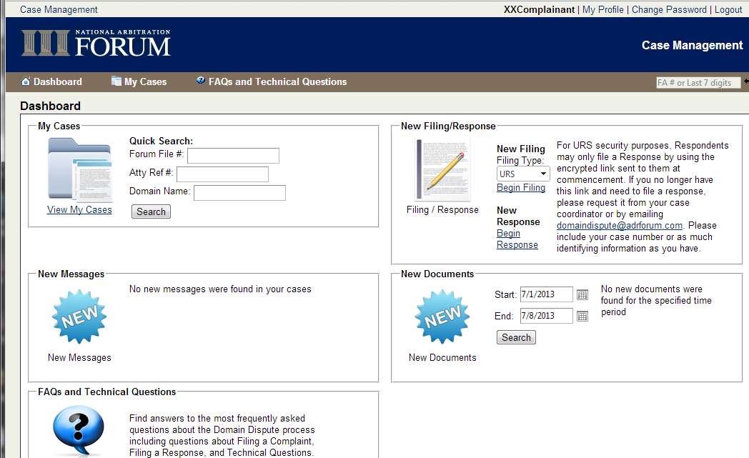
From your portal, select URS, then click “Begin Filing.” The system will automatically log you in.

Slide 8
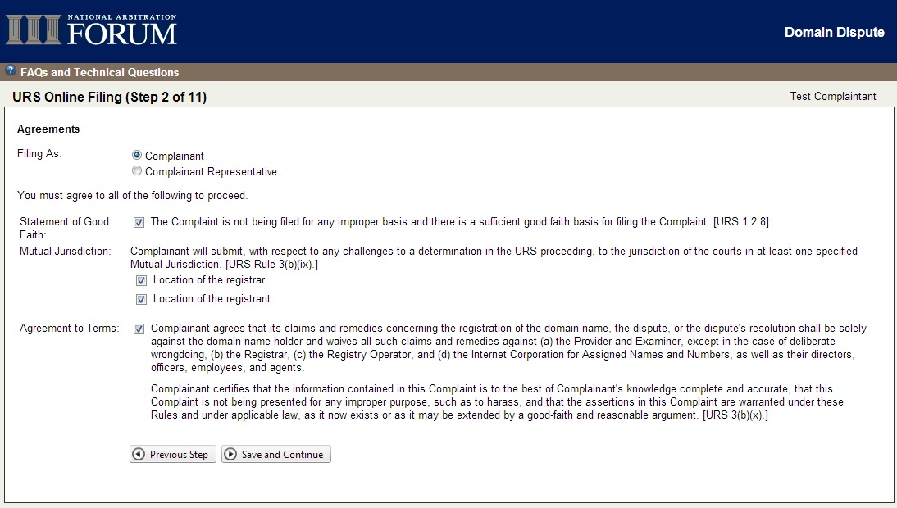
Agreements Page
URS Requires that you agree to certain terms before proceeding.

Slide 9
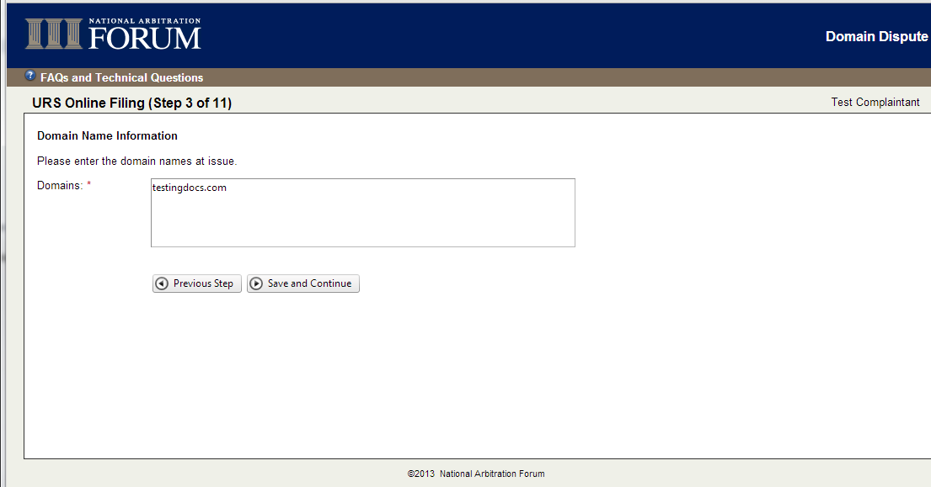
Enter Domain Name(s)
Notes:
Domain names are validated. You are unable to enter:
gTLDs that existed before Jan 1, 2013
ccTLDs that have not expressly adopted the URS
New gTLDs that are not available for registration
Third- or higher-level domains
IDNs are supported at the first and second levels.
DO NOT enter other strings to “get around” the validation. There is no way to amend your complaint and your complaint will ONLY proceed against the domain name(s) you enter.

Slide 10
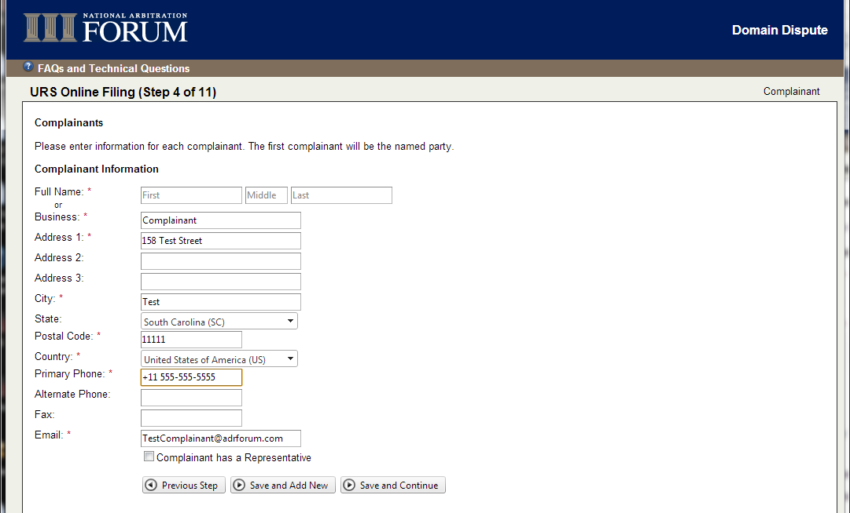
If you have logged in as an existing user, this will pre-populate, but you may edit it. Note that any edits you make will be for this case only. If you want to make changes to your profile contact the case coordinator.
If you have multiple, linked Complainants, you can add another here. You will be asked to explain the link.

Slide 11
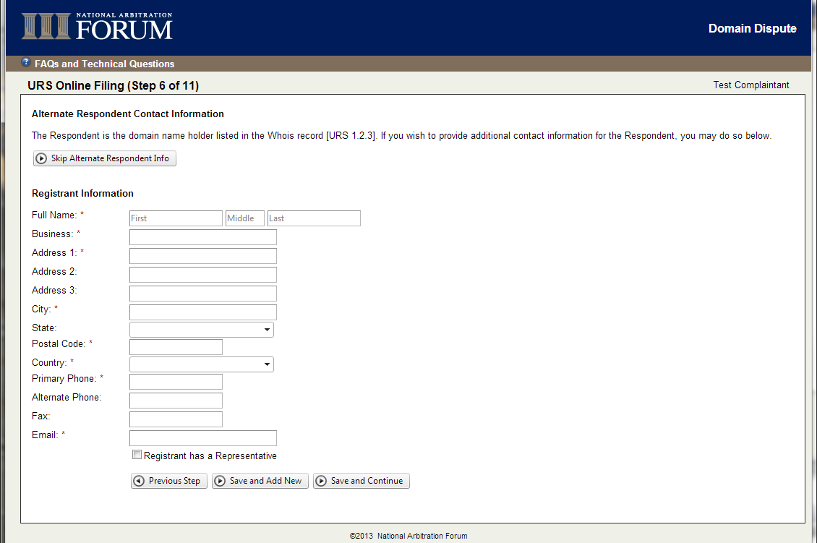
The Respondent is the entity in the Whois. If you want to add additional contact information that you have obtained, or information you have for Respondent’s counsel, enter it now.
If you enter one and/or there is more than one Whois record, you will be required to state how the entities are related.

Slide 12
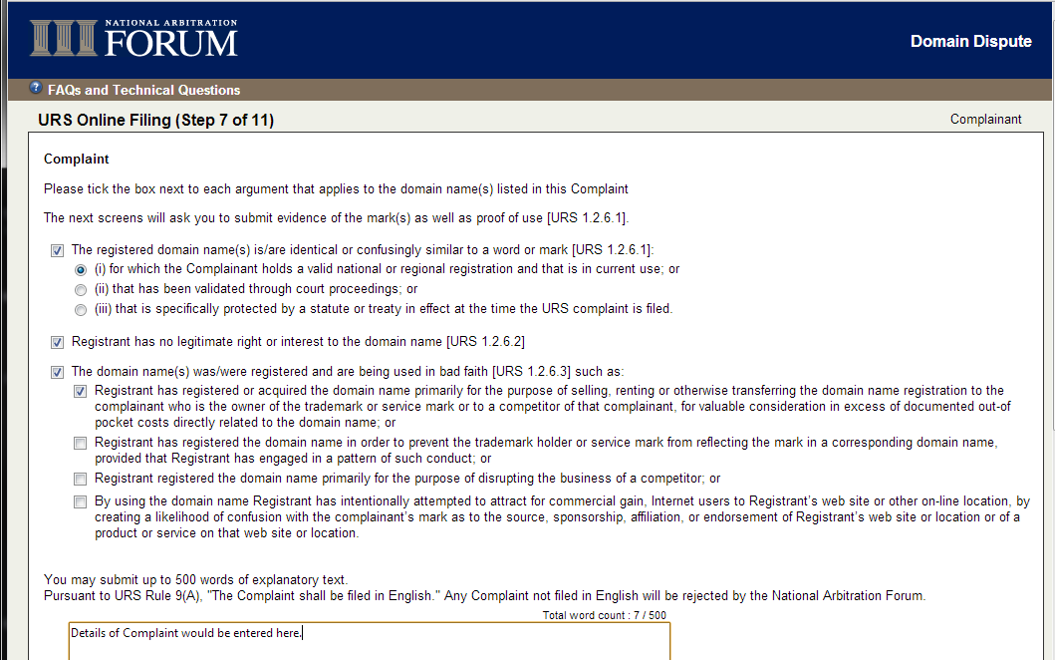
The Complaint is a series of check boxes, per the URS. You have 500 words of explanation.

Slide 13
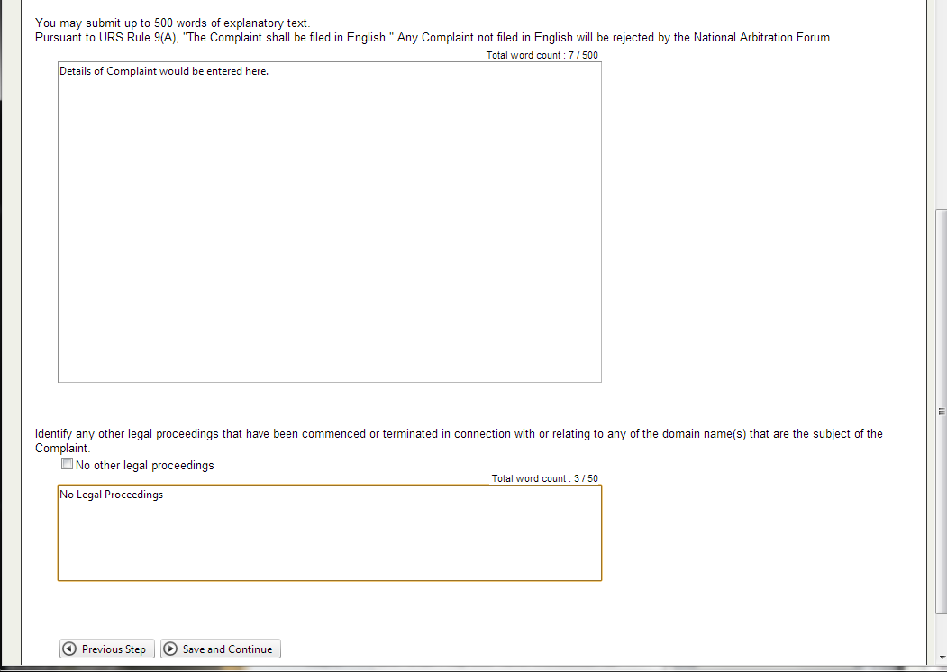
After entering your explanatory text, identify any legal proceedings.

Slide 14
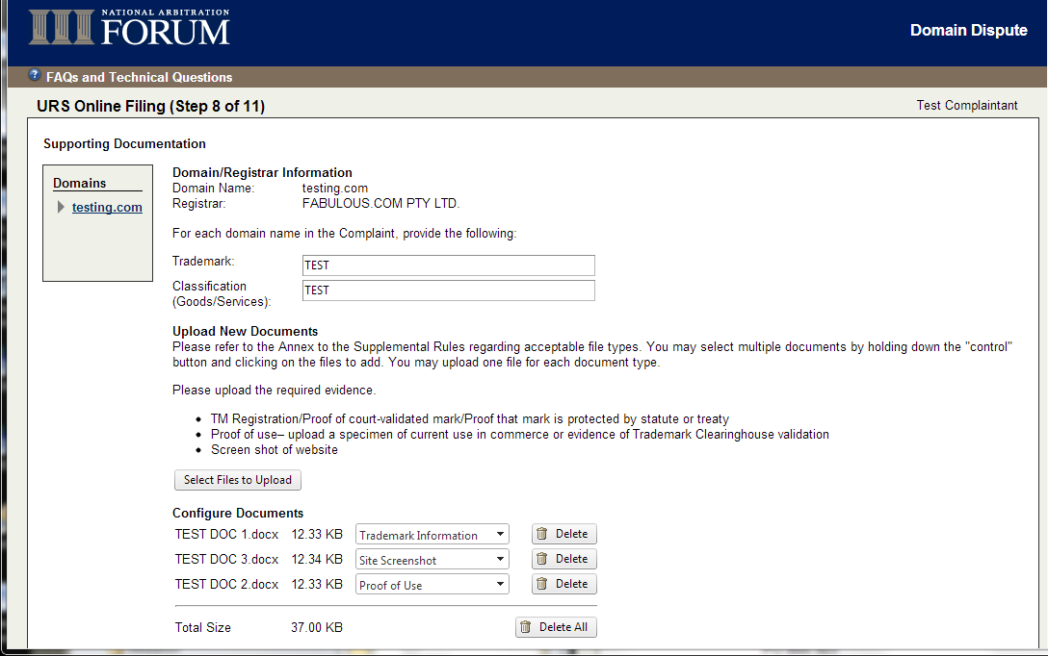
For each domain name, enter the information required under URS 1.2.6.
Notes:
Enter the Trademark and Goods and Services in the boxes provided.
For each domain name, you need to enter the TM(s) that apply to that DN.
In the upload section
upload a single file for the TM registration for the mark relating to that domain name.
Upload a single screenshot/file demonstrating what that domain name is being used for.
Upload a proof of use. This can be the TMCH validation key.
If the same information applies to more than one domain name, you can upload the same file as many times as is applicable.

Slide 15
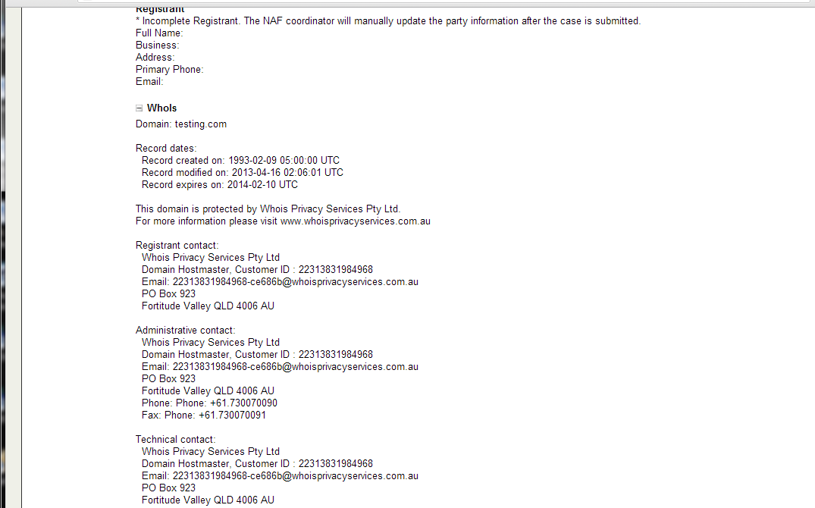
The Respondent information will automatically fill in for this domain name. If not, you will get a message like this one. The Whois should still be available. If not, please verify that the domain name is actively registered.

Slide 16
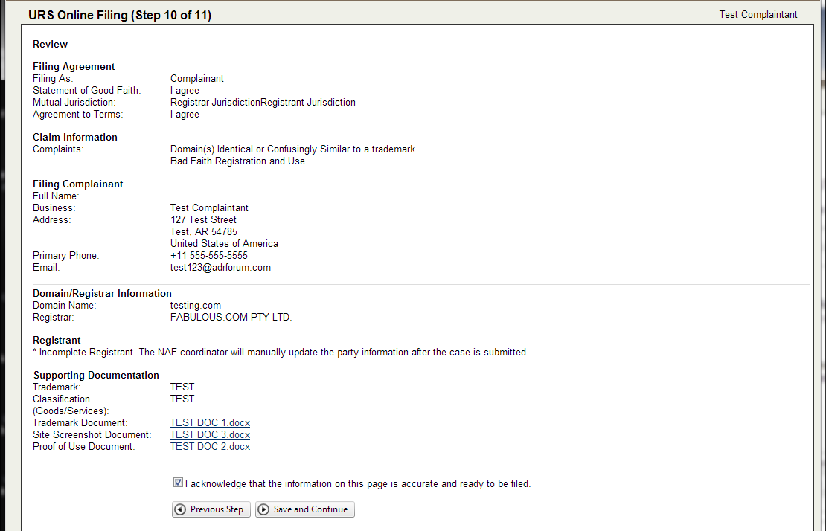
Verify that your information is correct and the case is ready to submit.

Slide 17
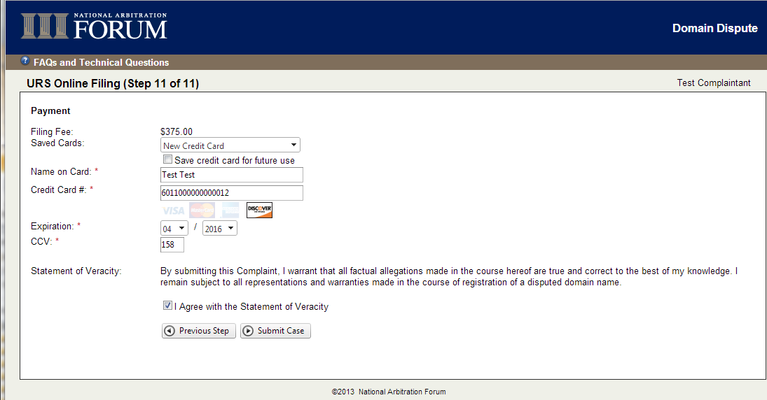
Enter credit card information. Agree that the information entered was true and correct.

Slide 18
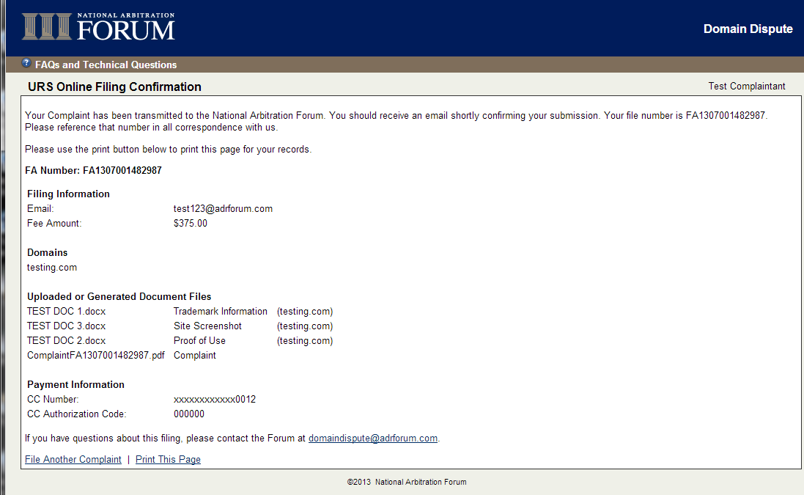
Confirmation Screen.
Includes your filing number.
If you already have portal access, you will see this case on the portal.
If the Case Coordinator needs to enter the Respondent information manually, they will regenerate the Complaint at that time and at will appear in your portal soon.
This is your receipt.

