Slide 1
CSC Overview and Current Issues
March 2019

Slide 2
Background from IANA
Transition Proposal
“The Customer Standing Committee (CSC) has been established to perform the operational oversight previously performed by the U.S. Department of Commerce’s National Telecommunications and Information Administration as it relates to the monitoring of performance of the IANA naming function. This transfer of responsibilities took effect on [October 1, 2016].
The mission of the CSC is to ensure continued satisfactory performance of the IANA function for the direct customers of the naming services. The primary customers of the naming services are TLD registry operators, but also include root server operators and other non-root zone functions.
The mission will be achieved through regular monitoring by the CSC of the performance of the IANA naming function against agreed service level targets and through mechanisms to engage with the IANA Functions Operator to remedy identified areas of concern.”

Slide 3
Membership
2 gTLD members, appointed by RySG
  Currently Gaurav Vedi and Elaine Pruis
2 ccTLD members, appointed by ccNSO
  Currently Brett Carr and Byron Holland (chair)
1 member non-ccTLD or gTLD – none appointed
6 Liaisons, appointed by their organizations:
  Mohamed El Bashir (ALAC), Jeff Bedser (SSAC), James Gannon (GNSO - Non-Registry), Nigel Cassimire, (GAC), Lars-Johan Liman (RSSAC)
  Naela Sarras (PTI)

Slide 4
Monitoring –
Core Responsibility
CSC monitors and reports on PTI compliance with the Naming Function Agreement including ‘Service Level Agreement’ (SLA) metrics
There are 62 individual metrics within 7 groups e.g. technical checks, staff processing time for gTLD creation
The SLA’s were developed by one of the CWG ‘Design Teams’ – DT-A, based on date collection done at that time
The SLAs are part of the IANA Naming Function Contract but it is being amended to move these onto the PTI website.

Slide 5
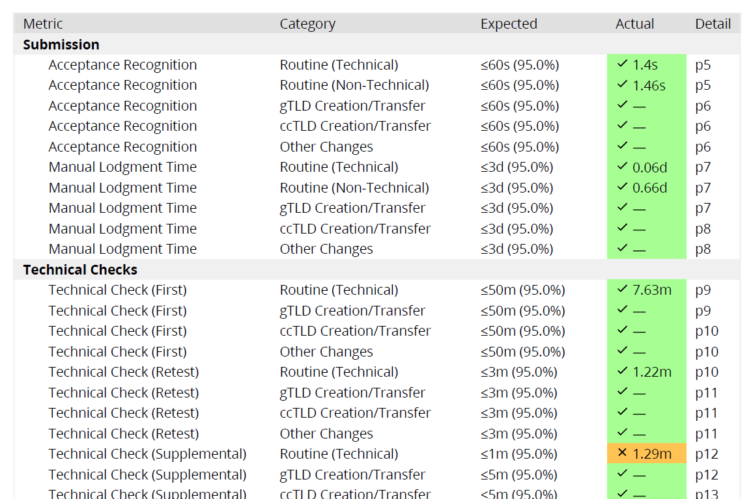
Extract from PTI Monthly
Report for Nov. 2018

Slide 6
Monitoring –
Monthly Reporting
The PTI monthly report summarizes their performance based on a percentage – the rating for November was 98.4%, as 61 of 62 SLEs were met
Based on this, the CSC produces a monthly report based on the following rankings:
  Excellent - PTI met all service level agreements (100 %) for the month.
  Satisfactory - PTI met the service level agreement for [less than 100%] of defined metrics. Missed service level agreements were satisfactorily explained and the CSC has determined that these exceptions were no cause for concern. No persistent problems were identified and no further action is needed.
  Needs Improvement - Performance needs improvement due to a) severe degradation in meeting SLAs from previous months, b) a trend in complaints that indicate a persistent issue to be resolved, and c) a negative trend in compliance to SLAs over several months.

Slide 7
PTI Monitoring
PTI Performance to 2018
 | 2016 | 2017 | 2018
Jan |  | 97.3% | 100%
Feb |  | 97.6% | 96.9%
Mar |  | 99.5% | 95.3%
Apr |  | 98.6% | 95.3%
May |  | 98.6% | 100%
June |  | 100% | 98.4%
July |  | 100% | 98.4%
Aug |  | 100% | 98.4%
Sept |  | 100% | 100%
Oct. | 95.9% | 96.9% | 100%
Nov. | 99% | 96.9% | 98.4%
Dec. | 99.4% | 100% | 100%
  Many of the ‘metric misses’ resulted from SLA metrics that the CSC and PTI propose to change

Slide 8
  Complaints & Performance
  Issue Remediation
  CSC’s Charter prevents it from becoming involved in individual complaints. CSC role is limited to:
      monitoring PTI’s overall complaint management system
      being informed of the status of individual complaints
  Unresolved complaints become ‘escalations’; PTI had x names related ‘escalations’ in 2017 and y in 2018; all have been closed.
  Where CSC believes that individual problems represent ‘systemic or persistent’ issues it can invoke ‘remedial action procedures’ (RAP)

Slide 9
  Remedial Action Procedures
  If the CSC determines that a ‘systemic problem’ exists, PTI is obligated to prepare and follow a ‘Remedial Action Plan’
  Failure to follow the plan can result in a three level escalation procedure being invoked:
    PTI board, then
    ICANN CEO, then
    ICANN Board
  The RAPs were approved in March 2018 while small changes were approved in January 2019.

Slide 10
Consulting and Informing
Informing community
  Monthly reports are produced and reviewed by CSC which produces its own reports
  Presentations to ICANN community
  Open, monthly meetings CSC & two public F2F meetings at the ICANN Community Forums and AGM’s
  Meetings with ICANN and PTI Boards
  PTI also has a dashboard which provides up to the minute stats on activity
PTI customer surveys
  PTI contracts for an annual customer survey as well as (need term for immediate feedback) surveys
  Overall, there is a high rate of satisfaction with approval growing
  CSC regularly reviews the survey results with PTI

Slide 11
CSC related Reviews
First CSC Charter review (October 2017-June 2018)
  Completed in June 2018; recommended changes
    to the CSC Charter which were approved by the GNSO and ccNSO;
    small changes to the RAPs were approved by CSC
    travel funding for CSC members to be provided
Review of CSC Effectiveness
  initiated in October 2018
  Initial report public comment closed in February 2019
Periodic IANA Function Review (IFR)
  First IFR ‘initiated’ in Oct. 2018
  Status pending
  One element is performance of CSC in providing PTI oversight (18.3 (j) of ICANN bylaws)

Slide 12
Travel Funding for PTI Members
Changes in CSC membership have compromised its ability to meet face to face – it gets no travel funds
  the future functioning and success of the CSC cannot be dependent on the members’ employers who have been providing funding
The CSC charter RT
  recommended that the CSC meet continue to meet the ccNSO and RySG at least twice annually that it also meet with the ICANN and PTI Boards,
  the CSC be eligible to seek travel funding for travel support in accordance with ICANN’s budget and travel policy requirements.
Support for ‘8 seats’ (4 members x 2 ICANN meetings) is being sought in ICANN FY20 budget

Slide 13
Revision of SLAs
PTI and CSC have previously identified the need for changes to the IANA Service Level Agreement (SLA) metrics:
  Three that need revision to the metric only
    Technical Check Retest,
    Technical Check Supplemental
    ccTLD creation/transfer
  One new SLA, for IDN tables
Currently SLA’s are part of the actual IANA Naming Functions Contract (INFC): changing a SLA proved to be a complex undertaking
To avoid having to amend the INFC every time changes are needed - even for trivial changes – mechanism is being amended to provide for a differentiated change procedures.

Slide 14
Status of SLA Changes
In December 2018, the CSC approved:
  a "Process for amending the IANA Naming Function Service Level agreements" and
  a "Procedure for Modifying the process for amending the IANA Naming Function Service Level agreements".
ICANN org and PTI management were involved in the conversations and agreed to the processes as well. The processes are not in force until such time as the IANA Naming Function Contract is amended.
Draft changes to the contract were published for comment on January 7.
The timing of actual approval not yet determined as approval of both the ICANN and PTI Boards is required.
CSC has begun the preparatory work for the actual changes, with the intention of proceeding upon approval of the contract changes.

Slide 15
Summary
PTI performance is extremely good - some minor metrics missed, no customer service impact nor operational problems
CSC has come together as a committee having completed all of its start-up tasks
The whole process is working very well
  problem areas are being identified immediately and corrective measures being developed cooperatively
  areas where SLAs need changing are being actioned
Only major challenge to the CSC’s continued success is the absence travel funding.

Slide 16
ADDITIONAL SLIDES

Slide 17
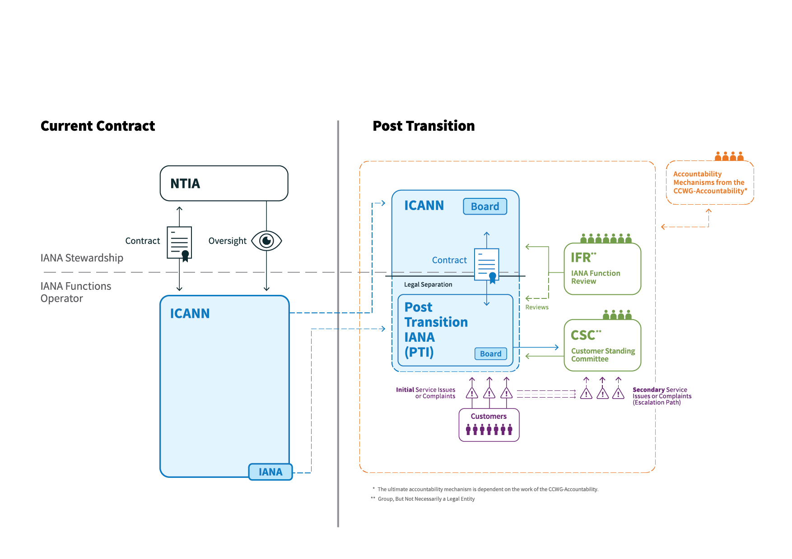
CSC in Context

Slide 18
  Complaints & Performance
  Issue Remediation
Overview of Remedial Action Procedures
Escalations
First
Second
Third
CSC Finds Performance Issue Exists
CSC Seeks Resolution with PTI
Remedial Action Procedures Invoked
Corrective Action Plan Agreed to by CSC, PTI President
PTI Board
ICANN CEO
ICANN Board
Resolved
Special IANA Function Review (IFR)
PTI & ICANN Remedial Action Plan
Path of Escalation if Terms of Corrective Action Plan Not Respected

