Slide 1
Expectations
How do we perform the IANA stewardship?
Describe what is being done today
“NTIA’s stewardship has been about allowing the communities to, over the years, develop all the necessary mechanisms”
Or, potentially make some enhancements
Or, describe something entirely new

Slide 2



Protocol
Numbers
Names
IETF
community
RIR
community
ICANN
community
Policy
IAB
NRO
ICANN
Oversight
IANA
IANA
IANA
Implementation

Slide 3
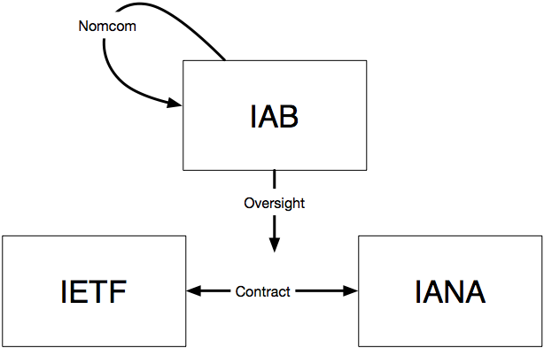
Expectations
Define:
The entity that sets the policies
The entity that implements the policy
The relationship between the two
How is oversight provided?
The mechanisms to use when something fails on the policy side?
The mechanisms to use when something fails on the implementation side?

