Slide 1
Review of Reviews
Cross Community Group
ICANN85

Slide 2
How Will we Structure this Discussion
Brief presentation of process
Walk through of first iteration of draft design proposal
Opportunities for questions and comment after each element of proposal
Opportunity for questions and comment on process at the end of presentation

Slide 3




Review of Reviews Process
CCG Chartered to: manage a fundamental evaluation of reviews set out in the ICANN Bylaws, as a whole system, including their implementation, and propose a refreshed system of reviews.
*20 plenary meetings to date.
2 ICANN staff Members
Observers
Two Advisors
Current Status: Design proposal for discussion at ICANN85.
2 Members per SO/AC
2 ICANN Board Members
Next Steps:
Public Comment on refined Draft Design
Draft Report for Public Comment and discussion at ICANN86 (Jun 2026).
ICANN org Support

Slide 4

Phases of Work and Key Deliverables
Phase 1
Phase 2
Phase 3
Phase 4
Fact Finding
Analysis & Development of Proposals
Finalization of Proposals
Finalizing of Report and Decision-making
Consult Community on issues around purpose and need for the ICANN reviews system, and of current and future reviews
Analysis of input received, develop draft report
Analysis of input received, identify core issues and priorities
Finalization of report and call for SO/AC support
We are here
Final Report and Documentation of Support Sent to Board (Aug 26)
Purpose of Reviews
at ICANN84 (Oct 25)
Initial Design for Discussion at ICANN85 (Mar 26)
Draft Report for Discussion at ICANN86 (Jun 26)

Slide 5
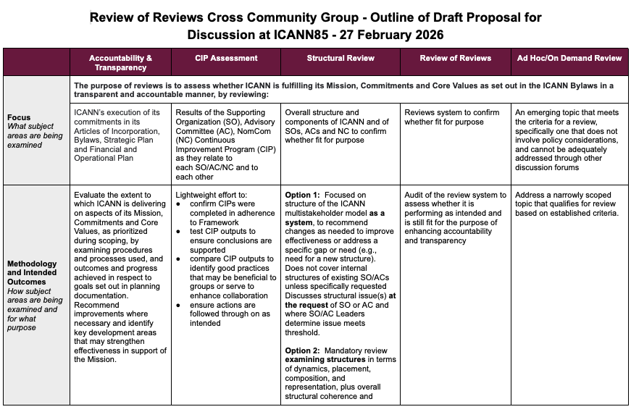
Draft Design Proposal - First Iteration
Focus
What subject areas are being examined
Methodology and Intended Outcomes
How subject areas are being examined and for what purpose
Cadence
How often would reviews be conducted
Prompted by
Where is the review established and what induces the review
Initiation Process
What steps are taken to initiate the review
Scope Parameters
Is the scope pre-set or is it agreed during the initiation process
Review conducted by
Who will carry out the review effort
Link
Recipient(s) of Outputs
Who will receive conclusions and recommended actions (if any)
Originates or Derives from
What is the root for this suggested review (if any)
Notes and Questions

Slide 6
Draft Focus
The purpose of reviews is to assess whether ICANN is fulfilling its Mission, Commitments and Core Values as set out in the ICANN Bylaws in a transparent and accountable manner, by reviewing:
Results of the Supporting Organization (SO), Advisory Committee (AC), NomCom (NC) Continuous Improvement Program (CIP) as they relate to each SO/AC/NC and to each other
(B) Assessment of Continuous Improvement
ICANN’s execution of its commitments in its Articles of Incorporation, Bylaws, Strategic Plan and Financial and Operational Plan
Overall structure and components of ICANN and of SOs, ACs and NC to confirm whether fit for purpose
(C) Structural Review
Accountability and Transparency Review
(E) Ad Hoc/On Demand Review
Reviews system to confirm whether fit for purpose
An emerging topic that meets the criteria for a review, specifically one that does not involve policy considerations, and cannot be adequately addressed through other discussion forums
(D) Review of Reviews

Slide 7
Draft Accountability and Transparency Review 1/2
Methodology and Intended Outcomes | Evaluate the extent to which ICANN is delivering on aspects of its Mission, Commitments and Core Values, as prioritized during scoping, by examining procedures and processes used, and outcomes and progress achieved in respect to goals set out in planning documentation. Recommend improvements where necessary and identify key development areas that may strengthen effectiveness in support of the Mission
Cadence | Flexible cadence conditioned on completion of steps as articulated in the initiation process
Prompted by | Prompted by ICANN Bylaws but subjected to agreement on cadence
Initiation Process | 1. Community analyses implementation of prior review outputs, the effectiveness of deployed solutions, considers whether timeline is meaningful in light of ongoing work, to inform need for review and scope setting 2. Community evaluates bandwidth, drafts scope accordingly and determines the associated prioritization 3. Resource requirements confirmed 4. Formal Board resolution to convene the review

Slide 8
Draft Accountability and Transparency Review 2/2
Scope Parameters | Variable scoping (within set boundaries) to be pre-agreed during initiation process
Review Conducted by | Cross Community Group with the option to be assisted by expert
Recipient(s) of Outputs | Board
Originates or Derives from | Originates from existing Accountability and Transparency Specific Review (ATR)
Notes and Questions | Process provides measures to ensure subsequent review occurrence is not postponed indefinitely

Slide 9
Questions and Comments

Slide 10
Draft Assessment of Continuous Improvement 1/2
Methodology and Intended Outcomes | Lightweight effort to: confirm CIPs were completed in adherence to Framework test CIP outputs to ensure conclusions are supported compare CIP outputs to identify good practices that may be beneficial to groups or serve to enhance collaboration ensure actions are followed through on as intended
Cadence | Set cadence based on CIP cycles (SO/ACs NomCom reports repeat every three years)
Prompted by | Prompted by ICANN Bylaws
Initiation Process | 1. Submission of SO, AC, NC reports 2. Cross Community Group convened

Slide 11
Draft Assessment of Continuous Improvement 2/2
Scope Parameters | Scope as pre-determined in ICANN Bylaws
Review Conducted by | Cross Community Group with the option to be assisted by expert
Recipient(s) of Outputs | The relevant SO, AC or NC If Board or org are discussed materially in the review, they should also receive the report
Originates or Derives from | Derives from the Continuous Improvement recommended by the Third ATR
Notes and Questions | CIP is a pilot Does not include a review of the CIP itself Question: Should the Board undertake a CIP in accordance with the CIP principles?

Slide 12
Questions and Comments

Slide 13
Draft Structural Review 1/2
Methodology and Intended Outcomes | Option 1: Focused on structure of the ICANN multistakeholder model as a system, to recommend changes as needed to improve effectiveness or address a specific gap or need (e.g., need for a new structure). Does not cover internal structures of existing SO/ACs unless specifically requested. Discusses structural issue(s) at the request of SO or AC and where SO/AC Leaders determine issue meets threshold Option 2: Mandatory review examining structures in terms of dynamics, placement, composition, and representation, plus overall structural coherence and effectiveness. Includes associated Board composition and decision-making processes
Cadence | Set cadence (every n years). Occurrence to be confirmed based on community agreement May be prompted out of cadence through ad hoc review process
Prompted by | Prompted by ICANN Bylaws but subjected to agreement process
Initiation Process | 1. Consultation on need to convene the review according to set cadence. Community evaluates bandwidth and resources 2. Formal Board resolution to convene the review

Slide 14
Draft Structural Review 2/2
Scope Parameters | Pre-determined or variable scope (within set boundaries) depending on whether there is a request from a SO, AC or NC
Review Conducted by | Cross Community Group (CEO, community leaders), with the option to be assisted by expert
Recipient(s) of Outputs | SO/AC/NC? then Board or structures directly
Originates or Derives from | Derives from recommendations made by the Third ATR
Notes and Questions | /

Slide 15
Questions and Comments

Slide 16
Draft Review of Reviews 1/2
Methodology and Intended Outcomes | Audit of the review system to assess whether it is performing as intended and is still fit for the purpose of enhancing accountability and transparency
Cadence | Set cadence (every n years). Occurrence to be confirmed based on community agreement May be prompted out of cadence through ad hoc review process
Prompted by | Prompted by ICANN Bylaws but subjected to agreement process
Initiation Process | 1. Consultation on need to convene the review according to set cadence. Community evaluates bandwidth and resources 2. Formal Board resolution to convene the review

Slide 17
Draft Review of Reviews 2/2
Scope Parameters | Scope as pre-determined in ICANN Bylaws
Review Conducted by | Cross Community Group (CEO, community leaders), with the option to be assisted by expert
Recipient(s) of Outputs | SO/ACs and NC? then Board
Originates or Derives from | Originates from a component of existing ATR mandate
Notes and Questions | Could be used as the mechanism for review of the CIP itself Could be an ad hoc review rather than its own bucket Could be recommended by ATR to occur as ad hoc review

Slide 18
Questions and Comments

Slide 19
Draft Ad Hoc/On Demand Review 1/2
Methodology and Intended Outcomes | Address a narrowly scoped topic that qualifies for review based on established criteria
Cadence | Convened under exceptional circumstances, should threshold be met
Prompted by | Process to convene defined in ICANN Bylaws
Initiation Process | 1. Submission of topic through dedicated process 2. SO/AC discuss and consult with the Board, org, community on bandwidth,estimated resources, timeline and feasibility 3. Secure resources accordingly (including possible deprioritization) 4. Formal Board resolution to convene the review

Slide 20
Draft Ad Hoc/On Demand Review 2/2
Scope Parameters | Variable scoping to be pre-agreed during initiation process
Review Conducted by | Dependent on agreed scope. Option to be assisted by expert
Recipient(s) of Outputs | Board and/or SO/ACs or NC? Depends on reason for review
Originates or Derives from | Non applicable
Notes and Questions | May be used to address existing topics of Specific Reviews (Competition, Consumer Trust, Consumer; Registration Directory Service; Security, Stability and Resiliency of the DNS) [which aligns with ATRT3]

Slide 21
Questions and Comments

Slide 22




Your Input is Important
Upcoming Public Comment proceedings on draft design proposal and Draft Report
Observers Welcome
For more information, see https://icann-community.atlassian.net/wiki/x/v4CtGw
Send us your input
at inputonreviews@icann.org (publicly archived) - see more information at https://icann-community.atlassian.net/wiki/x/dQD8Hg
Follow our work
at https://icann-community.atlassian.net/wiki/x/E4NnFQ

Slide 23
Questions and Comments

Slide 24
Thank you

