Slide 2
15 October 2014
IDN Program Update
Sarmad Hussain
IDN Program Senior Manager

Slide 3
Agenda
IDN Program - Sarmad Hussain
Maximal Starting Repertoire (MSR) – Marc Blanchet
Transitioning from MSR to LGR– Asmus Freytag
LGR Builder - Kim Davies
Community Updates
  Need for Latin GP – Cary Karp
  Update on Arabic GP – Meikal Mumin
Q/A

Slide 4
IDN Program
Overview and Progress
15 October 2014
Sarmad Hussain
IDN Program Senior Manager
IDN Program Update

Slide 5
IDN Program Overview
LGR Specific-ations (P1)
Commun-ications
LGR Devel-opment (P2.2)
LGR Implem-entation
(P7)
IDN Guide-lines
IDN Fast Track
Until recently Top Level Domains (TLDs) limited to a sub-set of ASCII in Latin script, e.g.: .com, .info, .br, .sg
Now possible in different scripts – referred to as Internationalized Domain Name (IDN) TLDs, e.g.: .中国, .рф, .شبكة, .ලංකා, .삼성
IDN Program supports and undertakes various projects and programs related to IDN TLDs

Slide 6
IDN Program Overview
IDN TLD Program – Label Generation Ruleset (LGR)
  Determine validity and variants of an IDN label for the Root zone
IDN Fast Track Process Implementation
  Assist IDN ccTLD string evaluation for eventual delegation
IDN Implementation Guidelines
  Promote IDN registration policies and practices to minimize consumer risk and confusion
Communications and Outreach
  Update and engage community with the IDN Program

Slide 7
IDN TLD Program

Slide 8
TLD Labels are Special - ASCII and IDN
ASCII
  Traditional rules for ASCII labels
    ASCII Letters [a-z],
    Digits [0-9] and Hyphen (LDH)
    Maximum length = 63
  --------------------------------------
  Traditional rules for Top Level Domain (TLD) labels
    Letter Principle: ASCII [a-z]
    Maximum length = 63
    (in practice much shorter)
IDN
  Rules for Internationalized Domain Name (IDN) Labels
    Valid U-Label: Only PVALID and CONTEXT O/J code points and other constraints per IDNA 2008
    Valid A-Label: Maximum A-label length = “xn--” + 59 chars for Punycode of U-label (RFC 3492)
      --------------------------------------------------------
  Rules for IDN TLD Labels
    “Letter” principle for U-Label ???
    Valid A-Label

Slide 9
Need Rules for Defining IDN TLD Labels
Which characters can form a label?
Which characters are confusable or variants?
What are additional constraints on labels?

Slide 10
IDN TLD Program
To support IDNs and variants in the root zone,
  the ICANN community, at the direction of the Board¹, undertook several projects to study and make recommendations on their viability, sustainability and delegation
Being conducted in multiple phases,
  these projects form the basis of an implementation plan that will be considered by ICANN's Board of Directors
¹ https://www.icann.org/resources/board-material/resolutions-2010-09-25-en

Slide 11
Work Completed under IDN TLD Program
PHASE 1 (2011)
Case Studies:
PHASE 2 (2011-12)
Integrated Issues Report
PHASE 3 (2012-13)
Projects:
Arabic
Chinese
Cyrillic
Devanagari
Greek
Latin
P1 LGR XML Specification
P2.1 LGR Process for the Root Zone
P6 User Experience Study for TLD Variants
Community agreed to define a Label Generation Ruleset (LGR)
  https://www.icann.org/resources/pages/reports-2013-04-03-en

Slide 12
LGR Development Process
Integration Panel
Generation Panel
Integration Panel
Maximal Starting Repertoire
(MSR)
MSR Sets Limits for Script Based LGR Analysis
LGR Proposal for Script 1
LGR Proposal for Script 2
LGR Proposal for Script n
Script based LGR Proposals Input for LGR
Root Zone Label Generation Ruleset
(LGR)

Slide 13
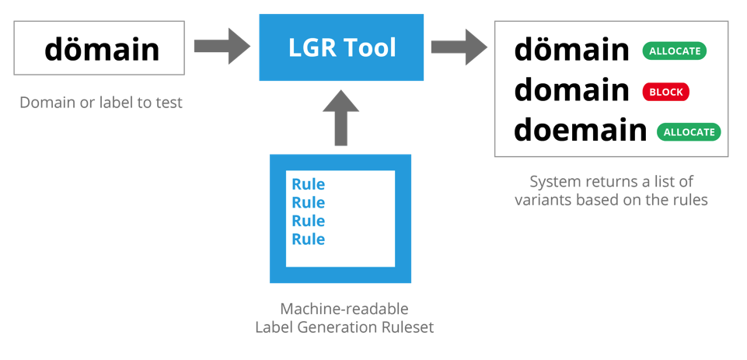
LGR Specification and Tool
LGR Tool
Label validity checking
Label variant generation
Variant disposition specification
Code Point Rules
Variant Rules
WLE Rules
  https://datatracker.ietf.org/doc/draft-davies-idntables

Slide 14
LGR Development Progress
Feb 14
Jun 14
Sep 14
Arabic Generation Panel Seated
MSR-1 Released
Chinese Generation Panel Seated
Dec 14
MSR-2
Jan 14
Arabic and Chinese Proposals for LGR
June 15
LGR-1
Integration Panel formed
Sep 13
Call for Generation Panels to propose Root Zone LGR
Jul 13
Call for Integration Panel to develop Root Zone LGR
Jun 13

Slide 15
Arabic | Khmer
Armenian | Korean
Bengali | Lao
Chinese | Latin
Cyrillic | Malayalam
Devanagari | Myanmar
Ethiopic | Oriya
Georgian | Sinhala
Greek | Tamil
Gujarati | Telugu
Gurmukhi | Thaana
Hebrew | Thai
Japanese | Tibetan
Kannada
Community Based GP Status
Speak up for your Language (and Script)
  Form a generation panel
  Volunteer to join a generation panel
  Take part in public review of the MSR, LGR proposals, integrated LGR, etc.
  Disseminate information to interested communities or individuals
Contribute by emailing interest to idntlds@icann.org
Seated | Meeting | Forming | No Progress

Slide 16
Communications and Outreach

Slide 17
Direct Community Engagement
IDN Program Sessions at ICANN meetings
IDN Program Updates to SOs/ACs at ICANN meetings
APTLD Meeting, May, Muscat
APrIGF, August, Delhi
IGF, September, Istanbul
TLDCON, September, Baku
APTLD Meeting, September, Brisbane
Email Communication to SOs/ACs – call to action

Slide 18
Community Outreach
Blogs
  http://blog.apnic.net/2014/09/30/speak-up-for-your-language/
ICANN Community Wiki
  https://community.icann.org/display/croscomlgrprocedure/Root+Zone+LGR+Project
ICANN Website
  www.icann.org/topics/idn
ICANN Mailing Lists
  {vip,lgr,ArabicGP, ChineseGP, …}@icann.org
Print and Social Media
IDN Program Videos
  http://youtu.be/hPeKfiS7MNU
  http://youtu.be/wnauGpYh96c

Slide 19
MSR Development
15 October 2014
Presented by: Marc Blanchet
Integration Panel Member
IDN Program Update

Slide 20
MSR Process Summary
Start with latest Unicode repertoire
Limit to PVALID code points from latest IDNA 2008 registry
Apply “Letter Principle”
Limit to modern scripts targeted for the given MSR version
Exclude code points that are unambiguously limited to
  Technical, phonetic, religious or liturgical use
  Historical or obsolete writing systems
  Writing systems not in widespread, common, everyday use (EGIDS)
Result is a starting set from which the GPs pick their repertoire

Slide 21
Narrowing down the MSR Repertoire
Latest Unicode Version
IDNA 2008 PVALID
Letters
Widespread, modern use
MSR

Slide 22
Expanded Graded Intergenerational Disruption Scale
EGIDS is an evaluation of language vitality
Used as proxy for “effective demand” for the writing system
    Not based on population size, but on “established vitality”
    Not a perfect correlation with script use, but a useful criteria
    Some writing systems are not stable or not widely used, even if the language isFor the MSR the IP uses the cut-off between Level 4 and Level 5
4: Educational
  Language in vigorous use, with standardization and literature being sustained through a widespread system of institutionally supported education
5: Developing
  Language in vigorous use, with literature in a standardized form being used by some
  though this is not yet widespread or sustainable
    https://www.ethnologue.com/about/language-status

Slide 23
MSR-1: Foundation for initial round of GPs
MSR-1 released on 20 June 2014:
    https://www.icann.org/news/announcement-2-2014-06-20-en
Work can now proceed for 22 scripts to create LGRs for the Root Zone
Generation Panels will:
  pick repertoire from within the MSR
  decide whether code point variants exist
    decide whether these should lead to allocatable or blocked variant labels
  generate an LGR proposal for public comment and
  review (and integration) by Integration Panel

Slide 24

MSR-1 Content
Script | Count | Script | Count
Arabic | 239 | Hiragana | 89
Bengali | 64 | Kannada | 68
Cyrillic | 93 | Katakana | 92
Devanagari | 91 | Lao | 53
Georgian | 37 | Latin | 305
Greek | 36 | Malayalam | 73
Gujarati | 66 | Oriya | 66
Gurmukhi | 61 | Sinhala | 79
Han | 19,850 | Tamil | 49
Hangul | 11,172 | Telugu | 67
Hebrew | 46 | Thai | 71
Common | 0 | Inherited | 21
Total: |  | 32,790
Starting Point:
Unicode 6.3 with
137,473 code points
Of these 97,973 are PVALID/CONTEXT
per IDNA 2008
Of these 32,790 are
in MSR-1 as eligible
for the Root Zone.

Slide 25
MSR-2 status
MSR-2 is cumulative, no deletions from MSR-1
MSR-2 completes the repertoire by adding:
  Armenian, Ethiopic, Khmer, Myanmar, Thaana, and Tibetan
  Content in numbers (as projected):
  28 scripts (up from 22 in MSR-1)
  ~ 33,500 code points (~700 added to MSR-1)
Schedule:
  Release for public comment by end of 2014
  Available in 2015

Slide 26
MSR-2 and IDNA 2008 registry
MSR-2 is formally based on Unicode 7.0
Content limited to Unicode 6.3 subset until the IDNA 2008 registry is updated to Unicode 7.0 at IANA
  http://www.iana.org/assignments/idna-tables
This affects the potential repertoire for:
  MSR-1 scripts (Arabic, Devanagari, and Telugu)
  MSR-2 new script (Shan subset in Myanmar)
Code points from 7.0 are considered candidates for addition if a new IANA table is published in time

Slide 27
Transitioning from MSR to LGR
15 October 2014
Asmus Freytag
Integration Panel Member
IDN Program Update

Slide 28
Developing an LGR – A Summary
Start with the most recent MSR
Create a repertoire based on selected script
Are variants needed for the script?
  define variant relations
  decide which variants should lead to blocked vs. allocatable labels
Must some labels be prohibited via Whole Label Evaluation rules (WLE) ?
Document the decisions and their rationale
Create a XML file for repertoire, variants and WLE
Submit for public comment and IP review

Slide 29
Creating a Repertoire
Start with the latest MSR
Select a script (defined in scope of GP)
Select code points needed for IDN TLDs
  Based on Principles laid out in the Procedure
  Avoid any significant systemic risks
  Avoid geographical or language bias
Document rationale for inclusion
  Cover each code point or collection of code points
  Show how selection satisfies the Principles

Slide 30
Building up the LGR Repertoire
MSR
Latest Unicode Version
IDNA 2008 PVALID
Letters
Widespread, modern use
Script A
Script B
Selected by GP
Selected by GP
…
LGR

Slide 31
Are Variants Needed?
Does the repertoire contain variants?
  Not all repertoires do. Some GPs will answer “no”.
Variants are
  Code points that are “the same” as other code points or code point sequences in the minds of users
Two types of variants
  Some lead to labels that are blocked, so two labels that are “the same” can’t be allocated separately
  Some lead to labels that can both be allocated to the same applicant
See the Variant Rules document for more detail

Slide 32
Defining Variants
Define which two code points are variants: A ~ B
Create the variant code point mappings
  must be symmetric: A → B ⇒ B → A
  and transitive: A → B and B → C ⇒ A → C
Assign a type to each mapping
  Default types are “blocked” and “allocatable”
    These work with predefined default actions
  Other types are able to reduce number of allocatable variant labels
    These require specific actions that finally evaluate to either “blocked” or “allocatable” variant labels

Slide 33
Constraints on Variants
Procedure : “maximize number of blocked variants, and minimize the number of allocatable variants”
  Steep complexity cost to allocatable variants
  Limit to what is required for the writing system
  Blocked variants can make LGR more robust

Slide 34
Are WLEs needed?
Should some sequences of code points be generally prohibited within a script?
  do they cause rendering problems? (in complex scripts)
Would such a prohibition satisfy the Principles?
  is increase in complexity offset by reduction in risk?
Most Generation Panels would answer “no”
  Advance discussion with the IP is recommended if a GP is considering WLEs

Slide 35
Defining WLEs
WLEs are akin to regular expressions
Labels matching a WLE are blocked
Creating an WLE requires
  Defining one or more “rules”
  Optionally, defining “classes” of code points
    Explicitly listed or based on Unicode properties
  Defining an “action” that causes the label to be “blocked” when a rule is matched
The MSR contains a Default WLE which serves as an example

Slide 36
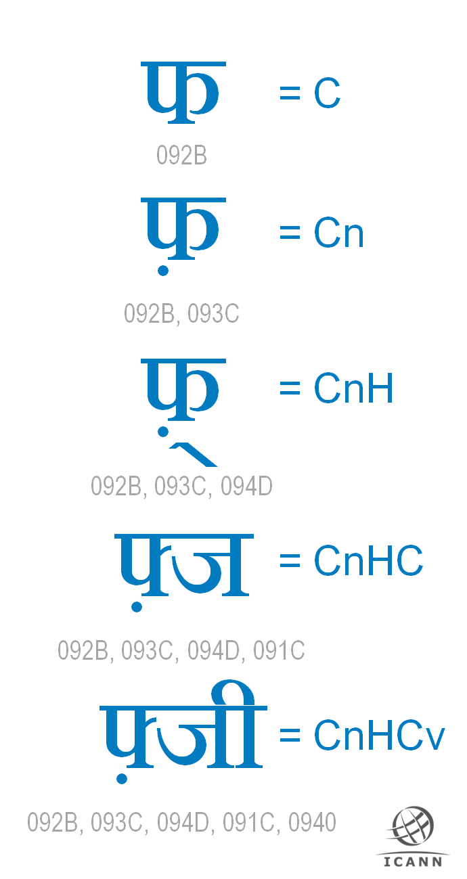
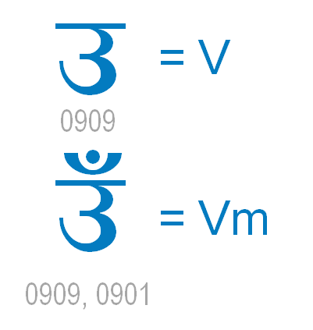
Indic Syllables
Rule 1: V[m]
Rule 2: {CnH}Cn[v][m]
Rule 3: CnH (at end)
where Cn is C[n]
Requirements:
1 : H must follow Cn
2 : m must not follow H
3 : v must follow Cn
4 : n must follow C
Potential candidates for WLE

Slide 37
Documenting the LGR
The GP documents the rationale for
  Choice of repertoire, coverage and contents
  Necessity, choice and type of variants
  Necessity and design of WLEs
The documentation will evaluate the design choices in light of the Principles
See Requirements for LGR for more details

Slide 38
Formal Definition for LGR
The formal definition of the LGR is an XML file
  Format described in Requirements for LGR
Plus: examples of labels, variant labels and labels blocked by WLEs
  Only needed if the LGR contains variants or WLEs
Optional: informative charts of the LGR repertoire
  For example, like the annotated PDF files in the MSR

Slide 39
Submission for Review
Submission format must match Requirement for LGR
Completed LGR proposal is submitted to
  ICANN for release for public comment
  IP for review
After comments are resolved
  IP will attempt to integrate the LGR
    If successful, the IP will submit an integrated LGR for public comment (consolidating several scripts)
    If not, the IP will reject the proposal and tell the GP which features prevented integration

Slide 40
Throughout the Process
Keep the Integration Panel in the loop
  IP can only approve or reject the LGR proposal as a whole
  Early discussions reduce the chance that some detail will lead to rejection
Follow the Procedure
  It is the authoritative prescription
  The LGR Proposal must be compatible with its Principles

Slide 41
Throughout the Process (cont’d)
Considerations for Designing an LGR for the Root
  provides a helpful list of items for GPs to consider during the process
Coordinate with GPs for Related Scripts
  Where scripts are related, the IP will look for consistent and compatible treatment
  If GPs coordinate among themselves, less chance that the IP will run into issues during Integration
  Goal: consistent user experience

Slide 42
What should be Coordinated?
Repertoire
  Consistent treatment of similar repertoires
    Examples: Indic scripts
Variants
  Compatible definition of variants
    Examples: Han
  Cross-script homoglyphs
    Examples: Latin, Greek, Cyrillic
WLE
  Consistent treatment of structurally similar scripts
    Examples: Indic scripts, definition of matra

Slide 43
Resources
Considerations for Designing a Label Generation Ruleset for the Root Zone
  https://community.icann.org/download/attachments/43989034/Considerations-for-LGR-2014-09-23.pdf
Maximal Starting Repertoire (MSR-1)
  https://www.icann.org/news/announcement-2-2014-06-20-en
  https://www.icann.org/en/system/files/files/msr-overview-06jun14-en.pdf
Procedure to Develop and Maintain the Label Generation Rules for the Root Zone in Respect of IDNA Labels
  https://www.icann.org/en/system/files/files/draft-lgr-procedure-20mar13-en.pdf
Representing Label Generation Rules in XML
  https://tools.ietf.org/html/draft-davies-idntables
Requirements for LGR Proposals
  https://community.icann.org/download/attachments/43989034/Requirements%20for%20LGR%20Proposals.pdf
Variant Rules
  https://community.icann.org/download/attachments/43989034/Variant%20Rules.pdf

Slide 44
LGR Builder
A Tool for Generation Panels and the Community
15 October 2014
Kim Davies
Director Technical Services, IANA
IDN Program Update

Slide 45
Goals
Interactive interface to build LGR files
  Files are formatted using XML
  XML is not always easy to author manually
  Authoring tool can prevent/catch errors in compilation

Slide 46
Recap: What is an LGR?
Machine-readable definition of registry policy regarding:
  Allowable code points
  Variant rules for specific codepoints
  Whole-label rules
  Processing rules (allocation, blocking, etc.)
Designed so that with an LGR, a registry can automatically apply policies

Slide 47
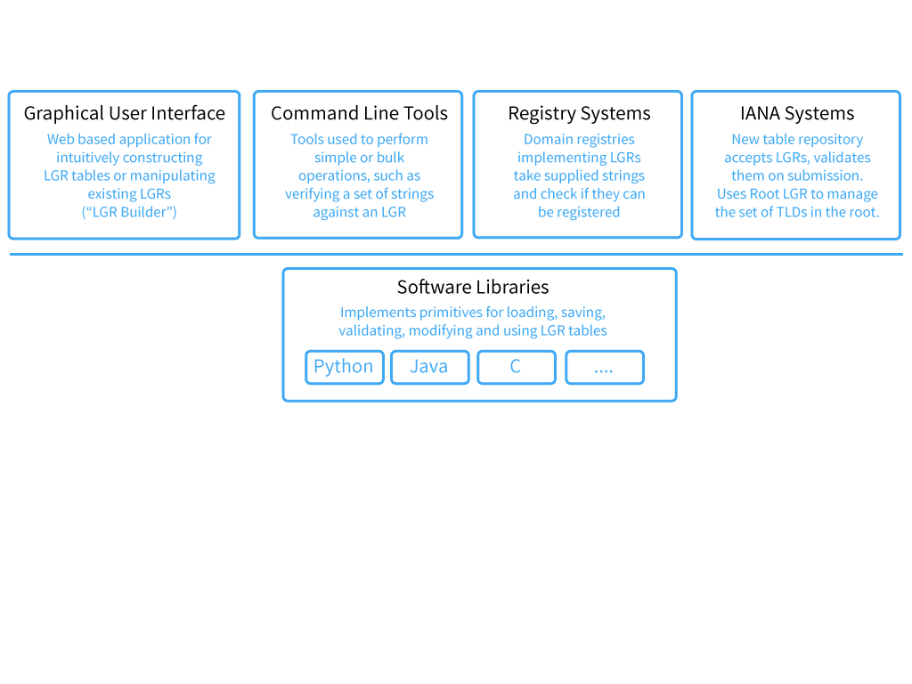
XML files

Slide 48
Phase 2 (Desirable functionality)
Comprehensive UI that allows intuitive construction of LGRs
Ability to test tables
More complex features of LGR: tagging, WLE rules, etc.

Slide 49
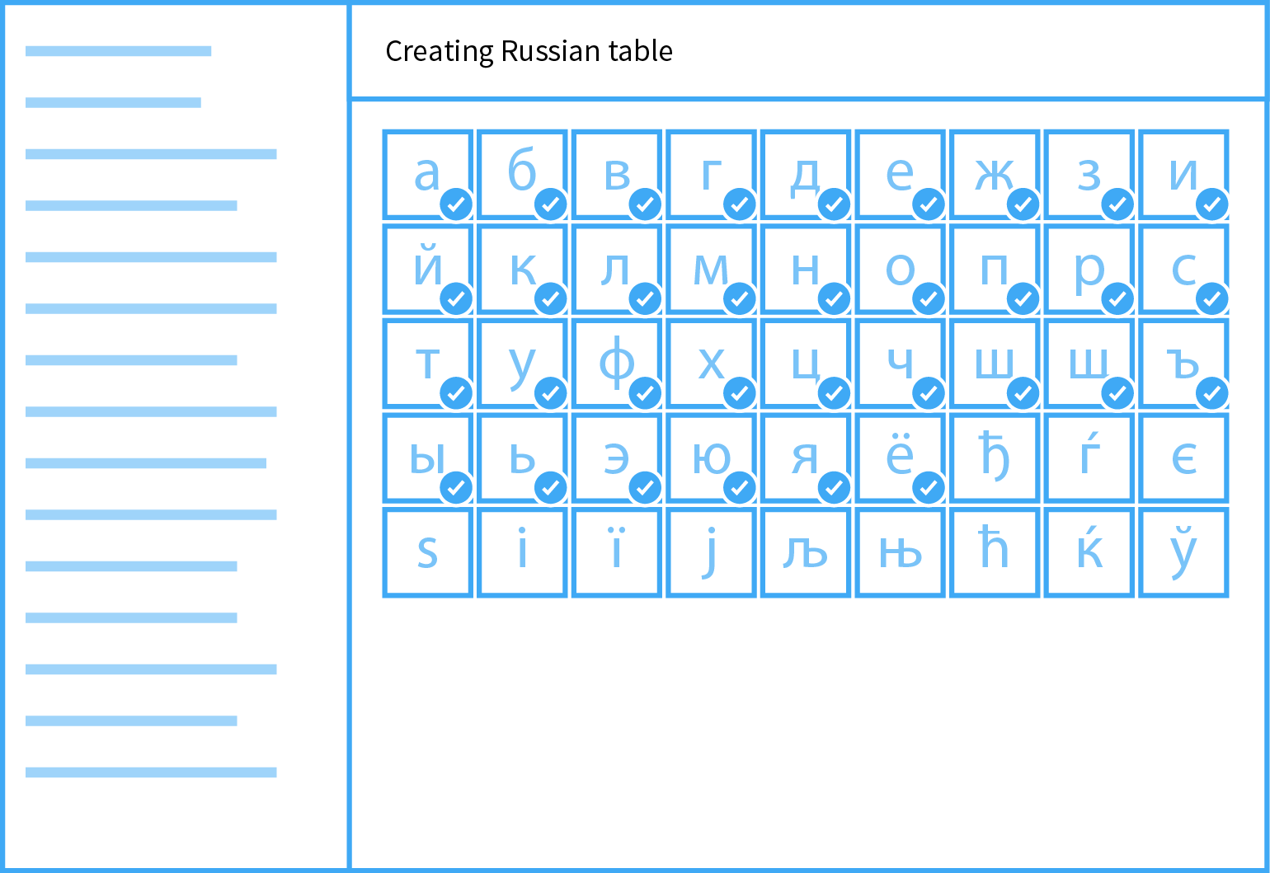

Slide 50
Next steps
Developing draft requirements
Consultation with community to ensure it is useful
Identify developers and execute
Tool will be open source

Slide 51
Developing a Latin Script
IDN Repertoire for the
Root Zone of the DNS
15 October 2014
Cary Karp
Latin Generation Panel
IDN Program Update

Slide 52
Latin Script
The Latin alphabet is used in the writing systems of more languages than is any other single script
Only a small number of languages are written exclusively with its basic twenty-six letters
The total requirement for additional forms is extensive

Slide 53
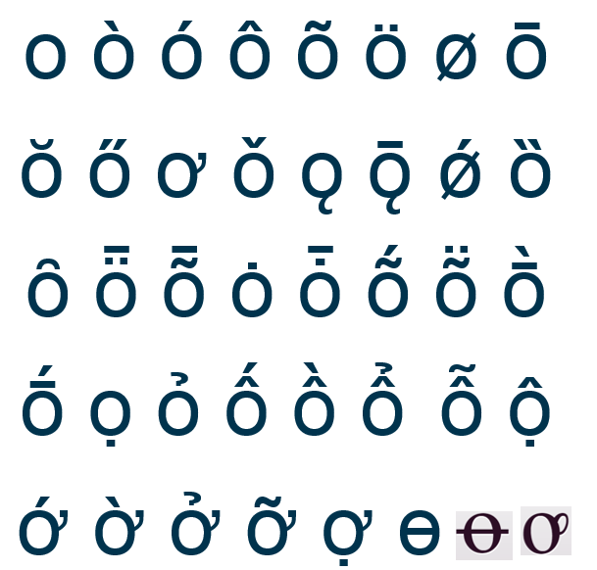
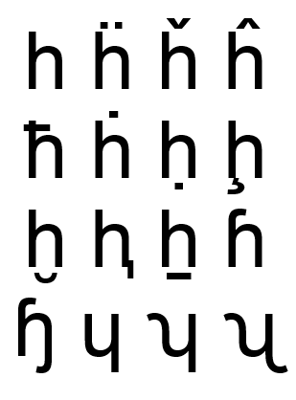
Two Base Letters of Many

Slide 54
Multiple Perspectives on Them
Distinctions between these forms are of fundamental significance to the communities that use them
AND
Communities that use the same characters often treat them in different ways

Slide 55
IDN Policies are Context Dependent
Local considerations are relatively easy to accommodate in IDN policies for a zone that has a clear language nexus
Even then, it may be necessary to limit the orthographic nuance that can be applied

Slide 56
ASCII Still Goes a Long Way
If forgoing a diacritical mark does not change meaning it is simple enough to accept the undecorated base letter
naivete
naïveté

Slide 57
But Doesn’t Even Fully Cover English
The situation is not quite the same when a diacritical mark is contrastive
resume
résumé

Slide 58
Much Less Swedish
Yet another situation applies when the alternative might be the substitution of two base characters for a single marked one
nörden
noerden
norden

Slide 59
Or Personal Names
This can be critical in the representation of proper names
goethe
göthe

Slide 60
Special Conditions Apply to the Root Zone
The root zone has no intrinsic language attributes and serves all language communities
Its IDN policies need to accommodate all communities in as equitable a manner as possible

Slide 61
Getting from Here to There
The final report of the VIP Study Group for the Latin Script root includes a list of the entire repertoire of Latin code points that can be used in an IDN label
The LGR Integration Panel reduced that list to a Maximum Starting Repertoire by excluding code points with properties that are not appropriate for the root zone
Neither document is intended to meet the IDNA protocol requirement for the operator of a zone — in this case the root — to collate a subset of the available repertoire appropriate for its target community
A Script Generation Panel is needed to address remaining concerns and propose a Latin code point repertoire specifically for the root zone

Slide 62
Update on Arabic GP
15 October 2014
Meikal Mumin
Task Force on Arabic Script IDNs / Arabic GP
IDN Program Update

Slide 63
Community driven way forward:
Task Force on Arabic Script IDNs
Creation and oversight by community based Middle East Strategy Working Group (MESWG;
https://community.icann.org/display/MES/MESWG+Members )
TF-AIDN Objectives: a holistic approach
  Arabic Script Label Generation Ruleset (LGR) for the Root Zone
  Second level LGRs for the Arabic script
  Arabic script Internationalized Registration Data
  Universal acceptability of Arabic script IDNs
  Technical challenges around registration of Arabic script IDNs
  Operational software for registry and registrar operations
  DNS security matters specifically related to Arabic script IDNs
  Technical training material around Arabic script IDNs

Slide 64
Membership
Currently 29 members – applications still being received
From 17 countries – Australia, Bahrain, Egypt, Ethiopia, Germany, Iran, Jordan, Lebanon, Malaysia, Morocco, Pakistan, Palestine, Saudi Arabia, Sudan, U.A.E., U.K., U.S.A.
Members of nine language communities using Arabic script – Arabic, Malay, Saraiki, Sindhi, Pashto, Persian, Punjabi, Torwali, Urdu, with further expertise in use of Arabic script from East Asia, South Asia, Middle East, and Africa
Coming from diverse disciplines – academia (linguistics and technical), registries, registrars, national and regional policy bodies, community based organizations, technical community

Slide 65
How to reach out to the Task Force on Arabic Script IDNs?
Membership open, community based
Details and interests of members posted by MESWG
Discussions publicly archived
Details at http://lists.meswg.org/mailman/listinfo/tf-aidn
Background and introduction to TF-AIDN
  https://community.icann.org/display/MES/Task+Force+on+Arabic+Script+IDNs
Workspace, news and document archive
  https://community.icann.org/display/MES/TF-AIDN+Work+Space
Email archive
  http://lists.meswg.org/pipermail/tf-aidn/

Slide 66
Arabic Script TLDs Assigned or Delegated
بھارت
المغرب
السعودية
سودان
مليسيا
شبكة
سورية
تونس
مصر
قطر
فلسطين
عراق
بازار
موقع
الجزائر
عمان
ایران
امارات
بازار
پاکستان
الاردن

Slide 67
Progress - Outreach to the community
Launch at the Arab IGF Meeting in Algiers
Presentation during the IGF in Bali
Outreach during the ME DNS Forum
Presentation to the community at ICANN Singapore
Presentation to the community at the APTLD Meeting
Presentation to the community at ICANN London
Presentation to the community at IGF Istanbul
Submitted a proposal for a workshop at Arabic IGF Lebanon

Slide 68
Progress –
Work accomplished / challenges encountered
Work accomplished
  Formation of Arabic Script Generation Panel
  Establishing principles for inclusion, exclusion, and deferral of Unicode code points
  Analysis of Maximum Starting Repertoire (MSR) and feedback to Integration Panel (IP)
  Analysis of code points for Label Generation Rules (LGR)
Issues encountered mainly due to
  Representation of scripts as a proxy of language
  Lack of data on orthographies
  Lack of representation of script/language communities

Slide 69
Progress - Summary of code points
Description | Number | Language / Example | Glyph
Total number of code points considered | 343
Code points PVALID according to IDNA 2008 | 289
Code points included in MSR-1 | 239
Code points for which TF-AIDN found evidence of use | 167
Specific code points shortlisted but excluded in IDNA 2008 | 1 | Jawi / U+0662 – | ۲
Specific code points shortlisted but excluded in MSR-1 | 5 | Sindhi / U+06FD | ۽
Code points where TF-AIDN found evidence of use but which are out of scope based on general MSR rules (Threatened or declining language, optional character) | 32 | Ormuri / U+076B Kurdish / U+0692 | ڒ
Number of code points suggested for LGR by TF-AIDN | 129

Slide 70
Progress - Next steps
XML representation
Finalize the discussions on variants
Whole Label Rules – Aug – Oct 14
  Document principles for whole label variants
  Define whole label variants
  Release for public comments
Finalization – Nov –Dec 14
  Finalize LGR for Arabic script
  Submit to ICANN/IP
  Release for public comments

Slide 71
ﺗﺮﻳﻤﺎ ﮐﺎﺳﻴﻪ
شكراً
شکریہ
با سپاس
تشكر
Thank you

Slide 72
Questions & Answers
USEFUL LINKS:
LGR Procedure: http://www.icann.org/en/resources/idn/variant-tlds/lgr-procedure-20mar13-en.pdf
MSR-1: https://www.icann.org/news/announcement-2-2014-06-20-en
Call for Generation Panels: http://www.icann.org/en/news/announcements/announcement-11jul13-en.htm
Setting up and running a Generation Panel: https://community.icann.org/display/croscomlgrprocedure/Generation+Panels
Community Wiki for LGR Project : https://community.icann.org/display/croscomlgrprocedure/Root+Zone+LGR+Project
IDN Variants: https://www.icann.org/resources/pages/variant-tlds-2012-05-08-en
To submit expressions of interest, or if you have additional questions, please contact ICANN at: idntlds@icann.org

Slide 73








Engage with ICANN on Web & Social Media
twitter.com/icann
gplus.to/icann
facebook.com/icannorg
weibo.com/icannorg
linkedin.com/company/icann
flickr.com/photos/icann
youtube.com/user/ICANNnews
icann.org
Notes:
[KEEP THIS PAGE UP]
Thank you for taking the time to listen. I’d love to hear your feedback or answer any questions.

