Slide 1
CGP LGR Updates from proposal 1 to proposal2
20160929
CJK coordination Meeting
Taipei

Slide 2
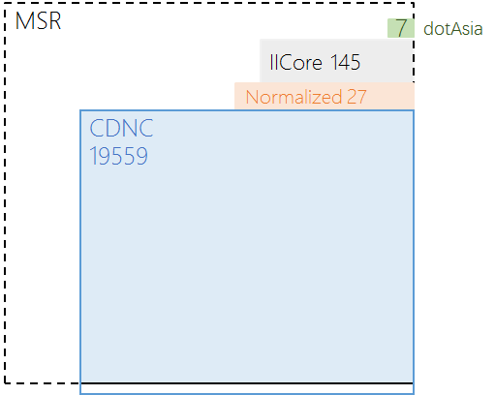
CGP LGR Proposal 1 （20160613）
Repertoire
0 | CDNC | 19559
1 | Normalized Hanzi for Common Use （NHCU） | 27
2 | IICORE | 145
3 | dotAsia | 7
 |  | 19738

Slide 3
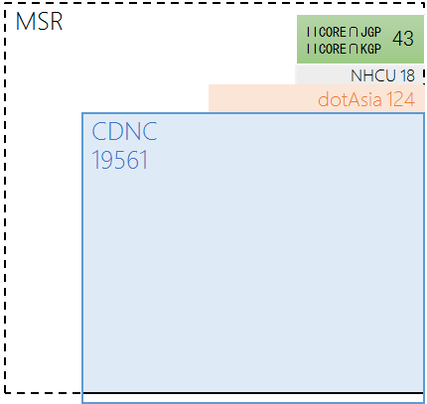
CGP LGR Proposal 2 （20160918）
Repertoire
0 | CDNC | 19561=19559+2
1 | dotAsia | 124=62+62
2 | NHCU | 18
3 | IICORE∩JGP IICORE∩KGP | 43
 |  | 19746

Slide 4
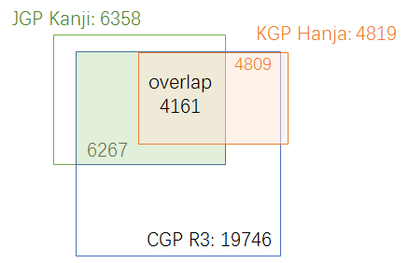

Slide 5
CGP LGR Proposal 1 （20160613）
Variant Mappings
Types and Sub-Types
“simp” | Allocatable | preferred simplified variant char;
“r-simp” | Allocatable | reflexive preferred simplified variant char;
“trad” | Allocatable | preferred traditional variant char
“r-trad” | Allocatable | reflexive preferred traditional variant char
“both” | Allocatable | preferred simplified and traditional variant chars are the same
“r-both” | Allocatable | reflexive preferred simp and trad variant chars are the same
“blocked” | Blocked | Non-allocatable variant char

Slide 6
CGP LGR Proposal 2 （20160918）
Variant Mappings
Types and Sub-Types
“simp” | Allocatable | preferred simplified variant char;
“r-simp” | Allocatable | reflexive preferred simplified variant char;
“trad” | Allocatable | preferred traditional variant char
“r-trad” | Allocatable | reflexive preferred traditional variant char
“both” | Allocatable | preferred simplified and traditional variant chars are the same
“r-both” | Allocatable | reflexive preferred simp and trad variant chars are the same
“r-neither” | Blocked | Non-allocatable reflexive/original char
“blocked” | Blocked | Non-allocatable variant char

Slide 7
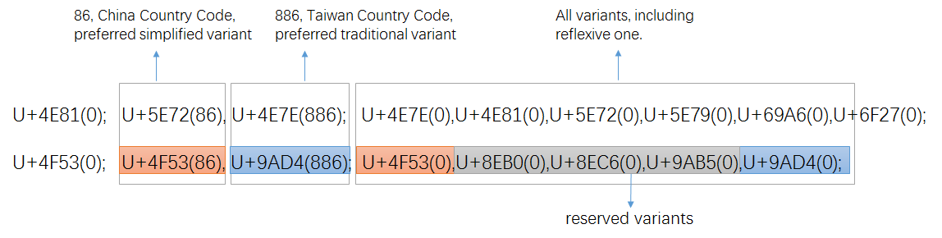
<char cp="4F53" tag="sc:Hani" >
<var cp="4F53" type="r-simp" comment="identity" />
<var cp="8EB0" type="blocked" />
<var cp="8EC6" type="blocked" />
<var cp="9AB5" type="blocked" />
<var cp="9AD4" type="traded" />
</char>
<char cp="4E81" tag="sc:Hani" >
<var cp="4E7E" type="trad" />
<var cp="4E81" type="r-neither" comment="identity" />
<var cp="5E72" type="simp" />
<var cp="5E79" type="blocked" />
<var cp="69A6" type="blocked" />
<var cp="6F27" type="blocked" />
</char>

Slide 8
CGP LGR Proposal 2 （20160918）
Variant Mappings
CGP interial coordination
CDNC
Variant Mappings
172 Non-CDNC Chars
Variant Mappings Review
CGP
Variant Mappings
69 Plane0 chars
62 Plane2 chars
7 dotAsia Chars Variant Mappings Review
dotAsia Variant Mappings

Slide 9
CGP LGR Proposal 2 （20160918）
Variant Mappings
CK 258 unacceptable chars coordination
141
258
117+

Slide 10
CGP LGR Proposal 2 （20160918）
Variant Mappings
Limit the number of allocable labels
“under the conservatism principle, LGRs should strive to minimize allocatable variants … can be fixed by not having multiple simp/trad mappings.
It may be an acceptable trade-off to eliminate the multiple mappings, and let applicants who need a specific all-simplified or all-traditional variant label apply for just the specific label. ”
台(53F0);台(53F0),台(53F0)檯(6AAF)臺(81FA)颱(98B1)
湾(6E7E);湾(6E7E),灣(7063)
台湾 (53F0 6E7E)
>>
檯灣‎ (6AAF 7063), ‎臺灣‎ (81FA 7063), 台灣‎ (53F0 7063), ‎台湾‎ (53F0 6E7E), ‎颱灣‎ (98B1 7063)

Slide 11
CGP LGR Proposal 2 （20160918）
Variant Mappings
Counter Example to IP suggestion
Original | Simplified | Traditional
台(53F0) | 台(53F0) | 台(53F0) 檯(6AAF)臺(81FA)颱(98B1)
檯(6AAF) | 台(53F0) | 檯(6AAF)
籉(7C49) | 台(53F0) | 籉(7C49)
臺(81FA) | 台(53F0) | 臺(81FA)
颱(98B1) | 台(53F0) | 颱(98B1)
Original | Simplified | Traditional
鉄(9244) | 铁(94C1) | 鐵(9435)
銕(9295) | 铁(94C1) | 銕(9295)
鐡(9421) | 铁(94C1) | 鐵(9435)
鐵(9435) | 铁(94C1) | 鐵(9435)
铁(94C1) | 铁(94C1) | 鐵(9435)
台(53F0)鉄(9244) >> 台(53F0)铁(94C1), 台(53F0)鐵(9435)/檯(6AAF)鐵(9435)/臺(81FA)鐵(9435)
/颱(98B1)鐵(9435)
台(53F0)鐵(9435) >>台(53F0)铁(94C1), 檯(6AAF)鐵(9435)/臺(81FA)鐵(9435)/颱(98B1)鐵(9435)

Slide 12
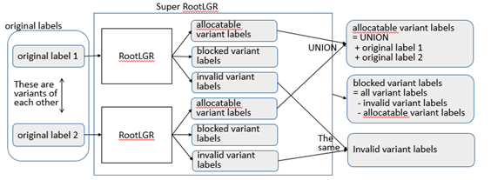
CGP LGR Proposal 2 （20160918）
Variant Mappings
Eliminate multiple mappings
Execute multiple times
Sub-Type | Type
“r-simp-m” | Blocked
“simp-m” | Blocked
“r-trad-m” | Blocked
“trad-m” | Blocked
“r-both-m” | Blocked
“both-m” | Blocked

Slide 13
CGP LGR Proposal (20160613>20160918）
WLE Rules
<rules>
<!--Action elements - order defines precedence-->
<action disp="invalid" match="leading-combining-mark" comment="labels with leading combining marks are invalid" />
<action disp="blocked" any-variant="blocked" comment="default action for blocked variant"/>
<action disp="allocatable" only-variants="simp r-simp both r-both" comment="simplified label" />
<action disp="allocatable" only-variants="trad r-trad both r-both" comment="traditional label"/>
<action disp="allocatable" only-variants="r-simp r-trad r-both r-neither" comment="original label"/>
<action disp="blocked" only-variants="simp simp-m r-simp r-simp-m both both-m r-both r-both-m" comment="multiple simplified label" />
<action disp="blocked" only-variants="trad trad-m r-trad r-trad-m both both-m r-both r-both-m" comment="multiple traditional label"/>
<action disp="blocked" any-variant="simp trad both r-simp r-trad r-both simp-m trad-m both-m r-simp-m r-trad-m r-both-m r-neither" comment="block any other mixed labels" />
<action disp="allocatable" comment="catch-all" />
</rules>

Slide 14
Q&A

