Slide 2
15 October 2014
IDN Root Zone LGR
Sarmad Hussain
IDN Program Senior Manager
IDN Root Zone LGR

Slide 3
Agenda
Introduction – Sarmad Hussain
Need, Limitations and Mechanisms for the Root Zone LGR – Marc Blanchet
Challenges in Addressing Multiple Languages using Arabic Script– Meikal Mumin
Coordination between Chinese, Japanese and Korean Scripts – Wang Wei
Coordination between Neo-Brahmi Scripts – Nishit Jain
Coordination between Cyrillic, Greek and Latin Scripts – Cary Karp
Q/A

Slide 4
Types of Coordination
One script – one GP
  Arabic
One script – many GPs
  Han – Chinese, Korean, Japanese
Many scripts – one GP
  Neo-Brahmi scripts
Many scripts – many GPs
  Cyrillic, Greek, Latin

Slide 5
Aspects of Coordination
Need – what work should be undertaken by the GPs
  Same code points
  Visually similar code points
  Similar rules
  Other?
Mechanism – how will these GP’s interact with each other
  After individual GP work
  During individual GP work
  Before individual GP work

Slide 6
Need, Limitations and Mechanisms for the Root Zone LGR
Presented by: Marc Blanchet
Integration Panel
IDN Root Zone LGR

Slide 7
The Need for LGRs
It’s not all about variants!
LGRs define what labels are valid
  They are needed for automated label validation
For some scripts, all that is needed is a defined repertoire
  Each application confined to one repertoire

Slide 8
Root Repertoire
Collection of single script repertoires
  Each tagged by script: “und-Cyrl,” “und-Jpan”
  No cross-repertoire labels
  No overlap, except “common” code points, Han
Each script repertoire limited to:
  Modern, widespread use
  Everyday use
  Stable code points

Slide 9
But What About Variants?
Some scripts require variants
  Code points that are “the same” to users
Two types:
  Those that lead to “blocked” variants
  Those that lead to “allocatable” variants
Procedure:
  Maximize number of blocked variants, and minimize the number of allocatable variants

Slide 10
More on Variants
Variant mappings will be used to automatically generate all permutations (variant labels)
Type of variant mapping determines whether:
  To block a variant label
  (either variant or original can be allocated, not both)
  To allow allocating it to the same applicant as original label
As result of integration, blocked variants can exist across GP repertoires
  GP coordination will ensure consistent outcome

Slide 11
What, Why and When of WLEs
Whole Label Evaluation Rules (WLE)
Why they are needed
  Prevent labels that cannot be processed/rendered
When to consider
  Generally affect “complex scripts”
  Not intended to enforce “spelling rules”
Example:
  Disallow vowel marks where they can’t be rendered:
  at the start or following other vowel marks, etc.

Slide 12
Limitations
TLDs are intended for:
  “Unambiguous labels with good mnemonic value” *
Not intended to capture all facets of a writing system
  Should focus on modern, everyday use
  OK not to support some conventions
    e.g., disallowing apostrophe does not support the ‘s ending for names of businesses, hyphen disallowed in root
  Some limits necessary to reduce systemic risks
*https://tools.ietf.org/html/draft-iab-dns-zone-codepoint-pples-02

Slide 13
What Should Be Coordinated?
Repertoire: Consistent treatment of similar repertoires
    Examples: Indic scripts
Variants: Compatible definition of variants
    Examples: Han script, overlapping repertoires
  Cross-script homoglyphs
    Examples: Latin, Greek, Cyrillic
WLE: Consistent treatment of structurally similar scripts
    Examples: Indic scripts, definition of matra

Slide 14
Resources
Considerations for Designing a Label Generation Ruleset for the Root Zone
  https://community.icann.org/download/attachments/43989034/Considerations-for-LGR-2014-09-23.pdf
Maximal Starting Repertoire (MSR-1)
  https://www.icann.org/news/announcement-2-2014-06-20-en
  https://www.icann.org/en/system/files/files/msr-overview-06jun14-en.pdf
Procedure to Develop and Maintain the Label Generation Rules for the Root Zone in Respect of IDNA Labels
  https://www.icann.org/en/system/files/files/draft-lgr-procedure-20mar13-en.pdf
Representing Label Generation Rules in XML
  https://tools.ietf.org/html/draft-davies-idntables
Requirements for LGR Proposals
  https://community.icann.org/download/attachments/43989034/Requirements%20for%20LGR%20Proposals.pdf
Variant Rules
  https://community.icann.org/download/attachments/43989034/Variant%20Rules.pdf

Slide 15
Challenges in Addressing Multiple Languages using Arabic Script
Meikal Mumin
Arabic Generation Panel
IDN Root Zone LGR

Slide 16
Representing scripts in a world of languages
abc.def is a Roman/Latin script IDN
ابت.ثجح is a Arabic script IDN
But we do not know which languages are used by website of either IDNs
So International Domain Names (IDNs) have a script as property, but not a language. So what does this mean?
  It means that IDNs cannot be based on the orthography of one language, such as Arabic language, but that…
  LGR and related standards must therefore address the entire community of readers and writers of Arabic script
The problem is that, while we can only represent scripts, we think in terms of language
  All data is at language level while we have to define LGR at script level
  There are no institutions representing scripts communities
  Writing is usually considered as a (reduced) representation of language
So what is the actual scope of Arabic script LGR?

Slide 17
Scope of the Arabic script LGR
Arabic script is centered around Africa and the Middle east as a writing system but in the course of time it has expanded across nearly all continents, with established past or present use in
  the Americas, (Western, Central, Southern, and Eastern) Europe, (nearly all areas of) Asia, Africa (North and South of the Sahara)
  Only within Africa, there is attested past or present use of Arabic script for the writing of 80+14 African languages apart from Arabic (Mumin 2014)
  With todays patterns of migrations, continuing proselytization, and population growth, more user communities of Arabic script are manifesting in both the Global South and North
Accordingly, Arabic script is used not just locally or regionally but globally, albeit to radically different degrees and in entirely different manners, since…
  for numerous languages, Arabic script is in active competition with other scripts, and…
  for numerous languages, Arabic script is used only by a part of the language community
  It is not foreseeable how the situation will evolve in the future and what the impact of IDNs would be on the community
  To give a more extreme example – Would a language community possibly care if they can register a domain name using the orthography of their language if any reading and writing is only done with pen & paper?

Slide 18
Representing the underrepresented
Unfortunately, this linguistic diversity is not well represented
  There is a lack of data on languages and orthographies
  Particularly languages of low status or socio-economic participation lack representation
  There is little available on non-western orthographies, while non-standardized orthographies are generally not considered
  Often much TF-AIDN has to rely on users intuitions from an entirely different part of the script community
  E.g. during code-point analysis, we frequently lacked data to establish whether a code point is used optionally or obligatorily in a given orthography, which required within the current process

Slide 19
Qualifying and quantifying script use: The EGIDS scale
Security and stability of DNS and the root zone are highly important, and therefore conservatism is a strong principle surrounding IDNs
  "Where the Integration Panel was able to establish to its satisfaction that a given code point was assigned a character solely for use in a disused orthography, or for a language in serious decline, the code point has been removed from the MSR.”
  Maximal Starting Repertoire — MSR-­‐1 Overview and Rationale, REVISION – June 6, 2014, p. 22
  MSR dictates that the Expanded Graded Intergenerational Disruption Scale [EGIDS] (Lewis and Simons 2010) is used to categorize the “effective demand” of languages within a given country:
    The EGIDS consists of 13 levels, ranking languages from the highest representation and role in society, being a National language, to the lowest, extinction
    “For the MSR the IP used the cut-off between EGIDS level 4 [Educational] and level 5 [Developing].”
Unfortunately, such representation of language in society is not just accidental but usually a result of historical processes

Slide 20
"Scripts divide languages into cultures, make dialects into new distinct languages, and create new dialects. […] If, as is often said, ‘A language is a dialect with an army and navy’, how much more is it ‘a dialect with a distinct script’!”
(Warren-Rothlin 2014: 264)

Slide 21
People, society, language and the role for IDNs
Languages and scripts are
  …evaluated by people (Language attitude)
  …assigned a status by both societies and scientists (Dialect vs. language)
  …and regulated by governments (Language policy)
  and this is reflected also in studies and statistics on languages
    There have even been historical reports of orthography suppression of Arabic script, where the use of writing systems has been banned and criminalized
We must be cautious not to strengthen further trends of linguistic discrimination and strive for equal treatment of languages, even where they lack socio-economic participation or political representation
  TF-AIDN did identify 32 code-points during the analysis, with evidence of use but which cannot be included in LGR because they do not have an EGDIS rating higher than 5

Slide 22
Example #1 – Code point analysis and issues with EGIDS data
Example Seraiki [ISO 639-3: skr]:
  Seraiki is a language of Pakistan
  There are numerous publications in Seraiki, including daily newspapers
  Within Pakistan, Seraiki has an EGIDS rating of 5 (Written)
  IP recommends excluding any language with an EGIDS rating lower than 4
Example Harari [ISO 639-3: har]:
  Harari is a language of Ethiopia
  There are significant expatriate communities, which seem to be very active
    E.g. The Australian Saay Harari Association, which published an orthography description and a virtual keyboard with the assistance of the State Library of Victoria, Australia, in 2009
  Within Ethiopia, Harari has an EGIDS rating of 6a (Vigorous), while it has not status in Australia
  Because of the activity of the expatriate community, TF-AIDN assumes an active use of the orthography and would suggest inclusion of relevant code points
  Unfortunately, this is not possible within the current process stipulated by IP

Slide 23
A-priori principles and a-posteriori analysis
In the case of Arabic script IDNs, ICANN has tasked two groups to work together to develop the Label Generation Rules (LGR)
  Integration Panel (IP) has developed the “Procedure to Develop and Maintain the Label Generation Rules for the Root Zone in Respect of IDNA Labels”, as well as the Maximal Starting Repertoire (MSR-1)
  On the basis of the procedure and the MSR-1, the Task Force on Arabic Script IDNs (TF-AIDN), should formulate the LGR, which is then approved by IP
  Accordingly, rules have been laid out by IP before observation and analysis of data was conducted by TF-AIDN
Therefore MSR and the LGR development process has been designed before an (ideally data driven) code point analysis could be conducted by script generation panels
  TF-AIDN noticed this, being the first script generation panel to take up work
  Accordingly, TF-AIDN did suggest to IP as public comment to MSR-1 that
    MSR-1 should only be frozen one script at a time
    after relevant script Generation Panel has been formed and given its feedback on its relevant portion
  Unfortunately, IP considered this as an effective request for removal of MSR1

Slide 24
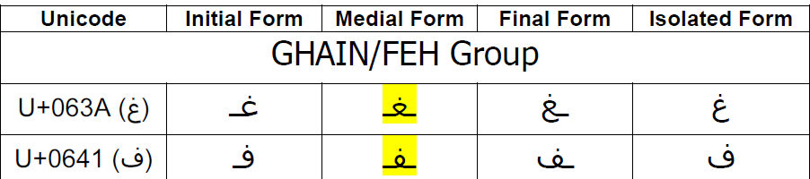
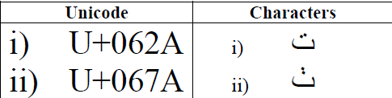
Example #2 - Variants
  Variants are required to balance the usability of IDNs as well as the representation of languages against security and stability of DNS and the root zone
  Arabic Case Study Team Issues Report has published a report, identifying 6 types of variants in Arabic script. Two examples:
So how can we reasonably argue that this difference in letter shape is not confusable by all readers and across all representations and fonts…
...while this difference is confusable to at least a subset of readers or in a subset of representations and fonts…
…when there are no empiric scientific tests to support either theory?
…when there is a systemic bias in representation with even within our group (as 15 out of 29 members are first language speakers of Arabic)?

Slide 25
ﺗﺮﻳﻤﺎ ﮐﺎﺳﻴﻪ
شكراً
شکریہ
با سپاس
تشكر
Thank You

Slide 26
Coordination between Chinese, Japanese and Korean Scripts
Wang Wei
Chinese Generation Panel
IDN Root Zone LGR

Slide 27
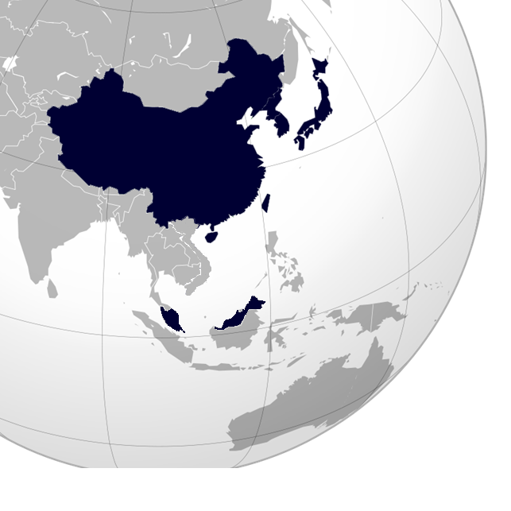
The Historical Changes of Chinese Character in East Asia
Second century BC to 5th century AD
In the modern Hangul-based Korean writing system, Chinese characters (Hanjia) are no longer officially used, but still sometimes used occasionally in daily life.
Chinese characters (Kanji) were adopted from the 5th century AD.
All three scripts (kanji, and the hiragana and katakana syllabaries) are used as main scripts.
Hanzi unification in the Qin dynasty (221-207 B.C.)
Now, two writing systems: Simplified Chinese (SC) and Traditional Chinese (TC). SC and TC have the same meaning and the same pronunciation, are typical variants.
TC: Taiwan, Macau, Hong Kong
SC: Mainland China, Singapore
TC & SC: Malaysia

Slide 28
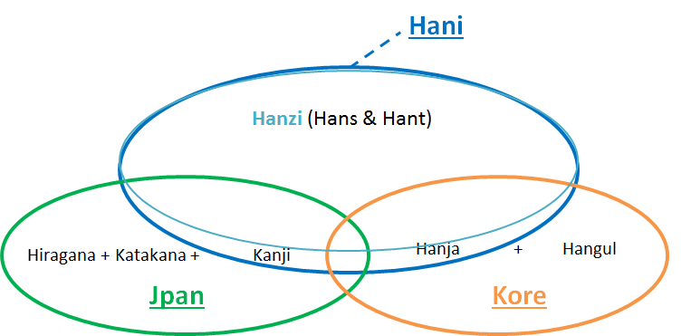
Relationship of Chinese Characters in Three Scripts
In ISO 15924, the script for Chinese characters is mainly defined in this specification:
ISO 15924 code: Hani
ISO 15924 no: 500
English Name: Han (Hanzi, Kanji, Hanja)

Slide 29
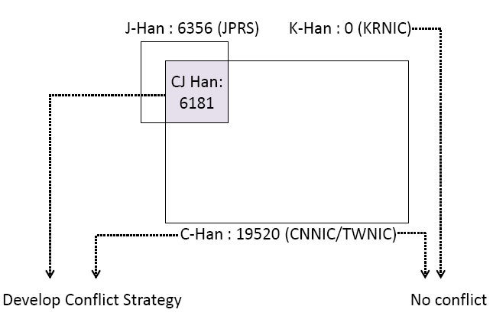
SLD/TLD Chinese Character IDN Registration
CDNC Character Table and Registration Rules under RFC 3743/4713
SLD: .CN, .TW, .HK, .SG, .ASIA
TLD: .中国, .台湾, .香港
JPRS IDN Registration
SLD: .JP
KISA:
NO Chinese character
registration under .KR
19535(CGP)
6186
19537 (CDNC)
So Far

Slide 30
Variant Solutions in Different Scripts
CDNC: RFC 3743 & 4713
Allocate all Applied-for IDL and Variant IDLs to the same registrant
Delegate Applied-for IDL, Preferred SC IDL, Preferred TC IDL
Reserve all the other variant IDLs
Delegate reserved variant IDLs when requested at a later date
JPRS: No Variant issue
Among Kanji characters, some are in a simplified form (called the “new character form”), derived from the traditional imported form (called the “old character form”).
It is appropriate to distinguish new and old forms as different and independent characters instead of pure variants. This understanding has been reflected in the IANA IDN table developed by the JPRS, in which no variants are identified for Kanji.
KISA: No Variant issue, so far …
Hanja is no longer widely used in the ROK. A law enacted in 2011 orders all ROK official government documents to be written ONLY in Hangul.
KISA stated that its SLD IDN policy does not allow and nor does they have any intention of allowing the use of Hanja in their domestic market.

Slide 31
Coordination Principle
Each CJK panel creates an LGR and each LGR includes a repertoire and variants.
The variant mappings must agree for the same code point for all LGRs.
The variant types may be different (blocked or allocatable), the variant types do not have to agree across LGRs.
The repertoires may be different.
Allocatable
A potential allocation rule says that once the variant label is generated, that variant label may be allocated to the applicant for the original label.
Blocked
A blocking rule says that a particular label must not be allocated to anyone under any circumstances.

Slide 32
Example to Illustrate: Case Study 0
Appendix F of draft-lgr-procedure-20mar13-en.pdf.
For CGP
Code Point | Allocatable Variant | Blocked Variant | Tag
爱 U+7231 | 愛 U+611B | - | und-hani
愛 U+611B | 爱 U+7231 | - | und-hani
Code Point | Allocatable Variant | Blocked Variant | Tag
爱 U+7231 | 愛 U+611B | - | und-hani
愛 U+611B | 爱 U+7231 | - | und-hani
愛 U+611B | - | 爱 U+7231 | und-jpan
For JGP, probably
Code Point | Allocatable Variant | Blocked Variant | Tag
愛 U+611B | - | - | und-jpab
Applying for U+611B using the und-jpan blocks the use of U+7231 in the same location in any label, no matter which tag it is applied under. This is so, even though U+7231 is not a character in Japanese at all and does not appear in the tagged repertoire und-jpan. Because it is not part of that repertoire, it cannot be used in any label applied for with the und-jpan tag.

Slide 33
Progress of CGP, JGP and KGP
CGP:
Formal establishment announcement on 24 September.
(https://www.icann.org/news/announcement-2014-09-24-en)
Draw up initial repertoire and variant type definition in XML format.
Provided some coordination study case for IP and K/J.
JGP: Not seated yet
?
?
KGP: Not seated yet
2014.08.21: KLGP domestic meeting.
2014.08.26: Joint meeting with Han Chuan LEE and other attendees
2014.09.03: CJK people discussion

Slide 34
CGP Repertoire and Variant Type
<char cp="575D" tag="sc:Hani">
<var cp="575D" type="simp" comment="identity" />
<var cp="57BB" type="block" />
<var cp="58E9" type="trad" />
</char>
<char cp="57BB" tag="sc:Hani">
<var cp="575D" type="simp" />
<var cp="57BB" type="block" comment="identity" />
<var cp="58E9" type="trad" />
</char>
<char cp="58E9" tag="sc:Hani">
<var cp="575D" type="simp" />
<var cp="57BB" type="block" />
<var cp="58E9" type="trad" comment="identity" />
</char>
In 2004, according to RFC 3743 and RFC 4713, CDNC submitted to IANA a unified Chinese Character Set (19520 characters) for domain name registration, building up mapping relationships between any given simplified character, its traditional character(s) and its variant(s).
In 2012, CDNC added 17 more Chinese characters as requested by Hongkong community, increasing the set number to 19537. But only 15 of those 17 characters are included in MSR-1.
Thus CGP takes the intersection of MSR-1 and the latest version of CDNC character set, amounting to 19535 characters, excluding Latin Hyphen, digits and letters.
Following CDNC registration rule and RFC 3743 & 4713, CGP take the second column (the preferred variants) as “allocatable,” while the rest of the variants as “blocked.”
Code Point | Allocatable Variant | Blocked Variant | Tag
坝(575D) | 壩(58E9) |  | und-hani
坝(575D) |  | 垻(57BB) | und-hani
垻(57BB) | 坝(575D) |  | und-hani
垻(57BB) | 壩(58E9) |  | und-hani
壩(58E9) | 坝(575D) |  | und-hani
壩(58E9) |  | 垻(57BB) | und-hani

Slide 35
CGP’s Perspective for Variant Mapping Coordination
CGP is aware that the coordination can not be achieved by one party.
CGP is tremendously open to make an unified variant mapping table working together with JGP and KGP.
CGP is ready to modify the initial repertoire and variant type annotation according to the coordination result, and if necessary, to delete some code points to avoid complicated conflicts.
Those UNIQUE Chinese character codes in JGP and KGP are NOT to be added into CGP repertoire.

Slide 36
Case Study 1
All code points are included in CGP initial repertoire and regarded as variants of each other.
The mapping relationship in RFC 3743 format is as follows:
    一4E00 (0); 一4E00(86),一4E00(886); 一(0),壱(0),壹(0),弌(0);
    壱58F1 (0); 壹58F9(86),壹58F9(886); 一(0),壱(0),壹(0),弌(0);
    壹58F9 (0); 壹58F9(86),壹58F9(886); 一(0),壱(0),壹(0),弌(0);
    弌5F0C (0); 一4E00(86),一4E00(886); 一(0),壱(0),壹(0),弌(0);
Meanwhile, all code points are included in JPRS IDN table as well.
(http://www.iana.org/domains/idn-tables/tables/jp_ja-jp_1.2.html)
There is no mapping relationship among them.
    一 4E00(2,3);4E00(2,3); # 16-76, CJK UNIFIED IDEOGRAPH-4E00
    壱 58F1(2,3);58F1(2,3); # 16-77, CJK UNIFIED IDEOGRAPH-58F1
    壹 58F9(2,3);58F9(2,3); # 52-69, CJK UNIFIED IDEOGRAPH-58F9
    弌 5F0C(2,3);5F0C(2,3); # 48-01, CJK UNIFIED IDEOGRAPH-5F0C

Slide 37
Case Study 1
Code Point | Allocatable Variant | Blocked Variant | Tag
一 (U+4E00) | - | 壱 (U+58F1) | und-hani
一 (U+4E00) | - | 壹 (U+58F9) | und-hani
一 (U+4E00) | - | 弌 (U+5F0C) | und-hani
壹 (U+58F9) | - | 一 (U+4E00) | und-hani
壹 (U+58F9) | - | 壱 (U+58F1) | und-hani
壹 (U+58F9) | - | 弌 (U+5F0C) | und-hani
弌 (U+5F0C) | 一(U+4E00) | - | und-hani
弌 (U+5F0C) | - | 壹 (U+58F9) | und-hani
弌 (U+5F0C) | - | 壱 (U+58F1) | und-hani
壱 (U+58F1) | 壹(U+58F9) | - | und-hani
壱 (U+58F1) | - | 一 (U+4E00) | und-hani
壱 (U+58F1) | - | 弌 (U+5F0C) | und-hani
一 (U+4E00) | - | - | und-jpan
壹 (U+58F9) | - | - | und-jpan
弌 (U+5F0C) | - | - | und-jpan
壱 (U+58F1) | - | - | und-jpan

Slide 38
Case Study 2
The code point and its variant(s) exist separately in CGP and JGP
    刊 (U+520A) # in CGP and JGP
    刋 (U+520B) # in CGP and JGP
    栞 (U+681E) # only in JGP
In CGP repertoire, the mapping is:
    刊520A (0);刊520A(86),刊520A(886);刊(0),刋(0);
    刋520B (0);刊520A(86),刊520A(886);刊(0),刋(0);
In JPRS table，code points are:
    刊 520A(2,3);520A(2,3);
    刋 520B(2,3);520B(2,3);
    栞 681E(2,3);681E(2,3);

Slide 39
Case Study 2
Though 栞(U+681E) is not included in CGP repertoire, but it is regarded as the variant of 刊(U+52-A) and 刋(U+520B) in ancient Chinese literature and some local areas.
CGP would like to extend the CGP repertoire by adding 栞(U+681E) and build up the variant relationship.
Code Point | Allocatable Variant | Blocked Variant | Tag
刊(U+520A) | - | 刋(U+520B) | und-hani
刊(U+520A) | - | 栞(U+681E) | und-hani
刋(U+520B) | 刊(U+520A) | - | und-hani
刋(U+520B) | - | 栞(U+681E) | und-hani
栞(U+681E) | 刊(U+520A) | - | und-hani
栞(U+681E) | - | 刋(U+520B) | und-hani
刊(U+520A) | - | - | und-jpan
刋(U+520B) | - | - | und-jpan
栞(U+681E) | - | - | und-jpan

Slide 40
Case Study 3
The code point ONLY exists in JPRS table:
    辻(U+8FBB)
‘辻’ does NOT exist in CGP now and traditionally, it is regarded as a Japanese UNIQUE character code.
If CGP linguistic experts keep the viewpoint that ‘辻’ is not associated any code point in CGP repertoire, CGP will not add this code point into CGP repertoire：
Code Point | Allocatable Variant | Blocked Variant | Tag
辻(U+8FBB) | - | - | und-jpan

Slide 41
Expectation for JGP and KGP
Generate the repertoire and variant type annotation ASAP
  JGP: Kanji repertoire and variant type annotation
  KGP: Allow Hanjia? >> Hanjia repertoire and variant type annotation
Work together on the unified variant mapping table for the overlapped code points
  Case 0: jpan or kore tagged code point block hani variant
  Case 1: NO change to any variant type annotation
  Case 2: jpan or kore tagged code point added into hani variant
  Case 3: jpan or kore UNIQUE code points
  Case 4: …
Revise each panel’s repertoire and variant type annotation
and cross-check the consistency and potential conflicts.
Generate each panel’s Whole Label Generation Rule
and cross-check the consistency and potential conflicts.
KGP: ????
JGP: 6356
???
6186
CGP: 19535

Slide 42
Challenges…
Postponed work plan
  Synchronization between C, J and K
  Extension from 31 Dec 2014 to 2015
Repertoire Modification
  Negotiation among three panels’ linguistic experts
  Code points extension or reduction
  Variant type annotation changes
Whole Label Generation Rule Set
  Each panel SHOULD be aware of PROs and CONs of the language tag based solution
  Focus on the techniques and best-practice

Slide 43
Thanks
Q&A

Slide 44
Coordination between Neo-Brahmi Scripts
Nishit Jain
Neo-Brahmi Generation Panel
IDN Root Zone LGR

Slide 45
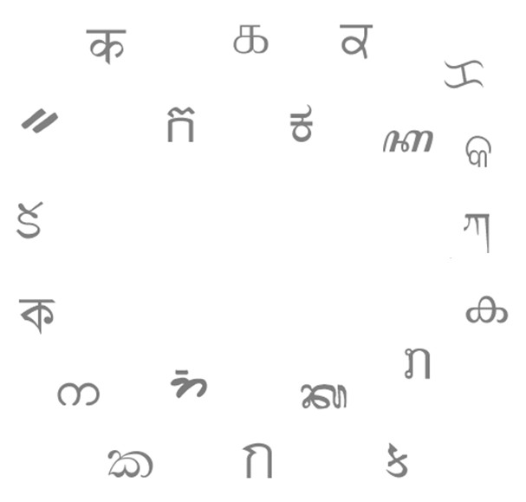
Neo-Brahmi Generation Panel

Slide 46
What is Brahmi?
An ancient script
Most of the modern scripts in Indian subcontinent
have been derived from Brahmi.
  Geographically the scripts being used in Central Asia, South Asia and South-East Asia
These scripts are used by multiple language families: largely by Indo-Aryan and Dravidian

Slide 47
Why Brahmi?
Despite their variations in the visual forms, the basic philosophy in their usage is common
They all are “akshar” driven, and follow a specific syntax
Analogical reference can be made to Indian National standard, IS 13194:1991 – Section 8
This syntax being the implicit foundation in representation of these scripts in the digital medium, adherence to the structure acts as a obligatory security consideration even in the case of Internationalized Domain Names.

Slide 48


Why Neo-Brahmi?
Of all the scripts derived from “Brahmi,” not all are in modern usage
Approach is in consonance with the "Conservatism Principle" of the LGR procedure.

Slide 49
Previous Similar Work
For IDN version of “.in” ccTLD, (.bharat) equivalent in 22 Official Indian Languages, similar exercise had been carried out
Following things were finalized for each language
  Permissible set of code points
  Visually similar variant strings
  Complex whole label evaluation rules
Recently .भारत ccTLD has been launched in Devanagari script covering Hindi, Marathi, Konkani, Boro, Dogri, Maithili, Nepali and Sindhi.

Slide 50
Revisiting the Rules in Context of LGR Framework
LGR work is different in following contexts
  Wider stakeholder group
  Overarching principles in the LGR procedure
    Especially Simplicity and Predictability principles
This revision, however, would not change
  The need for the well-formedness of the label in terms of Akshar formalism

Slide 51
Neo Brahmi GP - Current Status
Currently the group is 10 members
  Mixed bag expertise like linguistic, Unicode
Udaya Narayana Singh | Raiomond Doctor
Mahesh D. Kulkarni | Anupam Agrawal
Akshat S. Joshi | Abhijit Dutta
N. Deiva Sundaram | Neha Gupta
Nishit Jain | Prabhakar Pandey
We are in process of getting more members on-board

Slide 52
Neo Brahmi GP – Outreach Efforts
Conducted a workshop in AprIGF-2014 for awareness and call for participation in LGR procedure.
Topic: “Bringing diverse linguistic communities together for a unified IDN ruleset”
The panel discussion touched upon the various aspects of
creation of the LGR for the Neo-Brahmi scripts
http://2014.rigf.asia/agenda/workshop-proposals/workshop-proposal-13/
Participation and presentation in ICANN 49 public meeting at
Singapore
Participation and presentation in ICANN 50 public meeting at London
Reaching out to the community for wider participation

Slide 53
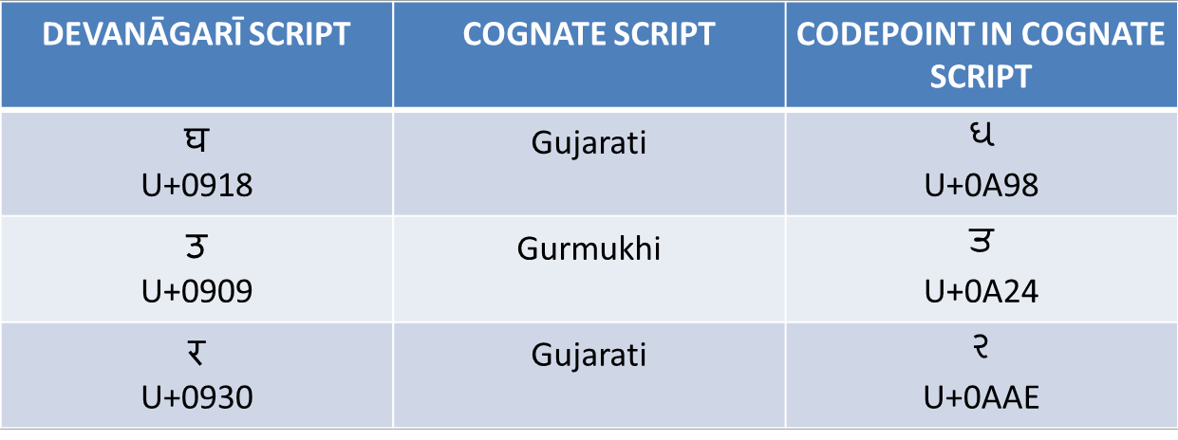
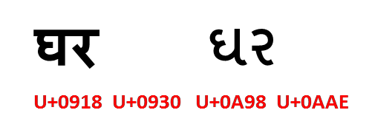

Cross-Script Similarities
Code point similarity across scripts
Cases where Devanagari-Gujarati and Devanagari-Gurumukhi strings look similar.

Slide 54
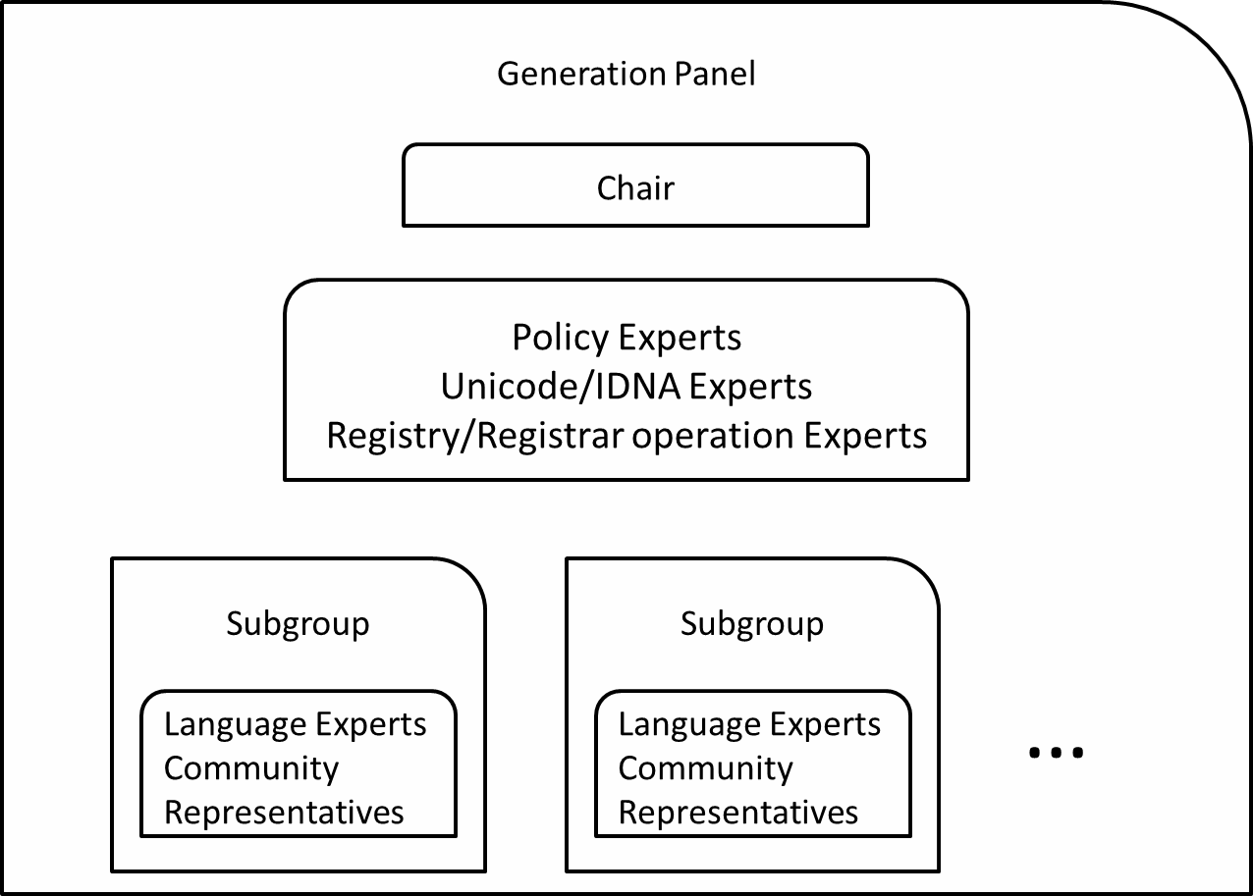
Neo Brahmi GP – Approach
10

Slide 55
Neo Brahmi GP – Approach
There are cases of:
  One script, one language
  One script, multiple languages
    In this case, multiple sub-groups may exist to ensure proper
representation of each language
Each sub-group ideally would comprise of
  Language expert(s)
  Community representative(s)

Slide 56











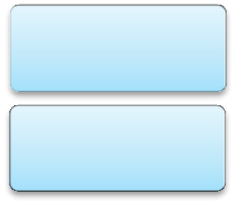







Neo-Brahmi GP Internal Composition
Hindi Marathi
Tamil Sub-Group
Telugu SG
Konkani
Nepali
Devanagari SG
Neo-Brahmi GP
Bodo
Integration Panel
Gujarati
Dogri
…
SG
Gurmukhi SG
Maithili
Santhali
…
Bangla
…
Bengali SG
Assamese
Manipuri

Slide 57


Thank You

Slide 58
Coordination between Cyrillic, Greek and Latin Scripts
Cary Karp
Latin Generation Panel
IDN Root Zone LGR

Slide 59
Apsyeoxic — two words that appear to be spelled identically but are actually sequences of characters from different scripts are said to be apsyeoxic /æpsiˈaːksɪk/. This term is derived from the graphic similarity between the string of Roman letters apsyeoxic and the visually confusable string of Cyrillic letters арѕуеохіс
  http://dictionary.sensagent.com/

Slide 60
Culling Cyrillic and Latin code points from the MSR which are commonly represented with congruent glyphs:
  Latin
    aäæcçdeëəhiïoöpsxyÿʒ
  Cyrillic
    аӓӕсҫԁеёәһіїоӧрѕхуӱӡ

Slide 61
Adding Greek and admitting closely similar, but not identical glyphs:
  Cyrillic
    а ҫїко р
  Greek
    αβγςϊκοόρν
  Latin
    ɑßɣçï oópv
The extent of the problem crossing all three scripts does not appear particularly great

Slide 62
Stepping away from both IDNA and the MSR and considering uppercase:
  Cyrillic
    АГВЕНІКМ ОПРТФХ
  Greek
    ΑΓΒΕΗΙΚΜΝΟΠΡΤΦΧΥΖ
  Latin
    A BEHIKMNO PTɸXYZ
IDNA expects issues relating to case to be resolved before the protocol is invoked
This does not mean that such issues are irrelevant

Slide 63
This does mean that if the LGR panels are to address cross-script issues, they may also need to deal with collateral details that lie outside the current scope of the initiative

Slide 64
Thank You

Slide 65








Engage with ICANN on Web & Social Media
twitter.com/icann
gplus.to/icann
facebook.com/icannorg
weibo.com/icannorg
linkedin.com/company/icann
flickr.com/photos/icann
youtube.com/user/ICANNnews
icann.org
Notes:
[KEEP THIS PAGE UP]
Thank you for taking the time to listen. I’d love to hear your feedback or answer any questions.

