Slide 1
First LAC Strategy Update Session
Rodrigo Saucedo| Open Webinar | January 2016

Slide 2
Agenda
1
2
3
Strategy Overview
Summary Projects 2015
Going forward – Renewed LAC Strategy
4
5
Implementation Plan
Q&A
Notes:
Strategies across all regions and key metrics
Planning and Development – Alignment with key icann objectives
Implementation
Regional Engagement & Policy Development
Outreach and Stakeholder Engagement Metric

Slide 3
LAC Strategic Plan overview
Notes:
Breakup your presentation, divide it into sections. This is especially useful if most of your presentation is text.

Slide 4

LAC Strategy
Recommended by regional community
4 key areas
Political issues
Capacity building and outreach
Operations
Economic issues
Implementation based on regional working groups
Notes:
Insert a 364 x 395 pixels photo.

Slide 5
LAC Strategy Timeline
April
2013
May
2014
June
2014
March
2015
Sep.
2015
Jan.
2016
Community presented LAC Strategic Plan in Beijing
5 pilot projects implemented
The Implementation Plan for the rest of the projects was presented
Implementing the projects on the first period – August 2014 to August 2015
LAC Strategy Steering Committee Workshop.
Implementation LAC Strategy 2016 -2020
Notes:
To adjust the length and width of the arrow, click on the arrow, grab a corner, and lengthen or shorten, depending on your preference.
To add a bubble, click on the bubble, ensure it is fully highlighted, COPY and PASTE. Then drag the bubble to your preferred placement.
To delete a bubble, click on the bubble, ensuring it is highlighted and click DELETE. If you make a mistake, go to your top bar on PP and click EDIT, UNDO

Slide 6
LAC Community participation
Latin America
38 people
1
Latin America/
Caribbean Islands
Number of Latin America and Caribbean Community members participating in one or more projects of the LAC Strategic Plan
Caribbean
25 people
Steering Committee (16 members)
9 members of this Committee are involved in 1 or more projects.

Slide 7
LAC Strategy Communication
Newsletter
Regional Website
Social media
Monthly Webinar

Slide 8
Summary Projects 2015
Notes:
Breakup your presentation, divide it into sections. This is especially useful if most of your presentation is text.

Slide 9
LAC DNS Observatory
Objective
The goal of the Latin America DNS Observatory is to establish a focal point for the measurement of the technical parameter of the Domain Name System (DNS) protocol in order to increase the knowledge on this critical infrastructure in the region.
Working Group
Hugo Salgado – NIC Chile
Alejandro Acosta – LACNIC
Victor de Oliveira - INATEL Brazil
Antonio Alberti – INATEL Brazil
Lia Solis – ENTEL Bolivia
Notes:
This is a simpler agenda slide, the outline for your presentation.

Slide 10
LAC DNS Observatory
Mediciones:
1. Número de servidores DNS por cada dominio.
Indicar/ consultar el numero de servidores que responden para cada nombre de dominio.
2. Número y diversidad de ASN por DNS de dominio.
Ver la robustez de la perspectiva de enrutamiento.
3. Dispersión de segmentos IP por DNS de dominio
Ver la robustez de la perspectiva de enrutamiento para determinar que no se encuentren en la misma sub red.
4. Estado de sanidad de servidores DNS
Soporte de estándares mínimos (EDNS, consultas incorrectas, TCP)
Verificar el cumplimiento de estándares minamos y mejores practicas en operaciones de servicio de DNS.
Métricas de seguridad (puertos variables, no recursividad, etc.)
Hacer el Query a servidores autoritarios para detectar vulnerabilidad.
5. Penetración de IPv6 y DNSSEC
Mostrar el índices de penetración de IPv6 y DNSSEC
Notes:
This is a simpler agenda slide, the outline for your presentation.

Slide 11
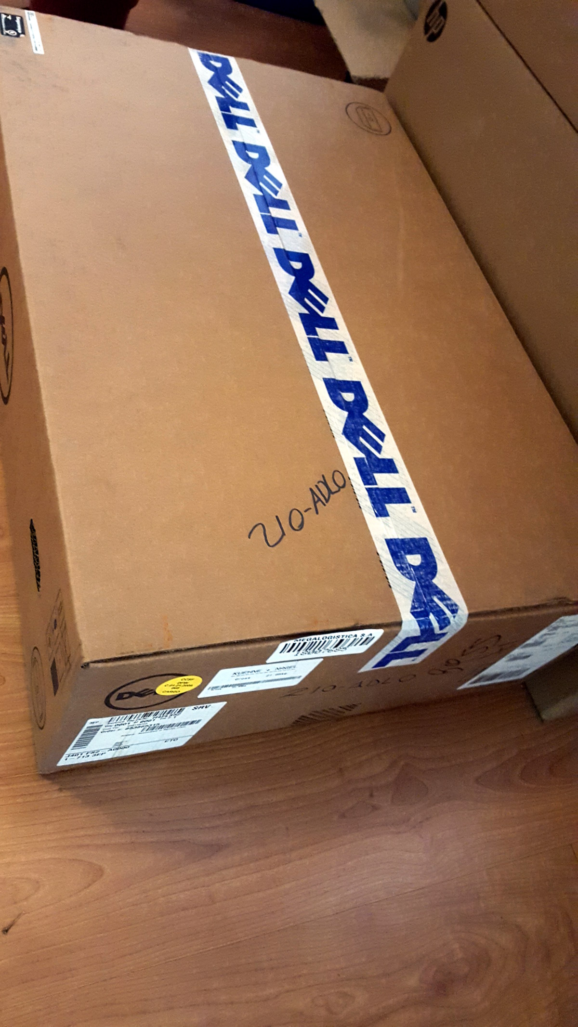
LAC DNS Observatory
Activity 2015
the Server was acquired and it was installed in NIC Chiles facilities in Santiago.
The project currently is in the implementation phase of the first report as proof of concept, using an observation point in Santiago de Chile, the first node will be operated by NIC Chile and, in the second stage, new observation points could be created in other cities in the region.
Notes:
This is a simpler agenda slide, the outline for your presentation.

Slide 12

Supporting the Commercial Development of ccTLD Registries in the LAC Region
Capacity Building - Webinars
Objective
The objective of this project was to support a study that helps develop a business vision of registries in the LAC Region,
Working Group
The project was lead by LACTLD
Carolina Aguerre
Alejandra Reynoso
Ruth Puente

Slide 13
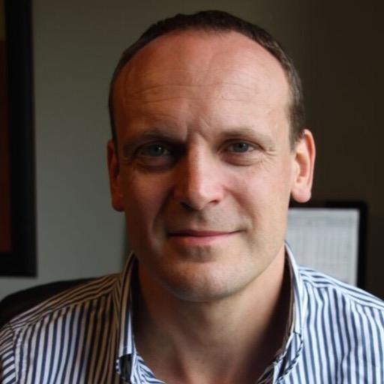
Supporting the Commercial Development of ccTLD Registries in the LAC Region
Capacity Building - Webinars
Consultant
Wim Degezelle, Internet policy analyst & consultant (DUERMOVO), who has more than 10 years’ experience in the Domain Name Industry and ccTLD Community was the consultant hired to conduct the study “The Commercial Development of ccTLD Registries in the Latin American and Caribbean Region”.
ICANN 53 Buenos Aires
LAC DNS Forum
LACTLD Workshop
LAC Space
Study
The study presented analyses the challenges and provides building blocks to develop strategies for ccTLDs in this new commercial environment.
Download:
https://goo.gl/wtAWaA

Slide 14
ccTLD Internship Program
Objective
The (ccTLD) Internship Program targets small and medium-sized ccTLDs in the Latin American and Caribbean region, with a focus on specific capacity building that will contribute to participant ccTLDs' growth and enhancement.
Working Group
The project was lead by LACTLD
Carolina Aguerre
Alejandra Reynoso
Sofia Zerbino

Slide 15
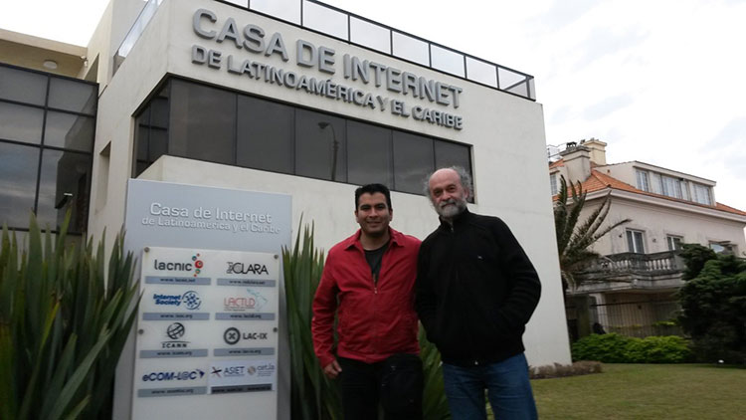
ccTLD Internship Program
First Internship
ccTLD .ve – ccTLD .uy
Date: October 26th to 30th
The first internship of the program Engineer Jhonder J. Depablos, Chief of the Domain Name Administration Division at .ve spent 5 days at the ccTLD .uy accomplishing the following goals:
Understanding the full operation of the Registry-Registrar Protocol Model and the Extensive Provisioning Protocol (EPP).
Short-term implementation with a couple of registrars (clients) in the Virtual Machines Lab.
Acquiring the knowledge necessary to complete the migration of OpenReg services within .ve.
Document:
https://goo.gl/tlzZO7

Slide 16
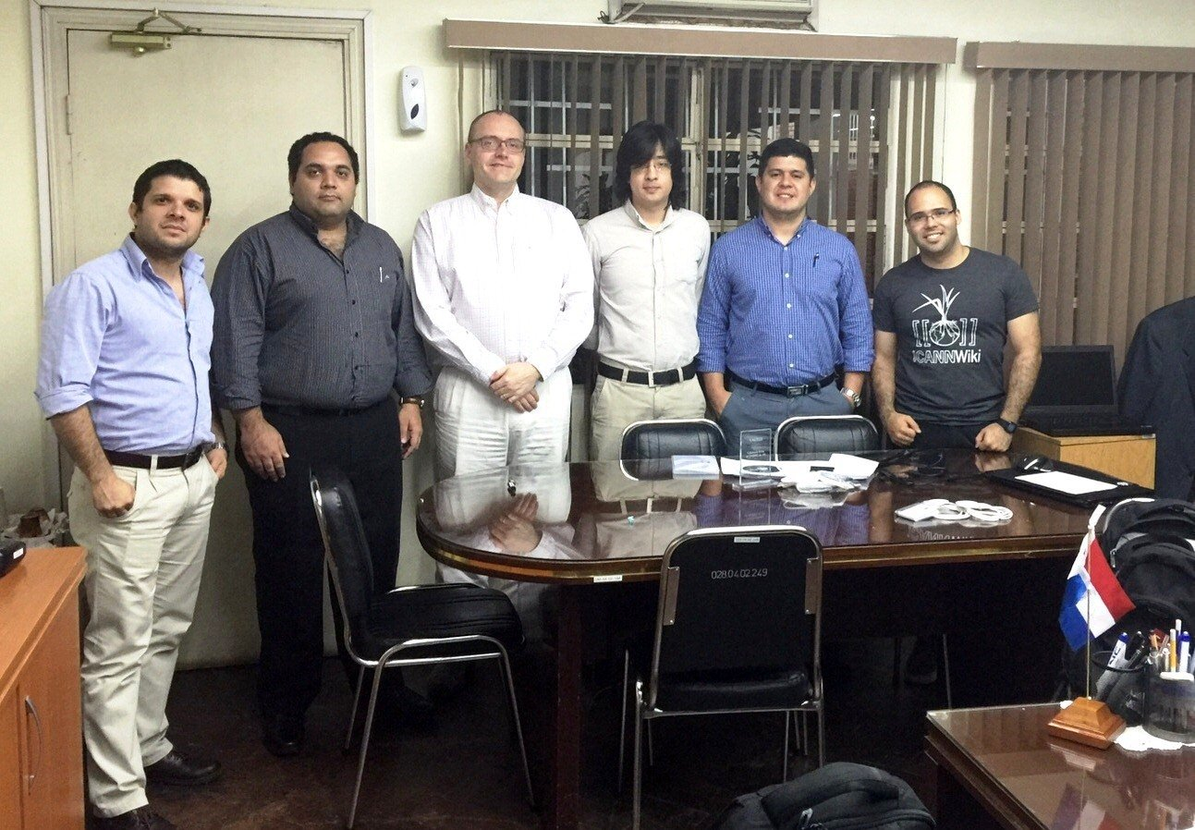
ccTLD Internship Program
Second Internship
ccTLD .py
Date: December 10th to 15th
In the month of December the second internship of the program took place, this time Robert Martin an expert in DNS and DNSSEC spent 5 days at the ccTLD .py helping with the DNSSEC deployment process.
Document:
https://goo.gl/QOamGE

Slide 17
ccTLD Internship Program
Local Press:
http://www.hoy.com.py/nacionales/centro-implementara-sistema-para-evitar-hackeos-a-dominios-paraguayos
http://m.ultimahora.com/cnc-pretende-dar-mayor-seguridad-sitios-py-n954201.html
http://www.ip.gov.py/ip/?p=72980
http://nanduti.com.py/2015/12/24/una-desarrolla-tecnologia-proteccion-sitios-web/

Slide 18

Contest and Awards
Objective
The objective of this project is to create contests or rewards for Internet users from the LAC region in order to strengthen regional participation.
Working Group:
Maritza Aguero
Alberto Soto
Trivia Contest was hosted in a Facebook Page created especially for the Contest, the Contest was a skill-based event, with the winner being the individual that answered the most correct questions in 240 seconds.

Slide 19
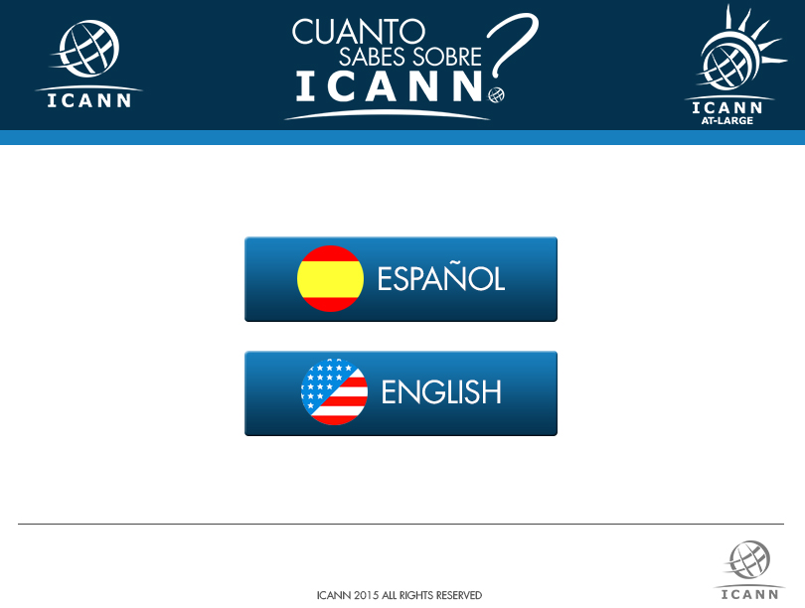
Contest and Awards

Slide 20
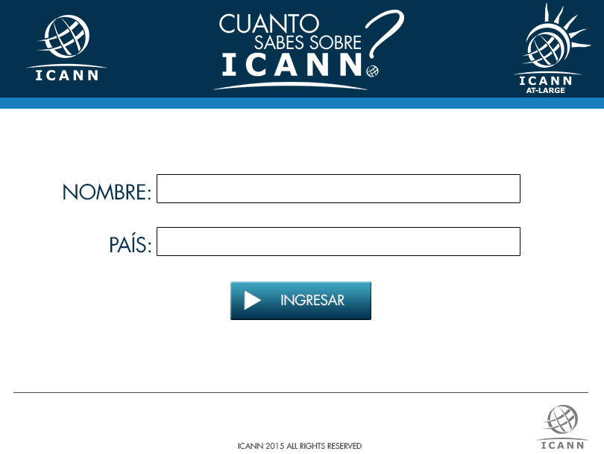
Contest and Awards

Slide 21
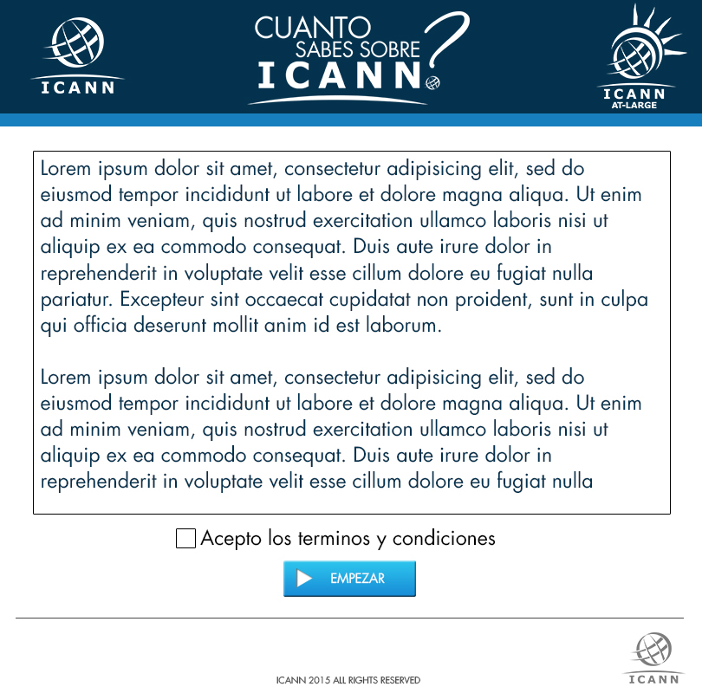
Contest and Awards

Slide 22
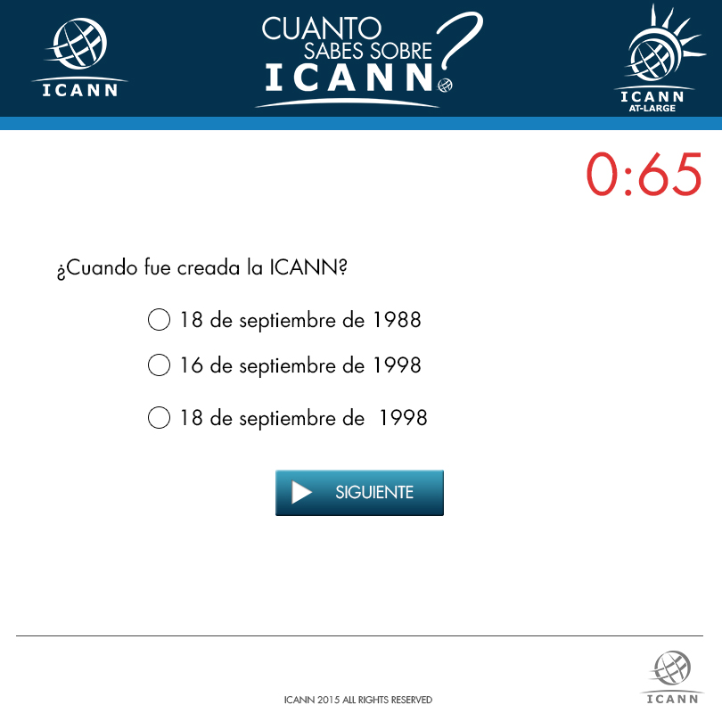
Contest and Awards

Slide 23

Contest and Awards

Slide 24

Contest and Awards
33 Participants in the Trivia from the LAC Region.
The Winner:
Barlett Morgan from Barbados
Participates in ICANN WGs since 2013
Part of the Inter-Registrar Transfer Policy WG
Never been on a ICANN meeting

Slide 25
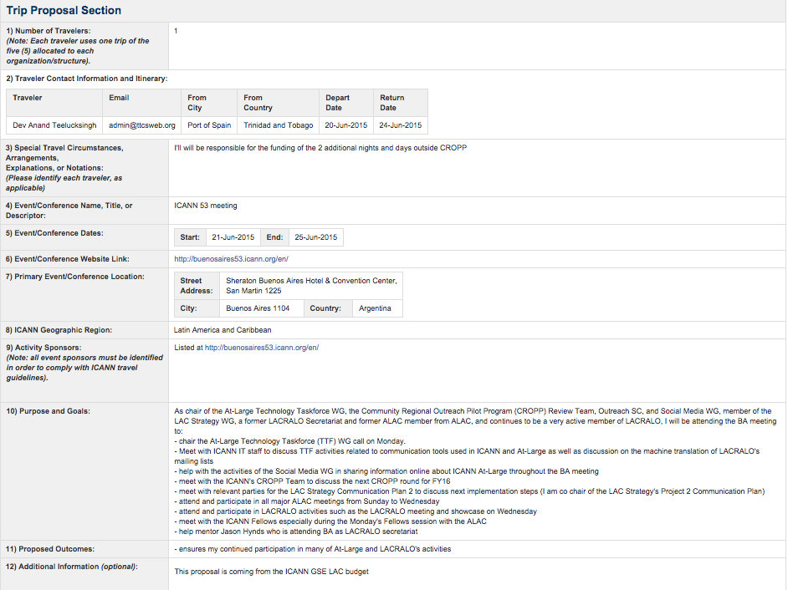
Supporting outreach through CROPP
Objective:
The objective of this project is to strengthen regional participation in outreach activities in the LAC Region.
Working Group:
Dev Anand Teelucksingh
Alberto Soto

Slide 26
Supporting outreach through CROPP
Each fiscal year LAC GSE will allocate a budget for (2) individual regionals trips to ICANN’s Constituency Travel so the LACRALO community can use these trips for outreach activities in the LAC region.
Travel application and procedure will be conducted following the rules established by CROPP program.
Activity 2015
Dev Anand Teelucksingh- Trinidad & Tobago and Juan Manuel Rojas - Colombia applied to this support through the CROPP program and both were able attend the ICANN 53 in Buenos Aires.

Slide 27


Mapping the Region
The idea behind this project was to create an inventory of relevant stakeholders in the region (who is who), IXPs, Online Service Providers, Telecom operators, ccTLDs, Registrar and registries.
This project is still a work in progress; with the collaboration of ACIET, LAC-IX LACTLD and other organizations we are collecting all the information.

Slide 28
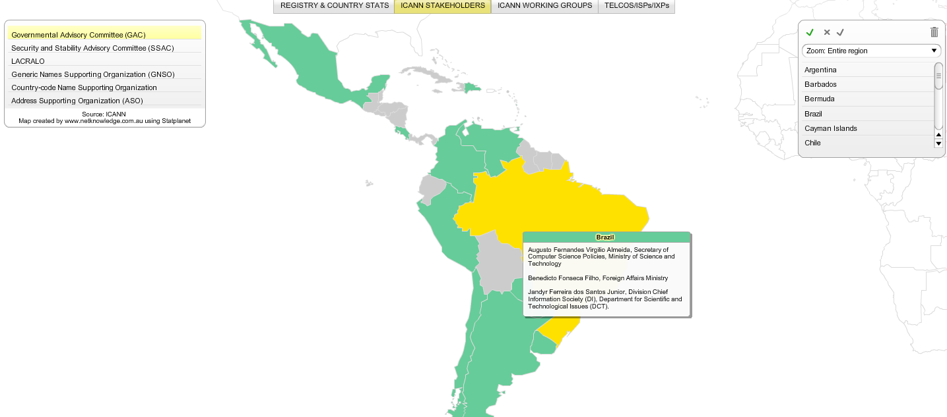
Mapping the Region
Visit our regional web site to see the map:
http://icannlac.org/Map-ICANN_LACTLD_ccTLDs/StatPlanet.html

Slide 29
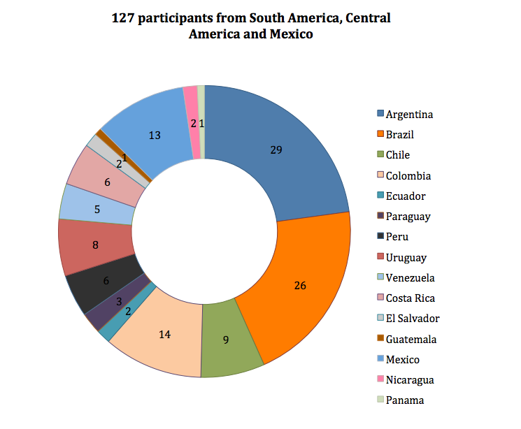
LAC participation in ICANN meetings
Objective:
The objective of this project is to create an observatory to develop growth indexes of LAC participants in ICANN meetings.
Working Group:
Olga Cavalli
Maritza Aguero
Visit our regional web:
http://icannlac.org/EN/participation-lac.php

Slide 30

Capacity Building (Webinars)
LACRALO
In coordination with the LACRALO leadership a syllabus of Webinars of various relevant topics were organized to provide training to Internet End-Users in 2015.
Working Group:
Alberto Soto
Humberto Carrasco
Carlos Dionisio Aguirre

Slide 31
Capacity Building (Webinars)
Webinars 2015
19 March 2015 - "GAC and Internet Users”
Recording:
https://community.icann.org/pages/viewpage.action?pageId=52892092
16 April 2015 – “Basic DNS”
Recording:
https://community.icann.org/pages/viewpage.action?pageId=52894631
27 May 2015 – “DNS Eco System”
Recording:
https://community.icann.org/pages/viewpage.action?pageId=53776154
07 July 2015 - “ICANN’s Structure”
Recording:
https://community.icann.org/pages/viewpage.action?pageId=53780859
12 November 2015 - The new gTLDs Program
Recording:
https://community.icann.org/pages/viewpage.action?pageId=54696395

Slide 32

Capacity Building (Webinars)
Governments
With the support of Olga Cavalli (GAC Vice Chair, Representative of Argentina) and Pedro Ivo Ferraz da Silva (Secretary, Foreign Affairs, Representative of Brazil) a webinar was organized before each ICANN meeting in 2015, these webinars were for government representatives in the LAC Region and the goal is to discuss relevant topics previous to each meeting and to provide information to new governments on how to become part of the GAC.
For watching the recorded session in Spanish (Adobe Connect room):
https://icann.adobeconnect.com/p3da8w1h40y/
For audio in English:
http://ftp.adigo.com/clients/icann/20151009_GAC_LAC_Webinar_EN.zip

Slide 33

Capacity Building (Webinars)
Governments
With collaboration of the Inter-American Telecommunication Commission (CITEL) the Telecommunications/ICT advisory body of Organization of American States (OAS), a webinar was organized for government representatives, 64 participants from 18 different countries of the LAC region attended the first edition.
Audio Recording:
http://ftp.adigo.com/clients/icann/20150723_Webinar_CITEL_Members_EN.zip
http://ftp.adigo.com/clients/icann/20150723_Webinar_CITEL_Members_ES.zip
http://ftp.adigo.com/clients/icann/20150723_Webinar_CITEL_Members_PT.zip

Slide 34
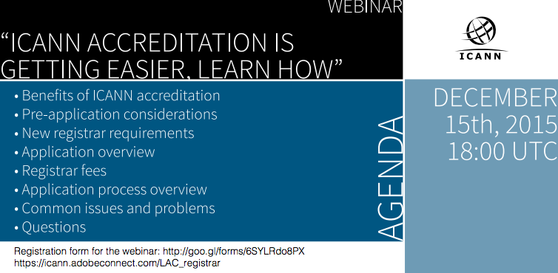
Capacity Building (Webinars)
1st. Webinar
https://icann.adobeconnect.com/p7n4impx9np/
2nd Webinar
https://icann.adobeconnect.com/p82d58gvl9j
Audio Recordings.
http://ftp.adigo.com/clients/icann/20150422_RAAWebinarLatinAmerica_EN.zip
http://ftp.adigo.com/clients/icann/20150422_RAAWebinarLatinAmerica_ES.zip
http://ftp.adigo.com/clients/icann/20150422_RAAWebinarLatinAmerica_PT.zip

Slide 35
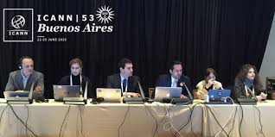
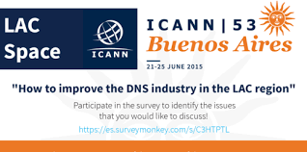
LAC SPACE
Objective
The objective of this project is to create a LAC Space in ICANN meetings in order for regional economic stakeholders to make specific presentation of the business related topics to the region.
Working Group:
Vanda Scartezini,
Gabriela Szlak,
Esteban Lescano,
Celia Lerman
Harold Arcos

Slide 36
LAC SPACE
LAC Space Editions 2015
ICANN 52 - February 2015 – Singapore (18 participants 12 Remote participants)
https://singapore52.icann.org/en/schedule/mon-lac-space
ICANN 53 – June 2015 - Buenos Aires (105 participants 16 Remote Participants)
https://buenosaires53.icann.org/en/schedule/mon-lac-space
ICANN 54 - October 2015 – Dublin (25 participants 18 Remote Participants)
https://meetings.icann.org/en/dublin54/schedule/mon-lac-space

Slide 37
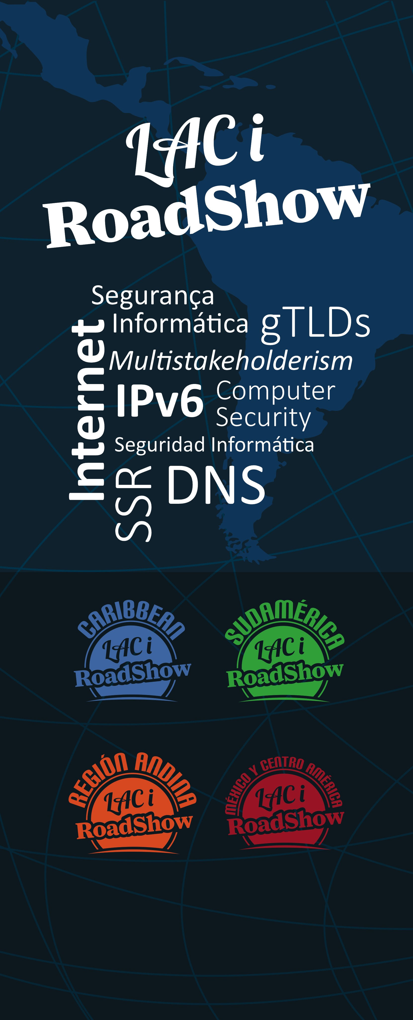
LAC – i Roadshow
Objective:
The objective of this project is to raise regional awareness about key topics related to the critical infrastructure of the Domain Name System (DNS), as well as the transition to IPv6, Security, Stability and Resiliency (SSR) and the impact on the new gTLD Program.
To ensure a well-distributed set of events, four editions of the LAC-i-Roadshow is organized annually in: Caribbean, Mexico/Central America, South America and the Andean Region
Working Group:
Anthony Harris
Andres Piazza
César Dias

Slide 38
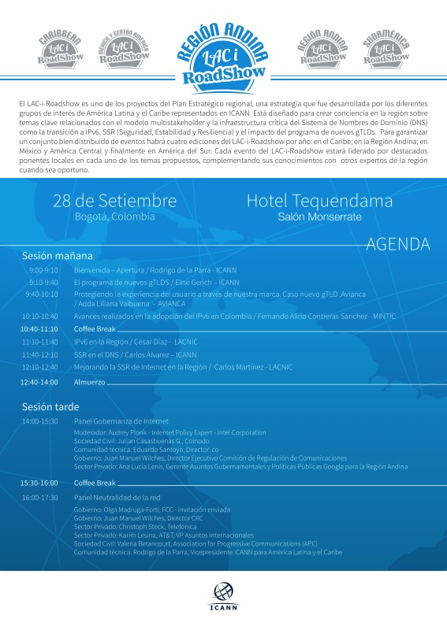
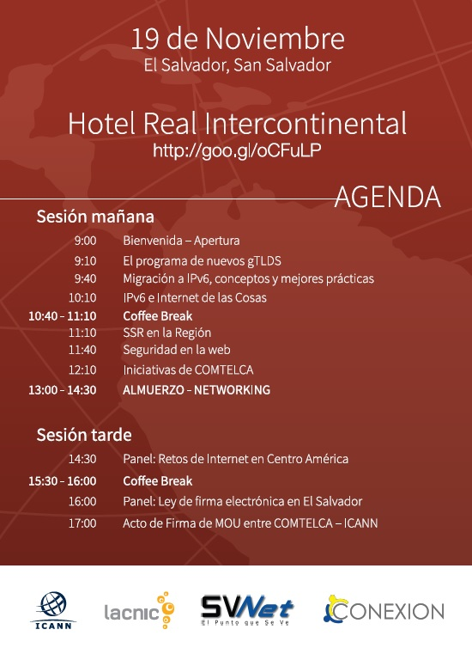
LAC – i Roadshow

Slide 39

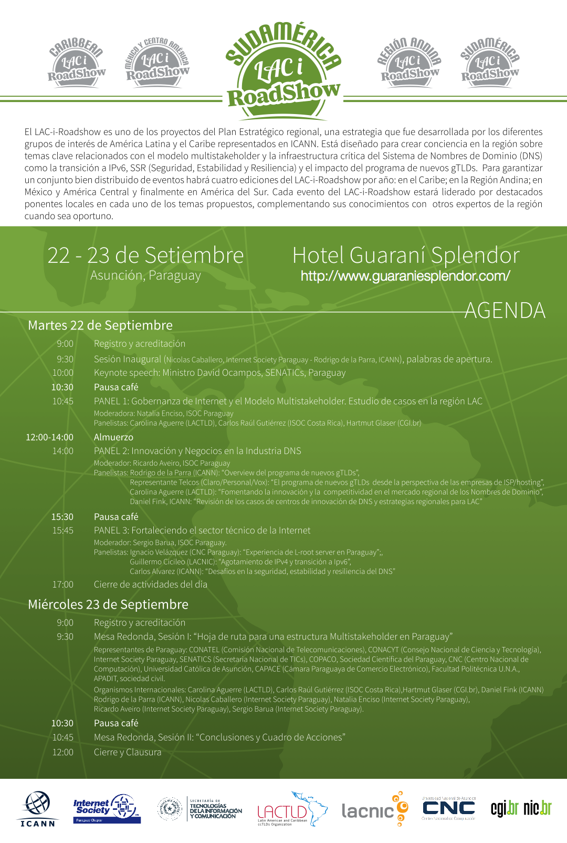
LAC – i Roadshow

Slide 40
Caribbean Working Group
Objective
The objective of this Working Group is to collaborate with ICANN’s Manager of Stakeholder Engagement in the Caribbean in order to collectively:
Determine capacity building necessities for the Caribbean region,
Multi-stakeholder Internet Governance mechanisms.
Build strong and competitive domain name industry.
To promote high level dialogue among governments in the Caribbean in ICANN related matters.
Members:
Rayman Khan Michelle Marius
Bennette Thomas Jason Hynds
Carlton Samuels Karel Douglas
Christopher Herbert Rodney Taylor
Cintra Sooknanan Lyndel McDonald
Claire Craig Rudi Daniel
Colin Bacchus Shiva Bissessar
Dev Anand Teelucksingh (Chair) Tracy Hackshaw
Wanda Perez

Slide 41
Going forward – Renewed LAC Strategy
Notes:
Breakup your presentation, divide it into sections. This is especially useful if most of your presentation is text.

Slide 42
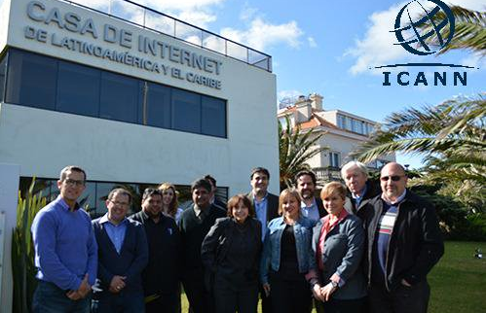
LAC Strategy Steering Committee Workshop
The LAC Strategy Steering Committee met in 2015 in Montevideo for a two-day workshop.
Objectives
The workshop had the following three primary objectives:
To provide an update of the results of ongoing Projects of the LAC Strategy.
To review new objectives for the LAC Strategy based on the experience of implementation and the community’s needs
To align the LAC Strategy with ICANN’s new Strategic Plan 2016 – 2020

Slide 43
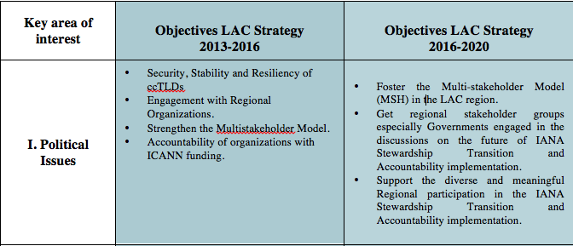
New Objectives

Slide 44
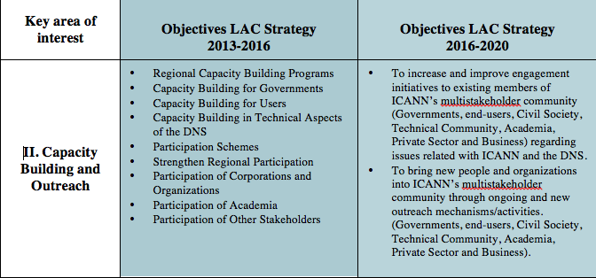
LAC Strategy Steering Committee Workshop

Slide 45
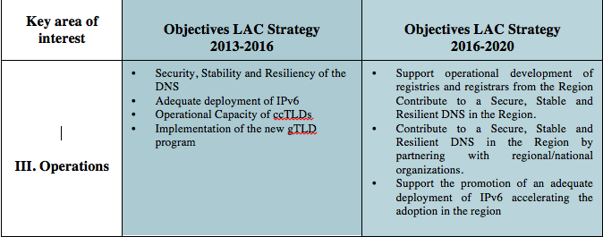
LAC Strategy Steering Committee Workshop

Slide 46
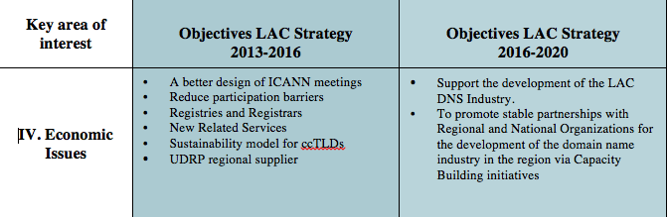
LAC Strategy Steering Committee Workshop

Slide 47
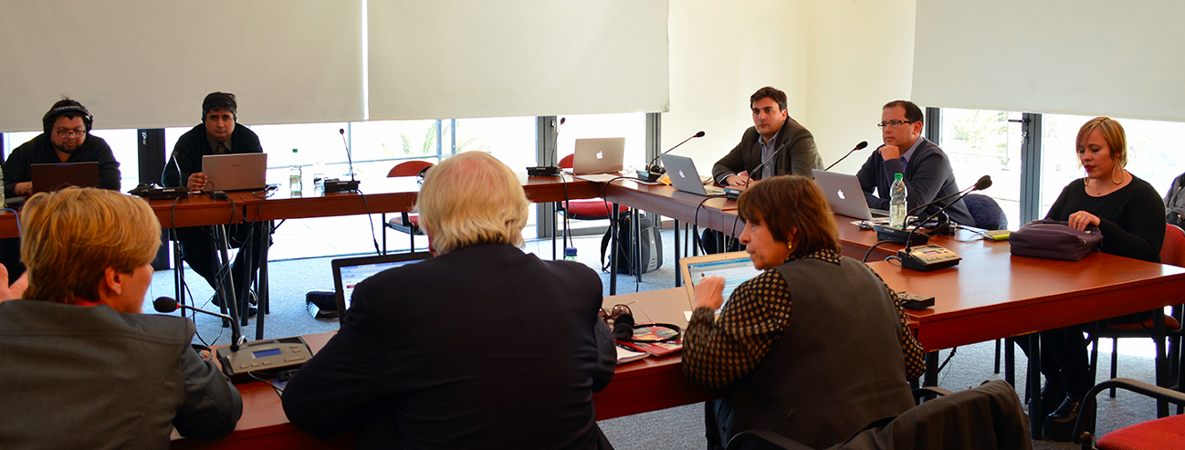
Renewed LAC Strategy 2016 -202
Renewed LAC Strategy 2016 - 2020
9 Objectives
Projects
11 Ongoing Projects (previous Strategy)
New Projects
Download Document:
https://goo.gl/Au5fuE

Slide 48
Implementation Plan
Notes:
Breakup your presentation, divide it into sections. This is especially useful if most of your presentation is text.

Slide 49
Implementation Plan
Prioritization exercise LAC GSE team.
LAC Strategy Steering Committee agreed.
Download document:
https://goo.gl/kPNo40

Slide 50
Implementation Plan

Slide 51
Implementation Plan

Slide 52
Study on the DNS marketplace in LAC
RFP launched in September 2015
Goal: identify and define the strengths and weaknesses in the industry ecosystem within the region, and develop recommendations on how to advance the industry and bring it closer to the opportunities available.
Consortium hired: Oxford Information Labs (OXIL); LACTLD; EURid; InterConnect
Tasks: Breakdown of domain name registrations; Type of contents; Growth rates; Local markets; Uptake factors; Premium domain names; Deep case studies in 13 countries; Business models.
Chronogram: January: Start; July: Draft report; September: Final report
LAC Strategy Working group (Project 4.1.1): oversee execution; implement recommendations

Slide 53
Thank You
Email: rodrigo.saucedo@icann.org
Notes:
You can adjust the email/web address to whichever email or web address is best suited to your presentation. This should be your final slide.

