Slide 1
Latin Generation Panel
Chris Dillon | IDN Program session, Dublin | 21 October 2015

Slide 2
Agenda
1
2
3
Potential scope of the Latin Generation Panel
Case study
Members of the Latin Generation Panel
4
5
6
Additional expertise needed
What next?
Questions and contact details
Notes:
This is a stylized agenda slide for your presentation.
To delete a box, if there are too many boxes, click the edge of the box, ensure the entire box is highlighted, then DELETE.
To update the numbers and text, click inside the circle for the numbers or in the box for the text, revise the text.

Slide 3
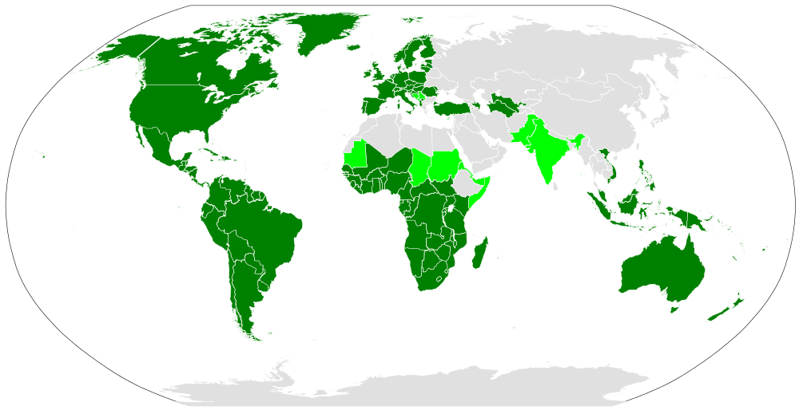
Distribution of the Latin script
Light green: countries where Latin co-exists with other scripts. Map by Canuckguy.
Notes:
Use this slide for diagrams or other graphic elements.

Slide 4
Latin script use in Africa today
Today, the Latin script is the writing system in widest use in Africa
It is estimated that over 500 out of the 2000 languages spoken in Africa today have orthographies (Bendor-Samuel 1996: 689), with the vast majority being Latin script-based
The Latin script has been significantly extended or modified to represent African languages
Frequently, supra-segmental features such as tone were encoded using super-and subscripted graph(eme)s, such as accent marks
Next to entirely new letters, di-, tri- and quadrigraphs, for example, are often-much used to represent single phonological units
A number of code-points are already excluded by the “letter principle” in the MSR, as well as IDNA 2008
Meikal Mumin

Slide 5
Current membership of Latin Generation Panel
Name | Organization
Eric Brunner-Williams (Co-Chair) | CORE
Chris Dillon (Co-Chair) | University College London
Hazem Hezzah | League of Arab States
Paul Hoffman | ICANN
Matthias Brenzliger | University of Cape Town
Tunde Adegbola | African Languages Technology Initiative
Danko Jevtovic | Fondacija
Jean-Jacques Subrenat | ICANN
Yashar Hajiyev | Information Policy Analytical Center
Mirjana Tasić | National Internet Domain Names of Serbia (RNIDS)
Oscar Gabriel Ledesma Piñeiro | Alfa-REDI
Daniel Omondi | Internet Society
Gideon Kiprono Rop | DotConnectAfrica
Tarik Merghani | AfTLD
Meikal Mumin | University of Cologne
Tarkan Doruk | Sanofi
Mert Saka | ICANN
Ahmed Bakht Masood | Pakistan Telecom Authority
Notes:
This slide can be used for text, graphics or any other elements.

Slide 6
What next?
Study Procedure documents, also MSR
Add members and apply to form panel
Create work plan
Create XML repertoire & WLEs & submit for review
Analyze similar code points, also in related scripts
Create a repertoire and WLEs

Slide 7








Engage with ICANN
Thank you and questions
Website: https://community.icann.org/display/ croscomlgrprocedure/Latin+GP
email: c.dillon@ucl.ac/uk
twitter.com/icann
gplus.to/icann
facebook.com/icannorg
weibo.com/ICANNorg
linkedin.com/company/icann
flickr.com/photos/icann
youtube.com/user/icannnews
slideshare.net/icannpresentations
Notes:
You can adjust the email/web address to whichever email or web address is best suited to your presentation. This should be your final slide.

