Slide 1
Latin Generation Panel
Chris Dillon | IDN Program session, Dublin | 21 October 2015

Slide 2
Agenda
1
2
3
Potential scope of the Latin Generation Panel
Case study
Members of the Latin Generation Panel
4
5
6
Additional expertise needed
What next?
Questions and contact details
Notes:
This is a stylized agenda slide for your presentation.
To delete a box, if there are too many boxes, click the edge of the box, ensure the entire box is highlighted, then DELETE.
To update the numbers and text, click inside the circle for the numbers or in the box for the text, revise the text.

Slide 3
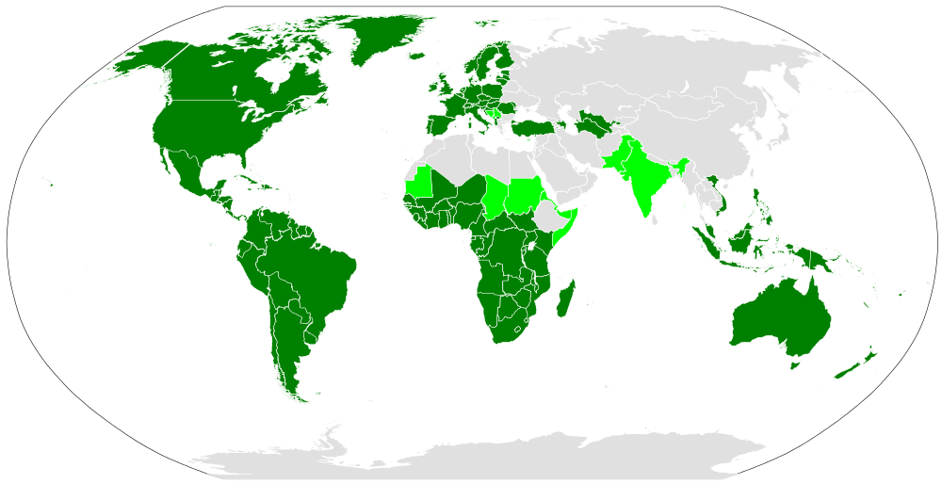
Distribution of the Latin script
See also: www.omniglot.com/writing/langalph.htm#latin
Light green: countries where Latin co-exists with other scripts. Map by Canuckguy.
Notes:
Use this slide for diagrams or other graphic elements.

Slide 4
Example: Latin script use in Africa today
Today, the Latin script is the writing system in widest use in Africa
  It is estimated that over 500 out of the 2000 languages spoken in Africa today have orthographies (Bendor-Samuel 1996: 689), with the vast majority being Latin script-based.
The Latin script has been significantly extended or modified to represent African languages:
  Frequently, supra-segmental features such as tone were encoded using super-and subscripted graph(eme)s, such as accent marks.
  Next to entirely new letters, di-, tri- and quadrigraphs, for example, are often-much used to represent single phonological units.
  A number of code-points are already excluded by the “letter principle” in the MSR, as well as IDNA 2008.
  Meikal Mumin
  The situation is similar for indigenous languages in the Americas.

Slide 5
Example: Romanizations of other scripts
The Latin script is used to Romanize other scripts:
  Standardized Romanizations such as Pinyin for Chinese:
  Hěn gāoxìng jiàndào nǐ.
  Informal Romanizations such as Arabic chat:
  ana raye7 el gam3a el sa3a 3 el 3asr.

Slide 6
Current membership of Latin Generation Panel
Name | Country | Language Expertise
Eric Brunner-Williams | US | English
Chris Dillon | UK | English, German, Spanish
Hazem Hezzah | Egypt | Arabic, German
Paul Hoffman | US | English
Matthias Brenzliger | South Africa
Tunde Adegbola | Nigeria
Danko Jevtovic | Serbia | Serbian, English
Jean-Jacques Subrenat | France | French, English
Yashar Hajiyev | Azerbaijan | Azerbaijani, English
Mirjana Tasić | Serbia | Serbian, English
Oscar Gabriel Ledesma Piñeiro | Argentina | Spanish, English
Daniel Omondi | Kenya
Gideon Kiprono Rop | Kenya
Tarik Merghani | Sudan
Meikal Mumin | Germany | German, English, use of Latin script for African languages
Tarkan Doruk | UAE | Turkish
Mert Saka | Turkey | Turkish
Ahmed Bakht Masood | Pakistan | Urdu, English
Notes:
This slide can be used for text, graphics or any other elements.

Slide 7
What next?
Study Procedure documents, also MSR
Add members and apply to form panel
Create
work plan
Create XML repertoire & WLEs & submit for review
Analyze similar code points, also in related scripts
Create a repertoire and WLEs

Slide 8








Engage with ICANN
Thank you and questions
Website: https://community.icann.org/display/
croscomlgrprocedure/Latin+GP
email: c.dillon@ucl.ac/uk
twitter.com/icann
gplus.to/icann
facebook.com/icannorg
weibo.com/ICANNorg
linkedin.com/company/icann
flickr.com/photos/icann
youtube.com/user/icannnews
slideshare.net/icannpresentations
Notes:
You can adjust the email/web address to whichever email or web address is best suited to your presentation. This should be your final slide.

