Slide 1
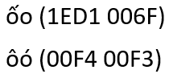
Tentative Variant Analysis Framework
“Same”
Visual Variant
Non-Visual Variant
Diacritics
Shape
Stacking
Spacing
Base Characters
1 – Identical
2 – Nearly Identical
3 – Distinguishable
4 – Different
a (0061) а (0430)
ă (0103) ǎ (01CE)
æ (00E6)
ae
f (0066)
ƒ (0192)
Underlining
IDNA2003 Compatibility
ss ß (00DF)

