Slide 1
Latin Generation Panel meeting with Integration Panel
Latin GP
Name of Presenter
ICANN 67 Cacún
9 March 2020

Slide 2
Agenda Overview
1
2
3
Short History and Scope of Work
Members
Project Timeline
4
5
6
Work Accomplished
Cross-s
In-Script Variant Analysis

Slide 3
Latin GP – Short History
June-August 2016 - GP restarted with a new call for volunteers.
15 May 2017 - The Latin GP is seated.
September 2017 - GP proposal for Principals on inclusion and exclusion of code points was sent for an informal public review.
September-November 2017 - GP collected information on 455 languages that use Latin script.
May 2018 (for MSR-3) and October 2018 (for MSR-4) - GP submitted the code point repertoire to the Integration Panel.
May 2018 – GP submitted the updated LGR proposal with repertoire.
January 2019 - GP submitted the updated LGR proposal with the cross-script variant analysis and the initial in-script variant analysis.
October 2019 - GP submitted the updated LGR proposal with some in-script variant analysis.

Slide 4
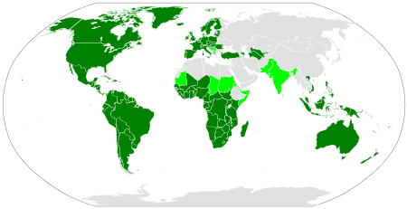
Latin Script Geographic and Linguistic Spread
Dark green = Latin script is the main script.
Light green = Latin co-exists with other scripts.
Grey = Latin-script alphabets are sometimes extensively used due to the use of
unofficial second languages, such as French in Algeria and English in Egypt,
and to Latin transliteration of the official script, such as in China or in Japan.

Slide 5
Latin GP – Scope of Work for Code Point Analysis
Maximal String Repertoire Version 4 (MSR-4)
Subset of code points allowed in IDNA 2008
Unicode ranges
Controls and Basic Latin
Controls and Latin-1 Supplement
Latin Extended-A only lowercase
Latin Extended-B
IPA Extensions
Combining Diacritical Marks
Combining Diacritical Marks Supplement
Latin Extended Additional
Latin Extended-C
Non-exhaustive list of 455 languages in scope.
Non-exhaustive list of EGIDS 1-5 languages contains 300 languages.
Non-exhaustive list of EGIDS 1-4 languages contains 181 languages.
Proposed repertoire has 210 Latin code points.

Slide 6
Latin GP – Members
14 members (7 active members), 3 observers
Language representatives
Africa
Asia
Australia and Oceania
Europe
North America
Diversity
Community representatives
Linguistic experts
Registry/registrar experts
Technical community, DNS experts
IDNA/Unicode experts

Slide 7
Latin GP – Project Timeline
Jul
2017
Jan
2018
May
2018
Jan
2019
Oct
2019
Mar
2020
Developed Principles
Developed code points repertoire and identified variants.
Submitted proposal with code points repertoire.
Submitted proposal adding cross-script variant analysis.
Submit proposal without complete in-script variant analysis.
Finalize the LGR proposal

Slide 8
Latin GP – Work Accomplished
Developing Repertoire
181 of 181 EGIDS 1- 4 languages processed.
29 EGIDS 5 languages processed.
193 of 279 MSR-2 code points attested.
3 non-MSR-2 code points are included in MSR-3.
3 non-MSR-3 code points are included in MSR-4.
22 Code Point Sequences identified.
Developing Variants
In-script variants still ongoing (80% finished).
Cross-script variants with Armenian script defined.
Cross-script variants with Cyrillic script defined.
Cross-script variants with Greek script defined.
Special HTML Link (underlining) analysis completed.
IDNA2003 compatibility analysis completed.
Submitted the third version of proposal to the IP in May 2018.
Submitted the fourth version of proposal to the IP in Jan 2019.
Submitted the fifth version of proposal to the IP in Oct 2019.

Slide 9
Latin GP – In-Script Variant Analysis – Work Organization
All investigations of code points should be done using wordmark.it.
Only Google fonts should be taken into consideration.
All seven members get the same amount of code points to analyze.
Results of analysis should be presented in the proposed template.
All results of analysis should be discussed by GP before accepting code points as an in-script variants.
All working material will be presented in the Final Report as Appendix.

Slide 10
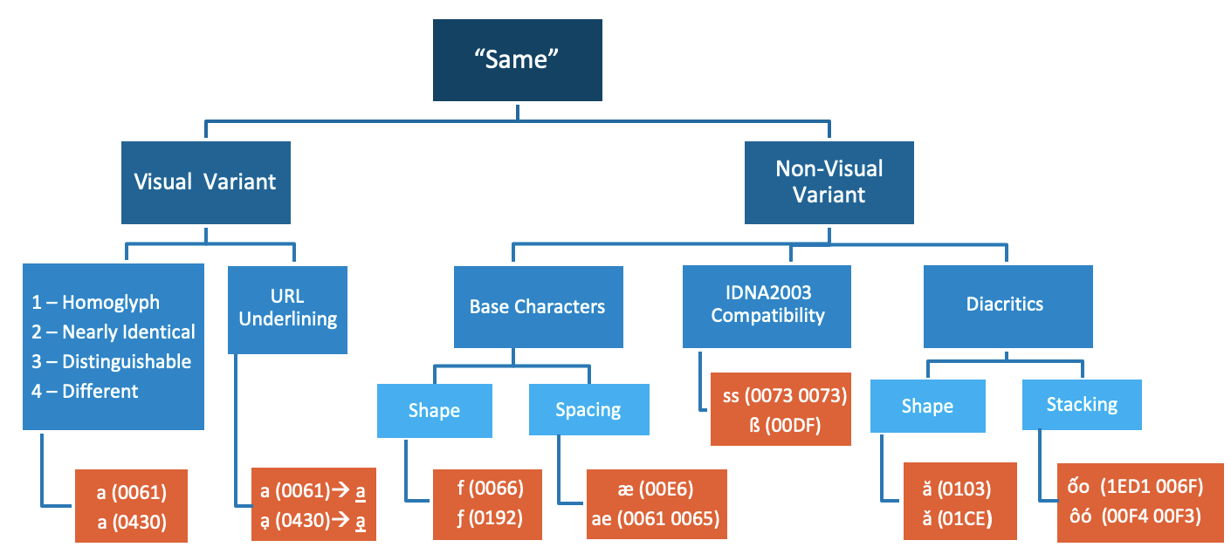
Latin GP - In-Script Variant Analysis Framework

Slide 11
Latin GP – Variant Principles Matrix Proposal (to be finalized)
Index # | Principle | Reason | Disposition
1 | Visual variant (homoglyph) | Security | Blocked
2 | Visual variant (glyph nearly identical) | Security | Blocked
3 | Visual variant (generally acceptable font design) | Security | Blocked
4 | Non-visual variant | Security | Blocked
5 | Symmetry property {a:b} | Security | Blocked
6 | Transitivity property {a:b; b:c} | Security | Blocked
7 | URL underlining | Security | Blocked
8 | IDNA2003 Compatibility | Security | Blocked
9 | Function (alternate orthography) | Usability | Allocatable

Slide 12
Latin GP – In-Script Variant – Visual Analysis
Score | Category
1 | Homoglyphs A pair of code points in this category has essentially identical appearance by design.
2 | Nearly Identical A pair of code points is considered Nearly Identical when the visual confusion can be attributed to font design.
3 | Distinguishable A pair of code points is considered Distinguishable when any of the code point’s glyphs have recognizably different features from the other code point.
4 | Different When the two glyphs in the pair are sufficiently different.

Slide 13
Latin GP – In-Script Variant – HTML Underlining
In many browsers and word processing software tools, links to websites are indicated by underlining the domain name.
This has obvious implications when the codepoint involves a diacritic below the line.
In some cases, the diacritic is entirely or partially obscured by the underline.
In other cases, the underline merely makes it very difficult to discern just what is going on below the line.
To address this, Latin GP has investigated both:
The code points themselves.
The code points when underlined.

Slide 14
Latin GP – In-Script Variant – HTML Underlining
Group | Underlining
Target |  |  | Source |  |  | Variant Candidate [Yes/No] | Disposition [Allocatable / | Rationale
Code Point | Glyph | Name | Code Point | Glyph | Name |  | Blocked]
0061 | a | Latin Small Letter A | 0105 | ą | Latin Small Letter A With Ogonek | YES | Blocked | Glyphs nearly identical due to underlining
0061 | a | Latin Small Letter A | 0061 + 0331 | a̱ | Latin Small Letter A + Combining Macron Below | YES | Blocked | Glyphs nearly identical due to underlining
0061 | a | Latin Small Letter A | 1EA1 | ạ | Latin Small Letter A With Dot Below | YES | Blocked | Glyphs nearly identical due to underlining

Slide 15
Latin GP – In-Script Variant – Non-Visual Analysis
Shape of Base Characters - Latin GP hypothesized that some hand-written forms may end up taking similar or the same shapes as some derived letters, and that readers may consider such unknown derived letters as hand-written variations of familiar letters, such as e.g. v vs. ʋ.
Spacing of base characters - Several letters have been derived by putting more closely together sequences of two or more glyphs. Depending on the spacing in between those glyphs in a font, ligatures may become indistinguishable from a sequence of glyphs of which the same ligature is composed e.g ae vs æ.

Slide 16
Latin GP – In-Script Variant – Diacritics
Shaping of diacritics - three types of potential issues with diacritic modifiers:
Certain diacritics may be considered to be conceptually the same as others by significant parts of the user community, such as dot below or a comma below.
Certain diacritics are not kept apart from one another in handwriting traditions:
caron being written in the same way as a breve.
dot above being written in the same way as an acute.
diaeresis being replaced by two vertical strokes could be mistaken for a double acute in italic fonts.
tilde being written ‘simply’ as a simple horizontal stroke above, i.e. a macron.

Slide 17
Latin GP – In-Script Variant – Diacritics
Shaping of diacritics - three types of potential issues with such modifiers:
Number of diacritics are only used in a very limited part of the script using community. This may lead to confusion:
Horn ( ̛ ) could be conceptually mistaken by some readers for a misplaced acute (´) or even an apostrophe (‘)
For someone to discern a difference between code points or between diacritics, they have to be aware that they exist. The average user, and even the "very careful user," is familiar with perhaps a half dozen of diacritics. As a result, they do not realize that it would be advisable to look for differences.

Slide 18
Latin GP – In-Script Variant – Diacritics
Stacking of diacritics - diacritics are combined with one another, such as ấ featuring both a circumflex and an acute. Glyphs featuring base characters with several diacritics:
May become visually identical or confusable to readers with sequences of glyphs featuring the same diacritics on two separate code points.
May even become effectively invisible in context by lapping over into adjacent glyphs.
Combining diacritics
Does not combine in some fonts (e.g. Courier New).
In some fonts, it combines with the next code point and does not stay on the correct code point.

Slide 19
Latin GP – In-Script Variant – IDNA Compatibility
00DF (LATIN SMALL LETTER SHARP S) – IP expected from Latin GP “to consider the inclusion of this code point in the LGR and to investigate the case for or against making it a blocked variant of ss.”
0069 (LATIN SMALL LETTER I) and 0131 (LATIN SMALL LETTER DOTLESS I) - case operations are locale sensitive. IP expected from Latin GP “to investigate the need to address any compatibility issues related to this code point, and if found, to suggest means to mitigate them.”

Slide 20
Questions?

