Slide 1



Slide 2
Root Zone Label Generation Rules (RZ-LGR) Update
ICANN72 Prep Week
14 October 2021

Slide 3
Agenda
Latin Script RZ-LGR Mats Dufberg
Japanese Script RZ-LGR Hirofumi Hotta
(to be Confirmed)
Next version of Root-Zone LGR (RZ-LGR-5) Asmus Freytag
(to be confirmed)

Slide 4
Latin Script Root Zone Label Generation Rules (Latin Script RZ-LGR)
Mats Dufberg
Latin Script GP Member

Slide 5
Topics [colors]
1
2
3
The Latin GP proposal of Latin script for the root zone LGR
Introduction and chapter 2
Chapter 4
4
5
6
Chapter 5
Chapter 6
Appendix E
Notes:
This is a stylized agenda slide for your presentation.
To delete a box, if there are too many boxes, click the edge of the box, ensure the entire box is highlighted, then DELETE.
To update the numbers and text, click inside the circle for the numbers or in the box for the text, revise the text.

Slide 6
The Proposal for Latin Script in Root Zone LGR
The proposal for Latin script in root zone LGR presented by the Latin Generation Panel is out for public comment. Comments are welcome up to 2021-11-23.
Link to the proposal:
https://www.icann.org/en/announcements/details/proposal-for-latin-script-root-zone-label-generation-rules-23-9-2021-en
Anyone is encouraged to review the proposal and provide comments and suggestions.
  Both minor and major comments are welcome. All comments will be considered by the Latin GP.

Slide 7
This Presentation
This presentation is a walk-through of the proposal to lower the threshold for you to read and comment.
Focus is on the main document and its appendices.
The LGR XML file is the normative document.

Slide 8
Introduction
Chapters not discussed in this presentation are just short chapters with general information.
Chapter 2 defines the delimitation of the scripts processed by this proposal:
  The proposal cannot include any character not included in so called Maximal Starting Repertoire (MSR).
  MSR is a subset of IDNA protocol valid code points, which is a subset of Unicode.
    MSR is defined by the Integration Panel.
  Only the Latin script subset of MSR is available for the Latin proposal.
    A few characters were added to MSR on the Latin GP's request.

Slide 9
Chapter 4: Development Process and Methodology
Chapter 4 describes the work process of the Latin GP.
  Languages using Latin script were identified and those on level 0 ("International") to 4 ("Educational") on the EGIDS scale were selected.
  Those on level 5 ("Developing") with at least 1 million speakers were also selected.

Slide 10
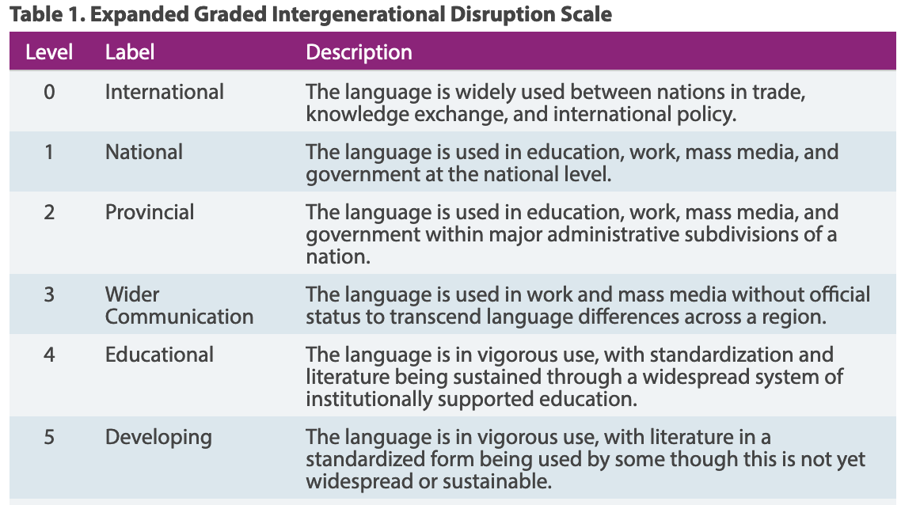
Chapter 4 – continued
  Definitions of the EGIDS scale levels can be found at https://www.ethnologue.com/about/language-status
  Level 6 and above are excluded here for clarity.

Slide 11
Chapter 4 – continued
  Appendix B has a complete list of all languages selected using those criteria. For each language in that list the following information is listed:
    Language name (in some cases the name in different languages)
    The ISO 639-3 three-letter language code
    The EGIDS level for the language
  Characters used by selected languages were identified.
    The character set of each language is not documented in the report, but they can be found through the reference for each language found in Chapter 9.
  Candidates for in-script and cross-script variants were identified (more on that below).

Slide 12
Chapter 5: Repertoire
The repertoire of Latin script in the proposal is based on Unicode "code point".
  In the simple case, a code point is a character, such as "a".
  A code point can also be a modifying mark used in combination with another code point to form a character, e.g. "g" + "~" → "g̃"
  In many cases, Unicode has a precomposed code point in which the base character is combined with an accent, e.g. "á". Such precomposed code points are always used when available.
The principles for including or not including a character identified in a language are spelled out in the introduction to Chapter 5.

Slide 13
Chapter 5 – continued
The Latin GP's proposed repertoire lists 218 characters.
  197 characters of the simple type of one code point
  21 characters formed by a sequence of two or more code points
For each character there is the following information:
  Unicode code point code or codes if it is a sequence.
  Language or languages that use that character for writing
  References for the alphabets of the languages using the character
The list of languages for a character is not exhaustive. The languages are there to support the inclusion.
For characters a-z no language is listed.

Slide 14
Chapter 5 – continued
The repertoire is also one of the main parts of the LGR XML file.
The repertoire in Chapter 5 is sorted numerically by code point code.
  The same repertoire, grouped by glyph shape, is found in Appendix C.

Slide 15
Chapter 5 – continued
Section 4 in Chapter 5 (5.4) lists excluded characters
  The excluded characters listed there are characters attested in at least one selected language, but which cannot be included because they do not belong to MSR.
    The LGR procedure requires that only characters included in MSR be selected.
    The MSR is a result of a pre-process where characters are excluded due to one or several criteria, e.g. not protocol valid or similar to a punctuation mark.
    Latin GP cannot include any character not included in MSR.

Slide 16
Chapter 6: Variants
Chapter 6 covers the concept and proposal of variant rules for Latin code points (characters)
  A variant set consists of two or more characters that in some sense are perceived as being "the same":
    Same – or almost – the same shape
    Used interchangeably for the whole or part of the script community
  Two types of disposition for variants: blocked or allocatable.
    For the Latin Script Proposal, in the majority of variant rules the variant labels are blocked.
  In-script variants sets have members from the same script
  Cross-script variant sets have members from different scripts, e.g. Latin, Cyrillic and Greek.
  Some sets are a combination of the two types

Slide 17
Chapter 6 – continued
Chapter 6, together with Appendices D.1 to D.9, contains
  Principles for variant sets
  Data and analyses of variant sets and candidate variant sets
With two exceptions all variant rules are blocking "other variants"
Two variant sets are special
  Relates to older IDNA version 2003
  Includes rules permitting allocating "other variant"
  The two sets relate to
    Sharp S ("ß") and "ss"
    Dotted I ("i") and Dotless I ("ı")
The Latin GP proposal of variant sets is presented in Section 6.7

Slide 18
Appendix E: Confusables
Appendix E contains candidate variant sets that were rejected as variant sets but accepted as "visually confusable".
  The appendix is not part of the formal LGR XML file.
  The appendix is for reference for anybody doing analysis of visual similarity between two strings (TLDs or candidate TLDs).

Slide 19
Current Step: Ongoing Public Comment Proceeding
Sep
2021
Oct
2021
Nov
2021
Jan
2022
Integration into the Root Zone LGR by the Integration Panel
Public Comment Proceeding Opened
ICANN 72 Prep Week
Public Comment Proceeding Closed
Submit the Final Version of the RZ-LGR proposal to the Integration Panel
Public Comment Proceeding: https://www.icann.org/en/announcements/details/proposal-for-latin-script-root-zone-label-generation-rules-23-9-2021-en
Closing Date: 23 November 2021
Notes:
To adjust the length and width of the arrow, click on the arrow, grab a corner, and lengthen or shorten, depending on your preference.
To add a bubble, click on the bubble, ensure it is fully highlighted, COPY and PASTE. Then drag the bubble to your preferred placement.
To delete a bubble, click on the bubble, ensuring it is highlighted and click DELETE. If you make a mistake, go to your top bar on PP and click EDIT, UNDO

Slide 20






Engage with ICANN and IDN Program
Thank You and Questions
Visit us at icann.org/idn
Email: IDNProgram@icann.org
@icann
facebook.com/icannorg
youtube.com/icannnews
flickr.com/icann
linkedin/company/icann
slideshare/icannpresentations
soundcloud/icann

